Slide 1
MTPBin
(and to some degree RCCalc)
Nomenclature

Slide 2
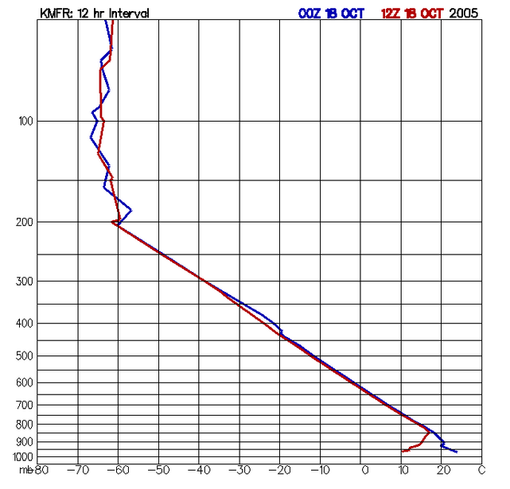
Retrieval
Levels
Flight Levels
Based on the project in question, a set of 15(is it always 15?) expected flight levels is devised.
There are 33 retrieval levels (16 above and 16 below the plane and 1 at flight level) . The MTP cannot resolve temperatures outside of the range represented. When points for the MTP Temperature Profile are determined, they are placed on retrieval levels. The retrieval levels map directly onto the number of retrievables (33).

Slide 3
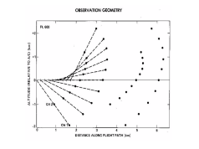
An MTP scan consists of 3 observation channels at 10 angles.
This results in 30 observables.
Observables are also called brightness temperatures and are

Slide 4

Post-Project
Pre-Project
Search RAOBs
Average
RAOB near
Flight path
Representative
Set of Similar RAOBs
A group of similar RAOB soundings are pulled together and an average is taken along with some error statistics (RMS). The Average is called the representative and the collection and its representative is called a template.

Slide 5
ETC.
RCCalc creates a “map” from Temperature Profile space to Brightness Temperature space (using multivariate regression) at a set of pre-defined flight levels and generates coefficients to map back
Creates one RCF (Retrieval Coefficient File) for each “template”

Slide 6
ETC.
RCCalc creates a “map” from Temperature Profile space to Brightness Temperature space (using multivariate regression) at a set of pre-defined flight levels and generates coefficients to map back
Creates one RCF (Retrieval Coefficient File) for each “template”

