Slide 1
Microwave Temperature Profiler (MTP)
High Level Software design and Plan for integrating into ADS

Slide 2
JPL Software
> 1 million lines of VB6 code
VB6 is no longer supported by Microsoft
Code written by scientist, not SE
Designed to support multiple MTP instruments and platforms
Complex algorithms that we’d like to understand better
Costly to subcontract to JPL for projects using MTP
Hope to reduce support over time

Slide 3
JPL Software
Sadly, MJ passed away leaving Boon Lim as JPL’s MTP expert
Boon finds MTP software as fragile as do we
Often times he “massages” data to allow MTP software to work with it rather than dive into the MTP source code

Slide 4
JPL Software
Boon’s small part-time team is pursuing the following:
Updates to MTP hardware and daq system
An algorithm based on physical rather than statistical retrieval methods
Invert radiative transfer equation; no need for a priori information (i.e., radiosondes)
But, without a priori information, finding the Tropopause is more error prone
A new version of the software to acquire rawinsondes (raobget)

Slide 5
Migration “Road Map”
Plan was to work more collaboratively with Boon
Progress has been slow and challenged
Contracts negotiations
Boon’s “publish before share” indication (retrieval method only)
Meanwhile use of VB6 software increasingly challenged (Windows 7 updates breaking it)
We feel we should return to previous Road Map

Slide 6
Migration “RoadMap”
Sequence of steps to bring MTP “into the fold”
Challenging owing to complexity
Break a large problem into smaller pieces
Identify top level JPL programs
Suggest approaches to addressing them
Describe what has been done so far

Slide 7
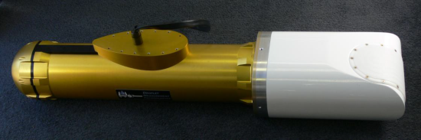
Diagram Legend
JPL Software
Component
MTP Instrument
3rd Party Software
Component
RAF Software
Component
Data File

Slide 8

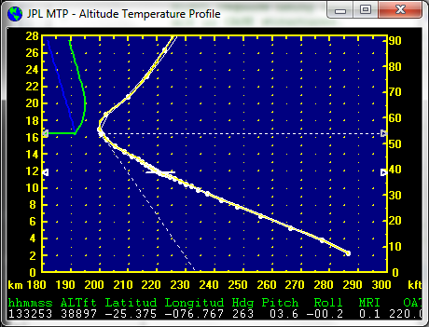
MTP Operations in Flight (JPL)
Archive Average Brightness Temps
ADS
nimbus
MTP Instrument
Preliminary Retrieval Coefficients
IWGadts
data
Calibration
info
“MTPbin”
Processing
“DAQ”
Command/
Control/
Acquisition
RAW MTP Data

Slide 9
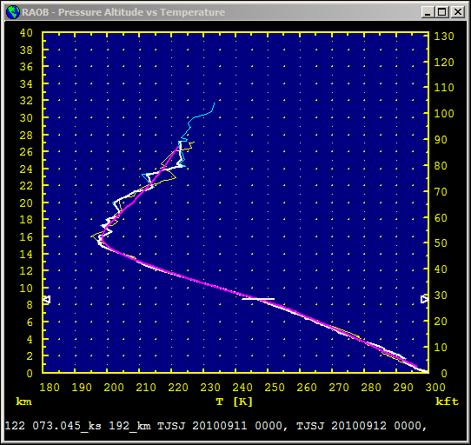
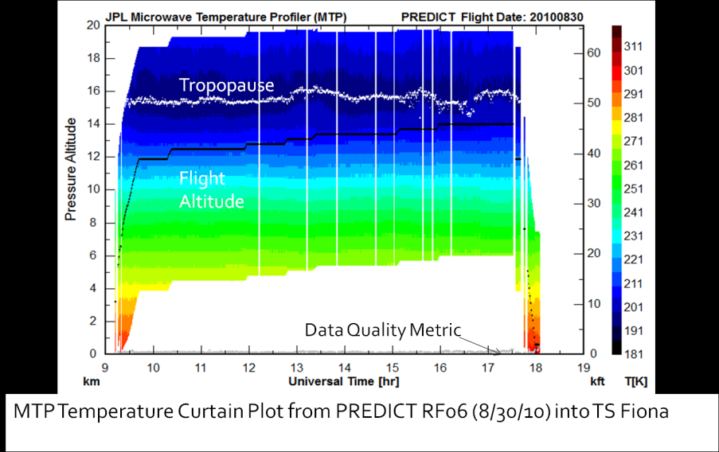
MTP Operations in Flight (JPL)
Archive Average Brightness Temps
MTP Instrument
Preliminary Retrieval Coefficients
Calibration
info
“MTPbin”
Processing
“DAQ”
Command/
Control/
Acquisition
RAW MTP Data

Slide 10
Temperature Retrieval Overview
Measurement
Retrieval
Temperature Profile (current)
Temperature Profile (archived)
Temperature Profile Retrieval
Retrieval Coefficients
Emitted Radiation
Forward Radiative
Transfer Model
Approximate RT equation in polynomial form
Brightness Temperature Measurement
Brightness Temperature Estimate
Brightness Temperature Measurement
Solve for
Retrieval Coefficients

Slide 11
Retrieval Coefficients
Generated twice during projects
Prior to project
For real time operations
Use RAOBs that represent expected conditions
After project
For final data processing
Use RAOBs that represent actual atmosphere flown through

Slide 12
Pre-Flight Retrieval Coefficients Generation
RAOB Resources
Raob Templates
“RCCalc”
Radiative Xfer Modeling
“RAOBGet”
Subset &
Statistics
ASCII RAOB Files
“RAOBMan”
Manager
Preliminary Retrieval Coefficients
Archive Average Brightness Temps

Slide 13
Post-Flight Retrieval Coefficients Generation
Excel File
“RAOBMan”
Manager
RAOB Resources
Excel Spreadsheet
Raob
Templates
“RAOBGet”
Subset &
Statistics
“RCCalc”
Radiative Xfer Modeling
Single Binary RAOB File
ASCII RAOB Files
Retrieval Coefficients
“RAOBMan”
Manager
Archive Average Brightness Temps

Slide 14
MTP Calibration and Retrieval (Post Flight)
Retrieval Coefficients
Archive Average Brightness Temps
Calibration
info
“MTPbin”
Processing
Recorded RAW MTP Data
Window Corrections
Brightness Temperature Comparisons
Excel Spreadsheet

Slide 15
Some integration to ADS has happened
RAOB Resources
MTP Instrument
nidas
“RAOBGet”
nimbus
“RAOBMan”
Manager
UDP:Raw
Counts
“DAQ”
“RCCalc”
Radio Xfer Modeling
“MTPbin”
Ground Database
Retrieval Coefficients
Profile
Archive Average Brightness Temps
aeros
Mission Coordinator

Slide 16
Proposed Next Step: Replicate MTPbin
MTP Instrument
nidas
nimbus
“DAQ”
UDP:Raw
Counts (calibration?)
“MTPbin”
Profile
Profile
Retrieval Coefficients
Archive Average Brightness Temps

Slide 17
Steps to nimbus acting as MTPBin
Reverse Engineer algorithm from MTPBin
Implement Algorithm in Nimbus
Modify Aeros
display profiles
Curtain Plots (or another program)
Goal: generate same set of profiles given same set of Retrieval Coefficients

Slide 18
Steps to nimbus acting as MTPBin
Will then run both the JPL and the RAF versions of “MTPBin” for projects
Allow refinement of RAF version
Create additional tools as needed (next slide)

Slide 19
Steps to nimbus acting as MTPBin
Data processing analysis tools
Quality Assessment
Interactive (is it enough like using ncplot or aeros?)
Generate statistics that can be displayed after a processing run
Try to approach this from a need basis rather than replicating everything
Goal: Determine what subset of these we need to be satisfied with the profiles we’re creating

Slide 20
Additional Work
Create a device driver/sensor class for MTP “DAQ”
Converting other programs
Perhaps a SUPER intern could work on RaobGet and RAOBMan
RCCalc will be nontrivial

