Slide 1
MTP Brainstorming
3/18/2015
Some slides to get us going

Slide 2
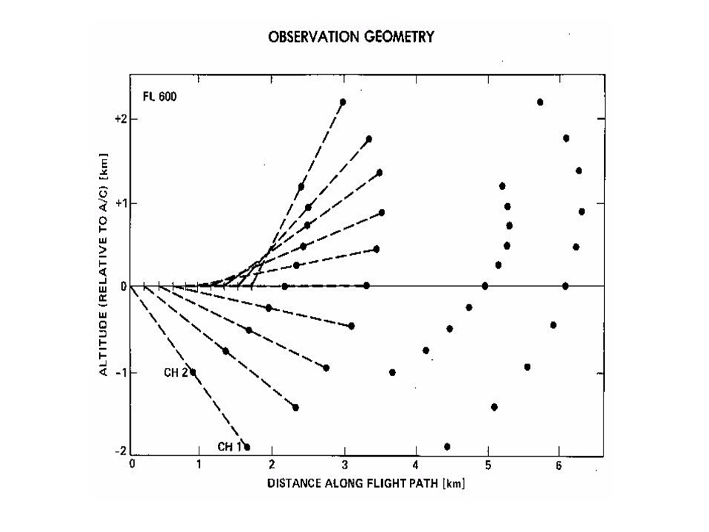
Our instrument has a 3rd channel
Raw data is 3 vectors of Brightness temperatures w/11th &12th scan of a known
source (with and without noise diode)
“Brightness Temperature Space”

Slide 3
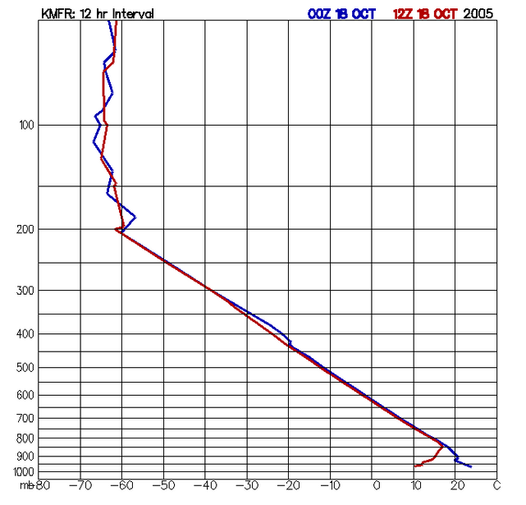
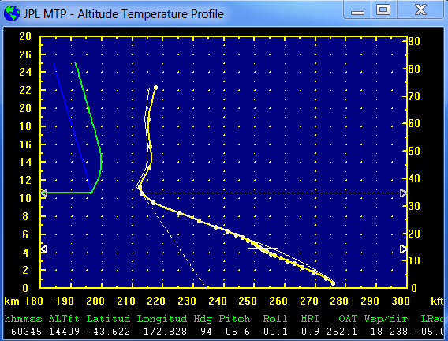
Radiosonde data (with temperature structure similar to the atmosphere being sampled) is critical to conversion of scans from “Brightness Temperature Space” to “Temperature Profile Space”

Slide 4
Retrieval Coefficients Generation
RAOB Resources
Raob Templates
“RCCalc”
Radiative Xfer Modeling
“RAOBGet”
Subset &
Statistics
ASCII RAOB Files
“RAOBMan”
Manager
Retrieval Coefficients
Archive Average Brightness Temps

Slide 5

ETC.
RCCalc creates a “map” from Temperature Profile space to Brightness Temperature space (using multivariate regression) at a set of pre-defined flight levels and generates coefficients to map back
Creates one RCF (Retrieval Coefficient File) for each “template”

Slide 6

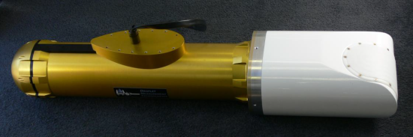
MTP Instrument
The MTP Instrument generates a scan in Brightness Temperature space
Using the Aircraft elevation MTPBin will look through the RCF files to find the best brightness temperature match for the scan
The corresponding retrieval coefficients will be used to map from the scan’s Brightness Temperature space into Temperature Profile space
NOTE: Sometimes an average of two sets is used
Weighted average of Brightness temperatures depending on flight level
Average of two well matched RCFs

Slide 7
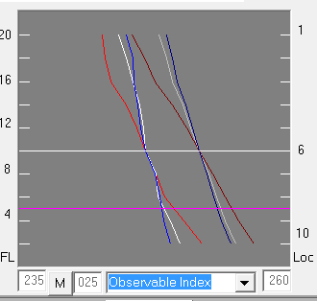
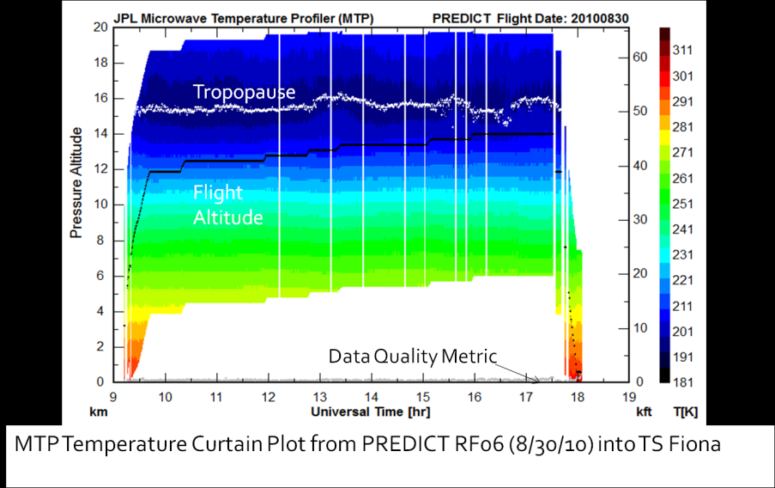
MTP Calibration and Retrieval
Retrieval Coefficients
Archive Average Brightness Temps
Calibration
info
“MTPbin”
Processing
Recorded RAW MTP Data
Window Corrections
Brightness Temperature Comparisons
Excel Spreadsheet

Slide 8
Profile Plot Minimum Requirements
Plot Profile Temperature value at each retrieval level (33) – (white dots)
Cubic spline through those points (yellow line)
Plot Aircraft elevation (white line) and Ambient Temperature (center of line)
Tropopause level (horizontal white dashed line) & Lapse rate (diagonal dashed)
Matched Radiosonde Temperature profile points and spline (white)
MRI (quality indicator)
Matched Radiosonde Template Designator (not shown)
Date/Time

Slide 9
Curtain Plot Minimum Requirements
Color Coded Temperature vs. Altitude (1 scan/line)
Aircraft altitude indicator
Tropopause indicator
MRI (data quality metric) (ranges from 0-2ish – plotted on Pressure altitude scale)
Eliminate “bad” scans

Slide 10
Scan & Template Plot Minimum Requirements
Plot of each channel of the scan (channel # on RHS) – brighter r/w/b lines
Plot of each channel of template’s Brightness Temperature for the elevation nearest to flight level – dimmer r/w/b lines
Should be correlated with Profile plot (i.e. same MTP scan and raob used)

Slide 11
Data Model
What will need to be in the database?
Possible NetCDF structure
MTPPROF (1,30)
Delta Alt: -,-,-,-,-
MTPTEMPL(1) [1-12]
TempL_Temp: -,-,-,-
TempL_Alt: -,-,-,-

