Slide 1

RAF Calibrations Process Proposal and First Example
A Presentation to the RAF Stakeholder Leads
Tom Baltzer
April 2016

Slide 2
Agenda
Modified proposal for overall calibration process
Pressure Cal example

Slide 3
Proposed Process for Inst. Cals
Endeavor toward better communication
Talk/Share/Question
Comments in calibration database
Involve all stakeholders in a 4 part process
Obtain (Techs)
Validate (PMs/PIs)
Advise (Rsig)
Apply (SEs)

Slide 4
Proposed Process for Inst. Cals
Obtain (Techs)
Setup
Place equipment as needed (e.g.cal cart)
Start ADS in cal flight mode
Cal
Apply standard value to “instrument”
Use aeros to obtain ADS result
Inform
When satisfied with the resulting cal:
Notify PM/PI of available cal

Slide 5
Proposed Process for Inst. Cals
Obtain (Techs)
Setup
Place equipment as needed (e.g.cal cart)
Start ADS in cal flight mode
Cal
Apply standard value to “instrument”
Use aeros to obtain ADS result
Inform
When satisfied with the resulting cal:
Notify PM/PI of available cal
Validate (PMs/PIs)
Pull
Assure Cal Source (plane) is on network
Verify
Use caledit to compare calibration to prior
Inform
If “not good” notify Rsig
Start Calibration Database Editor (caledit)
If “good” & desired for processing
use caledit to write calfile
If “good” notify SEs of available calfile
NOTE: Printout from
Aeros caltool is not
Guaranteed to compare
Correct previous/used
Calibration!

Slide 6
Proposed Process for Inst. Cals
Obtain (Techs)
Advise (Rsig)
Setup
Place equipment as needed (e.g.cal cart)
Start ADS in cal flight mode
Cal
Apply standard value to “instrument”
Use aeros to obtain ADS result
Inform
When satisfied with the resulting cal:
Notify PM/PI of available cal
Eval
Use caledit or other tools
Suggest possible corrections
Consider sources of “not good” result
Participate in corrections
Advise
Validate (PM/PI)
Pull
Assure Cal Source (plane) is on network
Verify
Use caledit to compare calibration to prior
Inform
If “not good” notify Rsig
Start Calibration Database Editor (caledit)
If “good” & desired for processing
use caledit to write calfile
If “good” notify SEs of available calfile

Slide 7
Proposed Process for Inst. Cals
Obtain (Techs)
Advise (Rsig)
Setup
Place equipment as needed (e.g.cal cart)
Start ADS in cal flight mode
Cal
Apply standard value to “instrument”
Use aeros to obtain ADS result
Inform
When satisfied with the resulting cal:
Notify PM/PI of available cal
Involve SEs
Eval
Use caledit or other tools
Suggest possible corrections
Consider sources of “not good” result
Participate in corrections
Advise
Validate (PM/PI)
Pull
Assure Cal Source (plane) is on network
Verify
Use caledit to compare calibration to prior
Inform
If “not good” notify Rsig
Start Calibration Database Editor (caledit)
If “good” & desired for processing
use caledit to write calfile
If “good” notify SEs of available calfile

Slide 8
Proposed Process for Inst. Cals
Obtain (Techs)
Advise (Rsig)
Setup
Place equipment as needed (e.g.cal cart)
Start ADS in cal flight mode
Cal
Apply standard value to “instrument”
Use aeros to obtain ADS result
Inform
When satisfied with the resulting cal:
Notify PM/PI of available cal
Eval
Use caledit or other tools
Suggest possible corrections
Consider sources of “not good” result
Participate in corrections
Advise
Validate (PM/PI)
Pull
Assure Cal Source (plane) is on network
Verify
Use caledit to compare calibration to prior
Inform
If “not good” notify Rsig
Start Calibration Database Editor (caledit)
If “good” & desired for processing
use caledit to write calfile
If “good” notify SEs of available calfile
Apply (SEs)
Archive
Assure updated database is backed up
Validate use in house & on planes
Check calfiles into subversion
Notify Techs & PMs they’re in place
Apply

Slide 9
Develop Cases for Instruments
General process is more a template than a rule
Assuming all agree to basic template then we should generated specific process diagrams for individual instruments
Involve only “that instrument’s” stakeholders
Assures that we handle unique situations
Make available for all to see (internal web?)
First cut at Pressure calibrations

Slide 10
Pressures (Digital)
Obtain (Techs)
Advise (Rsig)
Setup
Place calibration cart
Start ADS in cal flight mode
Cal
Apply standard pressures/differentials to sensors
Use aeros to obtain ADS result
Inform
If cal is not “close enough” (Lou?) to 0,1 then notify Lou
Eval
Use caledit or other tools
Suggest possible corrections
Consider sources of “not good” result
Participate in corrections
Advise
Validate (Lou)
Pull
Assure Cal Source (plane) is on network
Verify
Use caledit to compare calibration to prior
Inform
Consult with RSIG?
Start Calibration Database Editor (caledit)
If “not good” decide what to do
e.g. start using a cal? Check cal setup?
e.g. Replace?
Let SEs know that Database has been updated
Apply (SEs)
Archive
Assure updated database is backed up
N/A under current system
Apply

Slide 11
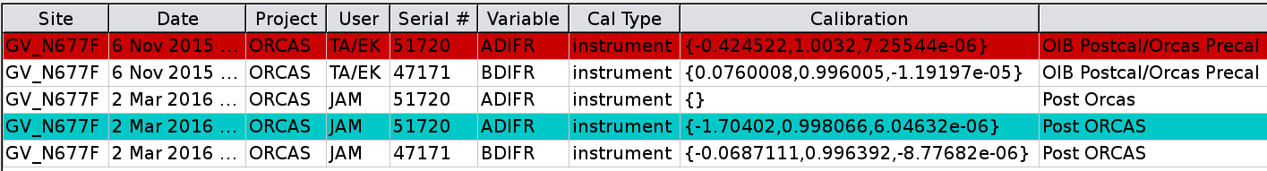
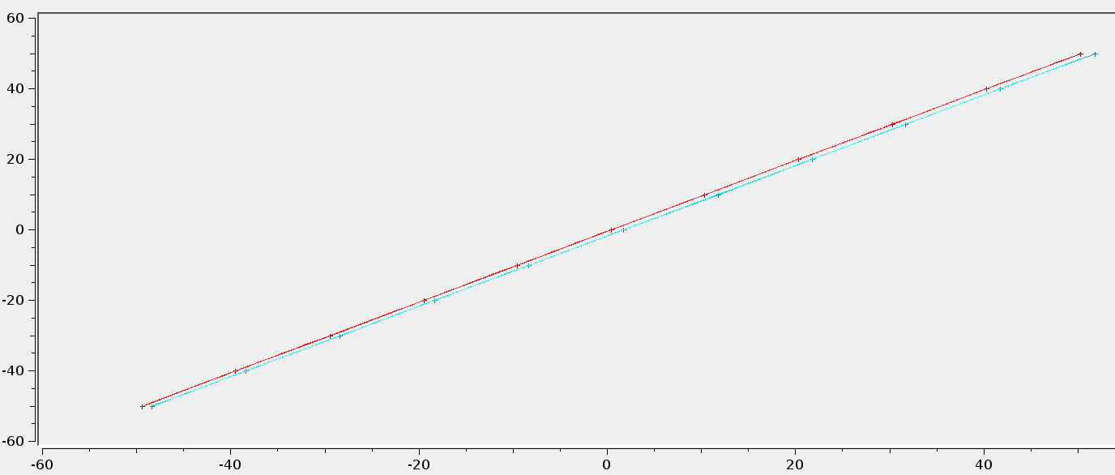
ORCAS

Slide 12
ORCAS
Is this good enough?
What criteria to give Tech group?
Should they be linear?

Slide 13
Action Items
Check lists for Instrument cals – work with PI
Get all stakeholders in a room to go through checklist
Get it onto the internal web site
Aeros to plot from the calfile rather than the onboard DB
Comes back to the question of the serial number

Slide 14
Action Items
ADIFR – go through step by
Try transducer by itself
Step by step along the line
Consider the set up of the calibration cart
E.g. the ruska can be affected by temperature change
Define set points and tolerances of set points (true for all instrument types)

Slide 15
Action Items
ADIFR – go through step by
Is cal cart too complicated?
Check out Tech’s multi-page cal setup document – values that are acceptable? E.g. leak rate?

