Slide 1
MTP Brainstorming
3/18/2015
Some slides to get us going

Slide 2
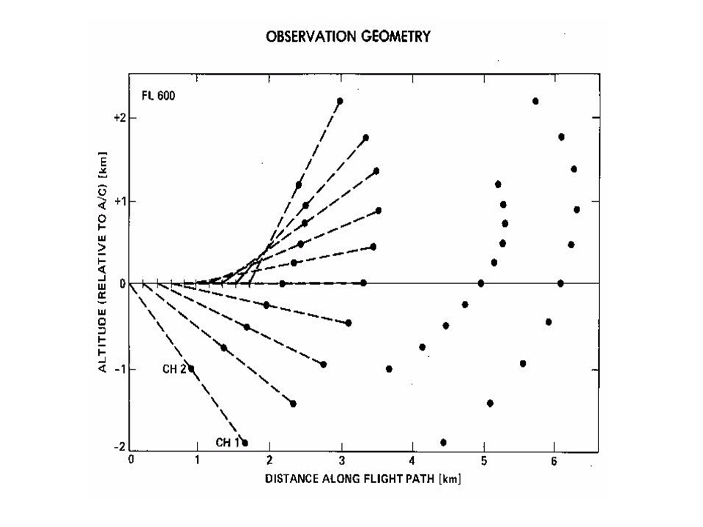
Our instrument has a 3rd channel
Raw data is 3 vectors of Brightness temperatures w/11th &12th scan of a known
source (with and without noise diode)
“Brightness Temperature Space”

Slide 3
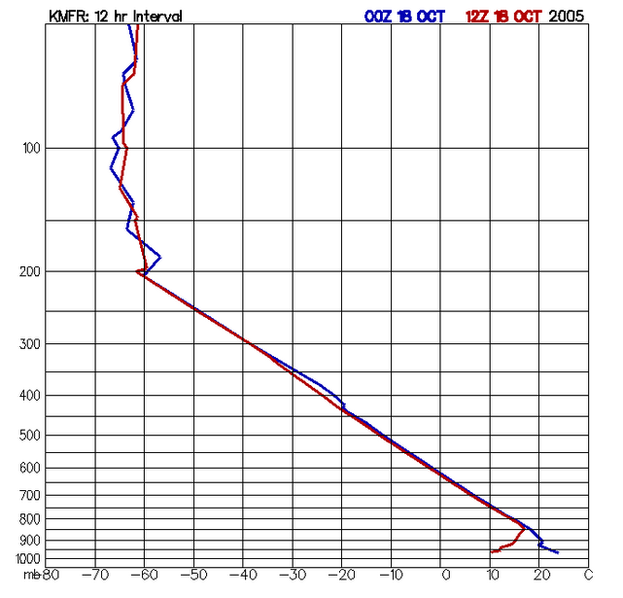
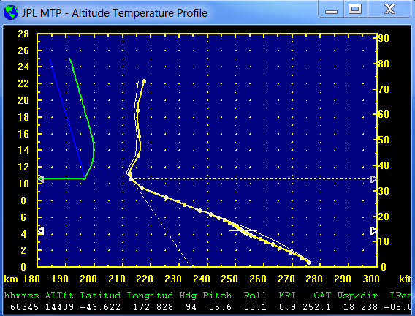
Radiosonde data (with temperature structure similar to the atmosphere being sampled) is critical to conversion of scans from “Brightness Temperature Space” to “Temperature Profile Space”

Slide 4
Retrieval Coefficients Generation
RAOB Resources
Raob Templates
“RCCalc”
Radiative Xfer Modeling
“RAOBGet”
Subset &
Statistics
ASCII RAOB Files
“RAOBMan”
Manager
Preliminary Retrieval Coefficients
Archive Average Brightness Temps

Slide 5

ETC.
RCCalc creates a “map” from Temperature Profile space to Brightness Temperature space (using multivariate regression) at a set of pre-defined flight levels and generates coefficients to map back
Creates one RCF (Retrieval Coefficient File) for each template

Slide 6

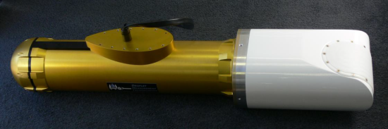
MTP Instrument
The MTP Instrument generates a scan in Brightness Temperature space
Using the Aircraft elevation and Ambient temperature, MTPBin will look through the RCF files to find the best match for the scan
The corresponding retrieval coefficients will be used to map from the scan’s Brightness Temperature space into Temperature Profile space
NOTE: Sometimes an average of two sets is used
Weighted average of Brightness temperatures depending on flight level
Average of two well matched RCFs

Slide 7
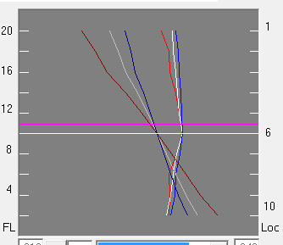
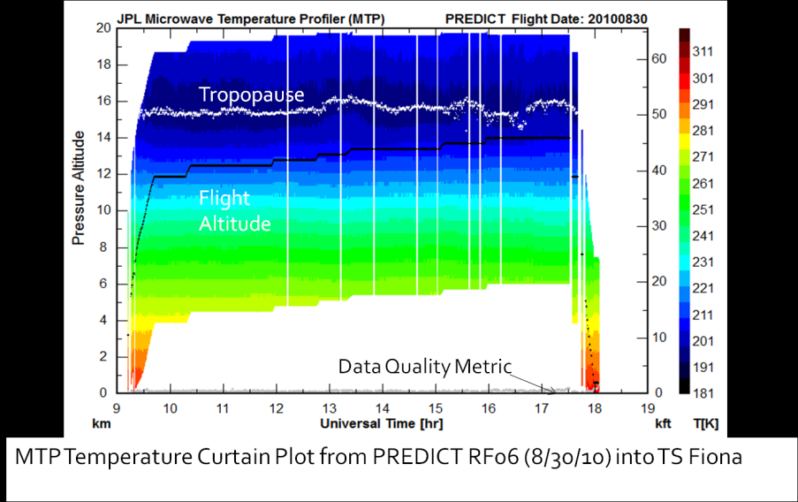
MTP Calibration and Retrieval
Retrieval Coefficients
Archive Average Brightness Temps
Calibration
info
“MTPbin”
Processing
Recorded RAW MTP Data
Window Corrections
Brightness Temperature Comparisons
Excel Spreadsheet

