Slide 1
Best practices for scientific computing
C. Titus Brown
ctb@msu.edu
Asst Professor, Michigan State University
(Microbiology, Computer Science, and BEACON)

Slide 2
Best practices for scientific computing
C. Titus Brown
ctb@msu.edu
Asst Professor, Michigan State University
(Microbiology, Computer Science, and BEACON)

Slide 3
Towards better practices for scientific computing
C. Titus Brown
ctb@msu.edu
Asst Professor, Michigan State University
(Microbiology, Computer Science, and BEACON)

Slide 4
Who are we?
Greg Wilson, D. A. Aruliah, C. Titus Brown, Neil P. Chue Hong, Matt Davis, Richard T. Guy, Steven H. D. Haddock, Katy Huff, Ian M. Mitchell, Mark Plumbley, Ben Waugh, Ethan P. White, Paul Wilson
Authors of “Best Practices for Scientific Computing”
http://arxiv.org/abs/1210.0530

Slide 5
Who am I?
“Computational scientist”
Worked in:
Evolutionary modeling
Albedo measurements (Earthshine)
Developmental biology & genomics
Bioinformatics
“Data driven biologist” – Data of Unusual Size + bio

Slide 6
Who am I?
(Alternative version)
Open source / free software
Member of the Python Software Foundation
Developed a few different pieces of non-scientific software, mostly in testing world.
=> Open science, reproducibility, better practices.

Slide 7
What is this talk about?
Most scientists engage with computation in their science…
…but most are never exposed to good software engineering practices.
This is not surprising.
Computer science generally does not teach “practice”
Learning your scientific domain is hard enough.

Slide 8
A non-dogmatic perspective
There are few practices that you really need to use.
Version control.
Testing of some sort
Automation of some sort (builds, deployment, pipelines)
There are lots of practices that will consume your time and eat your science.
…but figuring out which practices are useful is often somewhat domain and project and person specific.
There are no silver bullets. (Sorry!)

Slide 9
What do scientists care about?
Correctness
Reproducibility and provenance
Efficiency

Slide 10
What do scientists actually care about?
Efficiency
Correctness
Reproducibility and provenance

Slide 11
Our concern
As we become more reliant on computational inference, does more of our science become wrong?
“Big Data” increasingly requires sophisticated computational pipelines…
We know that simple computational errors have gone undetected for many years
a sign error => retraction of 3 Science, 1 Nature, 1 PNAS
Rejection of grants, publications!
http://boscoh.com/protein/a-sign-a-flipped-structure-and-a-scientific-flameout-of-epic-proportions

Slide 12
Our central thesis
With only a little bit of training and effort,
Computational scientists can become more efficient and effective at getting their work done,
while considerably improving correctness and reproducibility of their code.

Slide 13
The paper
Code for people
Automate repetitive tasks
Record history
Make incremental changes
Use version control
Don’t repeat yourself
Plan for mistakes
Avoid premature optimization
Document design & purpose of code, not details
Collaborate

Slide 14
The subset of these I’ll discuss
Use version control
Plan for mistakes
Automate repetitive tasks
Document design & purpose of code

Slide 15
Use version control!
Any kind of version control is better than none.
Distributed version control (Git, Mercurial) is very different from centralized VCS (CVS, Subversion).
Sites like github and bitbucket are changing software development in really interesting ways. (see: www.wired.com/opinion/2013/03/github/, “The github revolution”)

Slide 16
Use version control
Version control enables efficient single-user work by “gating” changes into discrete chunks.
Version control is essential to multiperson collaboration on software.
Distributed version control enables remixing and reuse without permission, while retaining provenance.

Slide 18
Plan for mistakes!
Program defensively --
Use assertions to enforce conditions upon execution
def calc_gc_content(dna):
assert ‘N’ not in dna, “DNA is only A/C/G/T”

Slide 19
Plan for mistakes!
2. Write/run tests –
def test_calc_gc_1():
gc = calc_gc(“AT”)
assert gc == 0
def test_calc_gc_2():
gc = calc_gc(“”)
asssert gc == 0

Slide 20
Plan for mistakes!
3. Black box regression tests:
For fixed input, do we get the same (recorded) output as last day/week/month?
(Very powerful when combined with version control.)

Slide 21
Plan for mistakes!
Write/run tests –
A few personal maxims:
- simple tests are already very useful (if they don’t work…)
- past mistakes are a guide to future mistakes
- any tests are better than no tests
- if they’re not easy to run, no one will run them

Slide 22
Automate repetitive tasks!
Automate your builds, your test running, your analysis pipeline, and your graph production.
Augments reusability/reproducibility.
Encodes expert knowledge into scripts.
Decreases arguments about culpability :)
Excellent training mechanism for new students/collaborators!
Combined with version control => provenance of analysis results!
Improves ability to revise, reuse, remix.

Slide 23
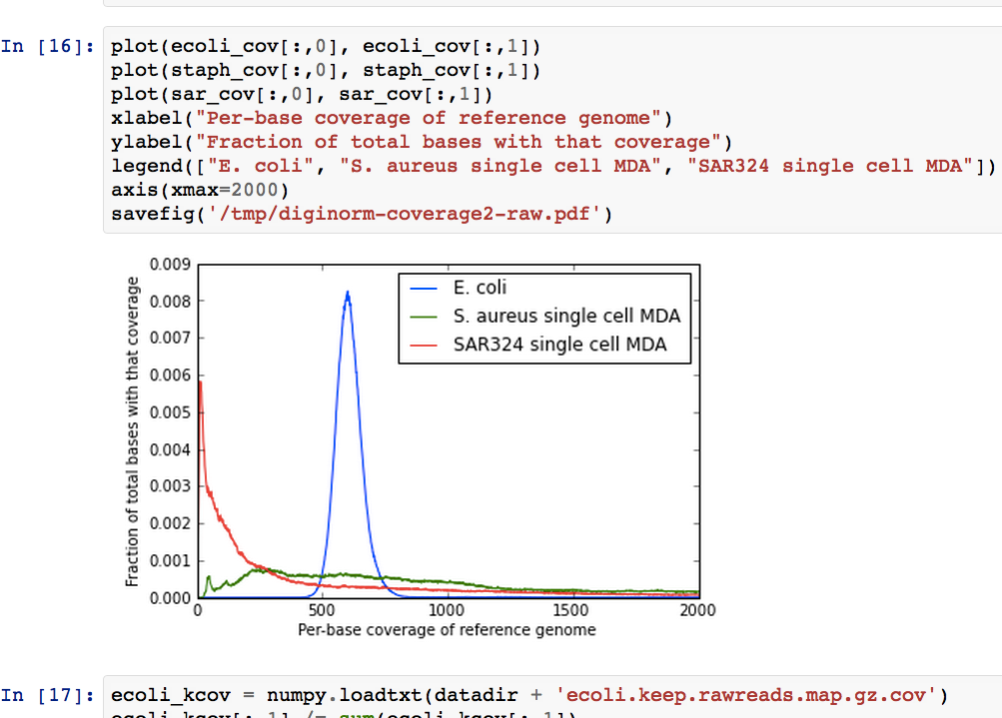
IPython Notebook
Notes:
Increasingly being connected via SOA to backend db

Slide 24
Cloud computing/VMs
One approach my lab has been using is to make publication’s data, code, and instructions available for Amazon EC2 instances:
ged.msu.edu/papers/2012-diginorm/
Reviewers have been known to actually go rerun our pipeline…
More to the point, this enables others (including collaborators) to revise, reuse, remix.

Slide 25
Document design & purpose
x = x + 1 # add 1 to x
vs
# increase past possible fencepost boundary error
range_end = range_end + 1

Slide 26
Document design & purpose
More generally,
- describe APIs
- provide tutorials on use
- discuss the design for domain experts &
programmers, not for novices.

Slide 27
Anecdotes I need to remember to tell
A sizeable fraction of my “single-use” scripts were wrong, upon reuse.
New students in my lab run through at least one old paper’s execution pipeline before starting their work.
Students may develop for long time on own branch, while continually merging from main.

Slide 28
DVCS particularly facilitates long term branching.

Slide 29
There are many, many practices I did not discuss.
Testing:
TDD vs BDD vs SDD?
Functional tests vs unit testing vs …
Code coverage analysis.
Continuous integration!
My view: be generally aware of what’s out there & focus on what addresses your pain points.

Slide 30
Software Carpentry
http://software-carpentry.org
Invite us to run a workshop!
2 days of training at appropriate/desired level:
Beginning/intro
Intermediate
Advanced (?)
Funded by Sloan and operated by Mozilla

Slide 31
Contact info
Titus Brown, ctb@msu.edu
http://ivory.idyll.org/blog/
@ctitusbrown on Twitter
This talk will be on slideshare shortly; google “titus brown slideshare”
Best Practices for Scientific Computing
http://arxiv.org/abs/1210.0530
Git can facilitate greater reproducibility… (K. Ram)
http://www.scfbm.org/content/8/1/7/abstract

