Slide 1


Symbolic Analysis of Concurrency Errors in OpenMP Programs
Presented by : Steve Diersen
Contributors: Hongyi Ma, Liqiang Wang, Chunhua Liao, Daniel Quinlen, and Zijiang Yang
University of Wyoming
Department of Computer Science
Notes:
Good afternoon!
I am here to talk about OAT, the OpenMP Analysis Toolkit. OAT is a symbolic analysis tool for the detection of concurrency errors in OpenMP programs. Unfortunately, the main two contributors for this paper were unable to be here today; my name is Steve Diersen and I will do my best to answer any questions you might have about this approach.

Slide 2

Outline
Motivation
Overview
Encoding
Experiments
Summary

Slide 3


Motivation
To detect concurrency errors within OpenMP programs.
  Specifically data race errors.
To reduce the number of false positives and false negatives during detection.
To reduce the analysis time in determining concurrency errors.
Notes:
Most of us have probably heard the ATM data race example: where a married couple try to withdraw money from two different ATMs at the same time and end up overdrawn. In computer terms, a data race is when two processes access the same shared variable and at least one of the accesses is a write. There are analysis programs that can detect these kinds of errors, for instance Viva64 (from PVS-Studio), Intel Thread Checker, and Sun Thread Analyzer. There is no one tool that is the perfect solution to this problem, each tool has its faults: producing false positives and/or false negatives, long analysis times, etc. Our goal is to create a tool that reduces the number of false positives and false negatives with a manageable analysis time for OpenMP programs.

Slide 4
Motivation
Example 1:
#pragma omp parallel for
for (i = 1; i < 1000; ++i)
x[i] = x[i] + x[i-1];
Example 2:
#pragma omp parallel shared(b) private(errors)
{
for(i = 0; i < 10; ++i)
dt[i] = b + dt[i] * 5;
errors = dt[9] + 1;
}
Notes:
In the previous slide I mentioned the concept of data races, on the next few slides I will show a couple concrete examples of potential data races in OpenMP programs.
Example 1 is a simple for loop, but when parallelized it produces a potential race condition. The expectation is that the array x should be modified sequentially from 1 to 999, but since the order threads execute the loop is not determined: a specific x[i] could be modified out of sequence, causing a data race.
Example 2 is a simple for loop followed by an assignment statement within a parallel region. Without a barrier after the for loop, each thread will execute its portion of the for loop then move to the assignment statement. This can produce a data race.

Slide 5
Motivation
Example 3:
#pragma omp parallel
{
/* Obtain thread number */
tid = omp_get_thread_num();
/* Only master thread does this */
if (tid == 0)
{
nthreads = omp_get_num_threads();
printf("Number of threads = %d\n", nthreads);
}
printf("Thread %d is starting...\n",tid);
};
Notes:
This example shows a parallel region that gets the threads ID and then, if the thread ID is 0 it prints the number of threads and finally all threads print the Thread # is starting… By default, tid is a shared variable and because of this the Thread # is starting… statement could use the wrong thread ID due to a data race.

Slide 6
Motivation
Example 3:
#pragma omp parallel private(tid)
{
/* Obtain thread number */
tid = omp_get_thread_num();
/* Only master thread does this */
if (tid == 0)
{
nthreads = omp_get_num_threads();
printf("Number of threads = %d\n", nthreads);
}
printf("Thread %d is starting...\n",tid);
};
Notes:
This issue is easily fixed by using the private attribute for tid, now there is no data race. These three examples are common errors in OpenMP programming and are some of the motivation behind OAT.

Slide 7


Motivation
Why do we need analysis tools?
  Simple programming errors.
  Large programs with many lines of code.
How should an analysis tools work?
  They should be automated and correct.
Notes:
Writing programs, even small programs, usually requires a manual error check after an initial compilation. Syntax errors, such as: typos, missing declarations, misplaced semi-colons, etc… happen with almost all programs. Thankfully, most of those types of errors are found by the compiler. Concurrency errors are typically semantic errors, which compilers don’t find and are just as easy to make as syntax errors. When creating large programs with multiple programmers semantic errors might not manifest until integration. Going through thousands of lines of code to find semantic errors is nobody’s idea of a good time, thus an analysis tool must be automated. An analysis tool must also find all errors that it is designed to detect. If it cannot find all errors then we are back to manually going through thousands of lines of code.

Slide 8
Motivation
Typical Analysis is either:
  Static Analysis – performed without executing a program. It examines all possible execution paths and variable values in an inaccurate and conservative way.
  Dynamic Analysis – tests and evaluates an application during runtime. It reveals subtle defects or vulnerabilities whose causes are hard to be discovered by static analysis.
Notes:
Static analysis examines the source code to determine execution paths of the program. It is limited in that it cannot accurately follow dynamic events such as: schedule ordering and dynamic heap operations. Dynamic analysis examines the program during execution. It is able to handle the dynamic events that static analysis cannot, but usually only a subset of the possible execution paths those dynamic events could create due to time or space considerations. Hybrid analysis is also possible. This is often the combination of static analysis and dynamic analysis, using static analysis to refine the search space for dynamic analysis.

Slide 9
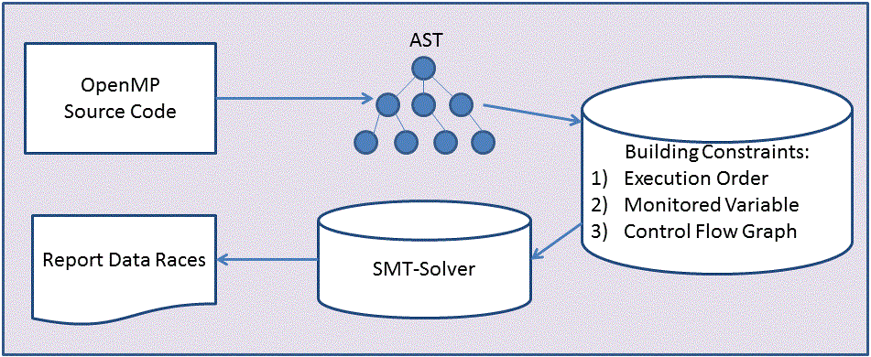
Overview
OAT is a symbolic analysis tool for detecting data races in a shared memory model (OpenMP).
Notes:
The novel approach to OAT is applying Symbolic Analysis to OpenMP concurrency error detection. Here we have a workflow of our OAT system. We start by converting an OpenMP program into its Abstract Syntax Tree representation using the Lawrence Livermore National Lab’s ROSE compiler. The AST is then used to create first-order logic formulas, which represent the parallel OpenMP sections of the source code. These formulas are then fed into an Satisfiability Modulo Theories solver (Yices). Yices is able to prove the Satisfiability of each construct, with regard to data race errors, during symbolic execution. The results are then reported in the final stage.
ROSE is an open source compiler infrastructure to build source-to-
source program transformation and analysis tools.
SMT –solver: the Satisfiability Modulo Theories (SMT) problem is
a decision problem for logical formulas with respect to combinations
of constraints expressed in classical first-order logic with equality.
SMT-solver may find more schedule order solutions!
Find trace ☺
Big Picture
Try to detect data races and deadlocks
in shared momery model (OpenMP).
Using Symbolic Analysis in our approach!
Why! Static analysis but can find traces!

Slide 10
Overview
The Benefits of the Symbolic Analysis approach:
  Schedule order simulation
  Simulated stack traces
  Reduces false positives and false negatives
Notes:
Using symbolic analysis we are able to simulate different scheduling orders of threads. This gives us one of the advantages of dynamic analysis using a static analysis tool. By simulating schedule order we are also able to produce stack traces of the program for those simulated orders, another advantage of dynamic analysis. Finally, we are able to reduce the number of false positives and false negatives compared to other static analysis tools by simulating execution through symbolic analysis.

Slide 11
Encoding
Encoding is only done for OpenMP parallel constructs.
Static Single Assignment (SSA) is used to track variables involved in multiple assignments.
Dynamic scheduling is simulated using a timing order encoding.
Loops can be encoded with loop bound or without loop bound.
Notes:
Sequential code does not need to be encoded to detect concurrency errors, as a result only OpenMP parallel constructs are encode. These constructs include parallel regions, work-sharing, synchronization directives, data environment clauses, and sequential statements within parallel constructs. SSA tracks variables with an increasing subscript at each write operation for the variable. For branch statements a dummy write is inserted in those branches without a specific variable write so that all SSA values are the same at the conclusion of conditional statements. Dynamic scheduling is simulated by encoding the timing order for each variable.
Loops can either be encoded using loop abstraction (without loop bound) or by unrolling a loop to a specific bound (with loop bound).

Slide 12
Encoding
A typical variable encoding looks like:
  The timing order is encoded by
  is the variable
  is the SSA subscript
  is the thread
  Then represents the value of at SSA index in thread
Notes:
So, is the timing order a two dimensional array with an integer value at each cell and then v[] becomes a one dimensional array that uses the timing order to access the value for v? Do we keep all values in the timing order matrix or just the most current? Is there ever a need to go back more than a few values?

Slide 13
Encoding
Schedule order in OpenMP
int i, j;
#pragma omp parallel for
for( i = 0; i < N; i++)
for( j = 0; j < N; j++)
a[i][j] = foo(i, j );
Notes:
Here we have a typical OpenMP parallel for structure. It is important to determine the possible order of execution that threads may follow. We use symbolic analysis to follow different scheduling orders in the detection of data races. Let’s assume only two threads for this example.

Slide 14
Encoding
Schedule order in OpenMP
i is private
int i, j;
#pragma omp parallel for
for( i = 0; i < N; i++)
for( j = 0; j < N; j++)
a[i][j] = foo(i, j );
j is shared!
Notes:
Only the first for loop is parallelized, therefore only i is private to each thread, while j is shared by each thread.

Slide 15
Encoding
Schedule order in OpenMP
i is private
order | Thread1 | Thread2
0 | Load i
1 | Swap out
2 |  | Load i
3 |  | Load j (j = 0)
4 |  | Call foo(i,j)
5 |  | j++
6 |  | Swap out
7 | load j (j = 1)
int i, j;
#pragma omp parallel for
for( i = 0; i < N; i++)
for( j = 0; j < N; j++)
a[i][j] = foo(i, j );
j is shared!
Notes:
One possible schedule ordering has Thread 1 swapping out after it loads i. Then Thread 2 loads i followed by j and proceeds through the incrementing of j, before it finally swaps out. Finally, at time 7, thread 1 loads j, which now has a value of 1.

Slide 16
Encoding
Schedule order in OpenMP
i is private
order | Thread1 | Thread2
0 | Load i
1 | Swap out
2 |  | Load i
3 |  | Load j (j = 0)
4 |  | Call foo(i,j)
5 |  | j++
6 |  | Swap out
7 | load j (j = 1)
int i, j;
#pragma omp parallel for
for( i = 0; i < N; i++)
for( j = 0; j < N; j++)
a[i][j] = foo(i, j );
j is shared!
j =0 is correct!
Notes:
Unfortunately, j should be 0. OAT encodes scheduling order to detect data races such as this one.

Slide 17
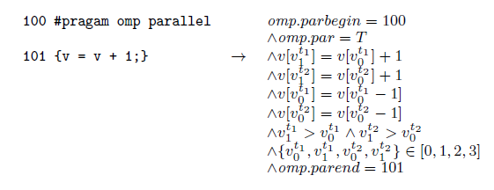
Encoding
Schedule Ordering Encoding
Notes:
Here we have another simple parallel section, where multiple threads will increment the value of v. In this example we only use two threads to simplify the encoding, which is to the right of the code fragment.
Suppose the SMT-Solver generates the timing orders: v(0) for thread 1 = 0, v(1) for thread 1 = 3, v(0) for thread 2 = 1, and v(1) for thread 2 = 2, then we have v[3] = v[0] + 1 and v[2] = v[1] + 1 and v[1] = v[0]. This indicates a schedule to increase v by 1. But if the SMT-Solver then generates v(0) for thread 1 = 0, v(1) for thread 1 = 1, v(0) for thread 2 = 2, and v(1) for thread 2 = 3, which indicates a schedule to increase v by 2; we get a non-deterministic result for the shared variable v. OAT reports a data race on v.

Slide 18

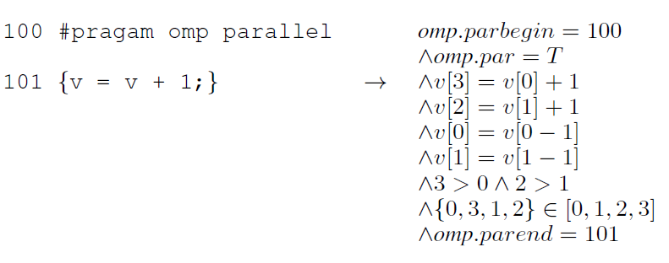
Encoding
Schedule Ordering Encoding
Notes:
Here we have another simple parallel section, where multiple threads will increment the value of v. In this example we only use two threads to simplify the encoding, which is to the right of the code fragment.
Suppose the SMT-Solver generates the timing orders: v(0) for thread 1 = 0, v(1) for thread 1 = 3, v(0) for thread 2 = 1, and v(1) for thread 2 = 2, then we have v[3] = v[0] + 1 and v[2] = v[1] + 1 and v[1] = v[0]. This indicates a schedule to increase v by 1. But if the SMT-Solver then generates v(0) for thread 1 = 0, v(1) for thread 1 = 1, v(0) for thread 2 = 2, and v(1) for thread 2 = 3, which indicates a schedule to increase v by 2; we get a non-deterministic result for the shared variable v. OAT reports a data race on v.

Slide 19

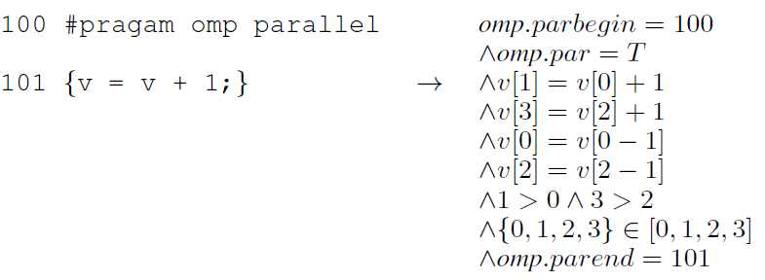
Encoding
Schedule Ordering Encoding
Notes:
Here we have another simple parallel section, where multiple threads will increment the value of v. In this example we only use two threads to simplify the encoding, which is to the right of the code fragment.
Suppose the SMT-Solver generates the timing orders: v(0) for thread 1 = 0, v(1) for thread 1 = 3, v(0) for thread 2 = 1, and v(1) for thread 2 = 2, then we have v[3] = v[0] + 1 and v[2] = v[1] + 1 and v[1] = v[0]. This indicates a schedule to increase v by 1. But if the SMT-Solver then generates v(0) for thread 1 = 0, v(1) for thread 1 = 1, v(0) for thread 2 = 2, and v(1) for thread 2 = 3, which indicates a schedule to increase v by 2; we get a non-deterministic result for the shared variable v. OAT reports a data race on v.

Slide 20
Encoding
Loops
  Without Loop Bound:
    Detects over-write conflicts and write-read conflicts
    Requires less analysis time than with loop bound
    May produce false positives and/or false negatives
  With Loop Bound:
    Detects data races that depend upon the number iterations
    Requires significantly more encoding; resulting in longer analysis times.
Notes:
Loops are arguably the most important structure with regard to parallelization. OAT handles loops in one of two ways: through loop abstraction or loop unrolling. We call this without loop bound and with loop bound, respectively. Without loop bound uses the loop index range to determine if it is possible for different threads to gain access to the same array element. This requires less encoding than with loop bound and as a result requires less time for analysis. Without loop bound may produce false positives and/or false negatives. With loop bound encodes the loop to a number of iterations up to a maximum number of iterations, which is a user defined parameter. Whenever possible OAT will try to determine the actual number of iterations for a loop and use that number. With loop bound is able to detect data races that are dependent upon the number of loop iterations, but this requires significantly more encoding. The extra encoding also means a longer analysis time, with the benefit of little to no false positives or false negatives.

Slide 21
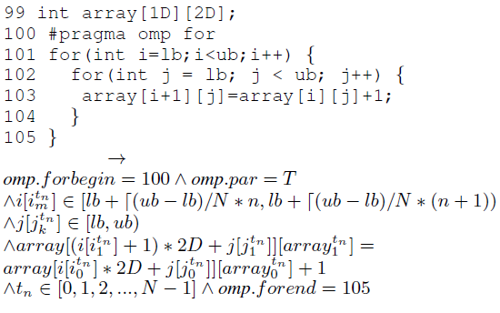
Encoding
OpenMP
For Loop
Without
Loop
Bound
Encoding
Notes:
At the top of this slide, we have a nested for loop where the outer loop is parallelized and the inner loop is not. For simplicity, we will assume the lower bound (lb) and the upper bound (ub) are the same for each loop. At the bottom of this slide, we have the corresponding without loop bound OAT encoding for the nested loop. In this encoding we assume there are N threads. The second line of the encoding checks to see if the current value of i is within the range allotted to the particular thread t_n. The third line ensure the current value of j is with the range given by the for loop for the particular thread t_n. The fourth line encodes the assignment statement that is the body of the inner for loop. Finally, the encoding makes sure that t_n is a valid thread id.

Slide 22
Experiments
Experiments were run by injecting errors into some NAS parallel benchmarks and OpenMP source repository code.
Experiments were also conducted on student homework assignments.
The following slides show results from our experiments.
Notes:
For NAS parallel benchmarks:
What are the CS, BT, EP, FT, LU, IS, MG, and SP benchmarks?
What was the data set used, why was that data set used and are there others that will be used in the future?
For OpenMP Source Repository:
What are the c_fft, c_pi, c_jacobi, c_quicksort, and c_mandel.c benchmarks?
What was the data set used, if applicable?
We used three student homework assignments from the HPC course at the University of Wyoming. No error injection required for these test codes.
We believed, prior to the experiments, that 2 threads would be enough to determine data race conditions. Empirical results from our experiments confirmed this assumption as the number of threads used in the experiment was independent of the results for each Analysis tool and source code combination.

Slide 23
Experiments
Data races were injected into the benchmarks in the following manner:
  By flipping the data-sharing attributes of variables
    Switching private for shared or visa versa
  By adding updating statements
    Adding a random write-read statement such as b = b * 2
Notes:
The NAS parallel benchmark and the OpenMP source repository codes are designed to test performance, and as a result are data race free. In order to test OAT we had to inject data races into these codes. We used two methods for injecting data races: flipping the data-sharing attributes of variables and adding updating statements. The first method flips variable attributes such as private/shared and firstprivate/lastprivate or may remove variables from a reduction clause. The second method injects a random write-read statement such as b = b * 2 for a randomly chosen variable b from the data-sharing attribute variable list.

Slide 24
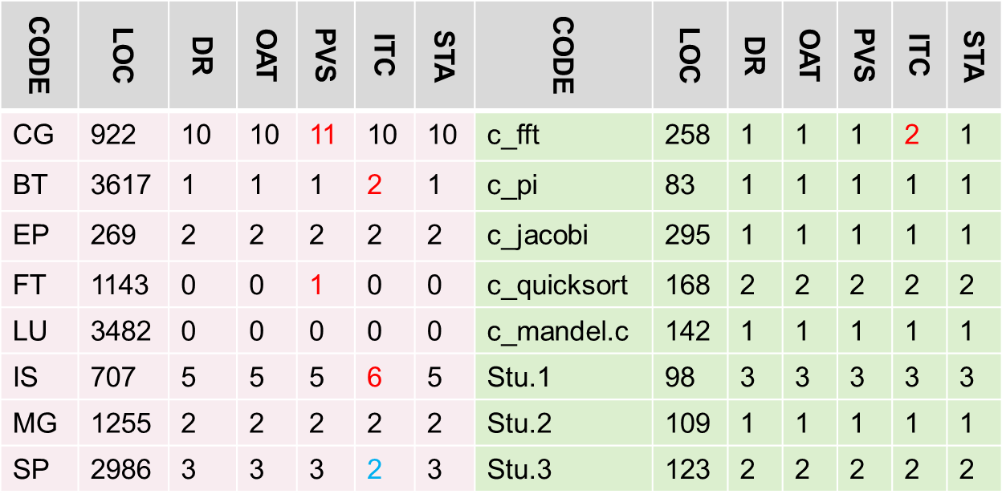
Experiments
CODE – test source code PVS – Viva64 from PVS Studio
LOC – lines of code ITC – Intel Thread Checker
DR – data race injections STA – Sun Thread Analyzer
OAT – OpenMP Analysis Toolkit
Notes:
The left “CODE” column is from the NAS Parallel OpenMP benchmark package. The right “CODE” column are from the OpenMP Source Code Repository (first 5) and Student Homework assignments from the High Performance Computing course at the University of Wyoming (last 3).
DR is the number of data races injected into the source code.
The numbers in the “OAT”, “PVS”, “ITC”, and “STA” columns are the number of data races detected.
NOTICE:
OAT and Sun Thread Analyzer did not report any false positives or false negatives
PVS reported false positives for “CG” and “FT” (We believe these false positives were reported due to updating variables outside of parallel regions.)
Intel Thread Checker reported false positives for “BT”, “IS”, and “c_fft” (We believe the false positives are because ITC cannot fully support #pragma omp critical.)
Intel Thread Checker reported one false negative for “SP” (We believe the false negative is because some data dependencies in #pragma omp sections cannot be determined.)

Slide 25
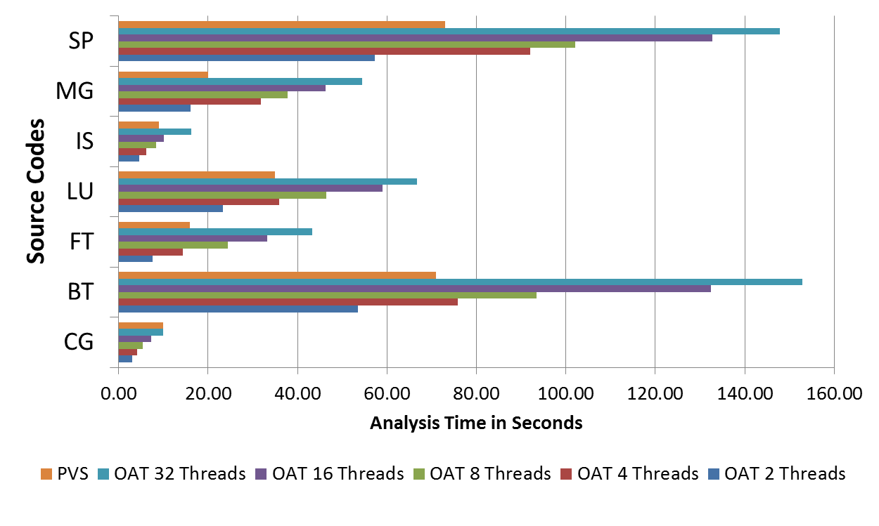
Experiments
Notes:
PVS is shown for 8 threads (The time for PVS was nearly constant independent upon the number of threads)
PVS is the top bar for each code source
OAT is the remaining 5 bars in order, from top to bottom: 32, 16, 8, 4, and 2 threads

Slide 26
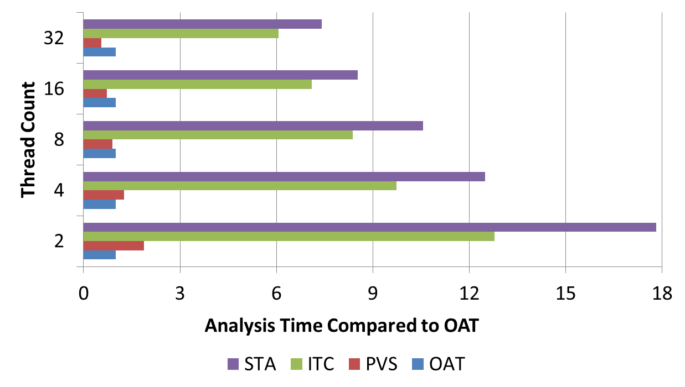
Experiments
Notes:
This is the average analysis time by thread count for test codes with > 500 lines of code.
OAT is the baseline
ITC, STA and PVS are multiples of the baseline analysis time for OAT
Said another way ITC, STA, and PVS are normalized to the OAT time for analysis of test codes with > 500 lines of code

Slide 27
Summary
Our Symbolic Analysis approach was able to find all data races in our experiments.
OAT had no false positives or false negatives.
Our analysis time was faster than the dynamic analysis tools.
For two threads our tool was faster than Viva64
Notes:
How about PVS? Do we need to mention that?
Our approach shows the feasibility of symbolic analysis to analyze the concurrency errors in OpenMP application. The overhead is significantly lower than that using dynamic analysis using 2-threads translation, but we still have to consider to optimize our tools in more threads translation.
Our approach OAT summary:
pros:
Symbolic execution to generate traces like real running.
Reduce false positives and negatives
cons:
More overhead due to more constraints.

Slide 28
Thank you
Contact information:
Hongyi Ma : hma3@uwyo.edu
Steve Diersen : sdiersen@uwyo.edu
University of Wyoming, Computer Science Department

