Slide 1
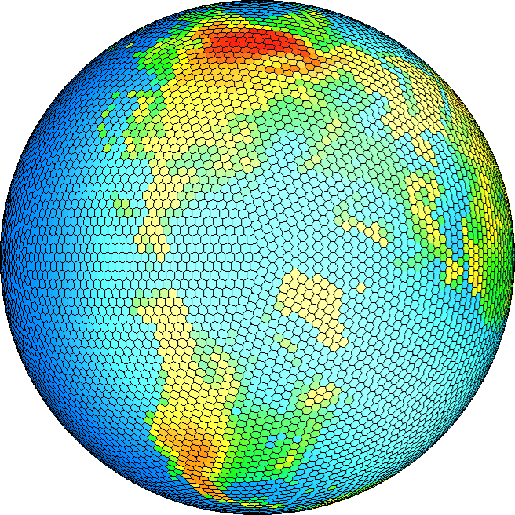
Experience Applying Fortran GPU Compilers to Numerical Weather Prediction
Tom Henderson
NOAA Global Systems Division
Thomas.B.Henderson@noaa.gov
Mark Govett, Jacques Middlecoff
Paul Madden, James Rosinski,
Craig Tierney
Notes:
GSD Subversion Tutorial

Slide 2
Outline
Computational accelerators and fine-grained parallelism
A wee bit about the Non-hydrostatic Icosahedral Model (NIM)
Commercial and open-source directive-based Fortran GPU compilers
Initial performance comparisons
Conclusions and future directions
2/22/12
Notes:
GSD Subversion Tutorial

Slide 3

More FLOPS = Better Forecasts
2/22/12
Thanks to Bruce Webster, NOAA
Notes:
GSD Subversion Tutorial

Slide 4
But the Moore’s Law “Free Ride” is Over
CPU clock frequencies have stalled
CPU vendors moving to more cores per chip to increase performance
Computational Accelerators
  GPGPU (NVIDIA, AMD)
    General-Purpose Graphics Processing Unit
    100s of simple cores
    Already on HPC top-500 list
    Initial NWP work by Michalakes
  MIC (Intel)
    Many Integrated Core
    10s of cores
    Under development
Common theme: exploit fine-grained parallelism
2/22/12
Notes:
GSD Subversion Tutorial

Slide 5
GSD Investigates New Architectures for NOAA
MPP (1992- )
GPU (2008- )
2/22/12
1st Operational MPP (2000)
Notes:
GSD Subversion Tutorial

Slide 6
GPU Fine-Grained Parallelism
“Blocks” of “threads”
  Many threads per core (1000s)
  Needs code that vectorizes well
Large on-chip (“global”) memory
  ~3x higher bandwidth than CPUs
  High latency (100s of cycles)
    Need lots of threads to hide memory latency
Limited per-thread fast (“shared”) memory & registers
  User-managed cache
  Limits number of threads
Slow data transfers between CPU & GPU
2/22/12
Notes:
GSD Subversion Tutorial

Slide 7
Traditional “Computational Accelerator” Approach
Model state arrays live in CPU memory
Model executes on CPU until an “expensive” routine is encountered
Data for routine is transferred to accelerator (GPU, MIC)
Accelerator executes routine
Data is transferred back to CPU
Too slow for memory-bandwidth-limited NWP!
2/22/12
Notes:
GSD Subversion Tutorial

Slide 8
For NWP CPU is a “Communication Accelerator”
Invert traditional “GPU-as-accelerator” model
  Model state lives on GPU
  Initial data read by the CPU and passed to the GPU
  Data passed back to the CPU only for output & message-passing
  GPU performs all computations
    Fine-grained parallelism
  CPU controls high level program flow
    Coarse-grained parallelism
Minimizes overhead of data movement between CPU & GPU
“Reverse offload” in MIC terms
2/22/12
Notes:
SMS is a tool based on MPI developed at GSD. I will sometimes use “exchange” in place of interprocessor communication

Slide 9
NIM NWP Dynamical Core
  NIM = “Non-Hydrostatic Icosahedral Model”
    New NWP dynamical core
    Target: global “cloud-permitting” resolutions ~3km (42 million columns)
    Rapidly evolving code base
“GPU-friendly” (also good for CPU)
  Single-precision floating-point computations
  Computations structured as simple vector ops with indirect addressing and inner vertical loop
Coarse-grained parallelism via Scalable Modeling System (SMS)
    Directive-based approach to distributed-memory parallelism
2/22/12
Notes:
GSD Subversion Tutorial

Slide 10
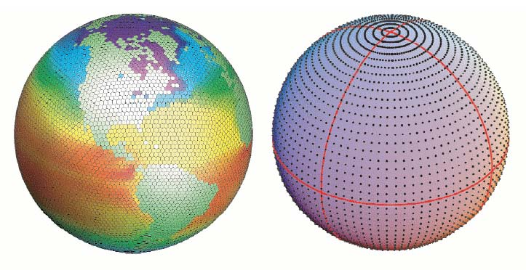

Icosahedral (Geodesic) Grid: A Soccer Ball on Steroids
Lat/Lon Model
Icosahedral Model
Near constant resolution over the globe
Always 12 pentagons
2/22/12
(slide courtesy Dr. Jin Lee)
Notes:
A low-resolution example
450km resolution, 2562 columns
Always 12 pentagons at any resolution (look closely)
GSD Subversion Tutorial

Slide 11
NIM Requirements
Must maintain single source code for all desired execution modes
  Single and multiple CPU
  Single and multiple GPU
  Prefer a directive-based Fortran approach for GPU
Can tolerate less stable HPC platforms for research
  “Opportunity” FLOPS
2/22/12
Notes:
GSD Subversion Tutorial

Slide 12
Why FORTRAN?
De-facto language of NWP
  # of atmospheric modelers >> # of SEs in domain
  Large legacy code base
Good language for HPC
  “Formula-translation”
    Especially multi-dimensional arrays
  50+ years of automatic optimizations
  Strong support for efficient floating-point operations
8/29/11
Notes:
GSD Subversion Tutorial

Slide 13
GPU Fortran Compilers
Commercial directive-based compilers
  CAPS HMPP 3.0.3
    Generates CUDA-C (NVIDIA) and OpenCL (NVIDIA or AMD)
  Portland Group PGI Accelerator 11.10
    Supports NVIDIA GPUs
    Previously used to accelerate WRF physics packages
  Cray (beta)
Open-source directive-based compiler
  F2C-ACC (Govett, 2008)
  “Application-specific” Fortran->CUDA-C compiler for performance evaluation
2/22/12
Notes:
GSD Subversion Tutorial

Slide 14
Use F2C-ACC to Evaluate Commercial Compilers
Compare HMPP and PGI output and performance with F2C-ACC compiler
  Use F2C-ACC to prove existence of bugs in commercial compilers
  Use F2C-ACC to prove that performance of commercial compilers can be improved
Both HMPP and F2C-ACC generate “readable” CUDA code
  Re-use function and variable names from original Fortran code
  Allows straightforward use of CUDA profiler
  Eases detection and analysis of compiler correctness and performance bugs
2/22/12
Notes:
GSD Subversion Tutorial

Slide 15
Current GPU Fortran Compiler Limitations
Some do not support all modern Fortran language features
Directive syntax still changing
Compiler capabilities still evolving
No common directive syntax yet
  OpenACC
Bugs are not uncommon
Debugging support limited
  Relative debugging still manual
Limited support for GPU “shared” memory
Limited support for nested subroutines
It ain’t easy yet
2/22/12
Notes:
GSD Subversion Tutorial

Slide 16
Current GPU Fortran Compiler Limitations
Both PGI and HMPP require “tightly nested outer loops”
  This can be a big problem!
    Legacy codes often split loop nests across subroutine interfaces
    Code transformations can increase memory use and reduce performance
  Not a limitation for F2C-ACC
    HMPP “loop permute” directive can help a bit…
! This is OK
do ipn=1,nip
do k=1,nvl
<statements>
enddo
enddo
! This is NOT OK
do ipn=1,nip
<statements>
do k=1,nvl
<statements>
enddo
enddo
2/22/12
Notes:
GSD Subversion Tutorial

Slide 17
F2C-ACC Translation to CUDA
(Input Fortran Source)
subroutine SaveFlux(nz,ims,ime,ips,ipe,ur,vr,wr,trp,rp,urs,vrs,wrs,trs,rps)
implicit none
<input argument declarations>
!ACC$REGION(<nz>,<ipe-ips+1>,<ur,vr,wr,trp,rp,urs,vrs,wrs,trs,rps:none>) BEGIN
!ACC$DO PARALLEL(1)
do ipn=ips,ipe
!ACC$DO VECTOR(1)
do k=1,nz
urs(k,ipn) = ur (k,ipn)
vrs(k,ipn) = vr (k,ipn)
trs(k,ipn) = trp(k,ipn)
rps(k,ipn) = rp (k,ipn)
end do !k loop
!ACC$THREAD(0)
wrs(0,ipn) = wr(0,ipn)
!ACC$DO VECTOR(1)
do k=1,nz
wrs(k,ipn) = wr(k,ipn)
end do !k loop
end do !ipn loop
!ACC$REGION END
return
end subroutine SaveFlux
2/22/12
Notes:
GSD Subversion Tutorial

Slide 18
F2C-ACC Translated Code (CPU)
extern "C" void saveflux_ (int *nz__G,int *ims__G,int *ime__G,int *ips__G,int *ipe__G,float *ur,float *vr,float *wr,float *trp,float *rp,float *urs,float *vrs,float *wrs,float *trs,float *rps) {
int nz=*nz__G;
int ims=*ims__G;
int ime=*ime__G;
int ips=*ips__G;
int ipe=*ipe__G;
dim3 cuda_threads1(nz);
dim3 cuda_grids1(ipe-ips+1);
extern float *d_ur;
extern float *d_vr;
< Other declarations>
saveflux_Kernel1<<< cuda_grids1, cuda_threads1 >>> (nz,ims,ime,ips,ipe,d_ur,d_vr,d_wr,d_trp,d_rp,d_urs,d_vrs,d_wrs,d_trs,d_rps);
cudaThreadSynchronize();
// check if kernel execution generated an error
CUT_CHECK_ERROR("Kernel execution failed");
return;
}
2/22/12
Notes:
GSD Subversion Tutorial

Slide 19
F2C-ACC Translated Code (GPU)
#include “ftnmacros.h”
//!ACC$REGION(<nz>,<ipe-ips+1>,<ur,vr,wr,trp,rp,urs,vrs,wrs,trs,rps:none>) BEGIN
__global__ void saveflux_Kernel1(int nz,int ims,int ime,int ips,int ipe,float *ur,float *vr,float *wr,float *trp,float *rp,float
*urs,float *vrs,float *wrs,float *trs,float *rps) {
int ipn;
int k;
//!ACC$DO PARALLEL(1)
ipn = blockIdx.x+ips;
// for (ipn=ips;ipn<=ipe;ipn++) {
//!ACC$DO VECTOR(1)
k = threadIdx.x+1;
// for (k=1;k<=nz;k++) {
urs[FTNREF2D(k,ipn,nz,1,ims)] = ur[FTNREF2D(k,ipn,nz,1,ims)];
vrs[FTNREF2D(k,ipn,nz,1,ims)] = vr[FTNREF2D(k,ipn,nz,1,ims)];
trs[FTNREF2D(k,ipn,nz,1,ims)] = trp[FTNREF2D(k,ipn,nz,1,ims)];
rps[FTNREF2D(k,ipn,nz,1,ims)] = rp[FTNREF2D(k,ipn,nz,1,ims)];
// }
//!ACC$THREAD(0)
if (threadIdx.x == 0) {
wrs[FTNREF2D(0,ipn,nz-0+1,0,ims)] = wr[FTNREF2D(0,ipn,nz-0+1,0,ims)];
}
//!ACC$DO VECTOR(1)
k = threadIdx.x+1;
// for (k=1;k<=nz;k++) {
wrs[FTNREF2D(k,ipn,nz-0+1,0,ims)] = wr[FTNREF2D(k,ipn,nz-0+1,0,ims)];
// }
// }
return;
}
//!ACC$REGION END
Key Feature: Translated CUDA code is human-readable!
2/22/12
Notes:
GSD Subversion Tutorial

Slide 20
Directive Comparison:
Loops (some are optional)
!$hmppcg parallel
do ipn=1,nip
!$hmppcg parallel
do k=1,nvl
do isn=1,nprox(ipn)
xnsum(k,ipn) = xnsum(k,ipn) + x(k,ipp)
enddo
enddo
enddo
HMPP
!$acc region
!$acc do parallel
do ipn=1,nip
!$acc do vector
do k=1,nvl
do isn=1,nprox(ipn)
xnsum(k,ipn) = xnsum(k,ipn) + x(k,ipp)
enddo
enddo
enddo
PGI
2/22/12
Notes:
GSD Subversion Tutorial

Slide 21
Directive Comparison:
Array Declarations and Calls
real :: u(nvl,nip)
…
call diag(u, …)
call vd(u, …)
call diag(u, …)
…
subroutine vd(fin, …)
…
subroutine diag(u, …)
…
Original
Code
2/22/12
Notes:
GSD Subversion Tutorial

Slide 22
Directive Comparison:
Array Declarations and Calls
! Must make interfaces explicit
include “interfaces.h”
real :: u(nvl,nip)
!$hmpp diag allocate, args[“u”,…]
…
!$hmpp diag callsite
call diag(u, …)
!$hmpp vd callsite
call vd(u, …)
!$hmpp diag callsite
call diag(u, …)
…
!$hmpp vd codelet, args[u, …] …
subroutine vd(fin, …)
…
!$hmpp diag codelet, args[u, …] …
subroutine diag(u, …)
HMPP
2/22/12
Notes:
GSD Subversion Tutorial

Slide 23
Directive Comparison:
Array Declarations and Calls
! Must make interfaces explicit
include “interfaces.h”
!$acc mirror (u)
real :: u(nvl,nip)
…
call diag(u, …)
call vd(u, …)
call diag(u, …)
…
subroutine vd(fin, …)
!$acc reflected (fin, …)
…
subroutine diag(u, …)
!$acc reflected (u, …)
PGI
2/22/12
Notes:
GSD Subversion Tutorial

Slide 24
Directive Comparison:
Explicit CPU-GPU Data Transfers
!$hmpp advancedLoad, args[“u”]
…
!$hmpp delegatedStore, args[“u”]
HMPP
!$acc update device(u)
…
!$acc update host(u)
PGI
2/22/12
Notes:
GSD Subversion Tutorial

Slide 25
Initial Performance Results
“G5-L96” test case
  10242 columns, 96 levels, 1000 time steps
  Expect similar number of columns on each GPU at ~3km target resolution
CPU = Intel Westmere (2.66GHz)
GPU = NVIDIA C2050 “Fermi”
Optimize for both CPU and GPU
  Some code divergence
  Always use fastest code
2/22/12
Notes:
GSD Subversion Tutorial

Slide 26
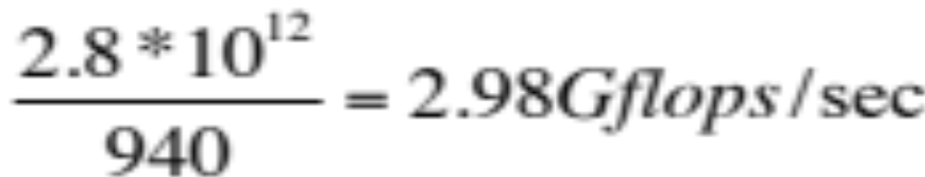
Good Performance on CPU
Used PAPI to count flops (Intel compiler)
  Requires –O1 (no vectorization) to be accurate!
  2nd run with –O3 (vectorization) to get wallclock
  ~27% of peak on Westmere 2.8 GHz
2/22/12
Notes:
GSD Subversion Tutorial

Slide 27
Fermi GPU vs. Single/Multiple Westmere CPU cores, “G5-L96”
NIM routine | CPU 1-core Time (sec) | CPU 6-core Time (sec) | F2C-ACC GPU Time (sec) | HMPP GPU Time (sec) | PGI GPU Time (sec) | F2C-ACC Speedup vs. 6-core CPU
Total | 8654 | 2068 | 449 | -- | -- | 4.6
vdmints | 4559 | 1062 | 196 | 192 | 197 | 5.4
vdmintv | 2119 | 446 | 91 | 101 | 88 | 4.9
flux | 964 | 175 | 26 | 24 | 26 | 6.7
vdn | 131 | 86 | 18 | 17 | 18 | 4.8
diag | 389 | 74 | 42 | 33 | -- | 1.8
force | 80 | 33 | 7 | 11 | 13 | 4.7
2/22/12
Notes:
GSD Subversion Tutorial

Slide 28
“G5-96” with PGI and HMPP
HMPP:
  Each kernel passes correctness tests in isolation
  Unresolved error in data transfers
    Worked fine with older version of NIM
PGI:
  Entire model runs but does not pass correctness tests
  Data transfers appear to be correct
  Likely error in one (or more) kernel(s)
2/22/12
Notes:
GSD Subversion Tutorial

Slide 29
Recent Experience With New NIM Version
Apply transformations to CPU code to achieve “tightly nested outer loops”
  Test as much as possible on CPU before running on GPU!
  ~ 1 week of effort to complete transformations
  Slows down CPU by 2x !
HMPP:
  HMPP3 directives much simpler than HMPP2
  ~1 week of effort, still debugging
PGI:
  ~2 weeks of effort, still debugging
2/22/12
Notes:
GSD Subversion Tutorial

Slide 30
Early Work With Multi-GPU Runs
F2C-ACC + SMS directives
  Identical results using different numbers of GPUs
  Poor scaling because compute has sped up but communication has not
  Working on communication optimizations
Demonstrates that single source code can be used for single/multiple CPU/GPU runs
Should be possible to mix HMPP/PGI directives with SMS too
2/22/12
Notes:
GSD Subversion Tutorial

Slide 31
Conclusions
Some grounds for optimism
  Fermi is ~4-5x faster than 6-core Westmere
  Once compilers mature, expect level of effort similar to OpenMP for “GPU-friendly” codes like NIM
Debugging and validation are more difficult on GPUs
HMPP strengths: user-readable CUDA-C, strong user support, quick response to bug reports
PGI strengths: strong user support
2/22/12
Notes:
GSD Subversion Tutorial

Slide 32
Future Directions
Continue to improve GPU performance
  Tuning options via F2C-ACC and commercial compilers
  Convince compiler vendors to support key optimizations
    MUST relax “tightly-coupled outer loop” restriction!
Address multi-GPU scaling issues
Cray GPU compiler
Intel MIC
2/22/12
Notes:
GSD Subversion Tutorial

Slide 33
Thanks to…
Guillaume Poirier, Yann Mevel, and others at CAPS for assistance with HMPP
Dave Norton and others at PGI for assistance with PGI Accelerator
We want to see multiple successful commercial directive-based Fortran compilers for GPU/MIC
2/22/12
Notes:
GSD Subversion Tutorial

Slide 34
Thank You
2/22/12
Notes:
GSD Subversion Tutorial

