Slide 1
A Strategy for Open Source Software at NASA
Chris A. Mattmann
Senior Computer Scientist, NASA Jet Propulsion Laboratory
Adjunct Assistant Professor, Univ. of Southern California
Member, Apache Software Foundation

Slide 2
Roadmap
Areas for Open Source within the NASA context
  Relevant to NCAR and other institutions
Strategies and Decision Points
Discuss outcome and recommendations from the NASA OSS
This is a shorter version of a longer, half day breakout on NASA Open Source that I led at the 9th NASA Earth Science Data System Working Group Meetings in October 2010
http://s.apache.org/anM
Also check out NASA OSS slides that inspired this: http://s.apache.org/pw
And ESIP Summer 2011: http://s.apache.org/Wd0
And AGU 2011: http://oreil.ly/xjbtvu
22-Feb-12
NCAR-SEA-2012

Slide 3
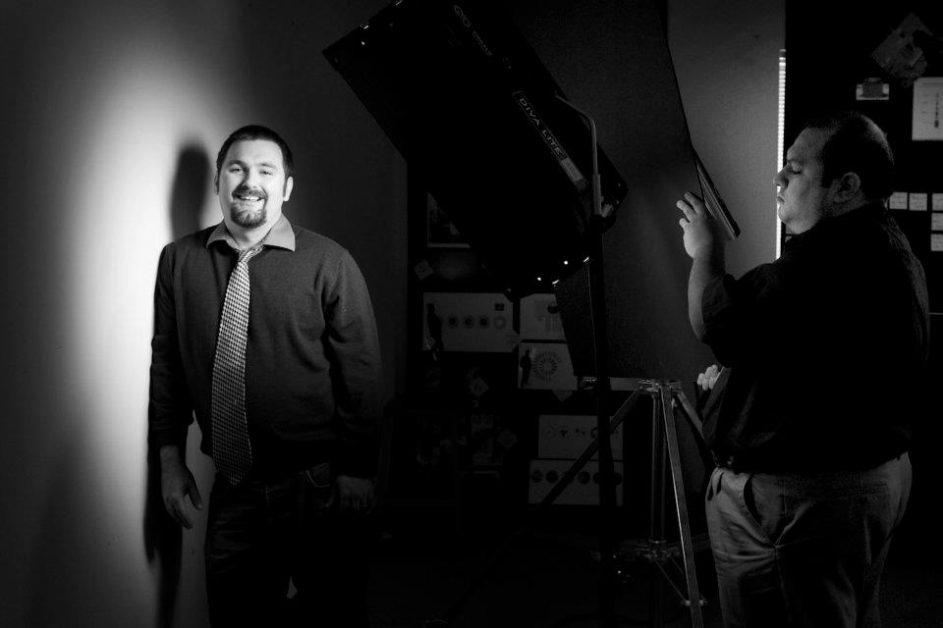
And you are?
Apache Member involved in
  OODT (VP, PMC), Tika (VP,PMC), Nutch (PMC), Incubator (PMC), SIS (Mentor), Lucy (Mentor) and Gora (Champion), MRUnit (Mentor), Airavata (Mentor)
Senior Computer Scientist at NASA JPL in Pasadena, CA USA
Software Architecture/Engineering Prof at Univ. of Southern California
22-Feb-12
NCAR-SEA-2012

Slide 4
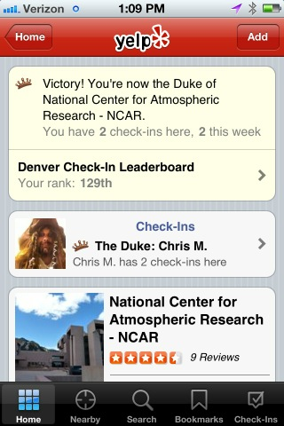
Dukedom
Just had to throw this in
22-Feb-12
NCAR-SEA-2012

Slide 5
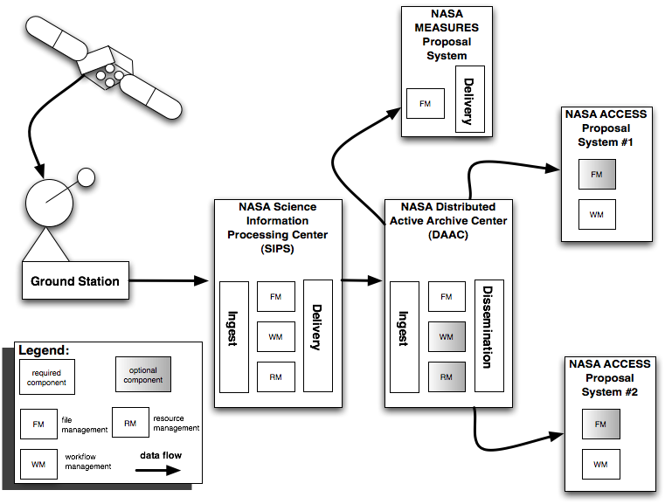
The NASA ESDS Context
Where is open source most useful?
Which area should produce open source software?
22-Feb-12
NCAR-SEA-2012

Slide 6
Concerns in the Open Source World
Licensing
  GPL(v2, v3?), LGPL(v?), BSD, MIT, ASLv2
  Your own custom license approved by OSS
    NASA OSS license?
    Caltech license?
  Copy-left versus Copy-right
Redistribution
  Can you take open source product X and use it in your commercially interested software Y?
    If so, do you have to pay for it?
  Should others pay for your open source product if they use it in their commercial application?
Open Source “Help Desk” Syndrome versus Community
  Are you trying to simply make your open source software (releases) available for distribution (aka help desk)?
  Are you trying to get others to “buy in” to your open source software?
22-Feb-12
NCAR-SEA-2012

Slide 7
Concerns in the Open Source World
Intellectual Property
  Who owns it?
  How does the Open Source Software affect your IP?
Open Source Ecosystems
  Where can you find the “killer app” you need?
  Which communities are conducive for longevity?
  How relevant are “generic” open source software communities to NASA Earth Science Data Systems?
Contributing
  Are you even allowed to contribute to a OSS community?
  Can you do it on “company” time?
  What’s required?
  What’s the governance?
Responsiveness
  How response is the OSS community to your projects’ needs?
22-Feb-12
NCAR-SEA-2012

Slide 8
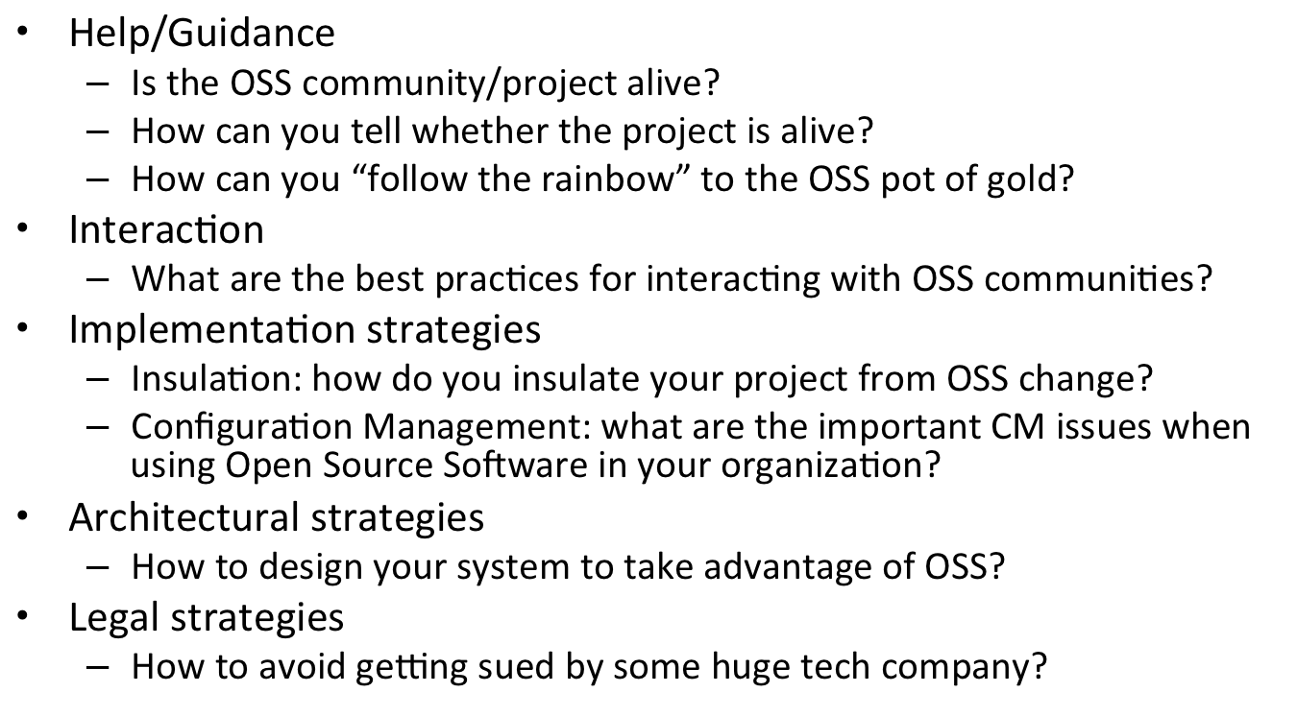
Concerns in the Open Source World
22-Feb-12
NCAR-SEA-2012

Slide 9
The NASA ESDS Context
The aforementioned OSS concerns are cross cutting against the whole ESDS enterprise!
22-Feb-12
NCAR-SEA-2012

Slide 10


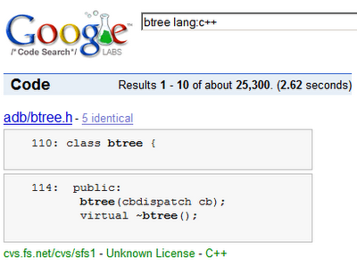

OSS Ecosystems
Where should you go to for your open source project?
Should your org have its own?
Should your project (SIPS, DAAC, proposal) have its own?
22-Feb-12
NCAR-SEA-2012

Slide 11
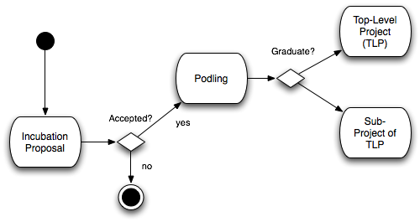
Apache Maturity Model
Start out
with
Incubation
Grow
community
Make
releases
Gain interest
Diversify
When the project is ready, graduate into
  Top-Level Project (TLP)
  Sub-project of TLP
Increasingly, Sub-projects are discouraged compared to TLPs
22-Feb-12
NCAR-SEA-2012

Slide 12
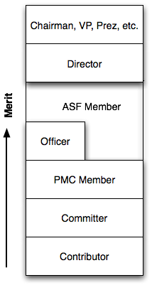
Apache Organization
Apache is a meritocracy
  You earn your keep and your
  credentials
Start out as Contributor
  Patches, mailing list comments, etc.
  No commit access
Move onto Committer
  Commit access, evolve the code
PMC Members
  Have binding VOTEs on releases/personnel
Officer (VP, Project)
  PMC Chair
ASF Member
  Have binding VOTE in the state of the foundation
  Elect Board of Directors
Director
  Oversight of projects, foundation activities
22-Feb-12
NCAR-SEA-2012

Slide 13
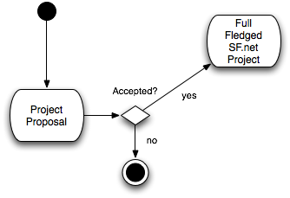
SourceForge (a different model)
Project Proposal
  Accepted? Get going!
No foundation-wide oversight
Tons of dormant projects with
no communities of interest
Goal is to host infrastructure and
host technologies
Goal is not to build communities
No foundation-wide rules or guidelines for committership or for project management
  Dealt with locally by the progenitor of the project
  Can lead to BDFL (benevolent dictator for life) syndrome
No foundation-wide license requirements
  BSD, GPL(v2, v3), MIT, LGPL, etc all allowed
22-Feb-12
NCAR-SEA-2012

Slide 14
Communities
Working on common software
  Measured not in terms of what center contributor works for, but in terms of
    Number of patches contributed (high quality)
    Mailing list questions answered
    # of releases made, or helped with
    Tests written
    Documentation added
  Take the politics out of it and just work on “core” common code of mutual interest
Deciding on the right redistribution mechanism and license
  Apache Software Foundation and ASLv2 provide openness and ability for center-local redistribution, commerciality and other decisions (for internal distributions and beyond)
22-Feb-12
NCAR-SEA-2012

Slide 15
Intellectual Property
Centers can similarly (if they so choose) have their own customizations/distributions of OSS
  NASA Langley DAAC’s FooBar powered by Apache Hadoop
  NASA AIRS SIPS’s Baz built on Apache Pivot powered by Linux
NASA protects its marks through the New Technology Report process
  Uncover marks
  Uncover potential patents
  License/etc., as appropriate
  We see this less on the ground side than we do with the flight
  Mostly NASA wide, but some center specifics (e.g., Caltech)
Takeaway: the answer to “who owns it” is still “the Center” or “the project” who initiated the software development, with or without OSS. OSS may have its own restrictions/rules, so need to be wary of that (recall copyleft syndrome)
22-Feb-12
NCAR-SEA-2012

Slide 16
Responsiveness
Measure of a “healthy” community
Does your patch sit?
Do your mailing list questions go unanswered?
Is the project electing new “committers” (if it’s in community mode)?
How should your group decide whether or not an OSS project you want to use is responsive?
How should your group decide how responsive it will be?
Heavily influenced by:
  Community mode: “Help desk” versus “Community”
22-Feb-12
NCAR-SEA-2012

Slide 17

Getting help: DIY
Build expertise and intellectual capital in existing open source technology
  If you are pulling it in and using it
  Involves: “Community” model, but also works in “Help Desk”
  Involves: active participation
  Involves: friendly license (especially if you want to redistribute)
If you are building your own technology that you want to put into open source
  Others may “help” you
  Solve challenges at ZERO cost to you
  (well not ZERO but minimal)
  Free cycles of interest
22-Feb-12
NCAR-SEA-2012

Slide 18
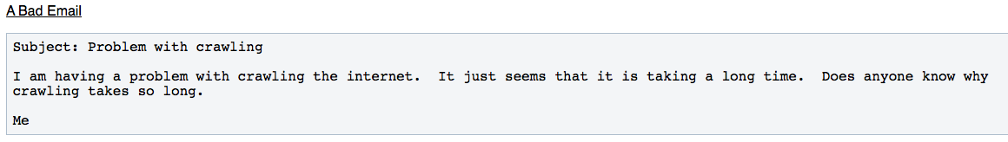
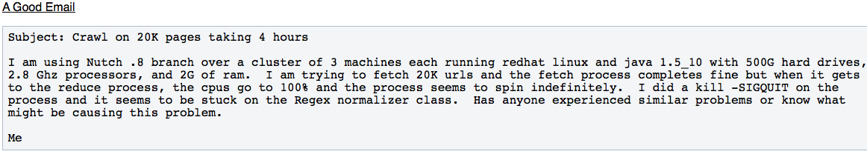
Interactions with Open Source
Case Study: Mailing lists communications*
* Taken from: http://wiki.apache.org/nutch/Becoming_A_Nutch_Developer
22-Feb-12
NCAR-SEA-2012

Slide 19
Interactions with Open Source
Mailing list interaction very important
  Most immediate feedback you get when contributing to open source, and also when creating your own open source project
  Is the biggest thing that turns people away to start out with
  “who are these nerds and why don’t they have any manners?”
  It’s all about “learning” their “language”
    Sure, the cost may be high in terms of ego and attitude, but the reward (free work!) is well worth it
Following and understanding the practices of the OSS project are hugely important
  Know the license for an OSS product
  Know whether they are “community” versus “help desk”
  Know its history
  Read its documentation
  Be informed!
Danger: thinking the OSS community is your personal help desk
22-Feb-12
NCAR-SEA-2012

Slide 20

Leverage active technologies
Don’t expect to use Haskel and have a huge OSS community there to assist you
Some modern active OSS languages
  Python
  Perl
  Ruby
  Java
Don’t just be a consumer, be a producer
  Pick up a shovel and help dig the hole
  Instead of overlooking the OSS
  community and telling them how
  the hole should be dug to meet
  your needs
  Will help you get needed OSS
  feedback for your technology
22-Feb-12
NCAR-SEA-2012

Slide 21
Free as in beer
“Something like the Apache foundation is the best place for released government software. A previous attempt at release and public distribution via a private company was a truly dismal failure. OpenPBS (portable batch system) is supposed to be available to anyone that asks. However when you do ask a sales rep strings you along for more than a month trying to sell you something that they can't actually assure you will fit your requirements (and is no longer under development) even when the free one is documented as doing so. It was a truly stupid waste of the salesperson's time and mine that would have exceeded the price of providing the file for download or sending by email by several orders of magnitude and generated a lot of ill will. I'll go as far as saying it was blatant false advertising using a government funded open source product to do a bait and switch to try to sell me an unmaintained product they picked up in a corporate take over. My experience appears to have been identical to that of many that attempted to obtain this government funded open source software that NASA had declared was available for anyone. Eventually due to this open source project becoming closed the project just had to fork and the compatible Torque batch system was developed by people that had actually get hold of the original OpenPBS.”
– Slashdot user comment
22-Feb-12
NCAR-SEA-2012

Slide 22
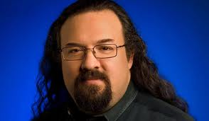
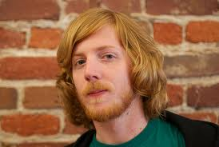


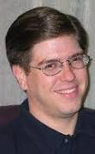
NASA Open Source Summit
22-Feb-12
NCAR-SEA-2012

Slide 23
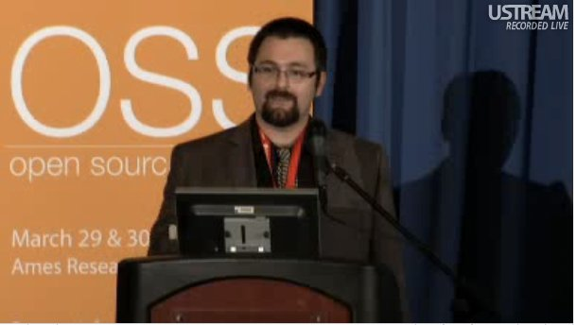
NASA Open Source Summit
http://www.nasa.gov/open/source/
22-Feb-12
NCAR-SEA-2012

Slide 24
Recommendations
Communication and Publicizing NASA’s Open Source Efforts
Define what open source licenses can be used
Remove barriers to involvement in open source
Remove barriers to open source development models
Define policy for dealing with ITAR/other restrictions
Define policy for contributing to external open source projects
Define governance model
Develop NASA cooperative support structure
Start projects out in open source
Close feedback loop between developers, policy makers and users
Hire open source talent (hint: it’s a specialized skill)
Make open source software more accessible
Unify open source and the office of the chief engineer
22-Feb-12
NCAR-SEA-2012

Slide 25
Wrapup
Open source is critical to the strategy of the organization
A great method of sustainability and longevity of software and community beyond organizational boundaries
Different licenses, communities, development practices
  Know what the differences mean
22-Feb-12
NCAR-SEA-2012

Slide 26

BESSIG
Boulder Earth and Space Science Informatics Group
  http://lasp.colorado.edu/galaxy/display/BESSIG/2012/01/27/BESSIG+Meeting+Wed,+February+22,+5+PM
Come and join us (5pm-7pm, Boulder Outlook Hotel)
  Jay Alameda and I are giving talks
22-Feb-12
NCAR-SEA-2012

Slide 27
Alright, I’ll shut up now
Any questions?
THANK YOU!
  chris.a.mattmann@nasa.gov
  @chrismattmann on Twitter
22-Feb-12
NCAR-SEA-2012

