Slide 1




Development of a Python GUI Interface to a YAML configuration File for Propagation of Largely Identical Database Records between Field Project Entries
Soo Park and Janine Aquino

Slide 2
Background and Context
EOL provides data management services to scientific field projects that occur all over the world
Instrument PIs (Principal Investigators) collect data and provide that data to EOL
EOL makes this data available to future users
Takes about 1 hour per dataset to load

Slide 3
Our task..
Create a GUI tool to load datasets into the EOL Metadata Database
Decrease the time to load a dataset from 1 hour to 15 minutes.
Make the overall dataset loading process easier
Increase consistency between similar data
Easy to add new fields

Slide 4
Why Python & YAML
We decided to create a Python GUI tool that creates or modifies YAML formatted configuration files (YAML stands for: YAML Ain’t Markup Language)
Python is a scripting language that has good support for GUI development.
Python is object-oriented
YAML is a powerful, human-readable data serialization language

Slide 5
Why Python & YAML (cont)
Our primary developer (Soo) is new to software engineering, so the following were key criteria
Python and YAML are both easy to work with for beginners
Prototype GUIs quickly using qt designer
There are other python/QT developed software in-house to learn from
YAML is used throughout EOL/CDS

Slide 6
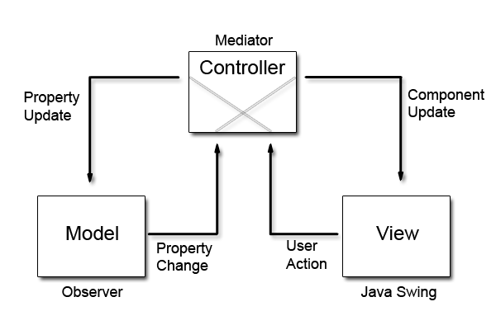
Code Structure
Model-View-Controller(MVC) architecture was used to structure the code
MVC architecture is effective at separating the Model(data processing) from the View(GUI)
Import external modules to perform repetitive tasks

Slide 7
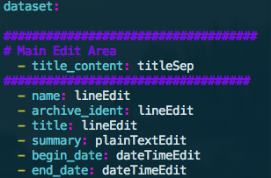
Code Structure
The model is stored within YAML-formatted files.
Adding a new parameter to the GUI is very easy. Simply add the field name and type to two YAML-formatted GUI configuration files.
Tab Separator
Single Line Fields

Slide 8
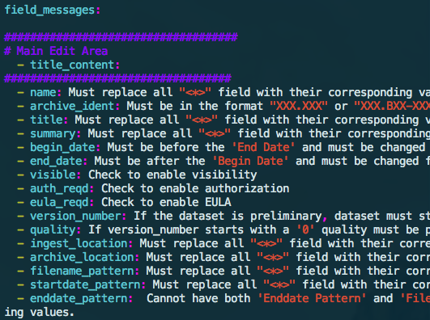
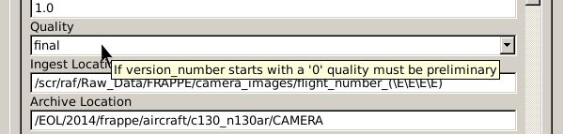
Code Structure
Simply add a line to a YAML-formatted message file to display a tooltip
The GUI is created by reading the YAML and creating fields in the order they occur, so order is important.

Slide 9
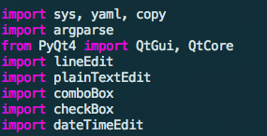
Code Structure
Five different field types: single line, multiple lines, drop box, check box, and date and time.
The GUI incorporates all five field types and can read them from, or write them to, a YAML file in the format required to be loaded to the metadata database.

Slide 10
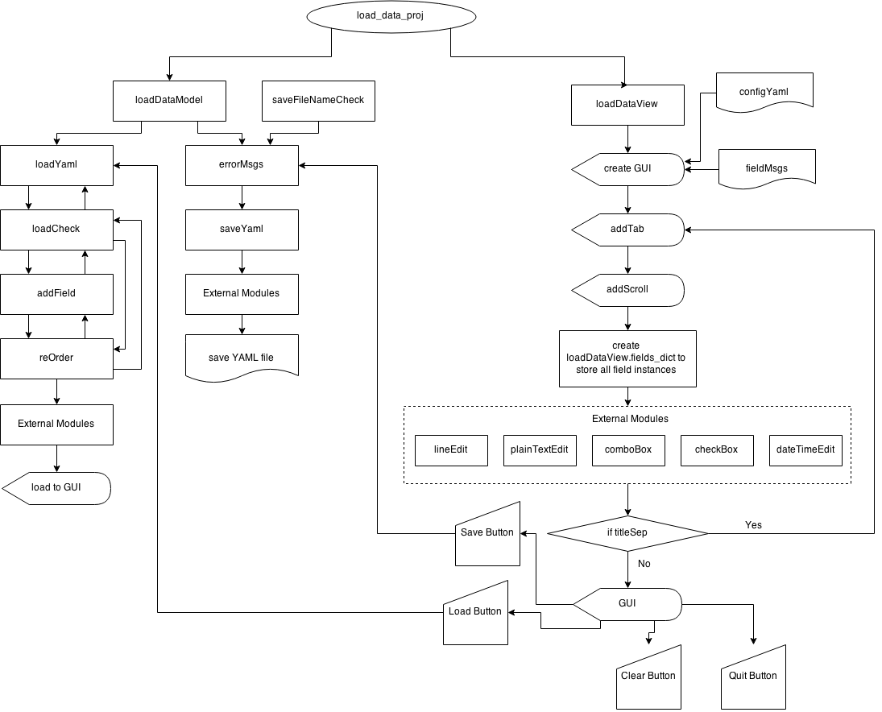
Code Diagram

Slide 11
What Worked Well
PyYaml, a YAML implementation for Python, is effective and easy to use
YAML files are parsed into Python dictionaries
Implementing PyQt4(Python bindings for Qt) is straightforward

Slide 12
What was hard & what we learned
MVC architecture
YAML does not keep data ordered
Making the code user-friendly

Slide 13
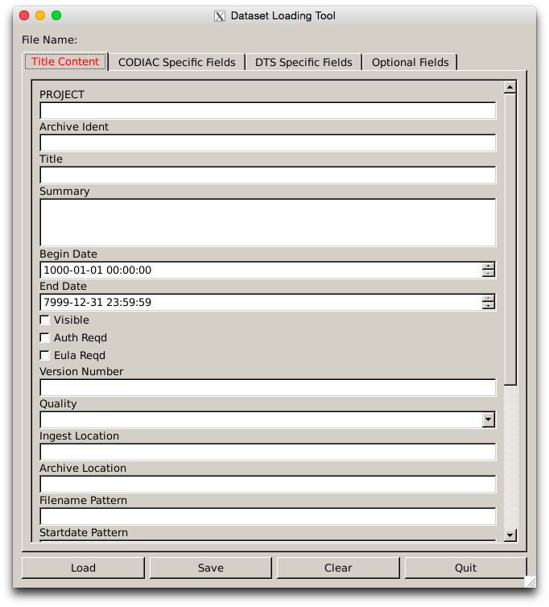
Demo
./load_data_proj

Slide 14
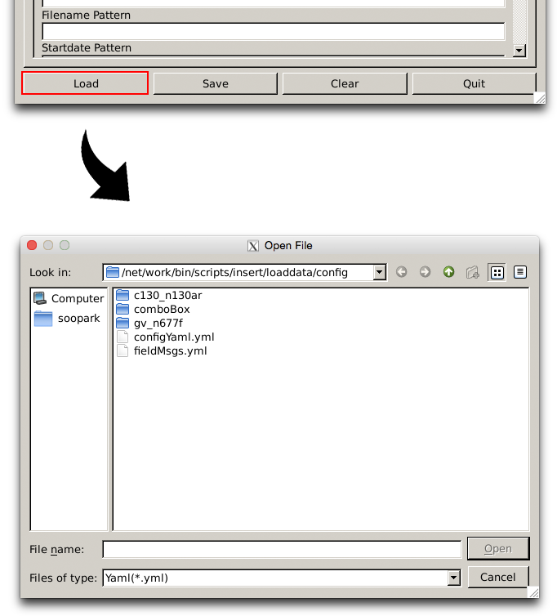
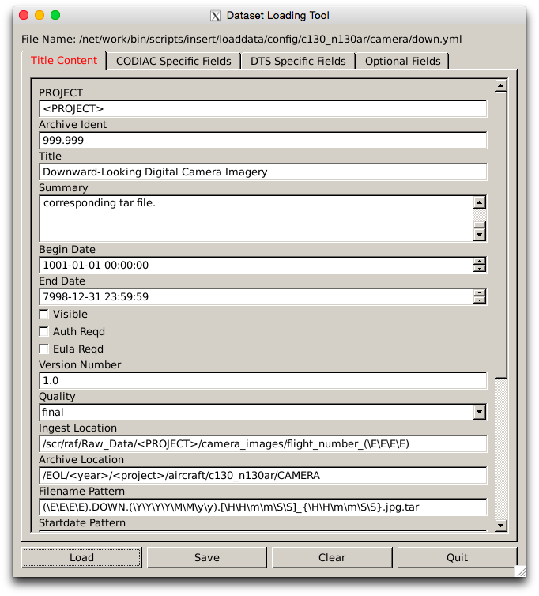
Demo

Slide 15
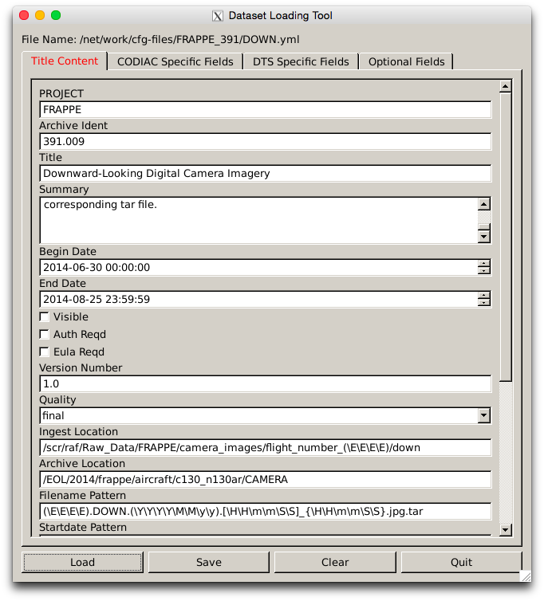
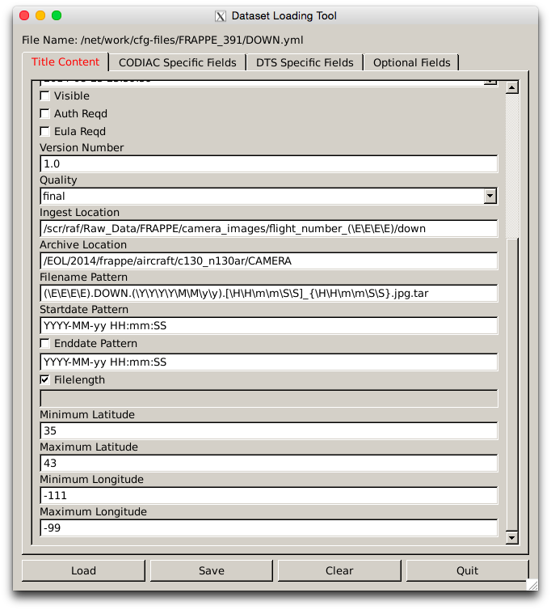
Demo

Slide 16
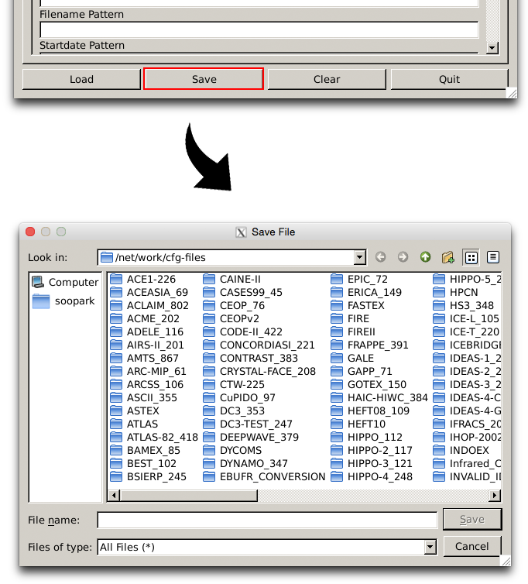

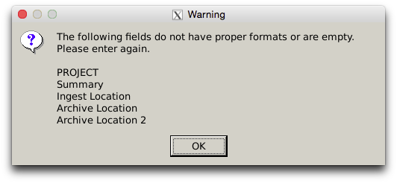
Demo
If the dataset does not pass the checks:

Slide 17
Conclusion
Python is a great object oriented language that effectively implements a GUI.

Slide 18
Thank you!
Questions?

