Slide 1


Slide 2
Architectural CONSIDERATIONS FOR SUPERCOMPUTING AS A SERVICE
2019 SEA Conference April 8 - 12, 2019
Michael Riera, Application Engineer, Intel Corporation, AZ, USA michael.riera@intel.com
Joonmoo Huh, Application Engineer, Intel Corporation, AZ, USA
Joonmoo.huh@intel.com

Slide 3
Agenda
Introduction and motivation behind HPC
Traditional High Performance Computing (HPC) (brief primer)
Usage Models
Current pain points in HPC infrastructures
Many players and roles.
Limitation in today’s infrastructure (what use to be convenient is now…)
What is HPC?
KISS principle
HPC in the cloud
Architectural decision when deploying a SuperComputer as a Service (SCaaS).
Definition(s) of a supercomputer as a services
Ingredients for a successful supercomputer as a service deployment
Aka. Portal(s)
Application (service) containers (WRF, NEK5000, Abaqus…etc)
Agent (services) containers (storage, performance, brokers..etc)
Conclusion

Slide 4
Motivation
There are many resources:
Platforms: AWS, Google, Azure, a plethora of supercomputers
There are many software components:
Cloud APIs, resource managers, different Operating Systems, drivers, … and more
There are many versions of software & hardware
There are many HPC frameworks
Abaqus, ANSYS, WRF, Tensorflow, NEK5000,… and more
Questions of hardware and software optimality
Questions of guided scientific parameter tuning
Questions of adding new science to an existing applications
Modularity of features, and scaling complexity.
Scaling and scheduling resource opaquely.
System Subject Matter Experts (SME) != Scientific SME != Framework Performance SME.

Slide 5
Traditional HPC in 5min or less (A Primer)
HPC applications are typically ran on supercomputers for optimal performance.
Spare no expense (relatively)
Not one, not two, or even three servers; thousands of servers interconnected with high performance interconnect (OmniPath, Infiniband, 100GbE... etc)
Typically running Linux (RHEL/CentOS or some derivative)
Each node can optionally have accelerator cards such as GPUS, FPGA and ASIC residing on the PCIe bus.
Resource manager (manages allocation of resources)
Resources are typically dedicated
Users are typically in charge of resource allocation (via LSF/SLURM)
Fees on a supercomputer is on a core*hour metric, or node*hour…
Typically do not have access to the outside word beyond port 22 (ssh+ scp)

Slide 6
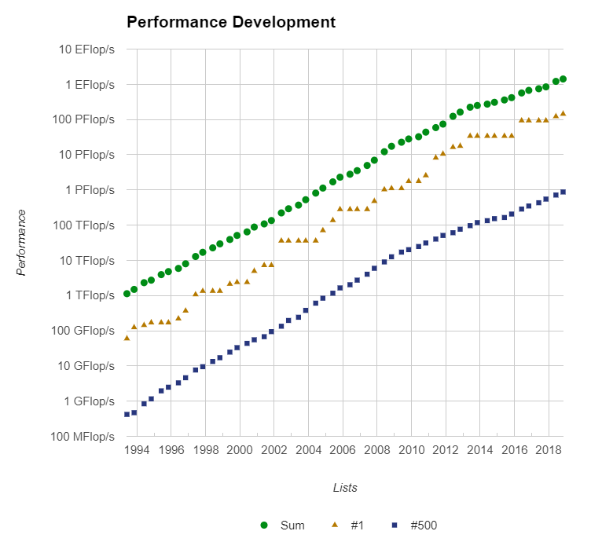
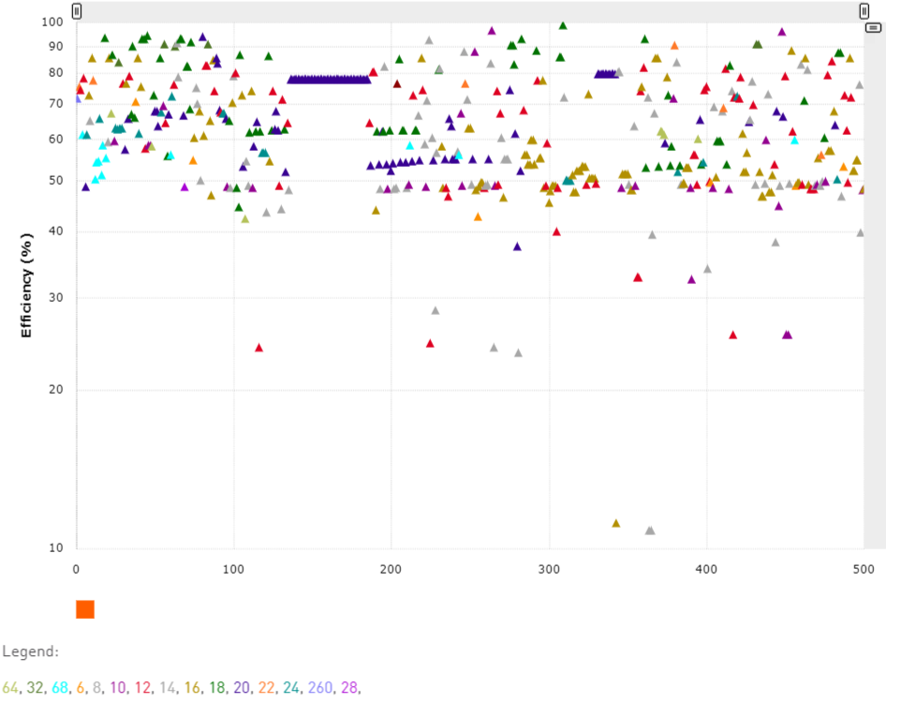
Supercomputer Statistics
Single Cascade Lake

Slide 7
Supercomputer Statistics

Slide 8
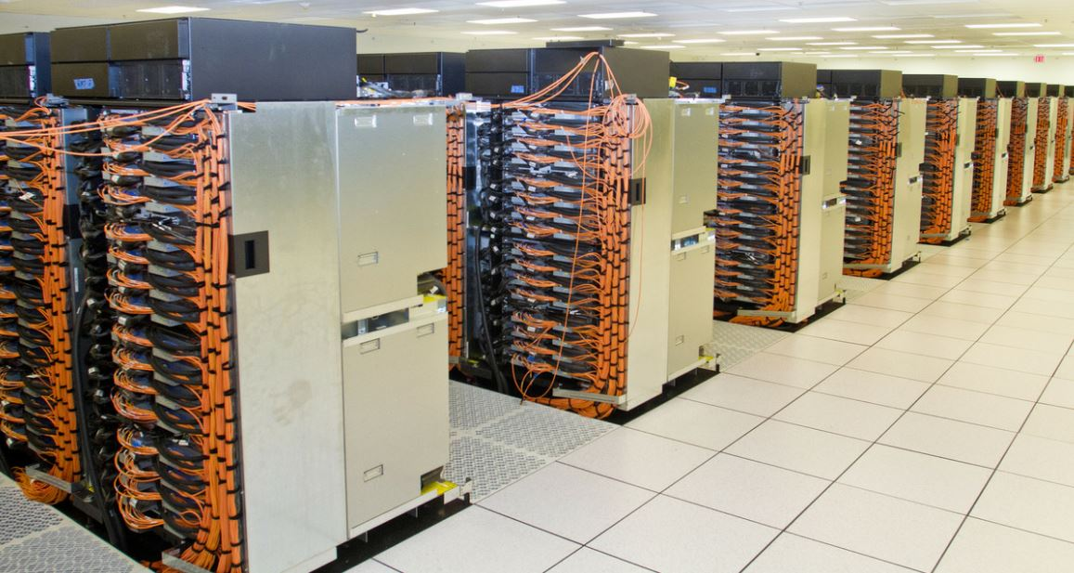
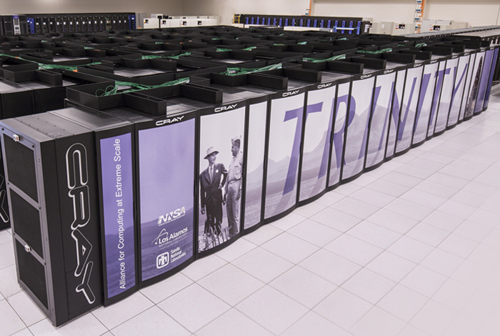
Top 10: Trinity Supercomputer

Slide 9
Limitations / Pain points / Role Players
Pain Points for Users
Job submissions
Wait times (no resources)
Environment setup
Optimal application recipes
Platform Health/Monitoring
Gathering results
Sharing results
Visualizing results
Resource Managers
Version control
Limitation
Single supercomputer
External network access
Generic/customization visible
Role Players
Scientists
System Administrators
Fabric support
File system support
Node support
Platform Health
Performance Engineers
Framework/Application Support
Managers
Portal Engineers NEW!!
Application Specific

Slide 10
What are trends in HPC: stop and look around
Over the horizon
Enables
Today

Slide 11
What are trends in HPC: stop and look around
Over the horizon
Enables
Today

Slide 12
What are trends in HPC: stop and look around
Over the horizon
Enables
Today

Slide 13
What are trends in HPC: stop and look around
Over the horizon
Enables
Today

Slide 14
What is SuperComputing as a Service (SCaaS)
Today’s Definition
Over the Horizon

Slide 15
What are Portal Services
Today, Portal Services exists, and they walk among us!
Intel Cloud (Benchmark Portal)
WRF Portal ( Model Portal)
Simulia, Ansys Cloud (Modeling Portal)
Nvidia Cloud/Grid (Container, Benchmark, and Gaming Portal)
LS-DYNA Cloud (Modeling Portal)
WeNMR (GROMACS), Tensorflow Playground, Render Rocket … etc (much much more)
Providing custom interfaces, environments, and services more closely aligned with applications and customer needs.
Why are these portals important? They provide ease of use, more functionality, scalability, automatic hardware and software upgrades, constant optimizations, and virtualization (just to name a few).

Slide 16
Surgeon General WARNING:
Your architecture ISN’T wrong. ☺
Performance portal still a work in progress. ☺

Slide 17
Major Ingredients for SCaaS Platforms
Major Ingredients:
Must add a service API to existing applications (microservice oriented)
Language selection : Python, GO, Java…etc
Frontend webserver(s) (REST API)
Backend master service strategy (warning, shared resource) – (REST to Socket API)
Inoperability and scaling strategy across containers (between agents and application containers)
Security in a container, between containers (database, object stores… etc), frontends.
Data injection and extraction strategy
Load balanced persistency service strategy (warning, shared resource)
Database services network (warning, shared resource)
Preliminary agent list, whether they are shared, bottleneck report, port definitions

Slide 18
Major Ingredients for SCaaS Platforms
Major Ingredients:
Must add a service API to existing applications (microservice oriented)
Language selection : Python, GO, Java…etc
Frontend webserver(s) (REST API)
Backend master service strategy (warning, shared resource) – (REST to Socket API)
Inoperability and scaling strategy across containers (between agents and application containers)
Security in a container, between containers (database, object stores… etc), frontends.
Data injection and extraction strategy
Load balanced persistency service strategy (warning, shared resource)
Database services network (warning, shared resource)
Preliminary agent list, whether they are shared, bottleneck report, port definitions

Slide 19
Major Ingredients for SCaaS Platforms
Major Ingredients:
Must add a service API to existing applications (microservice oriented)
Language selection : Python, GO, Java…etc
Frontend webserver(s) (REST API)
Backend master service strategy (warning, shared resource) – (REST to Socket API)
Inoperability and scaling strategy across containers (between agents and application containers)
Security in a container, between containers (database, object stores… etc), frontends.
Data injection and extraction strategy
Load balanced persistency service strategy (warning, shared resource)
Database services network (warning, shared resource)
Preliminary agent list, whether they are shared, bottleneck report, port definitions

Slide 20

Major Ingredients for SCaaS Platforms
Major Ingredients:
Must add a service API to existing applications (microservice oriented)
Language selection : Python, GO, Java…etc
Frontend webserver(s) (REST API)
Backend master service strategy (warning, shared resource) – (REST to Socket API)
Inoperability and scaling strategy across containers (between agents and application containers)
Security in a container, between containers (database, object stores… etc), frontends.
Data injection and extraction strategy
Load balanced persistency service strategy (warning, shared resource)
Database services network (warning, shared resource)
Preliminary agent list, whether they are shared, bottleneck report, port definitions

Slide 21
SCaaS Ingredients: Proposed Platform Overview

Slide 22
Ingredient: Frontend + Master Service
Frontend Webserver
Frontend bottleneck (shared resource)
Uploading large models/datasets
Sharing large results files
Visualizing data (streaming data)
Real time monitoring
Data-mining activities
And other functionality offerings
Master Service
Shared core services that persistent indefinitely.
Provides feature API to frontend
Provides interoperability to compute/agent microservices
Provides bookkeeping services to all platform services. (microservices)
Provides service catalog and deployment protocols
Provides large file interoperability
Provides single point of global visibility to the system.
And more, depending on portal specifics

Slide 23
SCaaS Ingredients: Proposed Platform Overview

Slide 24
SCaaS Ingredients: Proposed Platform Overview

Slide 25
Ingredient: Container Interoperability Ex.

Slide 26
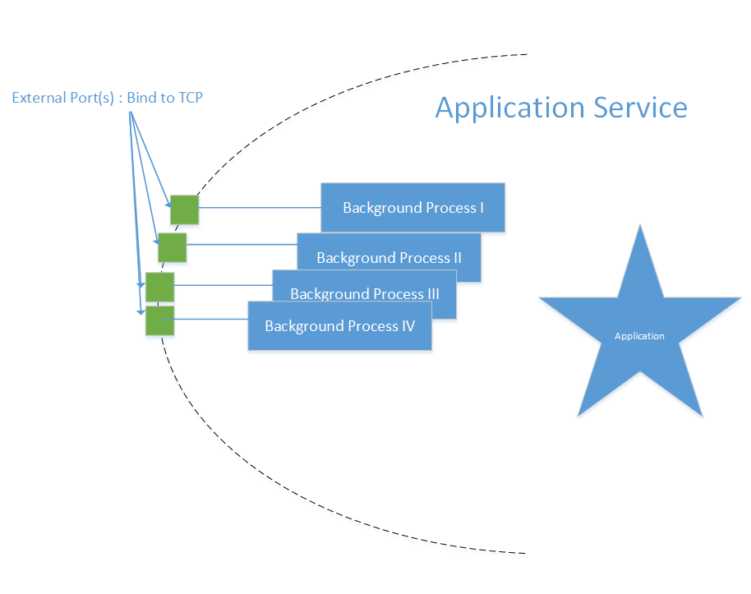
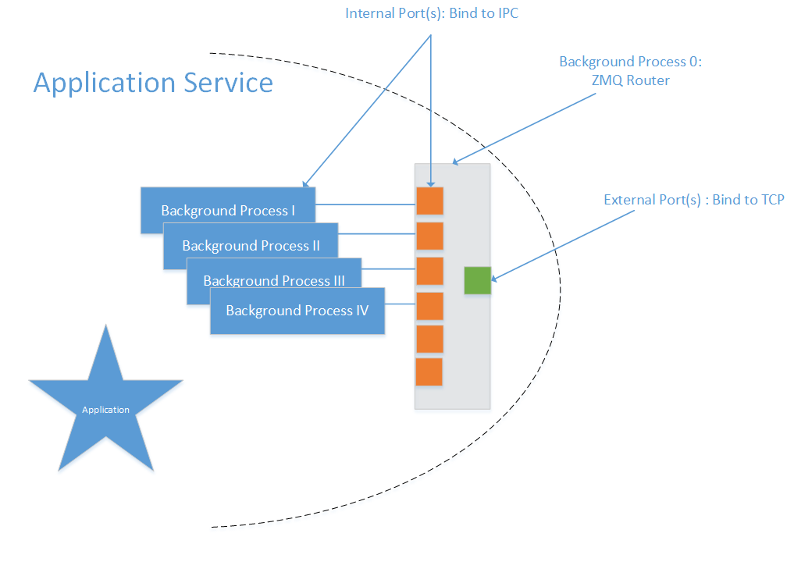

Ingredient: Container Interoperability

Slide 27
Ingredient: Agent Interface
SS controller registers applications with the agent.
Send Hostname to Agent and agent connects
Each application service receives a dedicated replica
The bootloader also has a ZMQ router to facilitate interoperability with the registrar and IO port
It is also the responsibility of the Registrar to communicate with the SS controller to update
State, input and output are shared between all the Replicas

Slide 28
Ingredient: Broker Agents
Broker agents are target and user specific.
They are booted when a requests are made and remain static until ALL request are completed
3-4 threads:
Monitoring Job Queue
SSH/SCP communications
Pushing data to/from persistency agents
Stream thread
Interfaces with target specific run controls: BSUB, SLURM, CfnCluster…etc
Attaches to a persistency agent
Master service indicates to the broker which object store to use.
Broker indicates to master service where result file(s) have been generated by AppSS.
Broker stages and setup the folder hierarchy for the application solar system.

Slide 29
Ingredient: App Object Store Agents
Load balanced persistent memory vaults
Have life expectancy similar to broker agents
Data is migrated from App OSA to Database/Object in the master service.
App object stores agent are a shared resource. (Required)
In our portal it is RESTful API for both object stores in the master and in the AppSS.
MinIO, s3, or others, are good example of scalable object stores. Data can pile up quickly.
Each agent should have a run id specific folder description with each observable agent writing into there own dedicated folder regions. Stick to a results hierarchy that is 1:1.
Relative naming convention to each SS increase reuse of Agents

Slide 30
Ingredient: Security Strategy
Frontend agents, and objects stores have TLS certs.
All containers need to be signed and encrypted and groups need to be made on traditional HPC env
All Application Agents have private keys stored in there container.
Public and Private key are stored in a PKCS12 archive file on the master service’s object store completely isolated from the passwords to the PKCS12 in the master service DB (both systems are separated by a MTLS).
Public keys are shared with agents in the application orbit (via the SS controller)
Secure every link between containers!
Secure link between containers and targets (clouds, supercomputers… etc)
Slight manual intervention for target setup for transparent supercomputer usage.
Enabling portal frontends for traditional HPC HW using user SSH keys

Slide 31
Ingredient: Data injection and Extraction Strategy
Input arguments to containers
Agents are started with:
Socket address of persistency agent
Application socket address
Root directory of staging environment
Socket address of SS controller
Solar system ID
Job ID
Data Injection & Extraction
Data Injections and extractions happens via ports.
Models are injected into the application agent
Environment settings are injected
Data injection happens between a background task in the application agent and the persistency agent.
Data extraction happens between a background task in the application and the persistency agent.
SS controller decides which final results in the persistency container to persist indefinitely

Slide 32
Ingredient: System Interoperability BKMs
Everything is a container! Life is tough when you have a component that is not a container.
The only entry/exit points for a container are through ports.
Frontends and frontend of the master services are RESTful interfaces.
Do not interface directly from the webpage to the compute/agent subsystem.
Consider simplifying life by sticking to a single port of entry and exit to the application and services through ZMQ routers and use the identification attribute to identify a class of service within container processes.
Use solar system as a namespace for interconnect endpoint disambiguation to simplify interconnections
Master services handles book keeping with regards to hostnames and port designations for external ports.
Agents connect to the applications and the solar system controller via ZMQ router, and self registers with the application.
All containers have SSH keys and all RESTful nodes have TLS certs
All containers should have direct access to persistent memory agent in the application orbit
Persistent memory home directory staging environment in orbit.

Slide 33
Conclusion
Distributed software is complicated!
All containers should have a well established API!
All containers should have a well established port of entry and exit!
Secure your links!
Clearly describe handshaking protocols between containers
Clearly describe the lifespan of each container
Clearly describe how each container scales
Don’t scale interconnects, use routers

Slide 34
Additional Legal Disclaimers
Intel technologies’ features and benefits depend on system configuration and may require enabled hardware, software or service activation. Learn more at intel.com, or from the OEM or retailer.
No computer system can be absolutely secure.
Tests document performance of components on a particular test, in specific systems. Differences in hardware, software, or configuration will affect actual performance. Consult other sources of information to evaluate performance as you consider your purchase. For more complete information about performance and benchmark results, visit http://www.intel.com/performance.
Cost reduction scenarios described are intended as examples of how a given Intel-based product, in the specified circumstances and configurations, may affect future costs and provide cost savings. Circumstances will vary. Intel does not guarantee any costs or cost reduction.
This document contains information on products, services and/or processes in development. All information provided here is subject to change without notice. Contact your Intel representative to obtain the latest forecast, schedule, specifications and roadmaps.
No license (express or implied, by estoppel or otherwise) to any intellectual property rights is granted by this document.
Statements in this document that refer to Intel’s plans and expectations for the quarter, the year, and the future, are forward-looking statements that involve a number of risks and uncertainties. A detailed discussion of the factors that could affect Intel’s results and plans is included in Intel’s SEC filings, including the annual report on Form 10-K.
Intel does not control or audit third-party benchmark data or the web sites referenced in this document. You should visit the referenced web site and confirm whether referenced data are accurate.
Intel, Xeon, Xeon Phi, the Intel logo and others are trademarks of Intel Corporation in the U.S. and/or other countries. *Other names and brands may be claimed as the property of others.
© 2019 Intel Corporation.
Optimization Notice
Intel’s compilers may or may not optimize to the same degree for non-Intel microprocessors for optimizations that are not unique to Intel microprocessors. These optimizations include SSE2, SSE3, and SSSE3 instruction sets and other optimizations. Intel does not guarantee the availability, functionality, or effectiveness of any optimization on microprocessors not manufactured by Intel. Microprocessor-dependent optimizations in this product are intended for use with Intel microprocessors. Certain optimizations not specific to Intel microarchitecture are reserved for Intel microprocessors. Please refer to the applicable product User and Reference Guides for more information regarding the specific instruction sets covered by this notice. Notice revision #20110804

