Slide 1
Lessons Learned from the Deployment and Integration of Microwave Sounder Based Tropical Cyclone Intensity and Surface Wind Estimation Algorithms into NOAA NESDIS Satellite Product Operations
Scott P. Longmore¹
Andrea Schumacher¹, Jack Dostalek¹, Robert DeMaria¹, Galina Chirokova¹,
John Knaff², Mark DeMaria³, Dylan Powell⁴, Angela Sigmund⁴ ,Wei Yu⁴
Sponsored by NESDIS/Product System Development and Implementation (PSDI)
¹Colorado State University (CSU)/ Cooperative Institute for Research in the Atmosphere (CIRA)/ Regional and Mesoscale Meteorology Branch (RAMMB), Fort Collins, Colorado ²National Oceanographic and Atmospheric Administration (NOAA)/ National Environmental Satellite, Data, and Information Service (NESDIS)/ Satellite Applications and Research (StAR), Fort Collins, Colorado
³NOAA/National Weather Service (NWS) /National Hurricane Center (NHC)/ Technology and Science Branch (TSB), Miami, Florida
⁴NOAA/NESDIS/Office of Systems Development (OSD)/ Satellite and Ground Systems Program (SGSP)/ System Engineering and Integration Division (SEID), Lockheed Martin, Silver Spring, Maryland

Slide 2
Outline
CIRA Microwave Sounder-based Tropical Cyclone (TC) Research Algorithms
Operational Requirements and Real-Time Frameworks
Migration from Research to Operations
Component and System Development Cycle
Testing, Debugging and Integration at CIRA and NESDIS
Successes, Challenges, and Lessons Learned
Future Development

Slide 3
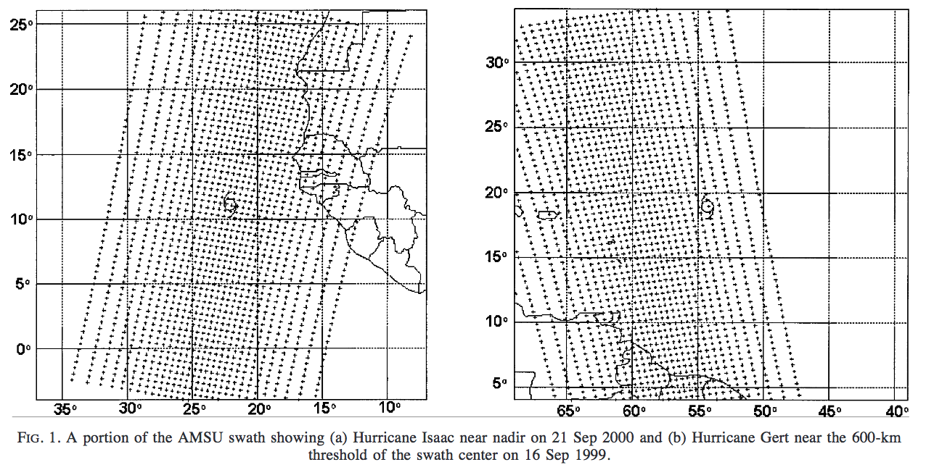
CIRA Microwave Sounder TC Algorithms
Estimates TC intensity and structure (extent of 34-, 50-, and 64-kt winds)
From microwave temperature soundings (retrievals) from polar orbiting satellites
Hydrostatic and gradient balanced relationship
Multiple linear regression algorithm
Demuth et. al. (2004)

Slide 4
CIRA Microwave Sounder TC Algorithms
Purpose: To provide TC structure/intensity guidance to NWS National Hurricane Center, etc for structure/intensity between aircraft reconnaissance
Implementations:
Advance Microwave Sounder Unit (AMSU_TC) soundings from NOAA18, 19, & METOPA
Developed in 2002
Operational algorithm since 2006
Advanced Technology Microwave Sounder (ATMS) on the Suomi National Polar-orbiting Operational Environmental Satellite System (NPOESS) Preparatory Project (S-NPP or NPP) launched Oct, 28, 2011 (NPP_TC)
Recently developed (2013)
Makes use of the AMSU_TC algorithm
Tested on limited NPP/ATMS test data.

Slide 5
NPP/AMSU TC Algorithms
Input data:
Global real-time TC information from Automated TC Forecast (ATCF)
Global Forecast System model boundary conditions (GFS)
AMSU/ATMS – based retrievals from the Microwave Integrated Retrieval Scheme (MIRS)
Products:
TC fix ATMS/AMSU ATCF format text file (afx)
Pressure analyses
t, u, v, z (p, lat, lon) text file (xya)
surface [t, u, v, p] (lat, lon) text file (xya)
Mean Azimuthal T, P, ρ, V_{gradient} (range, Z) text file (rza)
Plots
NPP_TC: V, z at 850,700,600,500,400,300,200,250 hPa (png)

Slide 6
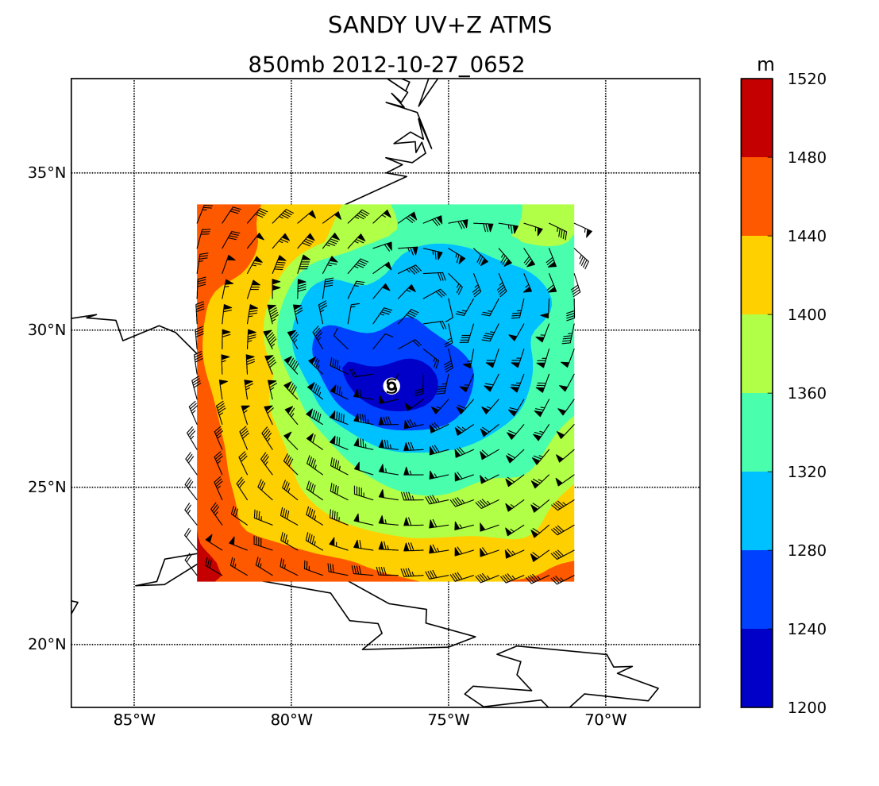
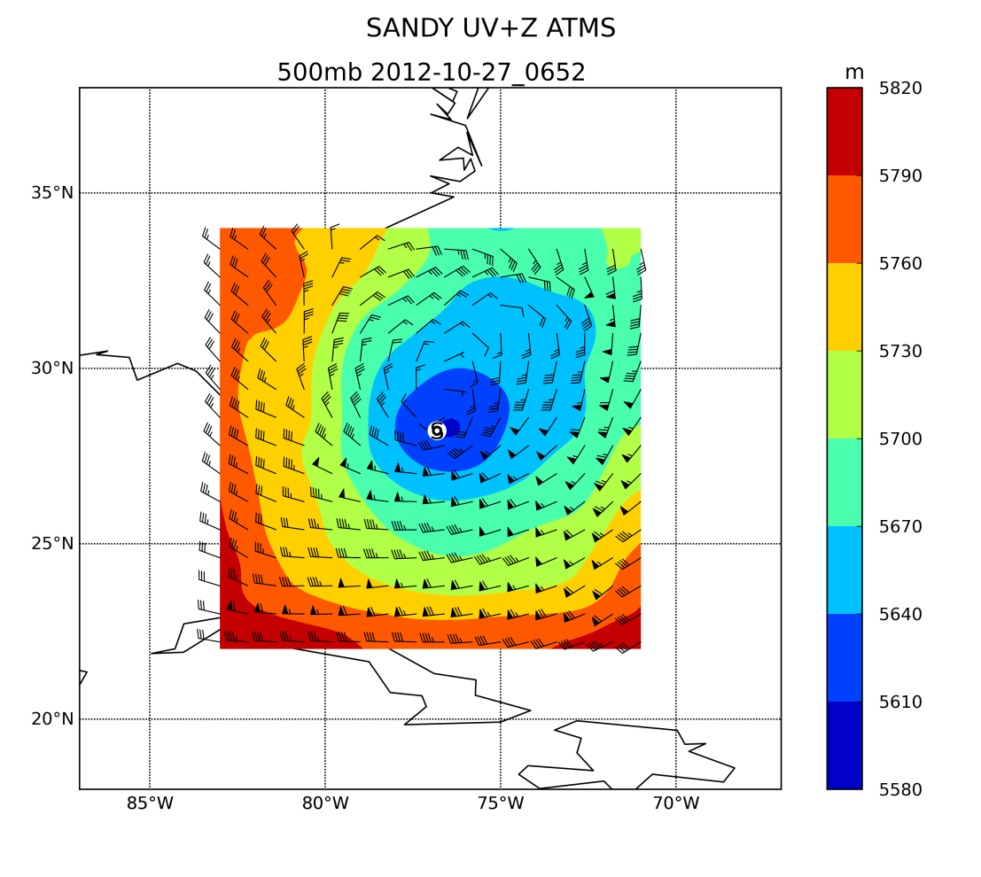
NPP/AMSU TC Algorithms Products
TC fix:
AL, 18, 201210270652, 30, ATMS, IPR, , 2822N, 7681W, , 1, 58, 2, 980, 2, MEAS, 34, NEQ , 211, 263, 192, 159, , , , , 2, 53, , L, NSOF, OPS, , , , , , , 980, , SNPP01, 34, NEQ , 211, 263, 192, 159, , , , , , , , , , , , , 2, storm center extrapolated from t=-12 and t=0 adeck
AL, 18, 201210270652, 30, ATMS, R, , 2822N, 7681W, , 1, 58, 2, 980, 2, MEAS, 50, NEQ , 87, 100, 81, 71, , , , , 2, 53, , L, NSOF, OPS, , , , , , , 980, , SNPP01, 50, NEQ , 87, 100, 81, 71, , , , , , , , , , , , , 2, storm center extrapolated from t=-12 and t=0 adeck
AL, 18, 201210270652, 30, ATMS, R, , 2822N, 7681W, , 1, 58, 2, 980, 2, MEAS, 64, NEQ , 0, 55, 0, 0, , , , , 2, 53, , L, NSOF, OPS, , , , , , , 980, , SNPP01, 64, NEQ , 0, 55, 0, 0, , , , , , , , , , , , , 2, storm center extrapolated from t=-12 and t=0 adeck
Plots:

Slide 7
NPP/AMSU TC Systems
Master Script – reads/sets environment, calls sub-programs, handles logging, errors and exceptions
MIRS_tc_input/validatePCF.py – retrieves/verifies ATCF, GFS, and MIRS data
grib2pack – converts GFS grib to internal CIRA pack format
data_pool.py – subsets the required MIRS variables and sub-domain
Storm Loop
shorttermrack – determines latest, 12hr previous TC track from ATCF
afdeck – determines latest TC time and coordinates
Satellite Loop
pool_query.py - retrieves MIRS data near storm track
satcenter - determines satellite scanline time coordinates closest to TC
oparet - determines wind fields from MIRS satellite and GFS model
convert2netcdf.py – converts oparet output to netCDF
main_read_plot_xya.py – plots oparet temp and wind fields

Slide 8
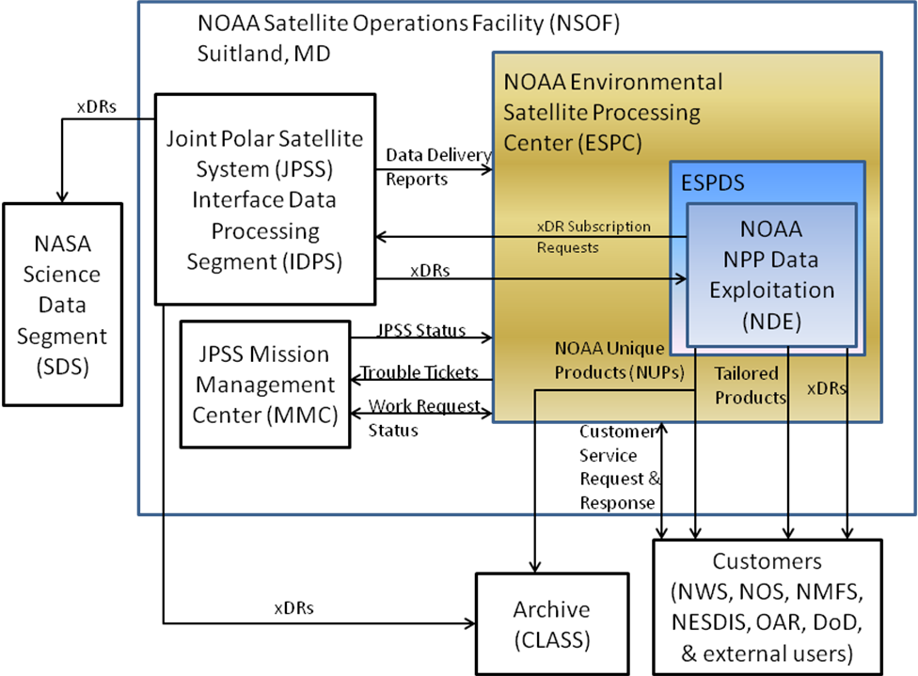
NOAA Satellite Operations Facility (NSOF)
Source: Standards for Science Algorithm Delivery and Integration using Delivered Algorithm Packages v1.4

Slide 9
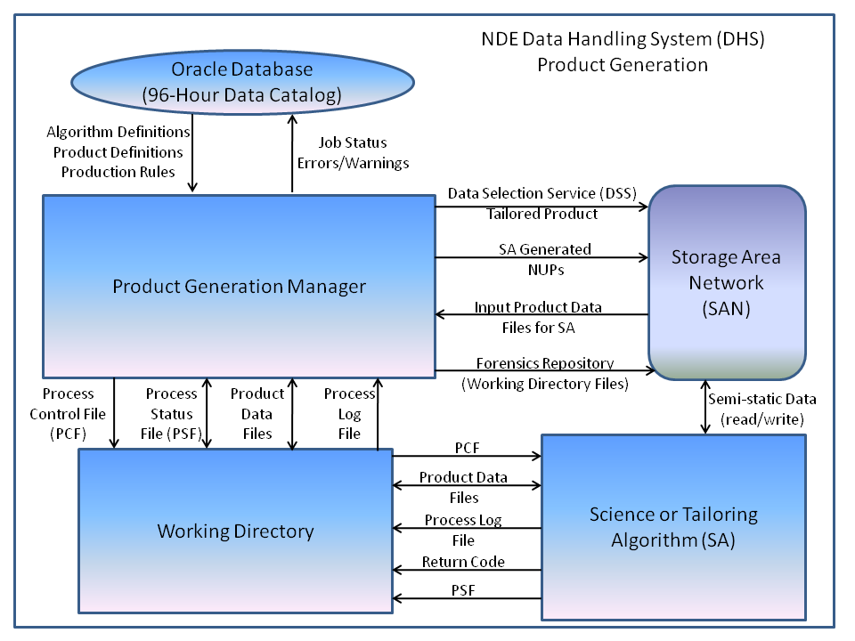
NDE Data Handling System (DHS)
Source: Standards for Science Algorithm Delivery and Integration using Delivered Algorithm Packages v1.4

Slide 10
NSOF SPSRB SA Standards
Satellite Products and Services Review Board (SPSRB) Common Standards Working Group
Fortran 90/95 (conversion from F77)
Requirement Tiers:
Standard - mandatory
Guideline - encouraged
Recommendation - optional
Encapsulation i.e. Modules (guideline)
Robustness
Implicit None (standard)
All variables declared and initialized (standard)
Discourages Elements
Common/data statements to modules (standard)
Goto statements to exit/cycle statements (standard)
Headers/Comments (standard/guideline)

Slide 11
NDE SA Framework Conventions
Process Control File (key=value)
Working directory
Job coverage start/end times
Input data files (ATCF, GFS, ATMS)
Other dynamic environment variables
Process Status File
List of NOAA Unique Product (NUP) files (afx, netCDF4, png)
NUP naming convention
CLASS archive network Common Data Format (netCDF4)
Climate and Forecast (CF) metadata convention
CF standard naming (variables/attributes)
Required NUP global, variable attributes
Process Log File
NDE log format: <datetime> | <prgrm> | <dsgn> message
NDE error, warning designators for diagnostics dump
Return/Error Codes
unique for each error/warning condition

Slide 12
NDE NPP/NSOF AMSU TC Implementation
NDE NPP_TC
DHS provides PCF, input data, invokes NPP_TC
NSOF AMSU_TC
Supplemental to NDE NPP_TC
Identical purposes as NPP_TC
Real-time implementation different from NDE NPP TC
Operational on stand alone server separate from NDE DHS
ATCF, GFS, AMSU data delivered on NWS DDS feed
Determines and links latest input data vs. reading NDE PCF
Processes multiple satellites, NOAA18, NOAA18, METOPA
Products: ATCF format fixes, XYA,RZA netCDF (no plots)
Products distributed via DDS
Products archived on NOAA Comprehensive Large Array-data Stewardship System (CLASS)
Algorithms invoked every 2 hours

Slide 13
CIRA Research to NSOF/NDE Operations
NPP_TC
AMSU_TC
CIRA NPP_TC
System
CIRA AMSU_TC
System
SPSRB Standards Conversion
SPSRB Standards Conversion
CIRA Internal Testing
CIRA Internal Testing
NDE SA Conventions Upgrades
NSOF AMSU_TC Installation and Testing
CIRA Internal Testing
NSOF AMSU_TC Operations
NDE NPP_TC Development Server Installation and Testing
Current Status:
NDE NPP_TC Test Server Testing
NSOF AMSU_TC Testing
NDE NPP_TC Test Server Installation and Testing
NDE NPP_TC Operations

Slide 14
CIRA NPP/AMSU TC Development Team
Andrea Schumacher - PI (NSOF NDE NPP TC), scientist
Proposal, development, calibration, validation, documentation
oparet, grib2pack, shorttermtrack components
Jack Dostalek - PI (NSOF AMSU TC), scientist
Proposal, development, calibration, validation, documentation
operet, afdeck, satcenter, master/sub-script components
Scott Longmore - software engineer/scientist
Development, Integration, Testing, Validation, Documentation
Software version control, component, system and NSOF/NDE integration
Component, system testing, case generation, testing, and validation
F77 to F90 oparet conversion, MIRS_tc_input, validatePCF, convert2netCDF, master/sub-script components
Robert Demaria - software engineer
Development, Validation
data_pool, pool_query components
Galina Chirokova - scientist
Development, Validation
main_read_plot_xya component

Slide 15
NPP/AMSU TC Development and Integration Cycle
Component Development
Integration Development
Component Subversion Repository
AMSU/NPP TC Subversion Repository
NSOF/NDE
AMSU/NPP TC Development Server
CheckOut
Component
Source Directory
Tar/FTP
Checkout
CheckOut
CheckIn
Tar/FTP
AMSU/NPP TC Subversion Source Directory Hierarchy
NSOF/NDE
AMSU/NPP TC Test Server
Component Staging Directory Hierarchy
Copy

Slide 16
NPP/AMSU TC Testing
@CIRA
Component testing used TC Sandy case (AMSU/ATMS)
Each component iteration was compared to verified TC Sandy component output
AMSU_TC system tested on ~3000 cases (Aug-Oct 2012/13)
NPP_TC system tested on ~2000 cases (Aug-Oct 2012)
Test run logs, sub-program output files checked for errors
Tests products verified for select TC’s
Set of test cases (13) built from verified TC’s
@NDE NPP_TC
Tested within Development NDE on 13 test cases
Migrated to Test NDE on 13 test cases, then real-time testing
@NSOF AMSU_TC
Currently running in real-time on CIRA development server
Migrated to Test/Operational NSOF standalone server

Slide 17
NPP/AMSU TC Debugging
NPP_TC:
Issues identified on NDE Development/Test servers replicated on CIRA Development server
Component(s) identified and resolved in next Delivery Algorithm Package (DAP)/release
Resolved issues:
PCF, PSF, log formatting, conventions
Product output naming
Script/sub-program invocation and data path issues
MIRS ATMS granule/data pool issue
MIRS ATMS variable attribute change issue
AMSU_TC:
Issues resolved in NPP_TC, applied to AMSU_TC when applicable.

Slide 18
NDE NPP TC System Releases
2014/03/06 v1.3.3 - PCF validator, removes older adeck/gfs files,
2014/02/08 v1.3.2 - netCDF bug fixes, minor updates
- Error to Warning messages for sub-programs inside storm loop
2014/02/02 v1.3.1 - netCDF converter for RZA files
2014/01/27 v1.3.0 - netCDF converter for XYA files, MIRS file fix
2014/01/07: v1.2.3 - ATCF (adeck), GFS grib file naming, product version in file names
2013/11/14: v1.2.2 - Data test case inclusion
2013/11/08: v1.2.1 - PCF formatting, required NDE and data input variable upgrades
- Data, temporary sub-directory hierarchy handling
- Static variables to master script, external and data variables to PCF
- Date format/handling between NDE and master script
- Executable/script location execution handling from working to operation directory
- PSF output file location and naming is now absolute
- LOG file location to top working directory
2013/10/31: v1.2.0 - NDE framework upgrades: PCF, PSF, logging, exception handling
- GFS grib to pack file converter
2013/06/25: v1.1.0 - NDE initial version
2013/06/14: v1.0.0 - Initial version

Slide 19
NSOF AMSU TC System Releases
2014/03/03: v1.1.1 - MIRS_tc_input.py determines input files from data source directories
- AMSU_TC_CRON.sh - determines run time, directory and calls AMSU_TC.sh
- AMSU_TC.crontab - sample crontab for AMSU_TC
2014/02/10: v1.1.0 - MIRS_tc_input.py determines input files, time from working directory
- AMSU_TC_ENV.sh - file added for environment variables
- makefile flags/parameters moved to master makefile
- XYA/RZA netCDF converter added
- Updated AMSU_TC master and sub-scripts
- Updated data_pool scripts
2012/11/27: v1.0.0 - AMSU_TC Initial version

Slide 20
NPP/AMSU TC Successes/Challenges
Successes:
CIRA/NSOF/NDE development and integration cycle for small development team and small number of components
Larger system/team would require use of working and stable subversion software repositories
Challenges:
Implementing NDE framework standards, e.g. logging, time matching/manipulation challenging in bash control system
Unplanned development time and software required for migrating CIRA NPP_TC system to NSOF/NDE framework
Limited time for unit/system test case planning and software development
Delays in MIRS ATMS data limited full testing of NPP system

Slide 21
NPP/AMSU TC Lessons Learned
Input data availability at algorithm testing (MIRS ATMS)
Time for development of software to work within operational framework
Correct software language/implementation for operations (bash/python)
Time for unit/system test case planning and software development
Component developers, integration lead using software repository
Adjust for team/project size
Development and stable trunks in future

Slide 22
NPP/AMSU TC Possible Development
NPP/AMSU systems migrated into one system
Control system and data preprocessing converted to python
Development of modular framework for NPOESS and other polar orbiting microwave sounder instruments
Configuration built on JavaScript Object Notation (JSON)
Refactoring of python input and netCDF converter

Slide 23
Questions?

Slide 24
References (more information):
Bessho, K., M. DeMaria, and J. A. Knaff, 2006: Tropical Cyclone Wind Retrievals from the Advanced Microwave Sounder Unit (AMSU): Application to Surface Wind Analysis. J. of Applied Meteorology. 45:3.
Demuth, Julie L., M. DeMaria, and J. A. Knaff. 2006: Improvement of Advanced Microwave Sounding Unit tropical cyclone intensity and size estimation algorithms. Journal of Applied Meteorology & Climatology 45.11.
Demuth, Julie L., M. DeMaria, J.A. Knaff, & T. H. V. Haar, 2004: Evaluation of Advanced Microwave Sounding Unit tropical-cyclone intensity and size estimation algorithms. Journal of Applied Meteorology 43.2.

