Slide 1
A Unified Data Model and Programming Interface for Working with Scientific Data
Doug Lindholm
Laboratory for Atmospheric and Space Physics
University of Colorado Boulder
UCAR SEA Conference – Feb 2012

Slide 2
Outline
Higher Level Abstractions
What is a Data Model
LaTiS Data Model
Higher Level Programming
Functional Programming
Scala Programming Language
Data Model Implementation
Examples
Broader Impacts
Data Interoperability
Notes:
-
We shouldn’t ignore “new” software engineering paradigms coming out of computer science

Slide 3
Scientific Data Abstractions
bits
10110101000001001111001100110011111110
bytes
00105e0 e6b0 343b 9c74 0804 e7bc 0804 e7d5 0804
int, long, float, double, scientific notation (Number)
1, -506376193, 13.52, 0.177483826523, 1.02e-14
array
1.2 | 3.6 | 2.4 | 1.7 | -3.2

Slide 4
Functional Relationships
Independent
Variable
(domain)
Independent
Variable
Dependent
Variables
(range)
Time Series:
Instead of pressure[time]
time → pressure
Gridded Time Series:
Instead of flux[time][lon][lat]
time → ((lon, lat) → flux)

Slide 5
What do I mean by Data Model
NOT a simulation or forecast (climate model)
NOT a metadata model (ISO 19115)
NOT a file format (NetCDF)
NOT how the data are stored (RDBMS)
NOT the representation in computer memory (data structure)
Logical model
What the data represent, conceptually
How the data are USED

Slide 6
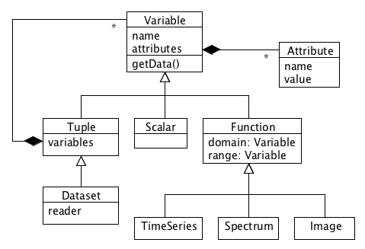
LaTiS Data Model
Represents the functional relationship of the scientific data
Scalar time series
Time -> Pressure
Time series of grids
T: Time
Lon: Longitude
Lat: Latitude
P: Pressure
dP: Uncertainty
T -> ((Lon,Lat) -> (P, dP))
Three core Variable types
Scalar (single Variable)
Tuple (group of Variables)
Function (domain mapped to range)
Notes:
There are many. Here’s another.
Inspired by the Unidata CDM and VisAD
See VisAD Earth Cube whitepaper.
Extend to add application domain specifics, e.g. Spectrum
Defines an implementation agnostic interface to data

Slide 7
Implementing the Data Model
The LaTiS Data Model is an abstract representation
Can be represented several ways
UML
VisAD grammar
Java Interface (no implementation)
Need an implementation in code
Scientific data Domain Specific Language (DSL)
Expose an API that fits the application domain
Scala programming language
http://www.scala-lang.org/
Notes:
Add ref

Slide 8
Why Scala
Evolution of Java
Use with existing Java code
Runs on the Java Virtual Machine (JVM)
Command line (REPL), script, or compiled
Statically typed (safer than dynamic languages)
Industrial strength (Twitter, LinkedIn, …)
Object-Oriented
Encapsulation, polymorphism, …
Traits: interfaces with implementation, multiple inheritance, mix-ins
Functional Programming
Immutable data structures
Functions with no side effects
Provable, parallelizable
Syntactic sugar for Domain Specific Languages
Operator “overloading”, natural math language for Variables
Parallel collections

Slide 9
The Scala Data Model Implementation
Three base Variable classes: Scalar, Tuple, Function
Extend Scala collections, inherit many operations (e.g. Function extends SortedMap)
Arbitrarily complex data structures by nesting
Encapsulate metadata: units, provenance,…
Mix-in math, resampling strategies
“Overload” math operators, natural math processing
Extend base Variables for specific application domain (e.g. TimeSeries extends Function), reuse basic math or mix-in domain specific operations without polluting the core API

Slide 10
Examples

Slide 11
Data Interoperability
Philosophy: Leave data in their native form, expose via a common interface
Reusable adapters (software modules) for common formats, extension points for custom formats
XML dataset descriptors, map native data model to the LaTiS data model
Catalog to map dataset names to the descriptors
Notes:
Inspired by NcML plus IOSPs

Slide 12
Applications
LaTiS server framework
Built around unified data model
XML dataset descriptors + data access adapters
Writer modules to support various output formats
Filter plug-ins to do server side processing
RESTful web service API, OPeNDAP interface, subsetting
http://lasp.colorado.edu/lisird/tss.html
LASP Interactive Solar Irradiance Data Center (LISIRD)
Uses LaTiS to read, subset, reformat data
http://lasp.colorado.edu/lisird/
Time Series Data Server (TSDS)
Common RESTful interface to NASA Heliophysics data
http://tsds.net/

Slide 13
Extra slides

Slide 14
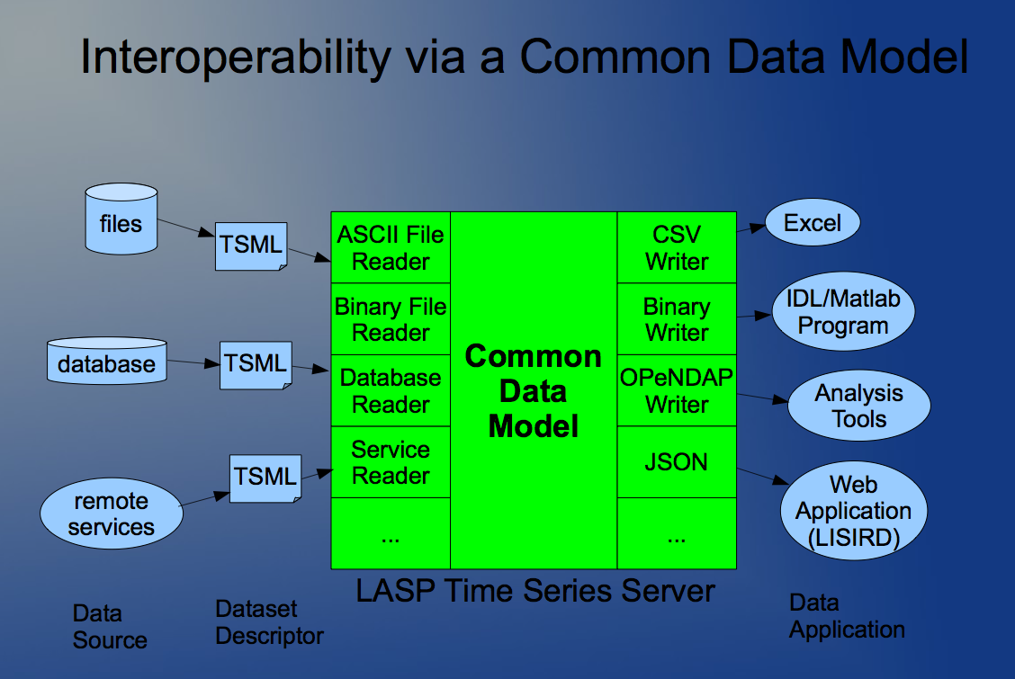

Slide 15

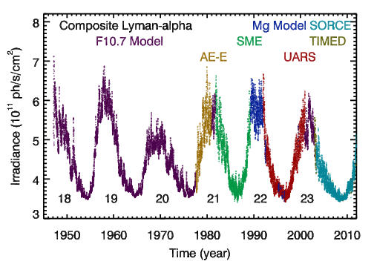
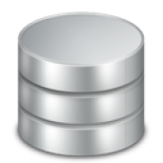
Data Fusion Problem
Solar irradiance at 121.5 nm from multiple observations and proxies
Disparate sources and formats
Different units and time samples
netCDF
database
Notes:
Solar spectral irradiance datasets from two missions.
One in NetCDF (not CF, 3d array), another in a relational database, join 2 tables.
User needs to be able to read both.
Even if we already have readers for both, we must get them in the same data structure.
Bridge the gap between data discovery and use.
Hopefully we can do better than just arrays.
Potentially Different units and time samples

Slide 16
Processing the Data
// Read the spectral time series data for each mission.
// t -> (w -> (I, dI))
val sorce = reader.readData("sorce", time1, time2)
val timed = reader.readData("timed", time1, time2)
// Make a time series with the Lyman alpha (121.5 nm) measurements only.
var sorce_lya = new TimeSeries() // t -> (I, dI)
for ((time, spectrum) <- sorce) {
sorce_lya = sorce_lya :+ (time, spectrum(121.5))
}
// Exclude time samples with bad values.
sorce_lya = sorce_lya.filter(! _.isMissing)
// Do the same for timed_lya.
...
// Combine the two time series, with scale factors.
// Let SORCE take precedence.
composite_lya = timed_lya * 1.03 ++ sorce_lya * 1.04

