Slide 1

Software Engineering and VAPOR
Alan Norton
National Center for Atmospheric Research
Boulder, CO USA
SEA Seminar June 30, 2011
This work is funded in part through U.S. National Science Foundation grants 03-25934 and 09-06379, and through a TeraGrid GIG award
Alan Norton (vapor@ucar.edu)

Slide 2
Outline
Introduction:
  What is VAPOR used for?
Quick demo of VAPOR
VAPOR architecture
VAPOR development process
What next?
Long-term challenges
Alan Norton (vapor@ucar.edu)
Notes:
Our ability to compute has outstripped our ability to analyze data – result: not getting full ROI

Slide 3
VAPOR project overview
The VAPOR project is intended to address the problem that datasets are becoming too big to analyze and visualize interactively.
VAPOR is the Visualization and Analysis Platform for Oceanic, atmospheric and solar Research
Goal: Enable scientists to interactively analyze and visualize massive datasets resulting from fluid dynamics simulation
Domain focus: 2D and 3D, gridded, time-varying turbulence datasets, especially earth-science simulation output.
Essential features:
  Multi-resolution data representation for accelerated data access
  Exploits GPU for fast rendering
  Interactive user interface for scientific visual data exploration
  Desktop app on Mac, Windows, Linux
Alan Norton (vapor@ucar.edu)
Notes:
Our ability to compute has outstripped our ability to analyze data – result: not getting full ROI

Slide 4
VAPOR background
VAPOR project began here at NCAR in 2004
Started by John Clyne, in response to problem of analyzing and visualizing massive data sets:
  Simulation output size is exploding
  Analysis and visualization is limited by I/O rates, which are not growing as fast
  Wavelet data representation facilitates massive data access
Technology challenges are continuing:
  Moore’s law continues to enable simulation data size increase
  I/O not increasing at the same exponent
  Interactivity becoming more difficult
  A bright spot: Rapidly increasing GPU performance and capability
Alan Norton (vapor@ucar.edu)
Notes:
Our ability to compute has outstripped our ability to analyze data – result: not getting full ROI

Slide 5
Problems with
Petascale Analysis/Vis Workflow
Only infrequent archival
Insufficient capacity, speed
Supercomputing
Temp
Disk
Archive
Only for small samples, statistics
Takes days or weeks
Offline processing:
Analysis and Visualization
Analysis
Repository
Insufficient speed
For interactivity
Alan Norton (vapor@ucar.edu)
Notes:
Our ability to compute has outstripped our ability to analyze data – result: not getting full ROI

Slide 6
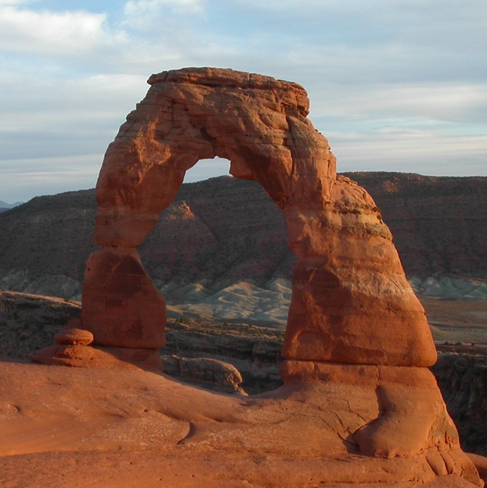



Wavelet transforms for 3D multiresolution data representation
Reduce I/O requirements for visualizing massive data.
Some wavelet properties:
  Data can be accessed at desired resolution and compression level
  Lossless or Lossy (up to 500:1 compression)
  Numerically efficient (O(n))
    Forward and inverse transform
  No additional storage cost
Alan Norton (vapor@ucar.edu)

Slide 7
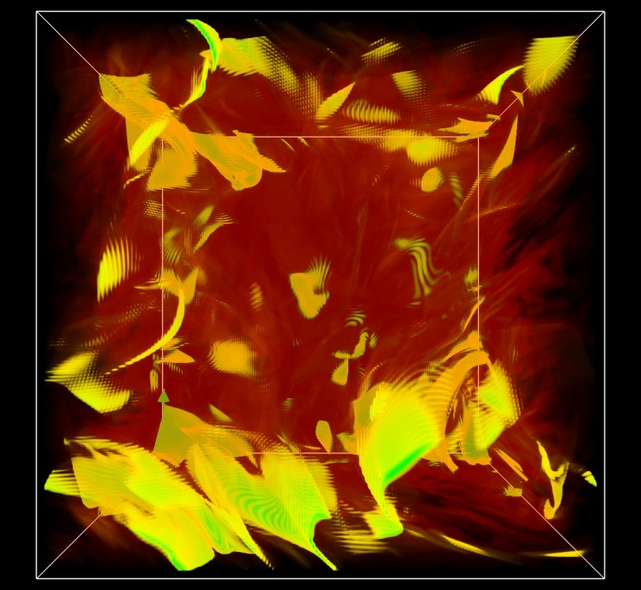
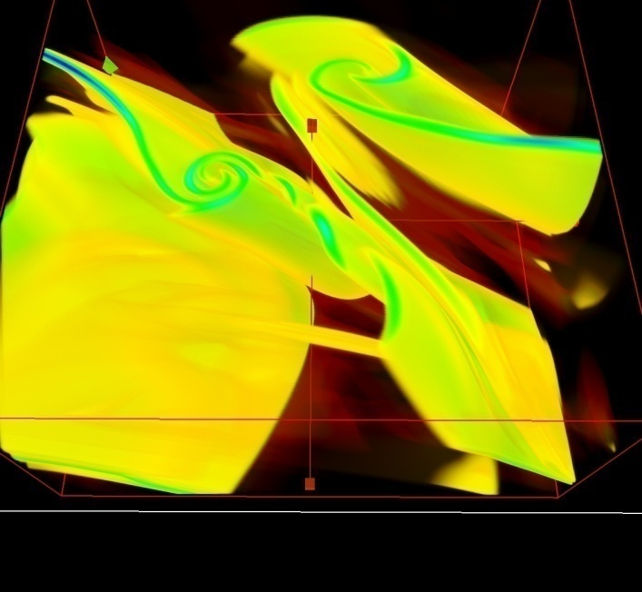
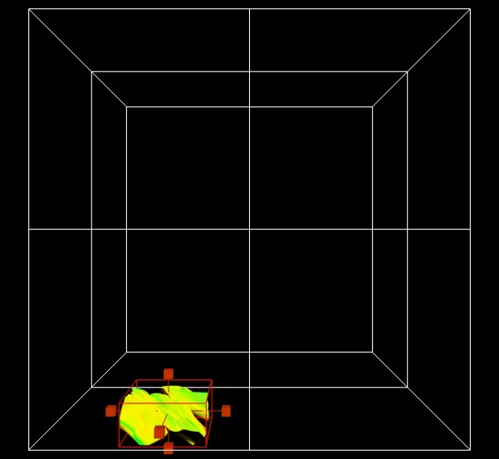
Demo: Multi-resolution data browsing
Wavelet data representation supports control of data resolution as well as compression level
Interactively visualize full data at low resolution, high compression
Zoom in, increase resolution, reduce compression for detailed understanding
P. Mininni, current roll
Alan Norton (vapor@ucar.edu)
Notes:
Variable is current magnitude. Note Pablo Mininni used this technique to identify interesting structure (current roll), in 1536 cube = 13.5GB per variable.
Start with full window (right) maximize it and use region tool to get down to current roll.
Then minimize window, set other visualizer to be the current one. Enable dvr, probes, flow.
Show how to insert other seed points.

Slide 8
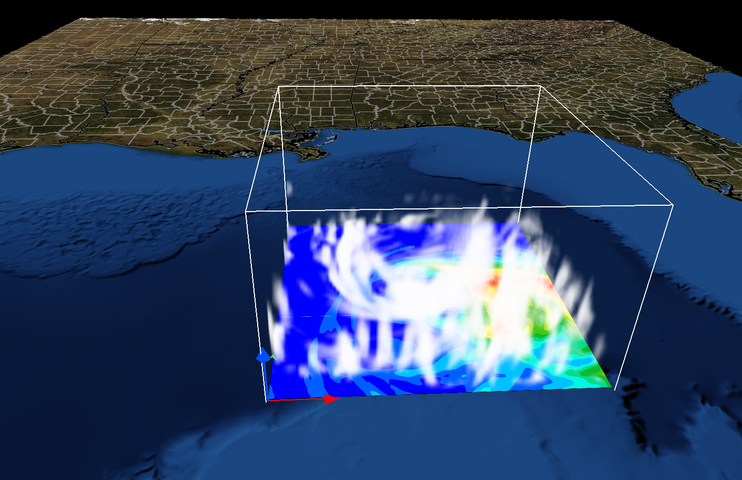
Geo-reference WRF-ARW output
Apply images and boundary maps obtained from Web Mapping Services onto terrain.
Geo-referencing provides spatial context for volume rendering, contour maps, etc.
Alan Norton (vapor@ucar.edu)

Slide 9
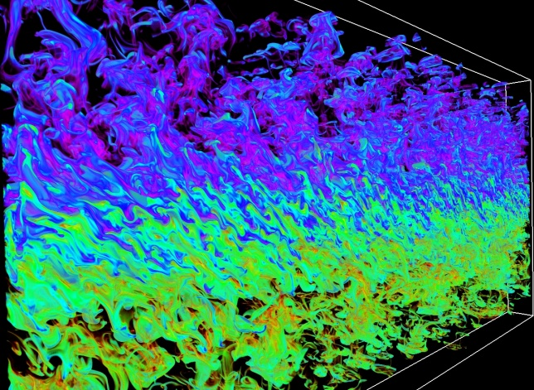
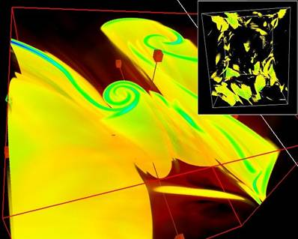
VAPOR capabilities (latest version: 2.0)
All tools perform interactively, exploiting multi-resolution representation
Wavelet compression enables up to 500:1 reduction of I/O reads
GPU-accelerated interactive graphics
Python calculation of derived variables
Flow integration
  Streamlines, particle traces
  Field line advection
  Image-based flow visualization
Data probing and contour planes
WRF-ARW terrain-following grids
  Direct import of WRF output files
Geo-referenced image support
Smyth, salt sheet boundary simulation
Mininni, Current roll
Alan Norton (vapor@ucar.edu)
Notes:
Just say: List of standard capabilities needed for fluid dynamics research

Slide 10
How VAPOR differs from other visualization platforms
Multi-resolution data representation with compression
  To enable interactive display and analysis of peta-scale datasets
Python and NumPy embedded support
Intended to be used by scientists, not visualization engineers
  Requirements defined by a steering committee of scientists
Narrow focus: turbulence simulation on gridded domains
Not built on existing visualization libraries (e.g. VTK)
Emphasis on desktop and laptop platforms: No distributed implementation
Alan Norton (vapor@ucar.edu)

Slide 11
Vapor Architecture
VAPOR environment
Platform: Linux/Mac/Windows workstation
  Modern (nVidia or ATI) graphics card
  Not highly parallel, can exploit SMP systems.
Coded mostly in C++, uses OpenGL for rendering
GUI based on Qt 4.6
Contrast with ParaView, VisIt:
  Should one use a supercomputer to visualize supercomputer output?
Alan Norton (vapor@ucar.edu)

Slide 12





Original
data
(raw or NetCDF)
raw2vdf, etc.
Wavelet Data + Metadata
Data
Manager Cache
piovdc
MPI app
Derived variables
(Python pipeline)
GUI
Renderer
VAPOR dataflow

Slide 13
Vapor Architecture
Organization
Main components:
  VDF lib: read, write, convert, decode, cache data
  Params lib: parameter database
  Render lib: OpenGL rendering
  GUI: Qt-based UI
Extensibility
  Goal: enable new renderers to be added by third parties, potentially to be integrated into version we ship.
  Support user-added Param/Renderer/GUI classes
  New grid topologies, e.g. WRF, spherical, POP
Python pipeline
Alan Norton (vapor@ucar.edu)

Slide 14
VDF lib (data access)
Flow lib (integration)
Params
(parameter
database)
Qt lib
Render lib
GUI
VAPOR
Basic Architecture

Slide 15
VDF lib (data access)
Vapor Extension Classes
Flow lib (integration)
Params
(parameter
database)
Params Class
(XML-based)
Qt lib
Renderer Class (OpenGL-based)
Render lib
EventRouter Class (Qt-based)
GUI
VAPOR Extensibility Architecture
GUI tab layout
(Qt XML file)

Slide 16
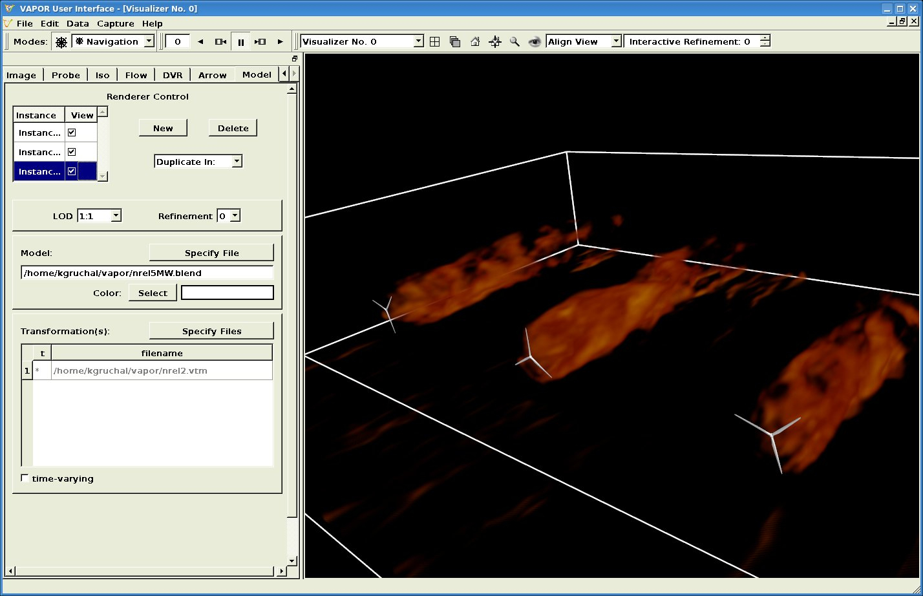
Example extension (K. Gruchalla, NREL)
Enable insertion of wind turbine geometry into turbulence visualization
Alan Norton and John Clyne (vapor@ucar.edu)

Slide 17


Python/NumPy in VAPOR
Python/NumPy fits nicely into VAPOR architecture:
  NumPy operates on 2D or 3D float arrays, supplied and saved by Vapor Data manager.
  Scripts applied just to data needed for visualization
Data manager cache
embeddedPython interpreter
2
3
Variable data
4
1
5
Renderer or GUI
Alan Norton (vapor@ucar.edu)

Slide 18
User Interface
Usability, convenience for scientists is primary goal.
Qt main window is arranged to minimize clutter: tabs, multiple visualizer widgets inside window frame.
Support for standard GUI conveniences, such as undo/redo, session save/restore, user preferences, etc.
Combine 2D and 3D GUI elements to improve interactivity:
  Manipulators
  Visual seed selection
  Selected tab instance controls selected visualizer
GUI complexity management is a continuing challenge.
Alan Norton (vapor@ucar.edu)

Slide 19
Development process
2-5 developers
190K loc in SourceForge CVS repository
SourceForge bug/feature databases
VAPOR releases every 6-12 months
Joys and sins of a small development team:
  Informal process model
    Lots of prototyping, incremental development
    Source tree is always buildable and testable
  Test coverage limitations:
    Developers & users are the testers!
    2-stage release process
  Responsible for our own documentation
  Informal requirements analysis
    Steering committee (of scientists) provides some guidance
    Periodic surveys (in person and on Web)
    Prioritize features based on user feedback and funding requirements
Alan Norton (vapor@ucar.edu)

Slide 20
Development process
Mythical man-month considerations
  Development time can be proportional to number of developers involved(!)
  At best, coding time of a feature (or a bug fix) is approximately proportional to the number of lines of code it touches
  Tendency is toward increase in connections, less modularity
  In VAPOR we have a constant struggle to increase modularity
  Major refactoring is often necessary but painful
Documentation: Can be as hard to maintain as code!
Extensibility will improve development
  Improved modularity
  Potentially the user community will extend our development efforts!
Alan Norton (vapor@ucar.edu)

Slide 21
What features are needed?
Users and funding agencies tell us..
Ocean data visualization
Animation control
Scripting (internal and external)
Improved usability, especially reduced GUI complexity
Better docs, improved Web access
Iso-lines, linear probes
Etc.
Alan Norton (vapor@ucar.edu)

Slide 22
Big challenges we face
Need to grow user community
Need to alter scientific dataflow (perform wavelet encoding when data is created)
Value of 3D in science is not widely appreciated
  Both in doing the science and in presenting the results
The petascale challenge: Improve understanding with less data retrieval
  Wavelets are one mechanism
  Feature identification and tracking
  Automated analysis, machine learning, etc
Technology continues to challenge visualization
  How will we navigate in an exascale dataset?
Alan Norton (vapor@ucar.edu)

Slide 23
Summary
VAPOR is designed to enable interactive visualization and analysis of massive datasets by exploiting the wavelet multi-scale representation.
VAPOR combines a highly interactive user interface with OpenGL rendering and a Python calculator so that scientific users can rapidly analyze and visualize their data.
VAPOR’s extensibility architecture will enable others to add custom features to VAPOR.
Alan Norton (vapor@ucar.edu)

Slide 24
VAPOR Status
Version 2.0.2 released in March 2011
  available on Website
Runs on Linux, Windows, Mac
System requirements:
  a modern (nVidia or ATI) graphics card (available for about $200)
  ~1GB of memory
Executables, documentation available (free) at http://www.vapor.ucar.edu/
Source code, feature requests, etc. at http://sourceforge.net/projects/vapor
Contact: vapor@ucar.edu
Alan Norton (vapor@ucar.edu)

Slide 25
Questions?
Alan Norton (vapor@ucar.edu)

Slide 26
Acknowledgements
Steering Committee
  Nic Brummell - UCSC
  Yuhong Fan - NCAR, HAO
  Aimé Fournier – NCAR, IMAGe
  Pablo Mininni, NCAR, IMAGe
  Aake Nordlund, University of Copenhagen
  Helene Politano - Observatoire de la Cote d'Azur
  Yannick Ponty - Observatoire de la Cote d'Azur
  Annick Pouquet - NCAR, ESSL
  Mark Rast - CU
  Duane Rosenberg - NCAR, IMAGe
  Matthias Rempel - NCAR, HAO
  Geoff Vasil, CU
  Leigh Orf, U Central Mich.
Systems Support
  Joey Mendoza, NCAR, CISL
WRF consultation
  Wei Wang – NCAR, MMM
  Cindy Bruyere –NCAR, MMM
  Yongsheng Chen-NCAR,MMM
  Thara Prabhakaran-U. of Ga.
  Wei Huang – NCAR/CISL
  Minsu Joh - KISTI
Design and development
  John Clyne – NCAR/CISL
  Alan Norton – NCAR/CISL
  Dan LaGreca – NCAR/CISL
  Pam Gillman – NCAR/CISL
  Kendall Southwick – NCAR/CISL
  Markus Stobbs – NCAR/CISL
  Kenny Gruchalla – NREL
  Victor Snyder – CSM
  Yannick Polius – NCAR/CISL
  Karamjeet Khalsa – NCAR/CISL
Research Collaborators
  Kwan-Liu Ma, U.C. Davis
  Hiroshi Akiba, U.C. Davis
  Han-Wei Shen, OSU
  Liya Li, OSU
vapor@ucar.edu

