Slide 1
Porting a 2D Finite Volume Advection Code to the Intel MIC
Kaushik Datta – NASA GSFC (SSSO) / Northrop Grumman
Hamid Oloso – NASA GSFC (SSSO) / AMT
Tom Clune – NASA GSFC (SSSO)
Dan Duffy – NASA GSFC (NCCS)
Project funded by NASA High-End Computing (HEC) Program
Notes:
NASA HEC is funding project, but work done by NCCS and SSSO

Slide 2
Outline
What is Intel’s MIC Platform?
Intel MIC Hardware
Intel MIC Programming Models
Intel MIC SGEMM Performance
FV 2D Advection Code
Conclusion

Slide 3
Intel MIC Overview
Intel MIC (Many Integrated Core) is a co-processor attached to CPU host via PCIe bus
MIC architecture:
Is designed for highly parallel, vectorizable codes
Uses many small, simple x86 cores with wide vector units
All results in this talk are run on prototype Knights Ferry (KNF) card with Alpha 8 release of software stack
As a result, we will focus more on programmability and experience than raw performance numbers
Knights Corner (first MIC consumer product, 22 nm process) expected in 2012 and 2013
Notes:
We expect the MIC architecture to be very scalable and power efficient (one way to reach exascale)
Intel: “Expect to program for hundreds of cores.”- that day is almost here.
MIC will be in the same market as GPUs
We expect Knights Corner to have much better performance than Knights Ferry

Slide 4
Outline
What is Intel’s MIC Platform?
Intel MIC Hardware
Intel MIC Programming Models
Intel MIC SGEMM Performance
FV 2D Advection Code
Conclusion

Slide 5
KNF Node
12 Xeon CPU cores (Westmere @ 3.33 GHz)
2 MIC co-processors (over PCIe) each with:
30 active cores
Up to 1.2 GHz clock
High-BW bidirectional ring connecting cores (for cache coherency)
2GB GDDR5 memory (graphics memory)
Only 1 MIC co-processor used in our testing

Slide 6
KNF MIC Core
4 hardware threads
Two pipelines
Pentium® processor-based scalar units
64-bit addressing
64 KB L1 cache and 256 KB L2 cache
Both are fully coherent
New vector unit
512-bit (16 SP or 8 DP numbers) SIMD instructions
DP is currently much slower than SP
32 512-bit wide vector registers
Pipelined one-per-clock throughput
Notes:
SSE only supported 128-bit, AVX only supports 256-bit

Slide 7
Outline
What is Intel’s MIC Platform?
Intel MIC Hardware
Intel MIC Programming Models
Intel MIC SGEMM Performance
FV 2D Advection Code
Conclusion

Slide 8
Programming Models
We tested two different ways to run on MIC:
Offload mode: Executable runs on CPU but parallel segments are offloaded to MIC
Native mode: Executable runs entirely on MIC
Used OpenMP + MIC directives for parallelization
MPI can also be supported, but have not tested it
Notes:
Mention the analogy with GPUs and PGI ACC

Slide 9
Outline
What is Intel’s MIC Platform?
Intel MIC Hardware
Intel MIC Programming Models
Offload Mode
Native Mode
Intel MIC SGEMM Performance
FV 2D Advection Code
Conclusion

Slide 10
Offload Mode Basics
Need to specify what gets offloaded to MIC card:
Data: !dir$ omp offload target(mic:0) in(a) inout(b)
Subroutines: !dir$ attributes offload:mic :: matmult
Offload directives must be followed by OpenMP parallel region
Distributes work over MIC cores
Code compilation:
Requires special offload flags
Generates report to show whether offloaded code is vectorized
Code execution:
Can control MIC parallelization via OMP_NUM_THREADS
Can control MIC affinity via KMP_AFFINITY
Can run MKL library calls on the MIC (as we will see…)
Notes:
Maybe compare this to PGI directives model?

Slide 11
Offload Mode Caveats
Overheads:
Connecting to the MIC card for the first time
Copying in data for an offload region
Copying out data for an offload region
Parallel regions in offload mode may run slower than in native mode

Slide 12
Offload Mode Issues
Currently cannot persist automatic arrays on the stack across offload regions
Even though array a is local to subroutine bar, it still needs to be “copied in”:
Solution: Restructure code to move local arrays inside layers of subroutines to the heap
Intel is aware of this issue and is addressing it for the next Alpha software releases
program foo
! array a now global (heap)
real, allocatable, dimension(:) :: a
allocate(a(size1))
call bar(size1, a)
end program
subroutine bar(size1, a)
! array a turned into dummy var
real, dimension(size1) :: a(:)
end subroutine bar
program foo
call bar(size1)
end program
subroutine bar(size1)
! local (automatic) array a
real, dimension(size1) :: a(:)
end subroutine bar
Notes:
“automatic” arrays means “local” arrays in this context
Moving local variables to the heap of the calling function
Another solution would be to inline everything (to create a single offload region), but this isn’t practical in most codes

Slide 13
MIC Offload vs. PGI Accelerator Model (Similarities)
Both approaches only require additional directives and possibly some code transformations
No large-scale code refactoring/rewriting
Both compilers report:
what data is being moved in and out of each offload region
which loops have been successfully vectorized/parallelized
Intel MIC offload keywords | PGI ACC data region keywords
in | copyin
out | copyout
inout | copy
nocopy | local

Slide 14
MIC Offload vs. PGI Accelerator Model (Differences)
Persisting data across offload regions:
MIC: user must specify which vars need to be retained for the next offload region
PGI ACC: user needs to create an encompassing “data region” to persist data across individual “compute regions”
Subroutine calls within offload regions:
MIC: allowed
PGI ACC: allowed within data regions, but not within compute regions
Running on the co-processor:
MIC: offload code will still run (slowly) even if it does not vectorize/parallelize
PGI ACC: will refuse to generate GPU kernels unless:
loop carried dependencies are removed
certain arrays are declared private
no live variables after parallel loops
etc.
Generally, since MIC card is also x86, there is less tuning than for PGI ACC running on GPUs
PGI ACC may require larger code transformations to expose lots of fine-grained parallelism

Slide 15
Outline
What is Intel’s MIC Platform?
Intel MIC Hardware
Intel MIC Programming Models
Offload Mode
Native Mode
Intel MIC SGEMM Performance
FV 2D Advection Code
Conclusion

Slide 16
Native Mode Basics
Everything runs on the MIC card
no need for offload directives
codes with large serial regions will suffer
OpenMP parallel regions will parallelize over MIC cores
Code compilation:
can build as is without any code changes
requires special native mode flags
generates report to show whether offloaded code is vectorized or not
Can use OMP_NUM_THREADS, KMP_AFFINITY, and MKL libraries (just like offload mode)
Code execution:
use ssh to remotely launch a native executable on MIC card, or:
ssh to MIC card and run natively there

Slide 17
Outline
What is Intel’s MIC Platform?
Intel MIC Hardware
Intel MIC Programming Models
Intel MIC SGEMM Performance
FV 2D Advection Code
Conclusion

Slide 18
MIC SGEMM Performance
Code was run natively on single MIC card
Attains up to 68% of hardware peak
Notes:
“SGEMM” is single precision matrix-matrix multiply
MIC card able to achieve good fraction of HW peak
We used special benchmarking scripts given to us by Intel to attain this performance -> may be able to leverage compiler flags in other codes to see improved performance

Slide 19
Outline
What is Intel’s MIC Platform?
Intel MIC Hardware
Intel MIC Programming Models
Intel MIC SGEMM Performance
FV 2D Advection Code
Description
Experience Porting to MIC
Performance
Conclusion

Slide 20
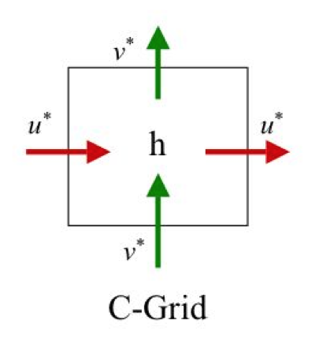

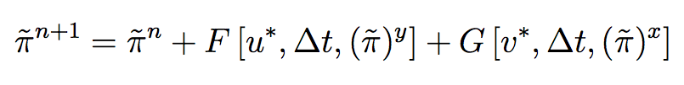

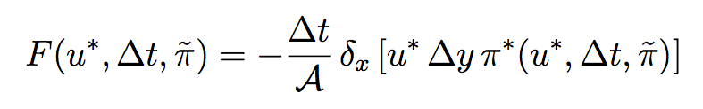
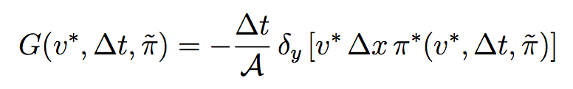

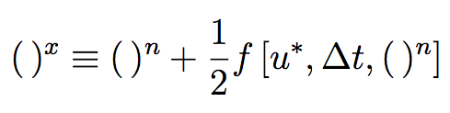
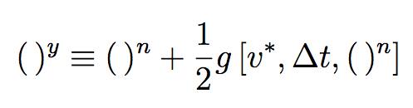
FV Advection Kernel (PPM Details)
Sub-Grid PPM Distribution Schemes
π
ORD=7 details (4th order and continuous before monotonicity)…
The value at the edge is an average of two one-sided 2nd order extrapolations across edge discontinuities
Directionally split
Positivity for tracers
1D flux-form operators
Fitting by Cubic Polynomial to find the value on the other edge of the cell
vanishing 2nd derivative
local mean = cell mean of left/right cells
Cross-stream inner-operators
Notes:
PPM is “piece-wise parabolic method”, used for subgrid advection
In general, in advection process we are conserving mass characteristics of the continuity equation
Total code was few hundred lines of code- several regions are amenable to parallelization and vectorization
Bill Putman’s work

Slide 21
Outline
What is Intel’s MIC Platform?
Intel MIC Hardware
Intel MIC Programming Models
Intel MIC SGEMM Performance
FV 2D Advection Code
Description
Experience Porting to MIC
Performance
Conclusion

Slide 22
OpenMP Parallelization (First Attempt)
Original code
program foo
real, dimension(:,:), allocatable a
allocate a(size1,size2)
do iter = 1, numTimeSteps
call bar(a, size1, size2)
enddo
end program foo
module bar
contains
subroutine bar(a, size1, size2)
real, dimension(size1,size2) :: a
! local
real, dimension(size1,size2) :: b
some_parallel_work
call bar1(b, size1, size2)
more_parallel_work
more_calls
etc
end subroutine bar
subroutine bar1(b, size1, size2)
real, dimension(size1,size2) :: b
! local
real, dimension(size1,size2) :: c
some_parallel_work
calls_to_other_inner_subroutines
more_parallel_work
etc.
end subroutine bar1
etc.
end module bar
Original code parallelized with OpenMP
program foo
real, dimension(:,:), allocatable a
allocate a(size1,size2)
do iter = 1, numTimeSteps
call bar(a, size1, size2)
enddo
end program foo
module bar
contains
subroutine bar(a, size1, size2)
real, dimension(size1,size2) :: a
! local
real, dimension(size1,size2) :: b
!$omp parallel do
some_parallel_work
call bar1(b, size1, size2)
!$omp parallel do
more_parallel_work
more_calls
etc
end subroutine bar
subroutine bar1(b, size1, size2)
real, dimension(size1,size2) :: b
! local
real, dimension(size1,size2) :: c
!$omp parallel do
some_parallel_work
calls_to_other_inner_subroutines
!$omp parallel do
more_parallel_work
etc.
end subroutine bar1
etc.
end module bar
OpenMP “parallel do” directives allow do loops to be parallelized
Each “parallel do” region can also become a MIC offload region (with appropriate directives)

Slide 23
Advection Code on the MIC (Offload Mode)
Original code parallelized with OpenMP
program foo
real, dimension(:,:), allocatable a
allocate a(size1,size2)
do iter = 1, numTimeSteps
call bar(a, size1, size2)
enddo
end program foo
module bar
contains
subroutine bar(a, size1, size2)
real, dimension(size1,size2) :: a
! local
real, dimension(size1,size2) :: b
!$omp parallel do
some_parallel_work
call bar1(b, size1, size2)
!$omp parallel do
more_parallel_work
more_calls
etc
end subroutine bar
subroutine bar1(b, size1, size2)
real, dimension(size1,size2) :: b
! local
real, dimension(size1,size2) :: c
!$omp parallel do
some_parallel_work
calls_to_other_inner_subroutines
!$omp parallel do
more_parallel_work
etc.
end subroutine bar1
etc.
end module bar
We could offload each “parallel do” region to the MIC, but local arrays would not persist
MIC code
program foo
real, dimension(:,:), allocatable a, b, c
!dir$ attributes offload : mic :: a, b, c
allocate a(size1,size2)
allocate b(size1,size2)
allocate c(size1,size2)
!dir$ offload target(mic:0) in(b, c) inout(a)
!$omp parallel
do iter = 1, numTimeSteps
call bar(a, b, c, size1, size2)
enddo
!$omp end parallel
end program foo
module bar
contains
subroutine bar(a, b, c, size1, size2)
real, dimension(size1,size2) :: a, b, c
!$omp do
some_parallel_work
call bar1(b, c, size1, size2)
!$omp do
more_parallel_work
more_calls
etc
end subroutine bar
subroutine bar1(b, c, size1, size2)
real, dimension(size1,size2) :: b, c
!$omp do
some_parallel_work
calls_to_other_inner_subroutines
!$omp do
more_parallel_work
etc.
end subroutine bar1
etc.
end module bar
As a result, we move local arrays to the top-most caller subroutine, and then create a single parallel offload region
Notes:
We only do this technique for performance reasons

Slide 24
Advection Code on the MIC (Steps Taken for Offload Mode)
Code reorganized to put automatic variables (b, c) on the heap and pass them as arguments
Code restructured to have only single “omp parallel” at highest level
Allows MIC data to be copied only once
MIC directives then added above “omp parallel” directive to offload work and data

Slide 25
Outline
What is Intel’s MIC Platform?
Intel MIC Hardware
Intel MIC Programming Models
Intel MIC SGEMM Performance
FV 2D Advection Code
Description
Experience Porting to MIC
Performance
Conclusion

Slide 26
2D Advection Code Performance
Speed-up basically flattens out at a maximum of:
about 28 at 50 threads for “offload”
about 30 at 60 (and 100) threads for “native”
Not shown but observed:
“native” about 30% faster than “offload”
Cost of spawning threads grows with number of threads in “native” mode but remains constant in “offload” mode
Notes:
Speedup is relative to 1 thread
Recall that there are 30 MIC cores, each of which supports 4 threads/core

Slide 27
Outline
What is Intel’s MIC Platform?
Intel MIC Hardware
Intel MIC Programming Models
Intel MIC SGEMM Performance
FV 2D Advection Code
Conclusion

Slide 28
Conclusions
Once automatic variables persist on the MIC, we expect porting of parallel codes to be quicker than for GPUs (typically within days)
Similar programming and environment between CPUs and MIC
“Offload” mode might only require addition of offload directives
“Native” mode might not require any code changes
Maintain a single code base?
Generating GPU kernels using PGI ACC still not easy
Have yet to see how Knights Corner performance compares to latest GPUs
Notes:
May need to make code changes to ensure parallelization/vectorization

Slide 29
Acknowledgements
Many thanks to Dr. Bill Putman (Goddard scientist) for letting us use his 2D finite-volume advection code

