Slide 1
Post-processing analysis of climate simulation data using Python and MPI
John Dennis (dennis@ucar.edu)
Dave Brown (dbrown@ucar.edu)
Kevin Paul (kpaul@ucar.edu)
Sheri Mickelson (mickelso@ucar.edu)

Slide 2
Motivation
Post-processing consumes a surprisingly large fraction of simulation time for high-resolution runs
Post-processing analysis is not typically parallelized
Can we parallelize post-processing using existing software?
Python
MPI
pyNGL: python interface to NCL graphics
pyNIO: python interface to NCL I/O library

Slide 3
Consider a “piece” of CESM post-processing workflow
Conversion of time-slice to time-series
Time-slice
Generated by the CESM component model
All variables for a particular time-slice in one file
Time-series
Form used for some post-processing and CMIP
Single variables over a range of model time
Single most expensive post-processing step for CMIP5 submission

Slide 4
The experiment:
Convert 10-years of monthly time-slice files into time-series files
Different methods:
Netcdf Operators (NCO)
NCAR Command Language (NCL)
Python using pyNIO (NCL I/O library)
Climate Data Operators (CDO)
ncReshaper-prototype (Fortran + PIO)

Slide 5
Dataset characteristics: 10-years of monthly output
dataset | # of 2D vars | # of 3D vars | Input total size (Gbytes)
CAMFV-1.0 | 40 | 82 | 28.4
CAMSE-1.0 | 43 | 89 | 30.8
CICE-1.0 | 117 |  | 8.4
CAMSE-0.25 | 101 | 97 | 1077.1
CLM-1.0 | 297 |  | 9.0
CLM-0.25 | 150 |  | 84.0
CICE-0.1 | 114 |  | 569.6
POP-0.1 | 23 | 11 | 3183.8
POP-1.0 | 78 | 36 | 194.4

Slide 6
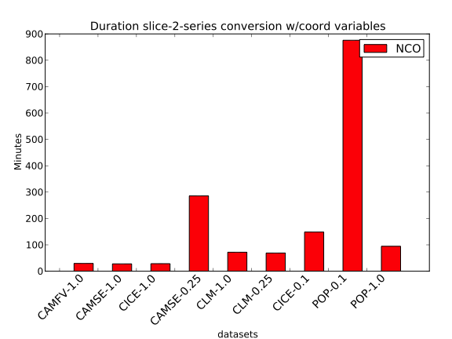
Duration: Serial NCO
5 hours
14 hours!

Slide 7
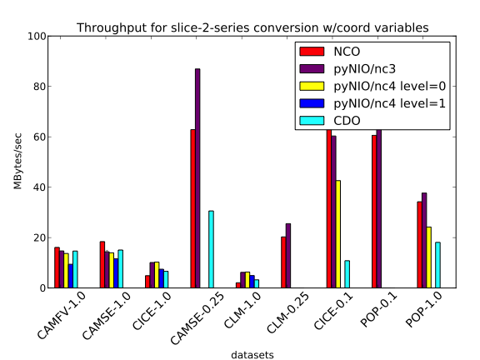
Throughput: Serial methods

Slide 8
Approaches to Parallelism
Data-parallelism:
Divide single variable across multiple ranks
Parallelism used by large simulation codes: CESM, WRF, etc
Approach used by ncReshaper-prototype code
Task-parallelism:
Divide independent tasks across multiple ranks
Climate models output large number of different variables
T, U, V, W, PS, etc..
Approach used by python + MPI code

Slide 9
Single source Python approach
Create dictionary which describes which tasks need to be performed
Partition dictionary across MPI ranks
Utility module ‘parUtils.py’ only difference between parallel and serial execution

Slide 10
Example python code
import parUtils as par
…
rank = par.GetRank()
# construct global dictionary ‘varsTimeseries’ for all variables
varsTimeseries = ConstructDict()
…
# Partition dictionary into local piece
lvars = par.Partition(varsTimeseries)
# Iterate over all variables assigned to MPI rank
for k,v in lvars.iteritems():
….

Slide 11
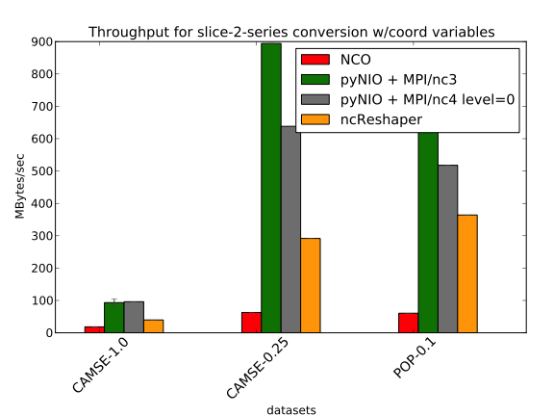
Throughput: Parallel methods (4 nodes, 16 cores)
task-parallelism
data-parallelism

Slide 12
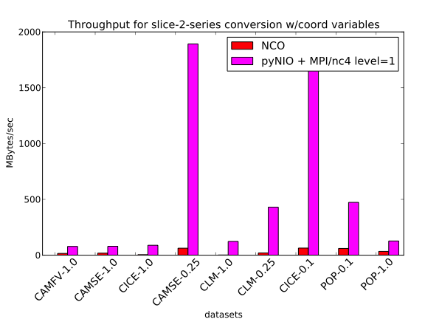
Throughput: pyNIO + MPI w/compression

Slide 13
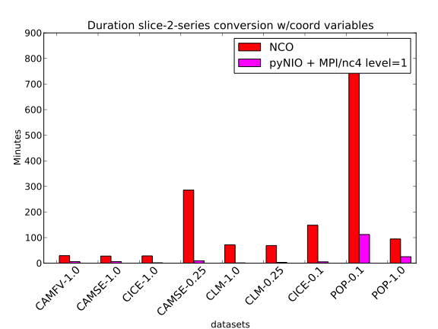
Duration: NCO versus pyNIO + MPI w/compression
7.9x (3 nodes)
35x speedup (13 nodes)

Slide 14
Conclusions
Large amounts of “easy-parallelism” present in post-processing operations
Single source python scripts can be written to achieve task-parallel execution
Factors of 8 – 35x speedup is possible
Need ability to exploit both task and data parallelism
Exploring broader use within CESM workflow
Expose entire NCL capability to python?

