Slide 1
Operational Dataset Update Functionality Included in the NCAR Research Data Archive Management System
Zaihua Ji
Doug Schuster
Steven Worley
Computational and Information Systems Laboratory
National Center for Atmospheric Research
http://dss.ucar.edu

Slide 2
Presentation Outline
Introduction
Research Data Archive Components
What Dataset Updates Do?
Challenges of Operational Dataset Updates
Design of DSUPDT
Implementation of DSUPDT
Examples
Conclusion

Slide 3
Introduction
Growing complexity, volume, and reliance for operational data archiving
Past tools focused on data delivered via media, such as tape, or ftp scripting
Presently most data are acquired using network transfers many times per day
Past archive management technologies do not scale to this new paradigm
DSUPDT uses open source databases and locally written utilities
fetching
Interrogating
Archiving
providing long-term research data stewardship
Over 150 RDA dataset products are managed under DSUPDT control
Update scheduled at hourly, daily, weekly, monthly, and yearly intervals
DSUPDT is fully scalable and supports addition of all new data streams

Slide 4
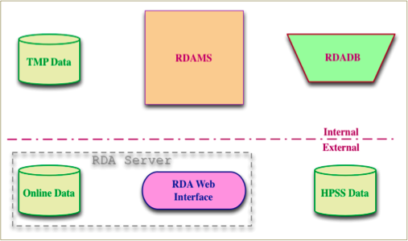
Research Data Archive Components

Slide 5
Research Data Archive Components
TMP Data – Temporary storage for data processing
RDAMS - Research Data Archive Management System
Retrieve remote data files
Build local data files
Archive data to disk and/or archive storage systems
Harvest file content standard metadata
Build and stage data for user requests
RDADB – Research Data Archive Database
File names, formats, and storage locations
Dataset discovery metadata
File content metadata
Online Data – Data on disk, available through RDA Web Interface
Data files for direct download
Data files for direct access by users on NCAR computers
Data files staged temporarily, resulting from one time user requests

Slide 6
Research Data Archive Components
RDA Web Interface – RDA web-server interface
Download Online Data - real-time
Download data re-staged from archive storage - delayed mode
Download data from subset requests - delayed mode
Download data from format conversion requests - delayed mode
HPSS Data – data on the NCAR High Performance Storage System
Primary archives of data
Directly serving users with NCAR accounts
Indirectly to public web users
Backup copies for the primary archives
Disaster recovery copies

Slide 7
What Dataset Updates Do?

Slide 8
Challenges of Operational Dataset Updates
Obtain original data from different sources
A single file from primary and secondary remote servers
Multiple files from a single remote server
Data files generated locally
Accommodate variation in source data provider schedules
Temporal intervals that divide the data stream into files along
a timeline (daily, monthly and etc.)
Temporal intervals during which the data files are available
on the remote server
Time window limit to look for past data on the remote server

Slide 9
Challenges of Operational Dataset Updates
Recover missing and replaced data
Restart interrupted update actions due to system outages,
both locally and remotely
Recover or skip data gaps
Recheck data files refreshed by provider
Process data updates for multiple time periods
Process data locally
Validate data integrity
Build a single archive file from multiple source data files
Gather file content metadata and verify metadata integrity
Store multiple copies
To online for web users
To archive (HPSS) - primary, backup, and disaster recovery

Slide 10
Design of DSUPDT
Data Update Cycle - a complete update process for a single
update interval
Download Remote File
Build Local File
Archive Data File
Clean Up Temporary Files
Temporal Update Control - synchronize the Data Update Cycle
with the data provider schedule

Slide 11
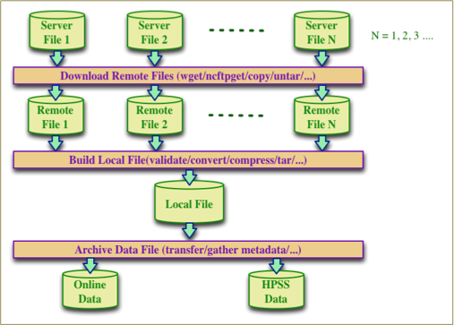
Design of DSUPDT – Data Update Cycle

Slide 12
Design of DSUPDT – Data Update Cycle
Server Files – Source data files on remote or local servers
Remote Files – Data files downloaded onto local disks
and prior to any local processing
Local File – A file built (created) from the Remote Files
and ready to be archived
Archive Files – Files on HPSS
and copies online for direct web services.
NOTE: Key file during a Data Update Cycle is the Local File and
the focus of an update cycle is to build and archive the Local File

Slide 13
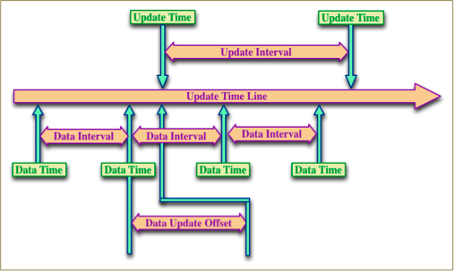
Design of DSUPDT – Temporal Update Control

Slide 14
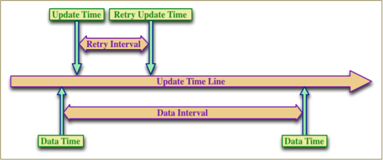
Design of DSUPDT – Temporal Update Retry

Slide 15
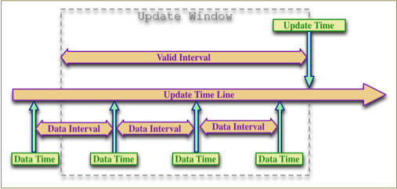
Design of DSUPDT – Update Window

Slide 16
Implementation of DSUPDT
Three levels of programming configurations:
Update Control - manages update schedules
Local File - configuration defines how a local file is built and archived
Remote File - defines the server/remote file information

Slide 17
Implementation of DSUPDT
Three levels of programming configurations:
Update Control - manages update schedules
Local File - configuration defines how a local file is built and archived
Remote File - defines the server/remote file information

Slide 18
Implementation of DSUPDT – Update Control Configuration
Control ID – Unique ID for an Update Control configuration
Parent Control ID – Do not process update actions until
a parent control configuration is finished
Action– Update actions (UF – a full update cycle)
Frequency – Update control frequency (6H – update every 6 hours)
Control Offset – Update control offset (2D8H, update at 8:00AM on day 3)
Retry Interval – Time to wait before retrying a failed update action
Control Time – Date and time when update actions are due to be processed
Valid Interval – Update control window (10D – reprocess 10 days backward)
Email Options – Send email for full report; summary, or error only
Update Options – Mode options for update actions (G – use GMT time)

Slide 19
Implementation of DSUPDT – Local File Configuration
Local File ID – Unique ID for an individual Local File configuration
Control ID – Unique ID linked to the Update Control configuration
Local File – Local file name, usually includes a temporal pattern
and unique for a data interval
Action– Data archive actions (AB – to both Online and HPSS)
Frequency – Data file frequency (1M – monthly data, 6H – 6-hourly data)
Download Command – (ncftpget ftp://ftp.ncdc.noaa.gov/pub/download/)
Data End Date – End Date of data interval (2011-10-31 – for October of 2011)
Data End Hour– End Hour of data interval (6, 12… – for data frequency of 6H)
Archive Options – Options to control how a local file is archived
Process Command – Customized command to validate
or further process the remote files

Slide 20
Implementation of DSUPDT – Remote File Configuration (Optional)
Remote File – Remote file name, usually includes a temporal pattern and
unique for a Time Interval
Local File ID –Refers to an individual local file configuration
Server File – File name on remote server, if it is different from remote file name
Download Command –if a unique command is needed for each remote file
Time Interval– Time internal for Remote Files, if multiple ones for a single
Local file

Slide 21
Examples – NCEP FNL 6 Hourly, Update Control Configuration
Control ID – 23
Parent Control ID – 0
Action– UF
Frequency – 6H
Control Offset – 3H45N (3:45, 9:45, 15:45 & 21:45)
Retry Interval – 3H
Control Time – 2012-02-23 15:45:00 (reset automatically)
Valid Interval – 5D
Email Options – S (Send Summary email only)
Update Options – GMN (G-GMT, M-Multi-Cycles & N-checkNewer)

Slide 22
Examples – NCEP FNL 6 Hourly, Local File Configuration – GRIB2
Local File ID – 213
Control ID – 23
Local File – fnl_<YYYYMMDD>_<HH>_00
Action– AB (to both Online and HPSS)
Frequency – 6H
Download Command –
Data End Date – 2012-02-23
Data End Hour – 12
Archive Options – -GX -DF GRIB2 -GI 2<YYYYMM>
Process Command –

Slide 23
Examples – NCEP FNL 6 Hourly, Remote File Configuration – GRIB2
Remote File – fnl_<YYYYMMDD>_<HH>_00
Local File ID – 213
Server File – gdas1.t<HH>z.pgrbf00.grib2
Download Command – wget http://nomads.ncep.noaa.gov/pub/data/ \
nccf/com/gfs/prod/gdas.<YYYYMMDD>/
Time Interval– 6H

Slide 24
Examples – NCEP FNL 6 Hourly, Local File Configuration – GRIB1
Local File ID – 214
Control ID – 23
Local File – fnl_<YYYYMMDD>_<HH>_00_c
Action– AB (to both Online and HPSS)
Frequency – 6H
Download Command – cnvgrib -g21 fnl_<YYYYMMDD>_<HH>_00 -LF
Data End Date – 2012-02-23
Data End Hour– 12
Archive Options – -GX -DF GRIB1 –GI 1<YYYYMM>
Process Command –

Slide 25
Conclusion
Three levels of programming configuration (recorded in RDADB)
Multiple actions to complete a full Data Update Cycle
Temporal Update Control for individual or all actions
Distributed daemons running on multiple servers for due dataset updates
Failed update processes are detected and reprocessed by any idle daemon

