Slide 1
Error estimation in PROFFIT revisited
By F. Hase
Motivation: Value of NDSC FTIR measurements relies heavily on specification of the quality of data products (trends, validation, …).
A reasonable error estimation is available in PROFFIT from Ver. 9.3 onwards (IRWG,2005). Practical experience with the new capabilities suggested some extensions: include additional error sources, include altitude assignment error, and support the distinction of statistical and systematic error sources.

Slide 2
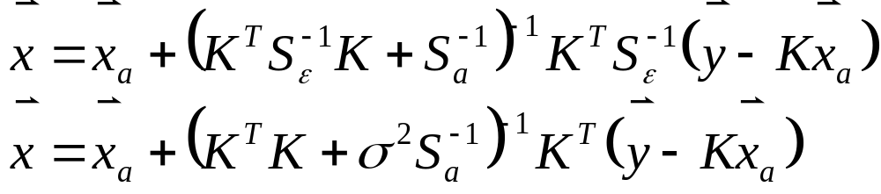
General outline of error estimation:
OE- Retrieval equation:
general
uncorrelated residual
Any error modifies the spectrum, thereby disturbs the retrieved quantities
Gain matrix G: sensitivity of retrieval wrt measurement error
(examples: noise, SZA, ILS, …)
Associated Covariance

Slide 3

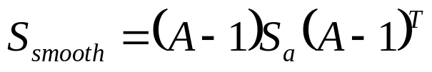
Smoothing error revisited
Retrieval does not preserve details of true atmospheric state.
However, the smoothing error is no ‘substantial’ error source: Any user of the data can calculate a smoothing error from data from reported x_{a} and A. (In some applications, the smoothing error cancels out anyway.)
In the following, only substantial error sources are treated which require an insider knowledge of the retrieval setup. (Or, alternatively, would require excessive reporting to allow for calculation by end user: gain matrix, derivatives, instrumental uncertainties, etc).

Slide 4
Error sources included in PROFFIT Ver. 93 (Ver. 95):
Error sources collected in groups to make error estimation handeable:
1: Baseline / continuum (offset, channeling)
2: ILS (linear modulation loss, constant phase error)
3: LOS
4: Solar lines (intensity, spectral scale)
5: T
6: Spectroscopy (intensity, γ)
7: Noise
Further details of the setup has been described in 2005 …

Slide 5
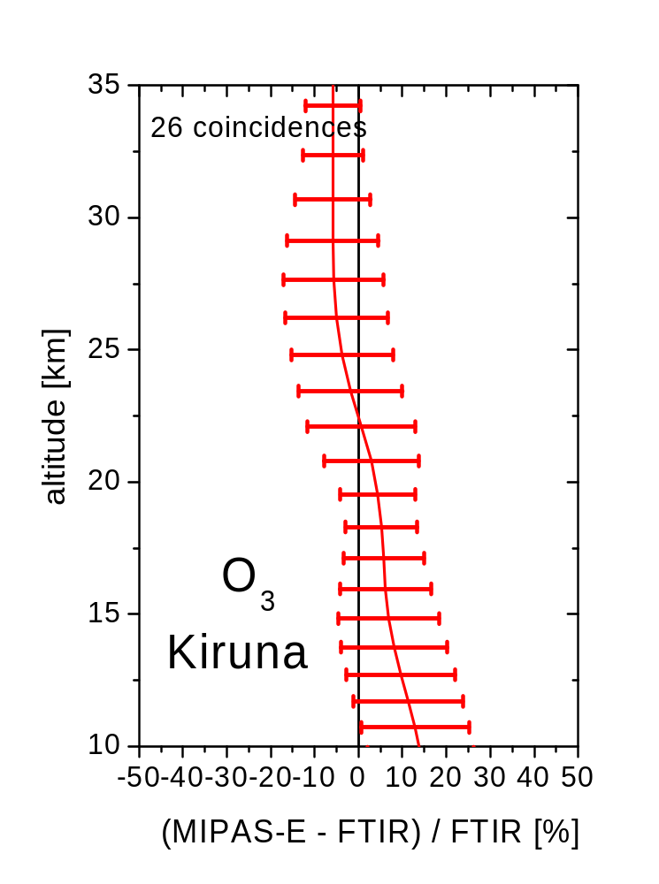
Statistical and systematic error contributions
Situation: Satellite data are to be validated
using gb profiles.
The differences found in each coincidence are
expected to be within the joint total error budget
of both instruments.
If the ensemble is large, the differences of the
means are expected to be within the systematic
error budgets.
Distinction of statistic and systematic contributions for each error source (e.g. SZA): either run error estimation twice or …

Slide 6
Discern statistical and systematic error contributions
New block in optional ‘errcalc9.inp‘ file:
********** error groups: statistical and systematic contributions
1: baseline (offset + channeling)
2: ILS
3: LOS
4: solar lines
5: T
6: spectroscopy
$
(0.5,0.5)
(0.5,0.5)
(0.9,0.1)
(0.8,0.2)
(0.7,0.3)
(0.0,1.0)

Slide 7
Altitude assignment error
The T-profile adopted in the retrieval affects the retrieved VMR-profile in two ways (imagine a layer bounded by p surfaces):
The T sensitivity of the spectral signatures, affects the retrieved VMR-profile in the layer.
Since we assume hydrostatic balance, the altitude assignment of the layer is changed.
It seems preferrable to split these both error contributions due to T:
Ascribe only the direct T error as VMR error bar.
The altitude assignment error remains separated and is treated as error of layer altitude.
An intercomparison can avoid the altitude assignment error if performed on a pressure grid.

Slide 8
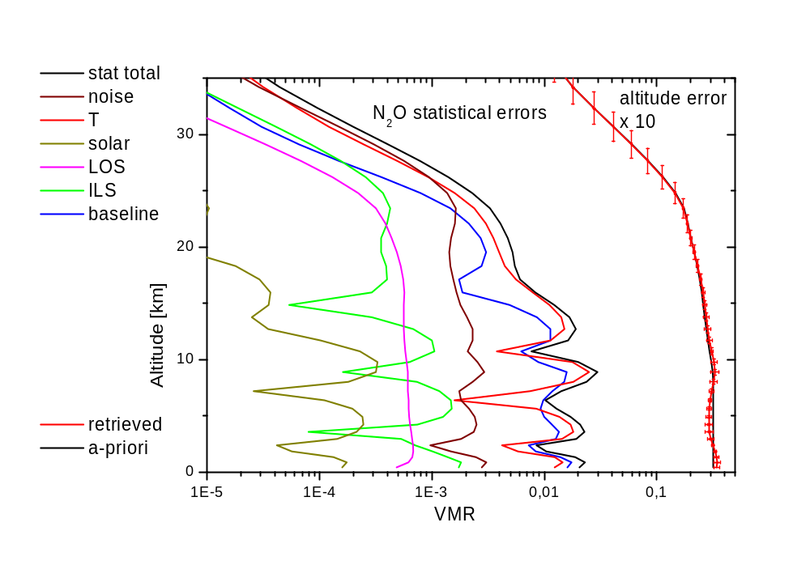
Example: N₂O (N2O_B)

Slide 9
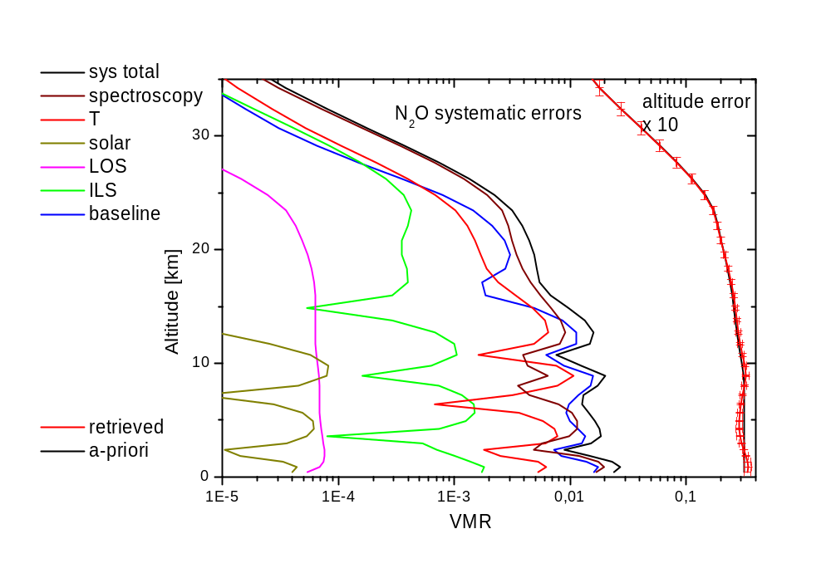
Example: N₂O (N2O_B)

Slide 10
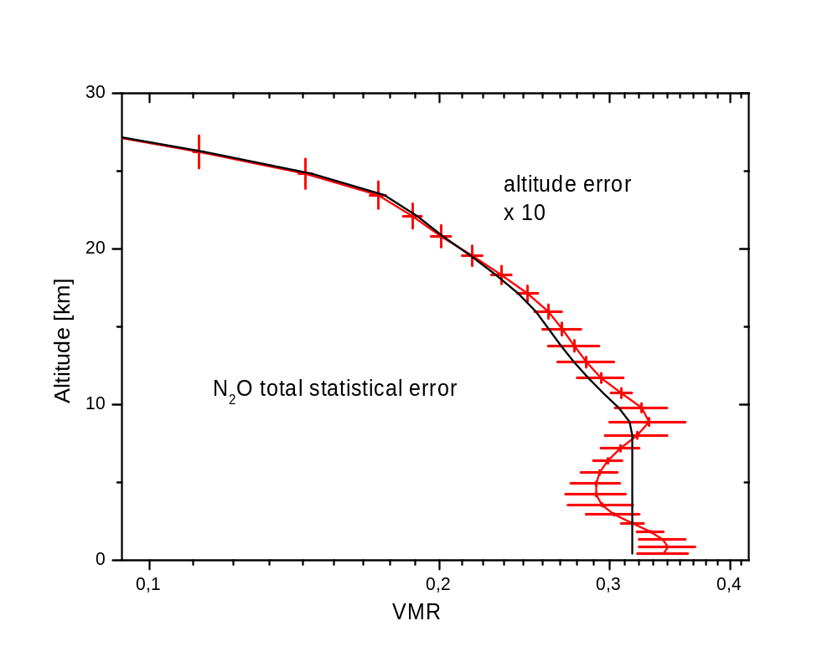
Example: N₂O (N2O_B)

Slide 11
Summary:
Some extension have been added to PROFFITs error estimation capabilities:
Improved description of spectroscopic error (include γ )
distinction between statistical and systematic error sources
explicit output of altitude assignment error

