Slide 1
Error estimation for profiles retrieved from ground-based solar absorption FTIR measurements: PROFFIT Ver 9.3
By F. Hase
Motivation: Value of NDSC FTIR measurements relies heavily on specification of the quality of data products (trends, validation, …).
Standard error estimation by current profile retrieval codes (SFIT2, PROFFIT9) is poor. Activities to improve the situation underway (S. Wood, error estimation working group), still neither a separate error calculation tool nor an extended error estimation option in the codes available. I try to sound the latter option: PROFFIT93

Slide 2
Central strategic decision: Error estimation option in the retrieval code EEO vs. separate tool ST
ST does not require any extensions in retrieval code
ST can include any error sources difficult to include into retrieval code architecture (e.g. pressure broadening, pressure shift, …)
ST can not start from the standard radiative transfer output + retrieval code output alone.
Powerful ST is considerably more complex than the retrieval tool itself.
ST requires own input, much overlap to original input. Interface??
ST updating along with the retrieval code (shared input, line mixing…).
Decision: Go for EEO, accept limited capability …

Slide 3
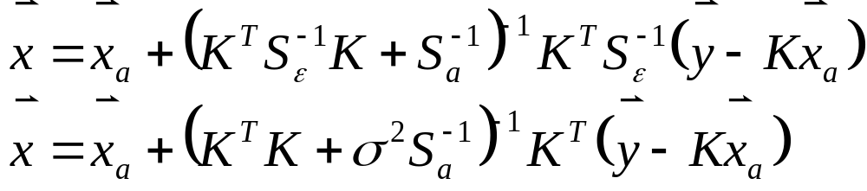
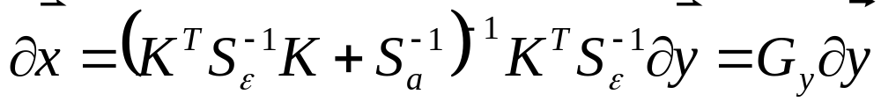
General outline of error estimation:
OE- Retrieval equation:
general
uncorrelated noise
Any error modifies the spectrum, thereby disturbs the retrieved quantity
Gain matrix G: sensitivity of retrieval wrt measurement error
(examples: noise, SZA, ILS, …)
Associated Covariance

Slide 4
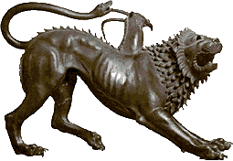


Smoothing error: A chimera?
Retrieval does not preserve details of true profile.
BUT: True state and observed state (best estimate of the true state) reside in different spaces! Any true state is projected into an observed state, but no way back…
Smoothing error abets a dangerous misconception: observed
state directly comparable with true state. Consequences:
… “smoothing error is large, no need to take further errors into account”
… direct comparison of “different” profiles (FTIR-in-situ, gb-satellite…)
… mixing incompatible assumptions on S_{a}
Decision: Smoothing error not included! (Note: x_{a} and A essential)

Slide 5
Error sources taken into account by PROFFIT v 93:
Offset in spectrum zero baseline
SZA
ILS (modulation + phase)
Tilt (for each MW)
Channeling (4 frequencies, cos + sin each)
Spectroscopic errors / interfering species (intensity error)
Temperature (concept of T-patterns)
Note: retrieval + reporting in altitude domain! – Hydrostatic equilibrium needs readjustment. Analytical handling difficult, therefore retrieval is repeated for each T-pattern. Expensive,
recalculation of absorption coeffs, but no T derivs required.

Slide 6
User interface:
PROFFIT switches to extended error mode if additional input file “errcalc.inp” is found in path. Required additional input given therein.
********** Target species for error calculation : #3
********** Channeling frequencies (4 frequencies, cm-1): 0.005 0.2 1.0 3.0
********** Assumed sds for: Offset (nW/(cm**2 sterad cm-1) LOS (rad) ILSmod (-) ILSphas (rad): 1500.0 0.0015 0.04 0.01
********** Assumed sds for Tilt per MW (cm): 0.005 0.005 0.005 0.001
********** Assumed sds channeling (cos + sin): 0.002 0.002 0.002 0.002 0.002 0.002 0.002 0.002
********** Assumed sds interfering species (-): 0.02 0.02 0.0 0.01 0.01 0.01 0.01 0.01
********** Number of T-patterns: 3
********** T-patterns (nlevels x nTpatterns)
… … …
************ Number of partial columns: 2
************ for each partial column: level contribution (nlevels x nPartialColumns)
… …

Slide 7
PROFFIT93 Output:
Jakobians for error parms (offset, LOS, ILS, channel, tilt, spectr.)
Individual error patterns for each parm (LOS: single pattern, channeling: 2 x NMWs x NChans, spectroscopy / interfering species NMWs x NSpezies, temperature NTpatt, …)
Full covariance due to all error parms (incl. noise covariance)
Error pattern groups: Gaussian summation of all patterns of the same kind (+ Grouping / Gaussian summation of different kinds of errors)
Final groups:
1: Zero baseline offset, LOS, ILS
2: Channeling + tilt
3: Spectroscopy / interfering species
4: All T-patterns
5: Noise
6: Sqrt(Diagonal) of full covariance
Full covariance for partial columns + sensitivities

Slide 8
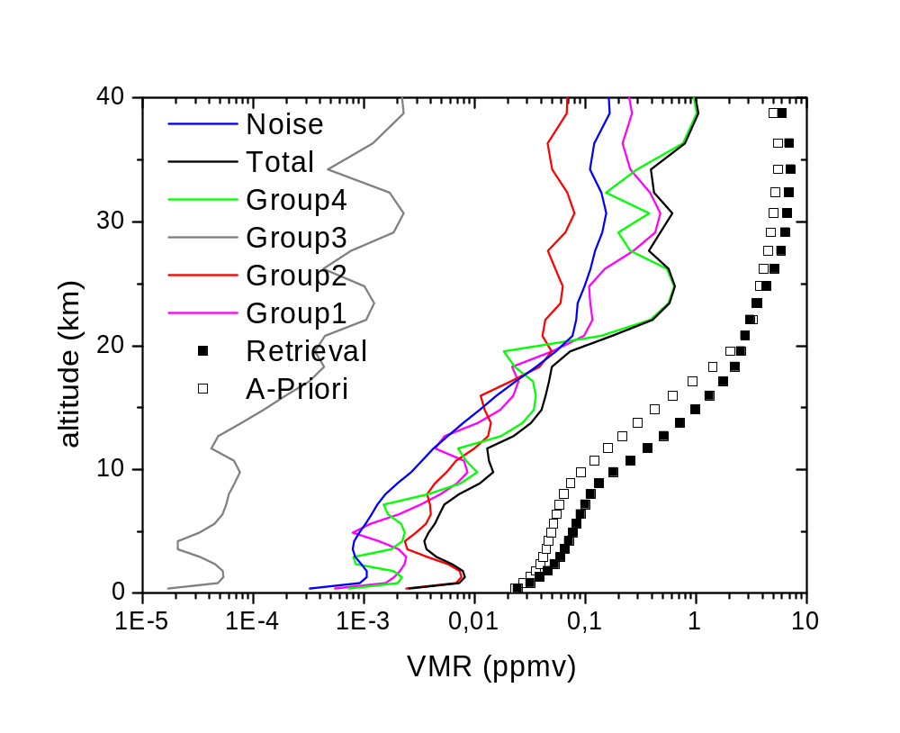
Results: O₃ UFTIR, main isotope

Slide 9
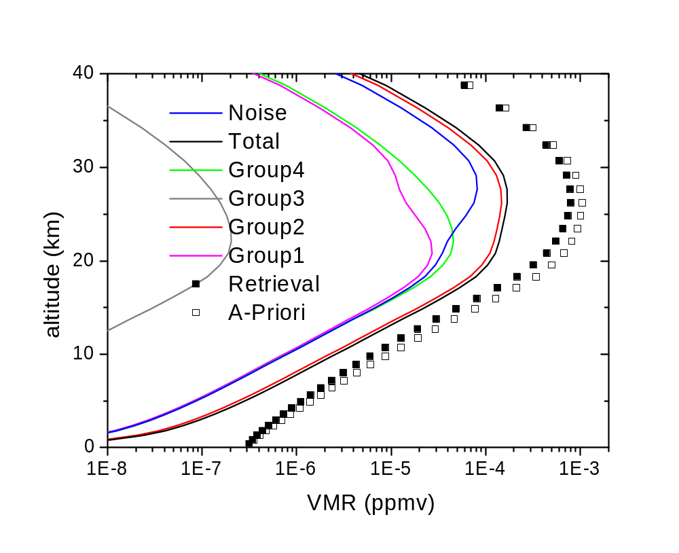
Results: ClONO₂

Slide 10
Estimation of errors due to interfering species
Problem: Error due to interfering species strongly underestimated!
Reason: Retrieval strategy minimises impact of interfering species on target, gain matrix maps spectral errors mainly on interfering species
But we aim at something else …
…residual spectral features due to interfering species affecting target
Solution: use modified gain matrix here, allow only fit of target species and aux parms (scale, tilt, shift, …)

Slide 11
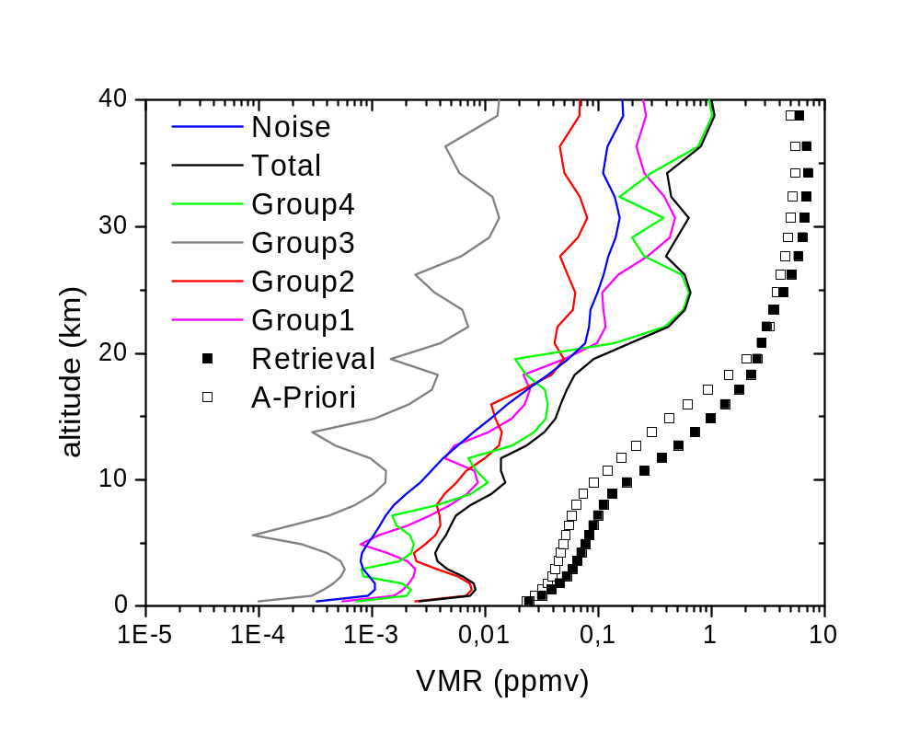
Results: O₃ UFTIR, main isotope

Slide 12

Results: ClONO₂

Slide 13
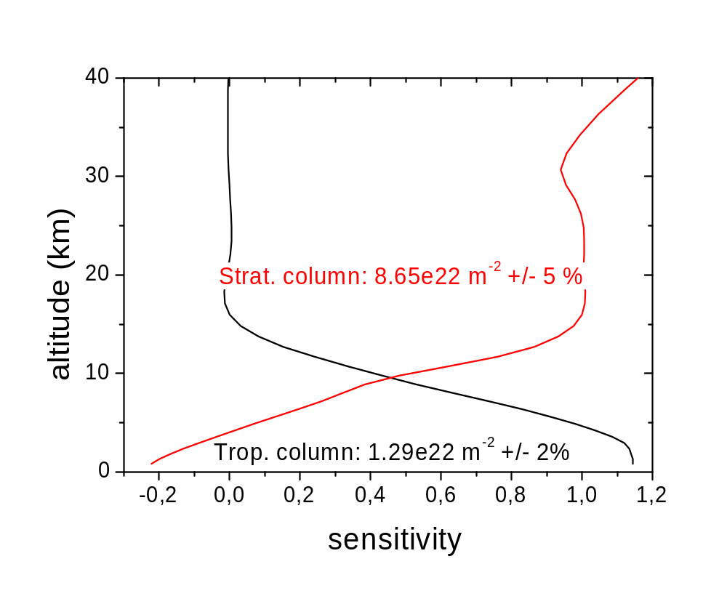
Results: O₃ UFTIR, main isotope

Slide 14
Summary:
Proffit Ver. 93 offers extended error calculation capabilities
Smoothing error not included (dangerous concept!)
Noise error typically not the leading error source
Offset, LOS, ILS, tilt, channeling: straightforward treatment
T error more complicated: perturbation method, pattern concept
Error due to interfering species: use of modified gain matrix
Rigorous determination of spectroscopic / interfering species errors impossible in EEO approach

Slide 15
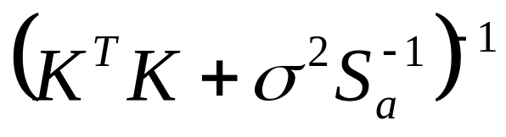
Note on Computational errors
Truncation error: can always be reduced to insignifcance …
Limited accuracy of matrix inversion (pointed out by A. Wiacek, UoT)
Ratio of largest to smallest eigenvalue can become quite large!

Slide 16
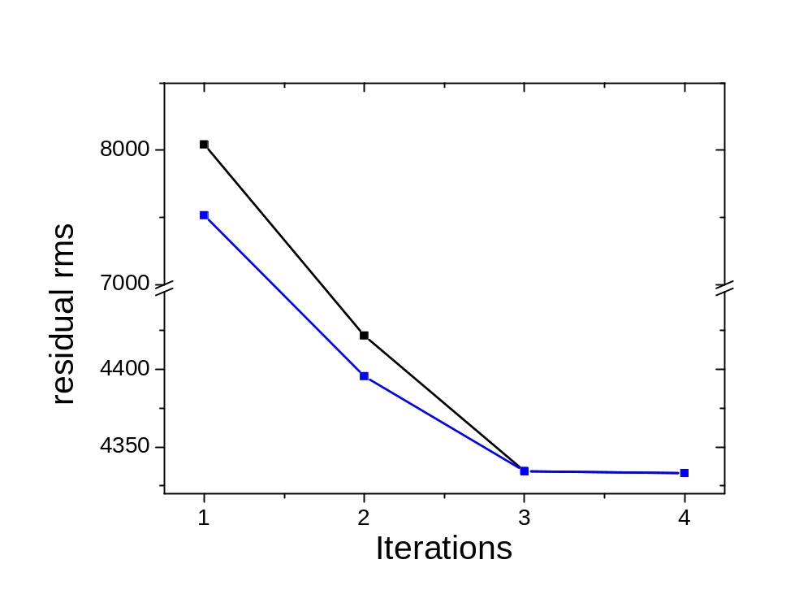
Truncation

Slide 17
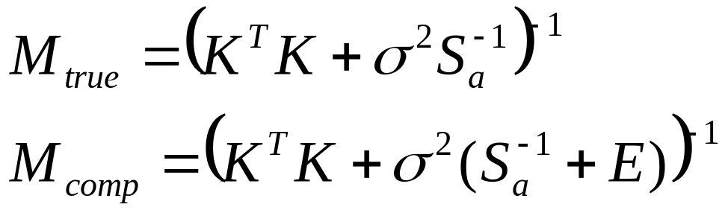
Computational error
Computed matrix equivalent to additional (unphysical) constraints. Results in coupling between independent components in state vector. Computed solution + averaging kernels refer to total constraint.
Problem might remain undetected if stable solution is still reached!

Slide 18
Simple test of computational accuracy
Test original total cost function! Does reduction of constraint still improve solution?
Most critical run found by Aldona in case of PROFFIT: UFTIR O₃ retrieval (148 elements in state vector!).

Slide 19
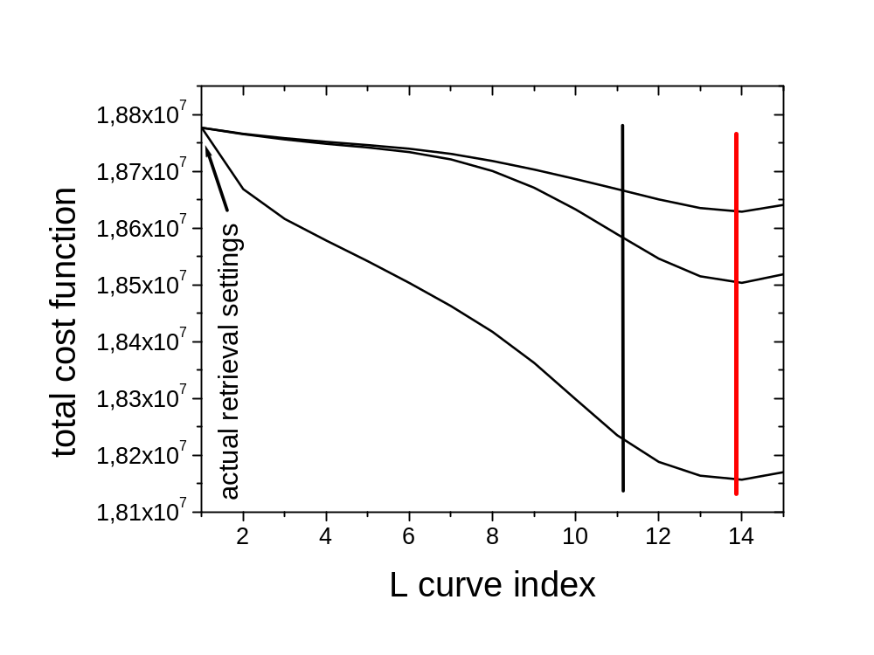
Simple test of computational accuracy
Result: PROFFIT resides well in stable region for UFTIR O₃ retrieval (constraint could be reduced by another factor 2^10…)

