Slide 1




SFit4 Updates for 2013
J Hannigan, M. Palm, N. Jones

Slide 2
Two foci of sfit4 Development
Flexibility – Exploratory analysis tool
S_{a} (S_{a}⁻¹) definition / direct input
Background parameters (slope, curvature, zero)
Shifts, by species, by fit
Channeling
SNR by region
Multiple regions / SZA
Fit gas by region
Phase, ME
Isotope separation
Solar background /shift
Levenberg-Marquardt non-linear iteration scheme
Emission spectra
Log(vmr) retrieval
Line mixing (co2, ch4 soon…)
SDV speed dependent Voigt lineshape
Spectra output by layer / gas
O2 CIA line data included
Process & I/O Speed – NDACC operational processing
Standard layering
Binary HITRAN input
Binary output for HDF ?

Slide 3
Sfit4 current version d0.9.2.1
log scaling of vmr by gas
include emission of atmosphere & source (moon)
analytic derivatives for vmrs
Levenberg-Marquardt iterative scheme
internal raytracing module
line mixing for CO2 (ch4…)
speed dependent Voigt (from C Boone)
tagged - variable input format
arbitrary SZA / µwindow / resolution
Spectral process code to support it
binary HITRAN input – end of cfgl files
Pre-raytrace isotope separation scheme
spectra-centric parameters in ascii spectra data file

Slide 4
required inputs
required output
sfit4.ctl
Retrieval specific params:
Region
Species
State vector
sit4.dtl (detail file)
Step-by-step of retrieval process
t15asc4
Spectrum specific params:
Date/Time
Solar zenith angle
N spectra
sfit4
raytracing
retrieval
stations.layers
Layering for each site
From WACCM
reference.prf
Z-p-T for reference profiles
Reference (apriori) chemical profiles
Binary (HITRAN) Line list file

Slide 5
auxiliary inputs
isotope separation data (new format)
instrument phase function
instrument modulation function
retrieval mixing ratio predefined covariance
retrieval mixing ratio predefined inverse covariance
solar line list

Slide 6
outputs
Output can be set to 3 levels of detail
Plus any given output file can be switched off or on
Any output file (other than sfit4.dtl – detail file) can be renamed
Many output files have been reformatted for easy read / write by batch scripts
All output files have version tag and timestamp
Direct binary or hdf output still planned

Slide 7
output files
See: docs/output_descrip_v4.docx
output level set to 1
Statevevctor file
Apriori profiles
Retrieved profiles
Final Calculated, observed and difference spectra
Fit summary
Averaging kernels
Complete Sa matrix
output level set to 2
K matrix
K_{b} matrix
AB matrix
Measurement error
Sa Inverse matrix
Se inverse matrix
Shat matrix
Retrieval-Calculated Smoothing error
Parameter array by iteration
Spectra by gas
output level set to 3
Channel spectra diagnostic
Raytracing diagnostics
Solar spectra calculation
L-M diagnostics
Cross-section diagnostics
gas spectra type
=1 final spectra by gas, and fit
=2 and by atmospheric level
raytrace type
=3 verbose output
=2 obsolete fastcode output

Slide 8
new HITRAN data input scheme
See: docs/hbin_descrip_v4.docx
Predefined directory structure:
Stand alone code hbin.f90 compiled with sfit4 is run before sfit4 call.
hbin* reads files:
sfit4.ctl
hbin.input
isotope.input
Hitran files directly
Writes file: lllll.dddddd-hhhhh.dddddd.hbin
Sorts all lines in wavenumber order, edits id numbers, separates isotopes, can choose gases and adds flags for:
CIA
line mixing parameters
Galatry parameters
SVD parameters
001_H2O:
01_hit08.par
01_hit08.zip
01_hit09.par
01.H2O
002_CO2:
02_hit08_f53.par
02_hit08_f53+LM.par
02_hit08.zip
02.CO2
co2_lm.dat
read_out_example.txt
.
.
.
hbin is run once for a specified retrieval

Slide 9
(slightly) new isotope separation input scheme
See: docs/isotope_descrip_v4.docx
Main differences:
Profile for new gas is now on pre-raytrace or ‘refmod’ grid
There are no default pre-separated species
You can add subsequent isotopes to the new species that will use the new profile eg.
H2O 1/4 -> HDO 80/1 (HD¹⁶O)
H2O 1/5 -> HDO 80/2 (HD¹⁸O)
H2O 1/6 -> HDO 80/3 (HD¹⁷))

Slide 10
(slightly) new ascii spectral data file
header for each block:
37.26100 6385.44500 40.03800 254.76000 402.3
2011 6 23 16 24 11
06/23/2011 16:24:11UT Z:37.261 A:284.29 D:0101.7 R:0.0035 P:BX F:01.9139mr
4881.8975000000000 4888.1025000000000 2.50000000000000005E-003 2483
0.315438E+00
0.293434E+00
0.285126E+00
0.271612E+00
0.240477E+00
.
.
.
KEY:
SZA° radius_of_earth [km] latitude [°N] longitude [°E] SNR
YYYY MM DD HH MM SS
arbitrary ascii comment, 80 characters
start_wn end_wn point_spacing Npoints
spectra values…
Any number of blocks are ok
All blocks with spectra within sfit4.ctl band limits will be fit
Spectra will be truncated to sfit4.ctl band limits

Slide 11
Calculated Kb
temperature
background
Slope
curvature
solar shift
solar line strength
phase
differential wavenumber shift
wavenumber shift
apodization function
phase function
zero level shift
solar zenith angle
field of view
optical path difference
hitran line parameters for retrieval or target gas
Strength
Pressure broadening
Broadening temperature depenence

Slide 12
Sample Retrieval O₂, O₂CIA & H₂0
Self & Foreign CIA lines use same O₂ profile
– Wollongong data

Slide 13
Example: HCl
2925 / 84.62 / 250cm
2925 / 83.11 / 250cm
2944 / 82.99 / 100cm
Single retrieval from 3 spectra with different SZA and resolutions.*
*all spectra from one µw must have same resolution & point spacing.

Slide 14
Work in progress
Retrieval of temperature profile from single CO₂ absorption feature
Line Mixing required for CCl₄
Only CO₂ so far

Slide 15
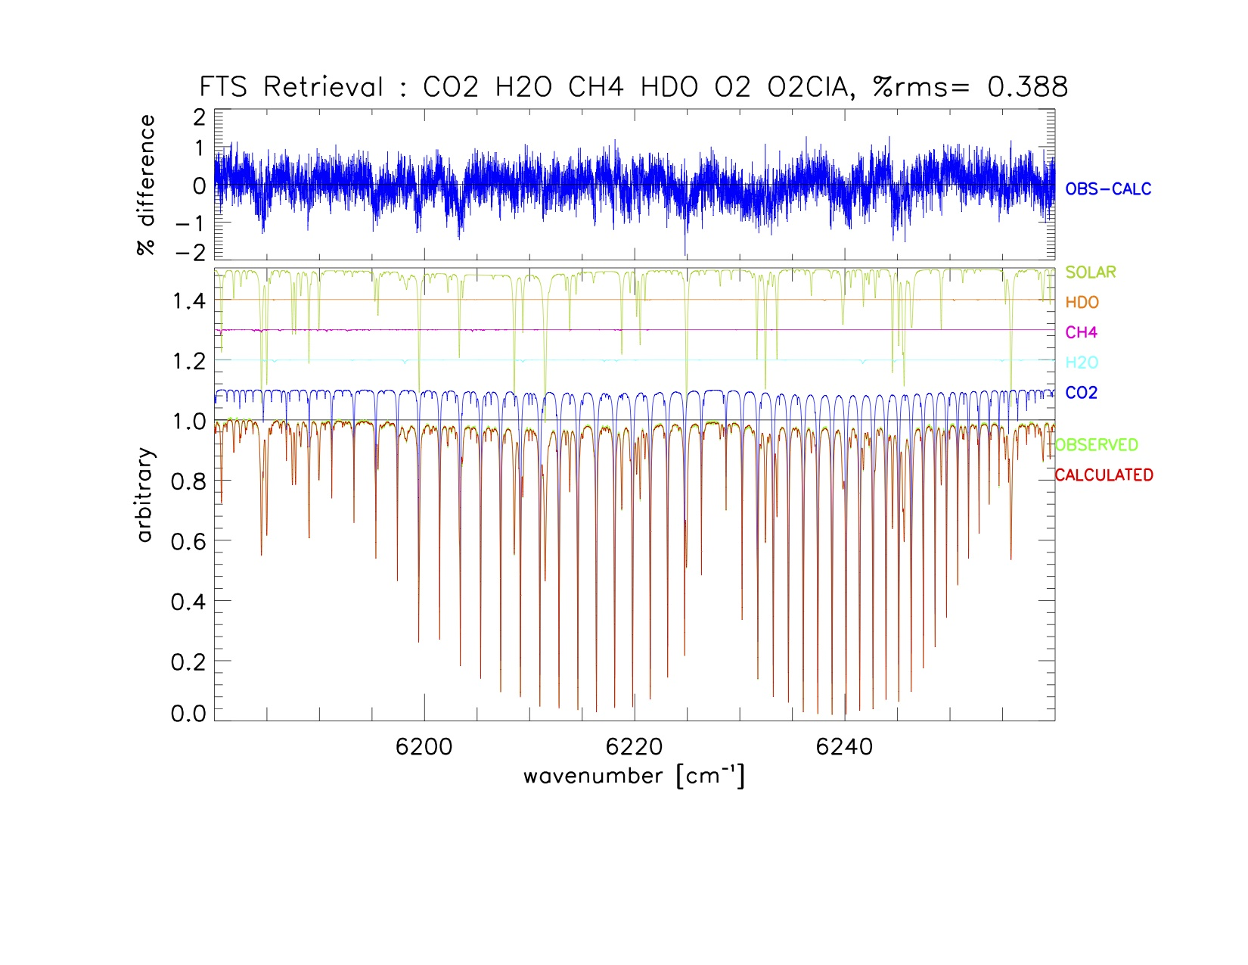
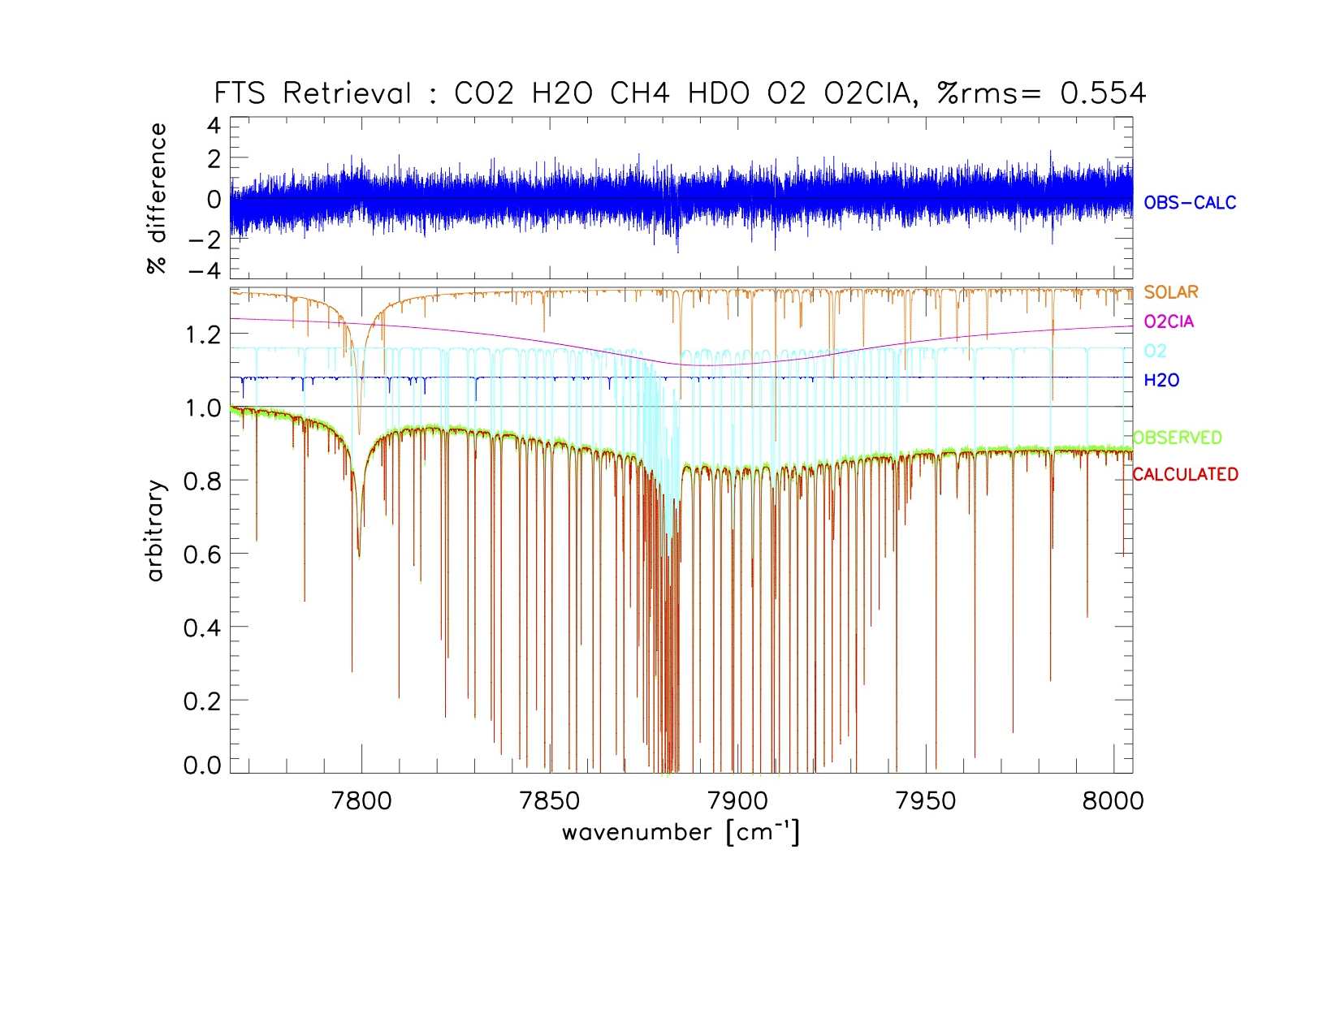
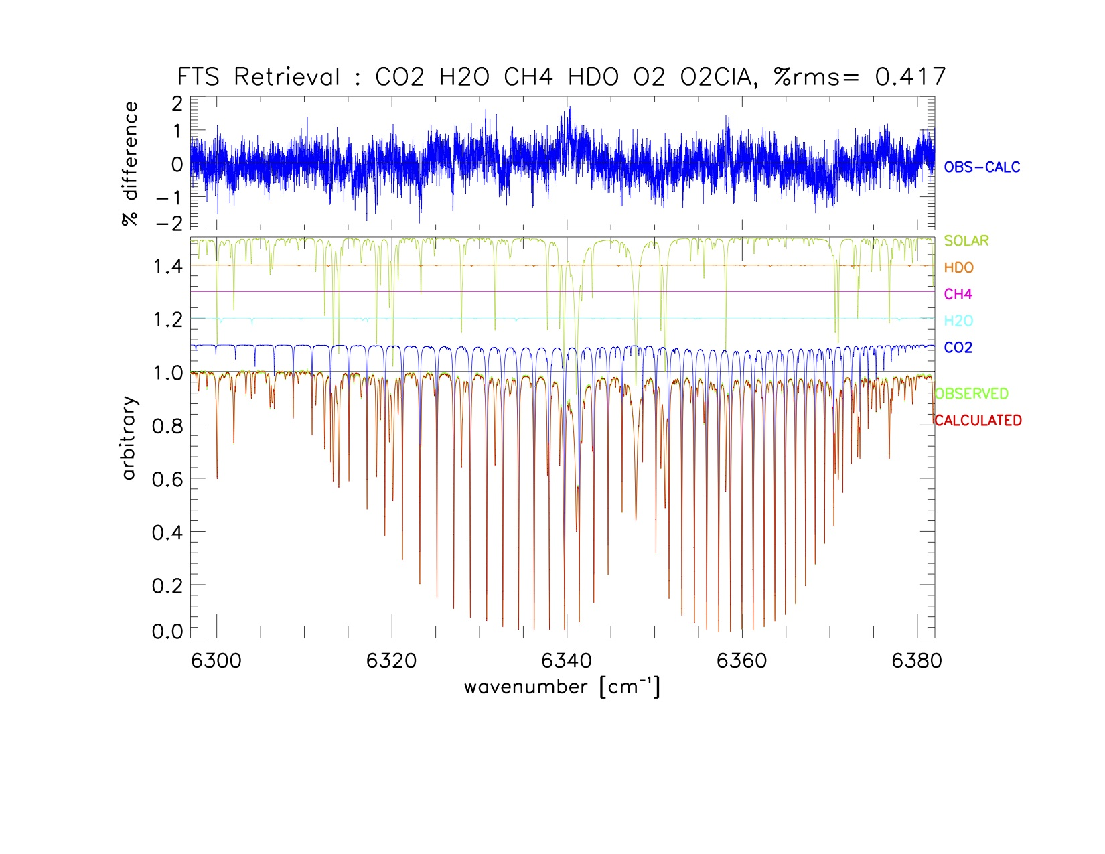
Simultaneous fit CO2, CO2 & O2
Bialystok, Poland

Slide 16
Status
Current version d0.9.2.1 with several testcases available :
ftp://acd.ucar.edu//user/jamesw/IRWG_NORS_EW/sfit4/delta
Input / output files & formats complete
Derivatives of several retrieval / model parameters calculated for error analysis (K_{b})
Temperature retrieval in process
Testing / bug fixes in process
Suite of testcases for IRWG windows in process
Python based spectral processing environment in process
A hot topic next week!
Some (but not complete) documentation available

Slide 17
end

Slide 18
Latest Release Version SFIT2 V3.94
SFIT2 v394 delivered Winter ’09
Primarily HITRAN 08 & molecular database
But also
Perturbation ability: Added flags to make small changes in
line intensity
Air broadened halfwidth
Use CH₃CH from H08 and previous pseudolines as CH₃CNPL
Bug fixes eg writing second Sa off diag elements
Intensity scaling in isotope substitution
Output Sa.complete, Parm.out, Prfs.out
Better use of matrix intrinsics
Lapack version available 3.94LP
Matrix inversion
direct output: AK & AK Eigenvectors, Smoothing error

Slide 19
Log scaling of Retrieval Gases
New flag in binput to switch on or off
vmr → ln(vmr)
Output (K-matrices and AVK) changed accordingly
Schneider and Hase (2009) for more information
Retrieval of ratio (e.g. HDO/H2O; Schneider et. al., 2006) only possible via extra SA matrix, not checked yet...
Schneider, M.; Hase, F. & Blumenstock, T. Ground-based remote sensing of HDO/H2O ratio profiles: introduction and validation of an innovative retrieval approach Atmos. Chem. Phys., 2006, 6, 4705-4722
Schneider, M. & Hase, F. Ground-based FTIR water vapour profile analyses Atmos. Meas. Tech., 2009, 2, 609 - 619
Emission modelling
New switch emission modelling off or on
Input Temperature of blackbody radiation at TOA
Switch: E – emission, M - for reflection of sunlight on moon)
Switch: Units Watt/(cm^-1 sr cmr^2)
Switch: - spectrum normalized

Slide 20
V 4.00 continued What do the changes mean?
More versatile, faster!
New inputs: binput, fastcode, t15asc
Some new coding for you
Ease for new users
Zypher2 future’s is unknown?
Support code
Preping spectra
Simple scripts for running – not quite batch processing
Users Meeting Planned

Slide 21
Levenberg-Marquardt Iteration Scheme
New flags in binput:
Switch: for Gauss-Newton iteration or Levenberg-Marquardt iteration-scheme
Value of start for gamma
Value for decrease of gamma if successful
Value for increase of gamma if not successful
Value to break off if cost does not decrease more than 0.5
Sample Output:
ITER= 8 RMS(%)= 0.0718869 NVAR=117 NFIT= 311
chi2_x = 9.7670E-01 cost for state vector
chi_2_y = 2.0671E+00 cost for spectrum
chi2 = 3.0438E+00 cost sum
chi2_old = 3.4307E+00 cost of last successful iteration
d chi_2 = 3.8689E-01 change in cost (decrease is positive)
gamma = 1.0e3 actual value of gamma
Chi_2_y is set up in a way, that it is 1 if the noise given (in binput) is the same as spectral noise and residual is perfect.

Slide 22
map of Input & output files … needs to be cleaned up
! --- SET DEFAULT FILENAMES
TFILE(08) = 'pbpfile'
! --- ISOTOPE SEPARATION FILE
TFILE(09) = 'isotope.input'
TFILE(15) = 't15asc'
TFILE(16) = 'detail'
! --- STATEVEC
TFILE(18) = 'statevec'
! --- SET MIXOUTPUT FILENAME AS STATE VECTOR FILENAME + .MXF
TFILE(17) = TRIM(TFILE(18))//'.mxf'
! --- SAVED SYNTHETIC SPECTRUM
TFILE(19) = 'synspec.out'
! --- SUMMARY
TFILE(20) = 'summary'
! --- SET PARTICAL COLUMN OUTPUT FILENAME AS STATE VECTOR FILENAME + .PRC
TFILE(22) = TRIM(TFILE(18))//'.prc'
! --- EMPIRICAL MODULATION FUNCTION
TFILE(23) = 'ils.dat'
! --- EMPIRICAL PHASE FUNCTION
TFILE(24) = 'ils.dat'
! --- CHANNEL OUTPUT
TFILE(30) = 'chnspec.data1'
TFILE(40) = 'chnspec.data2'
! --- SET SHORT FILENAME AS SUMMARY FILENAME + .ST
TFILE(31) = TRIM(TFILE(20))//'.st'
! --- DEFAULT FIRST RETRIEVAL GAS SA OUTPUT FILENAME
! --- OUTPUT DEPENDS ON NAME SA .NORM, .VMR, .PCOL
TFILE(61) = 'Sa.norm'
! --- DEFAULT SAINV INPUT FILENAME
TFILE(62) = 'Sainv.input'
! --- DEFAULT COMPLETE SA OUTPUT FILENAME
TFILE(63) = 'Sa.complete'
! --- DEFAULT K,SE,SA MATRICES OUTPUT FILENAME
TFILE(66) = 'K.out'
! --- SE OUTPUT
TFILE(67) = 'Se.out'
! --- DEFAULT K TRANSPOSED FILENAME
TFILE(68) = 'KT.out'
! --- LEVENBERG-MARQUARDT DETAILS
TFILE(70) = 'detail.opt'
! --- LAYERING SCHEME - OUTPUT FROM WACCM PROFILES
TFILE(71) = 'station.layers'
! --- REFERENCE VMR PROFILES
TFILE(72) = 'reference.prf'
! --- RAYTRACE DETAILED OUTPUT AKA TAPE6
TFILE(73) = 'raytrace.out'
TFILE(74) = 'raytrace.pt'
TFILE(75) = 'raytrace.ms'
TFILE(76) = 'raytrace.mix'
TFILE(77) = 'raytrace.sa'
TFILE(78) = 'raytrace.pnch'
! --- RESERVED FOR GASOUT NAME CHANGES - SEE FRWDMDL.F90
!TFILE(80)
TFILE(81) = 'AK.out'
TFILE(82) = 'SM.out'
TFILE(83) = 'SS.out'
TFILE(84) = 'A-S.out'
TFILE(85) = 'AEIGEN.out'
TFILE(88) = 'PRFS.out'
TFILE(89) = 'Parm.out'
TFILE(91) = 'Spec.out’

Slide 23
# General
file.stalayers = station.layers
file.refprofile = reference.prf
file.spectrum = t15asc.4
file.eap_dat = ils.dat
file.ephs_dat = ils.dat
file.sa_matrix = sa.input
file.isotope = isotope.input
file.solarlines = ..//linelist/solar/120621/solar.dat
file.linelist = ./02723.690800-02930.039200.hbin
# Definition for retrieval gases
gas.layers = 47
gas = HCL CH4 O3 HDO N2O NO2
gas.HCL.ifoff = 1
gas.HCL.zwid = 3.000
gas.HCL.zmin = 0.225
gas.HCL.zmax = 120.000
gas.HCL.logstate = F
gas.HCL.ifprf = T
gas.HCL.sigma =
0.62398 0.33613 0.33382 0.22898 0.14726
0.14435 0.14265 0.14204 0.14226 0.14383
0.14538 0.14531 0.14490 0.14430 0.14320
0.14272 0.14354 0.14652 0.15191 0.15851
0.16395 0.16691 0.17080 0.17993 0.19615
0.21887 0.24784 0.27969 0.30479 0.32309
0.34501 0.37861 0.42903 0.50225 0.58601
0.62527 0.61862 0.63071 0.73872 0.92782
1.08104 1.19786 1.28879 1.35951 1.42124
1.46301 1.48165
gas.CH4.ifprf = F
gas.CH4.sigma =
1.00000 1.00000
# Forward model parameters
fw.delnu = 0.10000
fw.lshapemodel = 0
fw.linemixing = T
fw.linemixing.gas = CO2
fw.solar = T
fw.solar.shift = 0.00000
fw.ifps = F
fw.ieap = 4
fw.neap = 0
fw.iephs = 4
fw.nephs = 0
fw.emission = F
fw.ifiso = T
fw.write_k = T
fw.write_gasfiles = T
fw.write_gasfiles.type = 1
(Very new) sfit4.ctl
General I/O files
Retrieval Gases
Forward Model Parameters

Slide 24
# Retrieval parameter
rt = T
rt.write_sa = F
rt.lm = F
rt.lm.gamma_start = 100000.
rt.lm.gamma_dec = 10.0
rt.lm.gamma_inc = 10.0
rt.convergence = 0.1
rt.tolerance = 0.05
rt.max_iteration = 15
rt.wshift = 2
rt.wshift.apriori = 0.000
rt.wshift.sa = 0.100
rt.slope = T
rt.slope.apriori = 0.000
rt.slope.sa = 0.100
rt.solar = T
rt.solar.apriori = 1.000
rt.solar.sa = 0.500
rt.ifdiff = T
rt.temperature = F
rt.raytonly = F
# Microwindows and their parameters
band = 1 2
band.1.nu_start = 2727.730
band.1.nu_stop = 2727.830
band.1.zshift = 0
band.1.zshift.apriori = 0.000
band.1.zshift.sa = 0.200
band.1.beam = 0
band.1.dn = 0.800E-03
band.1.wavfac = 1.000
band.1.pmax = 257.143
band.1.omega = 2.273
band.1.iap = 0
band.1.snr = 200.000
band.1.gasb = HCL O3 HDO
band.2.nu_start = 2775.700
band.2.nu_stop = 2775.800
band.2.zshift = 0
band.2.zshift.apriori = 0.000
band.2.zshift.sa = 0.200
band.2.beam = 0
band.2.dn = 0.800E-03
band.2.wavfac = 1.000
band.2.pmax = 257.143
band.2.omega = 2.273
band.2.iap = 0
band.2.snr = 200.000
band.2.gasb = HCL O3 N2O
# Retrieval parameter
rt = T
rt.write_sa = F
rt.lm = F
rt.lm.gamma_start = 100000.
rt.lm.gamma_dec = 10.0
rt.lm.gamma_inc = 10.0
rt.convergence = 0.1
rt.tolerance = 0.05
rt.max_iteration = 15
rt.wshift = 2
rt.wshift.apriori = 0.000
rt.wshift.sa = 0.100
rt.slope = T
rt.slope.apriori = 0.000
rt.slope.sa = 0.100
rt.solar = T
rt.solar.apriori = 1.000
rt.solar.sa = 0.500
rt.ifdiff = T
rt.temperature = F
rt.raytonly = F
# Microwindows and their parameters
band = 1 2
band.1.nu_start = 2727.730
band.1.nu_stop = 2727.830
band.1.zshift = 0
band.1.zshift.apriori = 0.000
band.1.zshift.sa = 0.200
band.1.beam = 0
band.1.dn = 0.800E-03
band.1.wavfac = 1.000
band.1.pmax = 257.143
band.1.omega = 2.273
band.1.iap = 0
band.1.snr = 200.000
band.1.gasb = HCL O3 HDO
band.2.nu_start = 2775.700
band.2.nu_stop = 2775.800
band.2.zshift = 0
band.2.zshift.apriori = 0.000
band.2.zshift.sa = 0.200
band.2.beam = 0
band.2.dn = 0.800E-03
band.2.wavfac = 1.000
band.2.pmax = 257.143
band.2.omega = 2.273
band.2.iap = 0
band.2.snr = 200.000
band.2.gasb = HCL O3 N2O
Retrieval parameters
Band Parameters

