Slide 1
Migration Notes from the Reasoner API v0.8.0 to v0.9.0 and to 0.9.1
Updated 2019-03-08

Slide 2
State of v0.8.0 in 2 slides

Slide 3
0.8.0
id
query_type_id
query_type_id
datetime
terms {}
response_code
terms {}
Query
options
message
original_question
n_results
restated_question
query_plan []
reasoner_id
Response
schema_version
page_size
tool_version
page_number
Result
table_column_names
max_results
result_list []
asynchronous
Result
id
essence
bypass_cache
Result
description
reasoner_ids []
result_type
original_question
row_data []
restated_question
confidence
result_graph {}
message
score
score_name
reasoner_id
score_direction
result_group
result_group_similarity_score

Slide 4
0.8.0
Node
id
name
type
Node_attribute
value
Node
name
type
Node_attribute
description
url
Result
Node
uri
Node_attribute
node_list []
symbol
node_attributes []
result_graph {}
Edge
source_id
target_id
name
Edge_attribute
value
Edge
type
relation
type
edge_list []
Edge_attribute
negated
url
Edge
qualifiers
Edge_attribute
confidence
provided_by
attribute_list []
is_defined_by
publications
evidence_type

Slide 5
Status 2019-03-08 for v0.9.0 and v0.9.1 in 5 slides
The proposed v0.9.0 and v0.9.1 now includes components of the proposed “knowledge map scheme”:
https://github.com/NCATS-Gamma/TranslatorInterchangeAPI-Specification/blob/master/translator_interchange.yaml
https://docs.google.com/presentation/d/1N1n1zOAx1FJRem97momH1_Pmxz9Z-54udfDgj99IRNE/edit
although some parts have been reorganized a bit to fit better into the layout of the previous standard.
This new design attempts to preserve much of the design of v0.8.0 so that a reasoners can test/migrate to the new
concepts of the “knowledge map scheme” gradually while still supporting v0.9.0

Slide 6
0.9.1
page_size
page_number
Query
max_results
asynchronous
bypass_cache
reasoner_ids []
query_message {}
Message
previous_message_processing_plan {}
previous_message_uris []
previous_messages []
PreviousMessageProcessingPlan
processing_actions []
Message
options {}
Message
green box is a JSON key
required key
red text is notable change
blue box is a YAML class invisible in the JSON

Slide 7
0.9.1
context
query_type_id
terms {}
type
id
original_question
datetime
restated_question
message_code
query_options {}
code_description
n_results
Message
reasoner_id
query_graph {}
schema_version
tool_version
table_column_names
B
knowledge_graph {}
oneOf or
url
Result
results []
credentials {}
username
Result
password
cleartext passwords?
Result

Slide 8
0.9.1
QNode
node_id
n00
curie
QNode
type
nodes []
is_set
True/false
New in v0.9.1
QueryGraph
QNode
edge_id
e00
edges []
QEdge
source_id
target_id
QEdge
type
relation
QEdge
negated

Slide 9
0.9.1
id
essence
A
Answer types:
A – Simple values and types
B – Tabular result
C – Full graph result
D – Knowledge map result
essence_type
A
description
result_type
row_data []
B
Result
result_graph {}
C
Same as knowledge_graph (but can be limited to just ids)
knowledge_map []
D
Lookup table (dict) that maps QueryGraph entities to KnowledgeGraph entities
confidence
score
n00
QNode.node_id
Node.id
MONDO:123
score_name
n01
QNode.node_id
Node.id
[ UP:1, UP:8, … ]
score_direction
e00
QEdge.edge_id
Edge.id
320
n02
QNode.node_id
Node.id
MONDO:456
reasoner_id
e01
QEdge.edge_id
Edge.id
837
result_group
result_group_similarity_score
May now be
a scalar
or a list
New in v0.9.1

Slide 10
0.9.1
Node
id
name
type []
Node_attribute
value
Node
name
type
Node_attribute
description
url
Node
uri
Node_attribute
nodes []
symbol
node_attributes []
KnowledgeGraph
id
320
Edge
source_id
name
target_id
Edge_attribute
value
Edge
type
type
edges []
Edge_attribute
relation
url
Edge
negated
Edge_attribute
provided_by
qualifiers
is_defined_by
confidence
defined_datetime
edge_attributes []
evidence_type
publications []

Slide 11
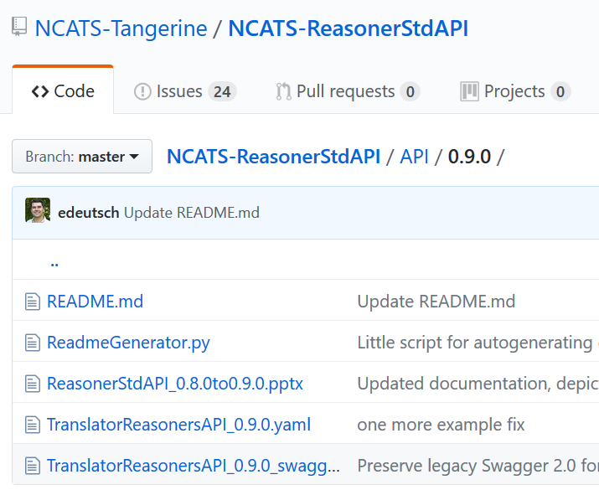
Implementation notes
The main TranslatorReasonersAPI.yaml file is now OpenAPI 3.0.1 formatting
The secondary TranslatorReasonersAPI_swagger2.0.yaml remains on the Swagger 2.0 formatting
The Swagger 2.0 formatting is retained for now since some tools do not support OpenAPI 3.0.1 yet
Swagger-codegen 2.4.x series supports Python-flask and Swagger 2.0, but not OpenAPI 3.0.1
Swagger-codegen 3.0.x series supports OpenAPI 3.0.1, but not Python-flask (yet)
There is a fork of Swagger-codegen 2.4.x series that does support OpenAPI 3.0.01 but seems buggy
RTX is currently using Swagger-codegen 2.4.x and TranslatorReasonersAPI_0.9.0.yaml
Robokop is using flasgger, which apparently does support OpenAPI 3.0.1?

