Slide 1
OMOPomics Day3 update
Nick Giangreco, Andrew Clugtson,
Alex Francette, Anish Chakka, Yash Gokhale

Slide 2
OMOPomics
Observational Health Data Sciences and Informatics (OHDSI, pronounced as Odyssey) is a collaborative effort to bring out the value of health data through large-scale analytics.
OHDSI network formats patient data in OMOP for evidence-based medicine.
Omics data in OMOP is called OMOPomics.
Experiments interoperability
Time course
Treatment vs control
Different assays, disease, perturbations, collection times
OMOPomics
Data Sharing
Database creation with data files pointers
Integration with additional data sources
Integration with patient clinical data for precision medicine
Reproducible analysis
Fetch data with specified queries
Exact covariate extraction

Slide 3









Flowchart
2. Encode data into OMOP formatted tables
1. Collect and extract data
3. Initialize SQL database of OMOP tables
5. Pass file paths to personalized, automated analysis/imaging pipeline
4. Perform SQL queries that output file paths to relevant cohort data
Icons obtained from flaticon.com by authors Wanicon, Freepik, Nhor phai

Slide 4
PERSON_TABLE
PROVIDER_TABLE
SPECIMEN_TABLE
Column | Name
person_id | 100001
gender_concept_id | 8507
person_source_value | Donor1
gender_source_value | male
Column | Name
provider_id | P100001
provider_source_value | GEO
provider_type_source_value | GSE60682
person_id | 100001
Column | Name
specimen_id | S1
specimen_source_value | GSE60682
specimen_type_source_value | CD4+ T cells
person_id | 100001
CONDITION_OCCURENCE_TABLE
ASSAY_OCCURENCE_TABLE
Column | Name
person_id | 100005
condition_occurence_id | C100005
condition_type_value | cutaneous T cell leukemia (CTCL)
Column | Name
assay_occurrence_id | A1
specimen_source_value | GSE60682
assay_start_date | 4:00:00
assay_source_value | ATAC
assay_type_source_value | Sequencing
specimen_id | S1
ASSAY_PARAMETERS_TABLE
Column | Name
specimen_id | S1
assay_parameters_id | AP1
reference_source_value | Homo sapiens
reference_genome_value | hg19
PERTURBATION_TABLE
Column | Name
specimen_id | S1
perturbation_id | Z1
perturbation_source_value | ionomycin
perturbation_type_source_value | activation
perturbation_start_date | 2:00:00
perturbation_dose_value_as_number | 1
perturbation_dose_unit | ug/mL
ASSAY_OCCURRENCE_DATA _TABLE
Column | Name
assay_occurrence_data_id | AD1
file_source_value | /pylon5/brz3a1p/codeathon/Chroma_T-Cell/Data/GSE60682/GSM1484802_Donor1_TCA4hrs_Rep1.bed.gz
specimen_id | S1

Slide 5
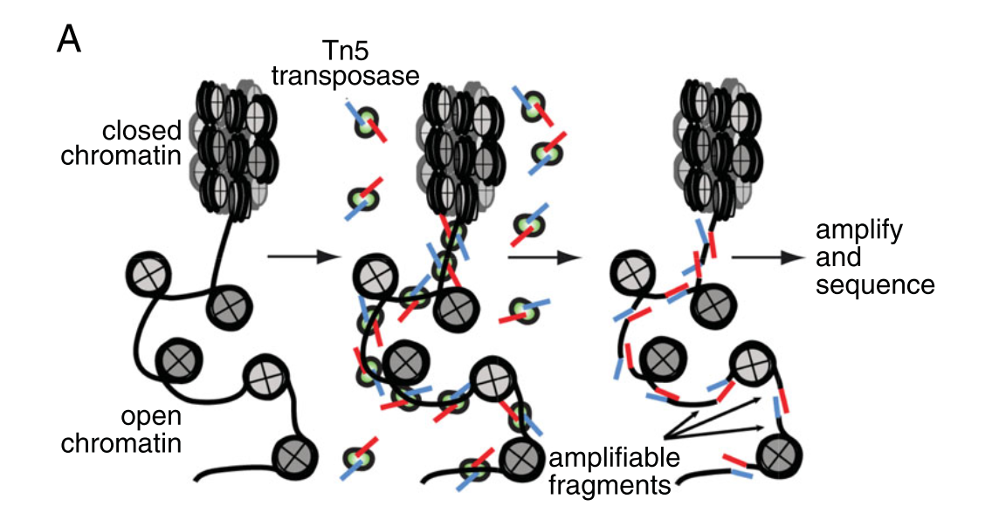
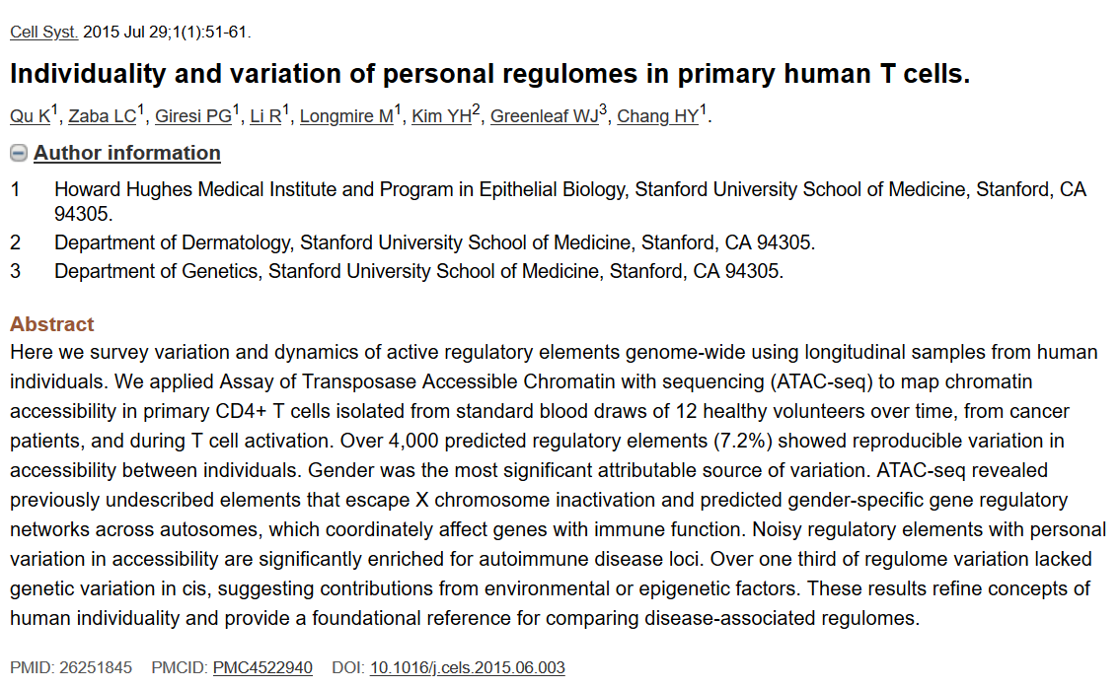
Usage example: ATAC-seq analysis I
ATAC-seq measures accessible chromatin, reflects epigenomic changes.
What epigenomic changes take place following T-cell activation?
(Buenrostro, Wu, Chang, & Greenleaf, 2015)

Slide 6
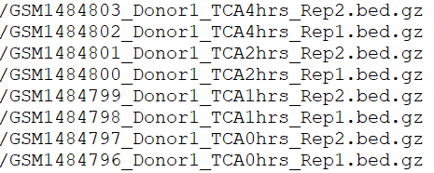
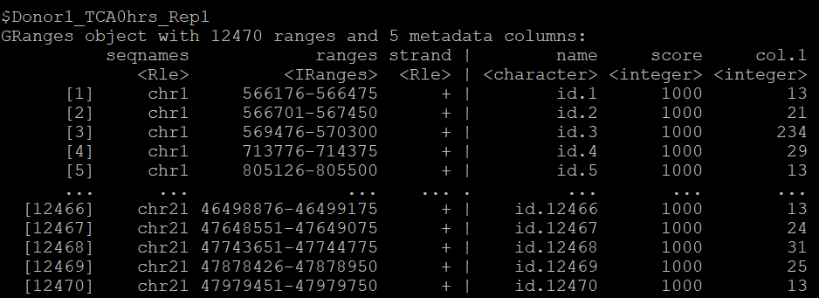
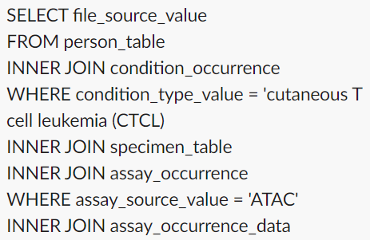
Usage example: ATAC-seq analysis II
Use search query to pull accessibility time course files measured at 0, 1, 2, and 4 hours post activation.
Read peak regions and counts into R.
Analyze epigenomic profiles.
OMOP

Slide 7
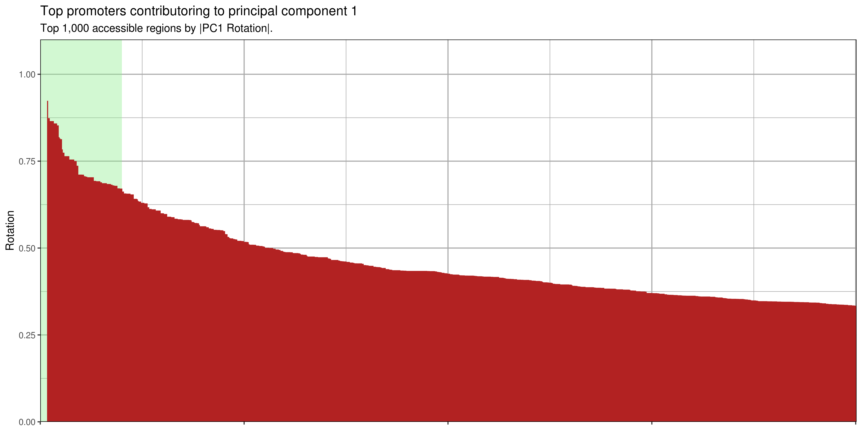
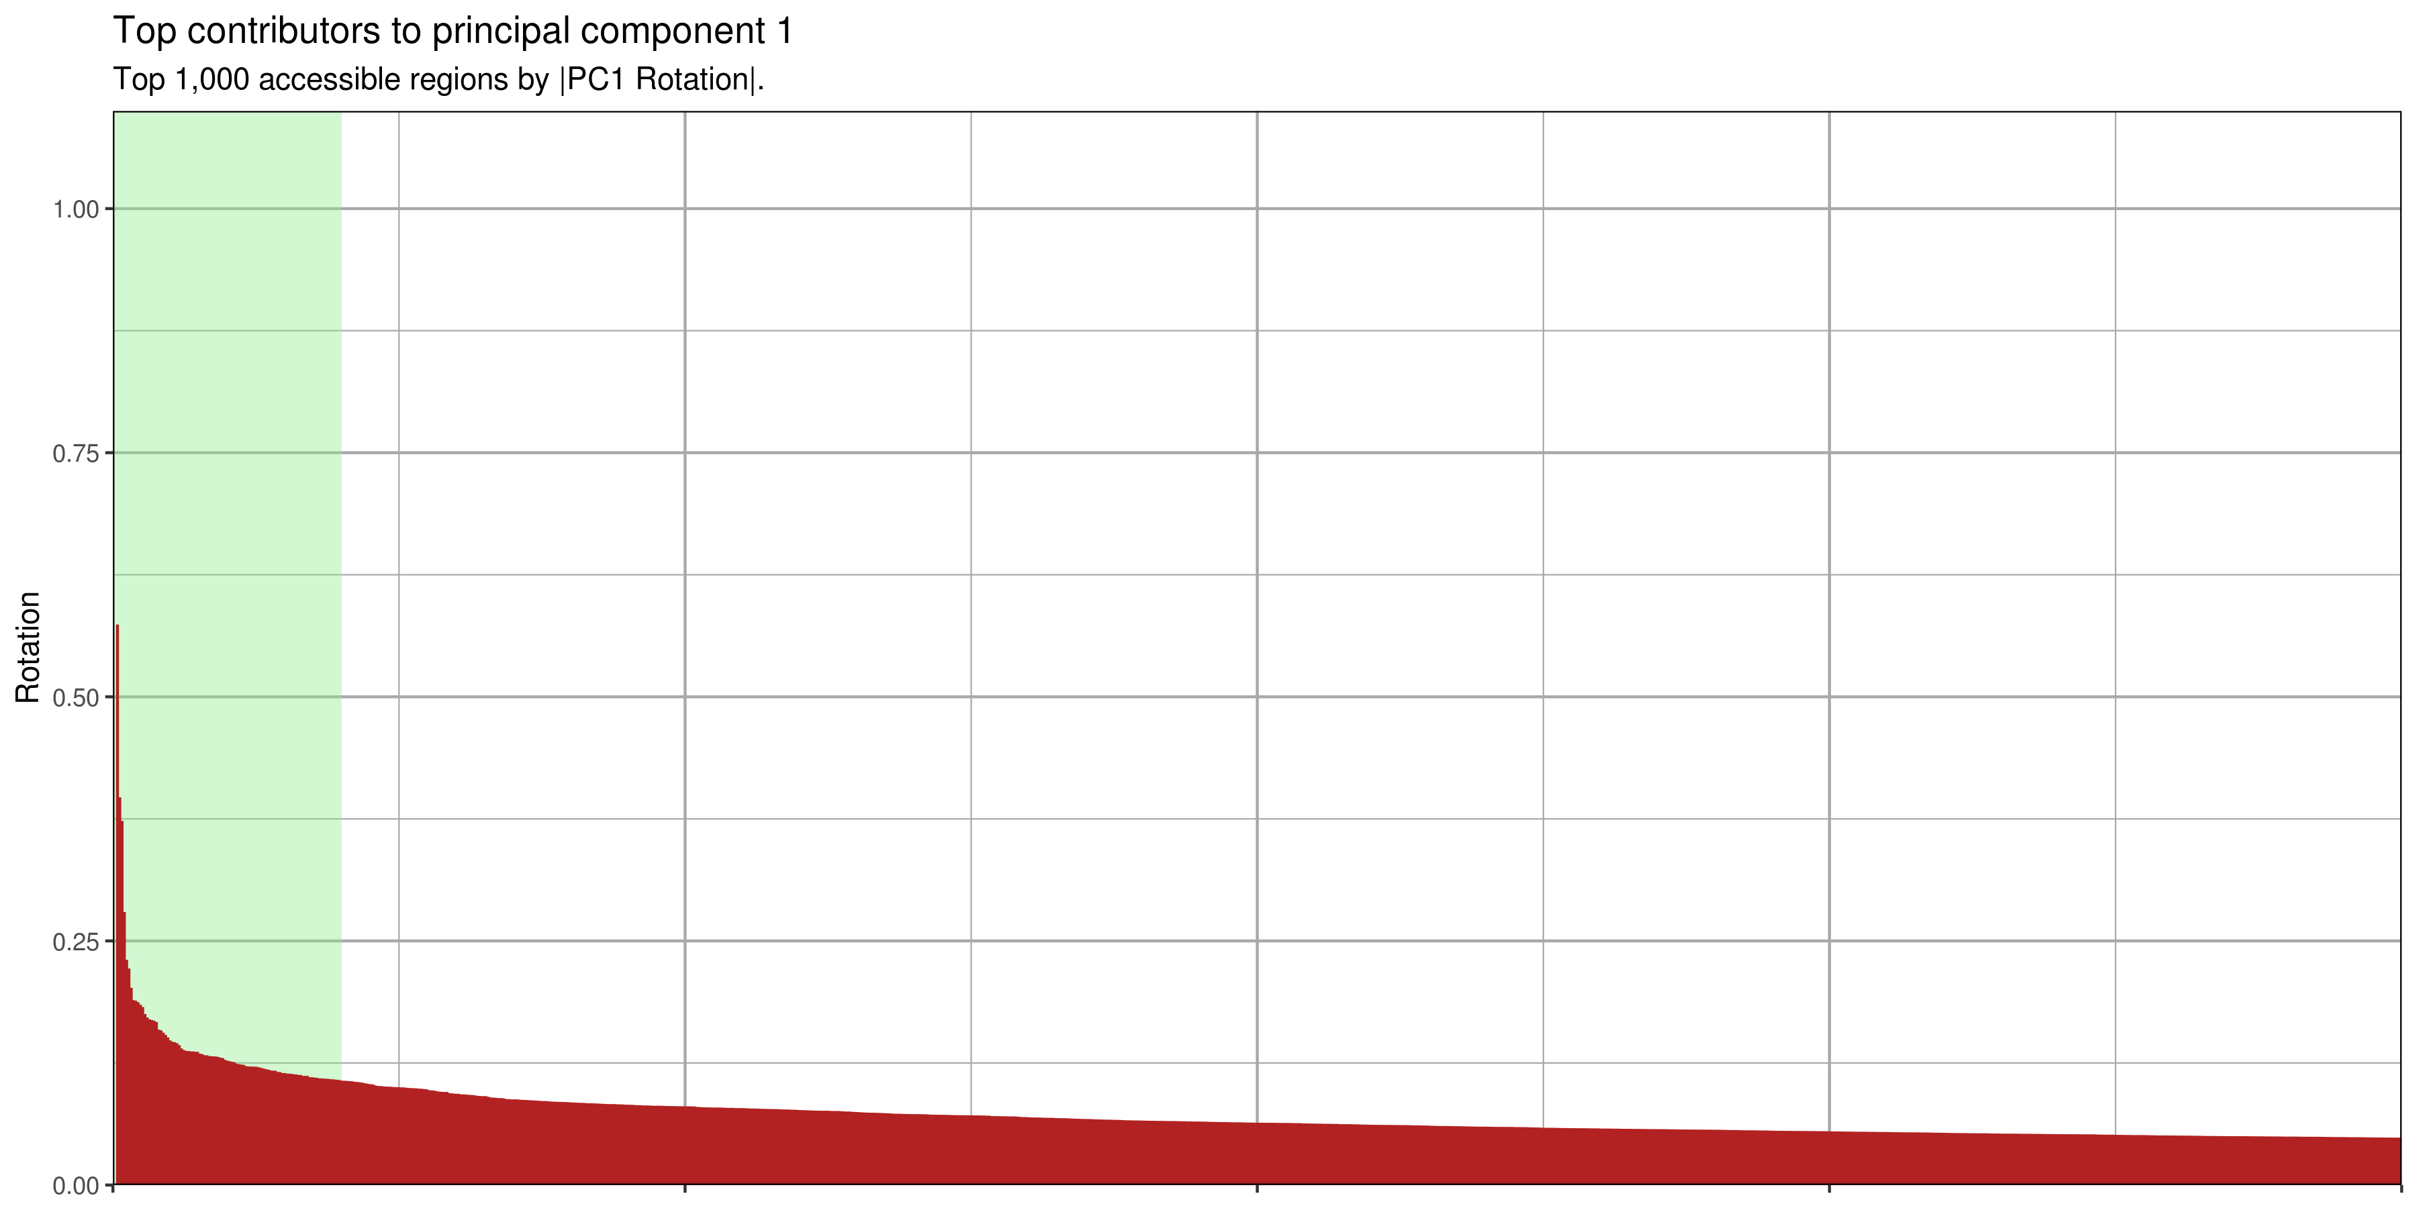
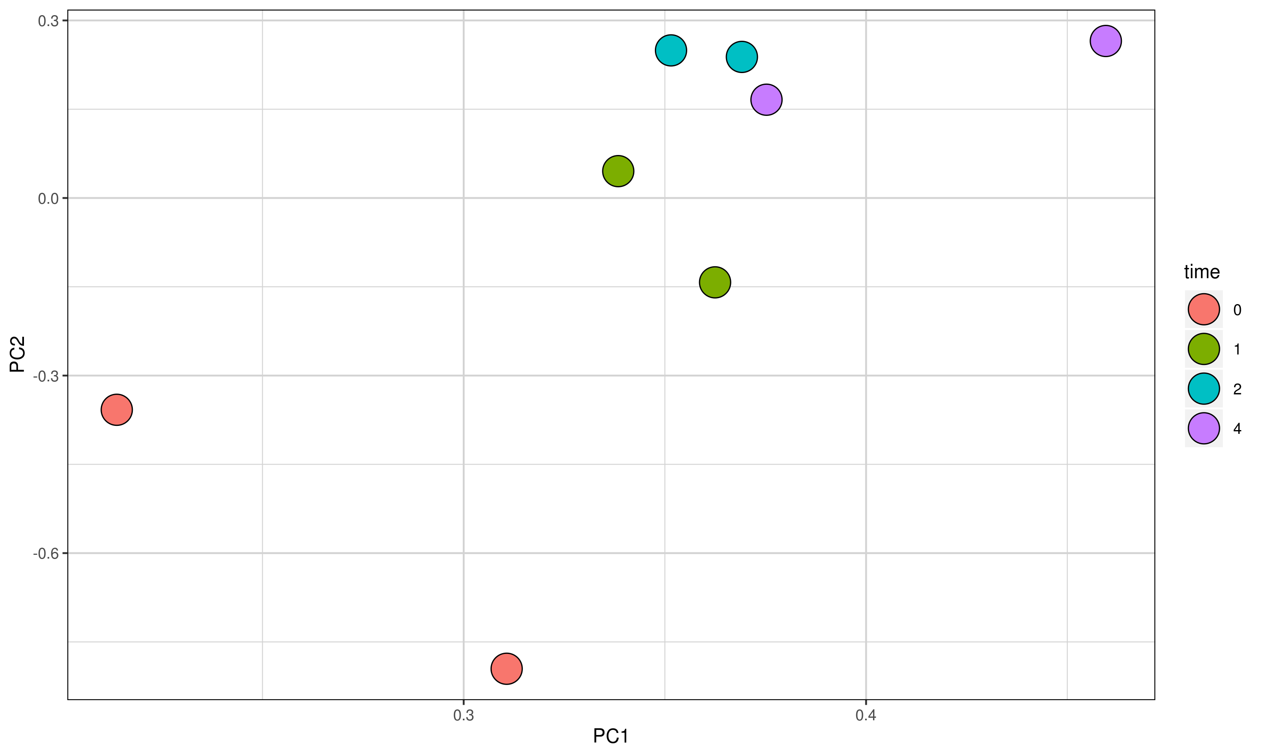
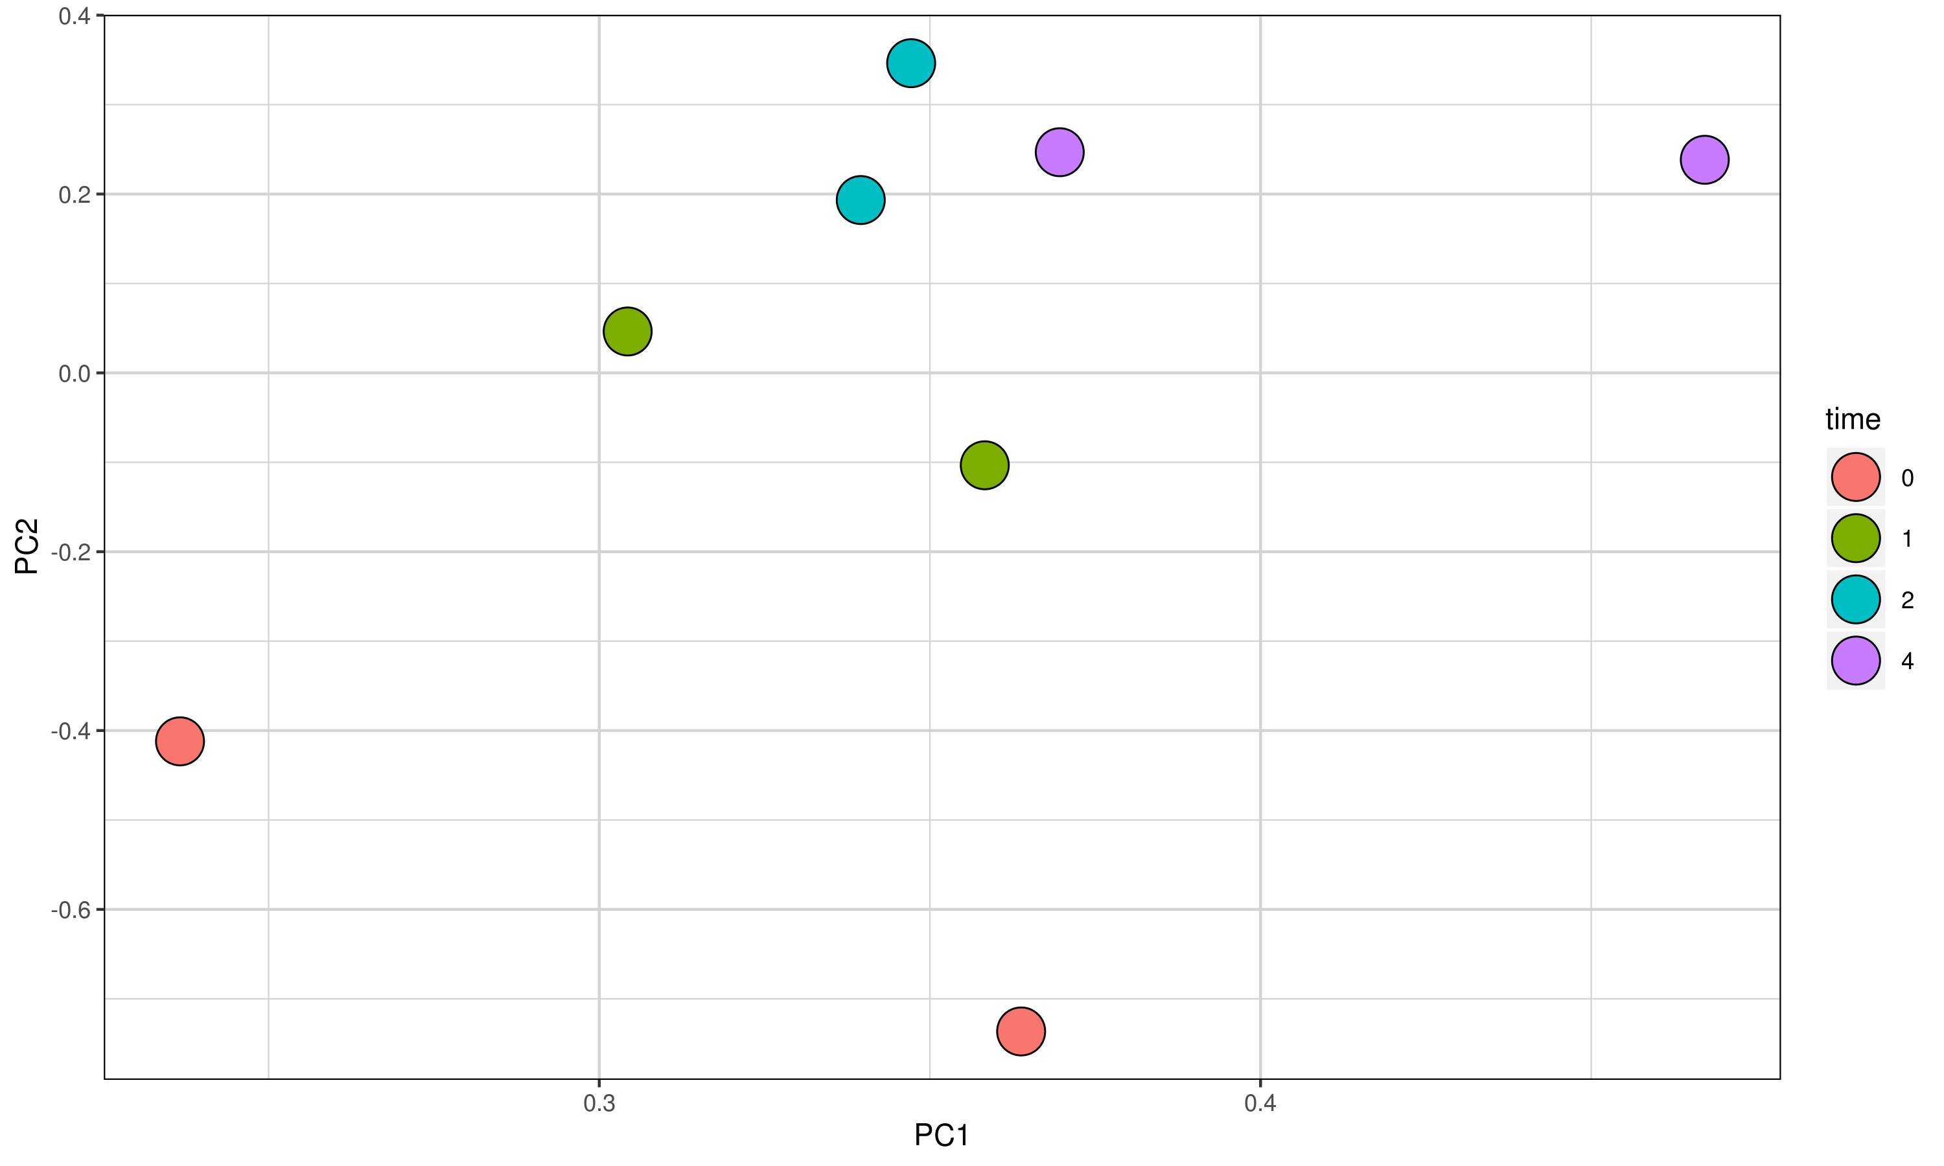
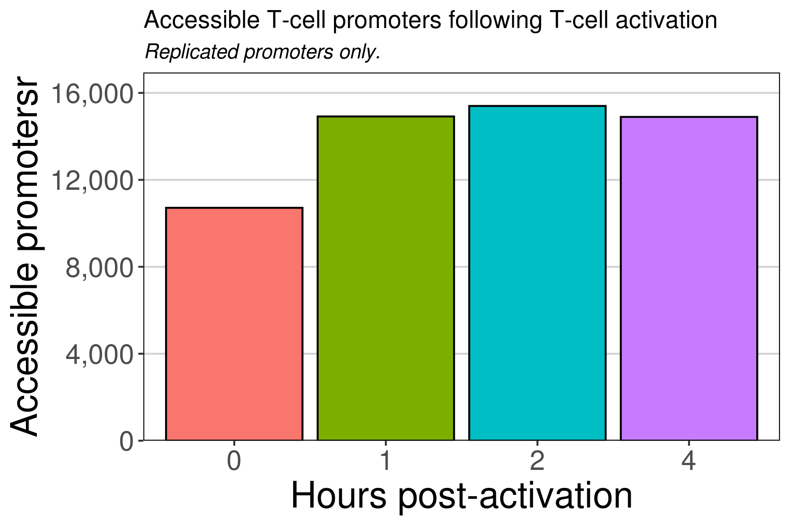
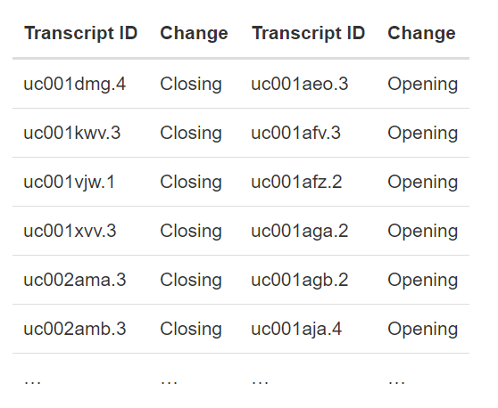
Usage example: ATAC-seq analysis III
How many accessible regions are found in each sample?
What transcript promoters open/close?
How similar is the epigenomic profile between samples?
…Promoters only?
Which genomic regions drive PC1?
…Promoters only?
Etc.

Slide 8
Main Conclusions
Extended existing clinical data infrastructure to promote interoperable and reproducible data storage/analysis of biological data
Promoted integration of patient clinical and molecular data
Enumerated experimental processing to improve understanding and downstream analysis

Slide 9
OMOPomics post-codeathon
Communicating through Slack channel and GitHub issues
Contacting OHDSI project manager (Maura)
Reserve presentation on weekly conference call
On the look out for OHDSI 2020 conference call-for-papers
Posting OMOPomics on OHDSI forum for feedback and collaborations
Open Science Foundation project created for OMOPomics
Writing manuscript in Google documents
Adding data from other projects
Data from SVAI?
GTEx?
TCGA?

