Slide 1
OMOPOmics
Day 2 update
Nick Giangreco, Andrew Clugtson, Alex Francette, Anish Chakka, Yash Gokhale

Slide 2
An OMOP extension for patient molecular data
OMOP is a standardized infrastructure for promoting reproducible analysis
Data are encoded as concepts with source values
Data are related with primary and foreign keys
Data tables are encoded in a (SQL) database
Data are extracted with reproducible (SQL) queries
Cohort data are input to custom analysis pipelines

Slide 3
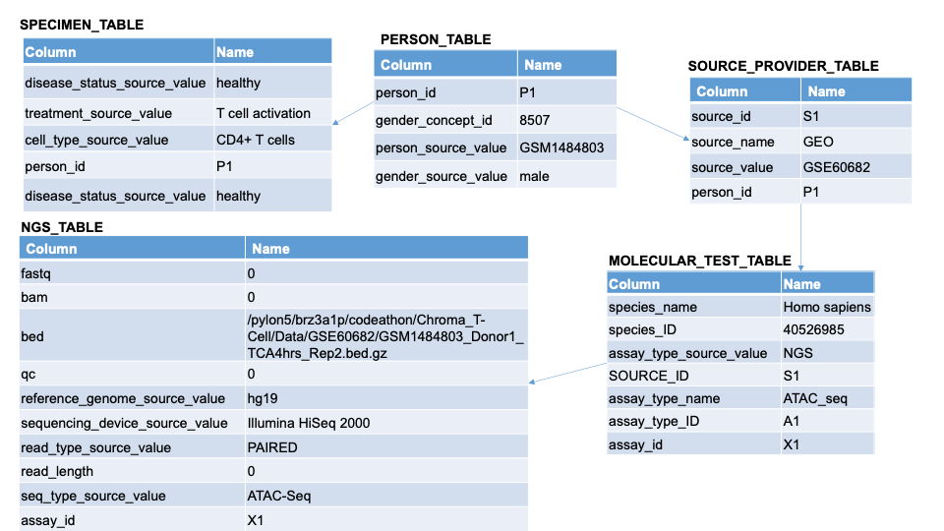
Other updates
Created OSF project (still private for now) for OMOPOmics
We want to use your data so please work with us!

Slide 4
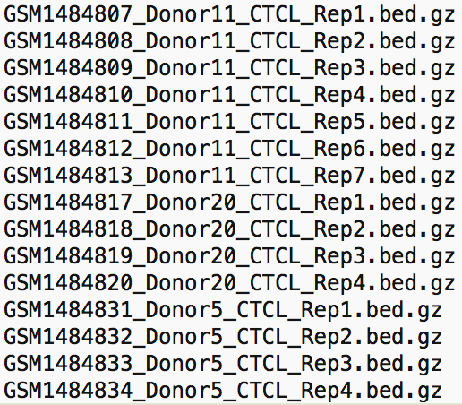
Reproducible queries for cohort data creation
Generate .txt file w/ list of matching file paths
Query:
Select file_path
From file where
disease == CTCL
Assay == ATAC-seq
Pass file paths into automated
Analysis script

Slide 5
Analysis of cohort data by custom pipelines

