Slide 1
Smart insole to monitor patient body weight and activities
Team 3
Erin Butler, Pegah Merdasi, Sanjay Ananthanarayan, Bharani Nammi, Guanglin Tang

Slide 2
Introduction
Clinical matters
Monitor body weight
25% of 60,000 cancer patients revisit hospital after treatment each year.
Monitor physical activities for healthy life
Conventional solutions
Depends on patient self report
Informational solutions
Automatic monitor
More reliable
Reduce patients’ stress

Slide 3
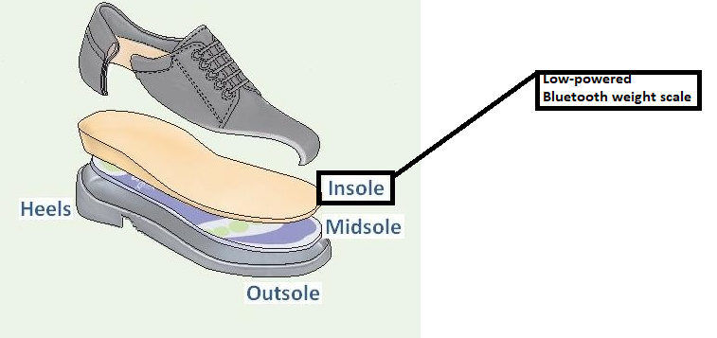
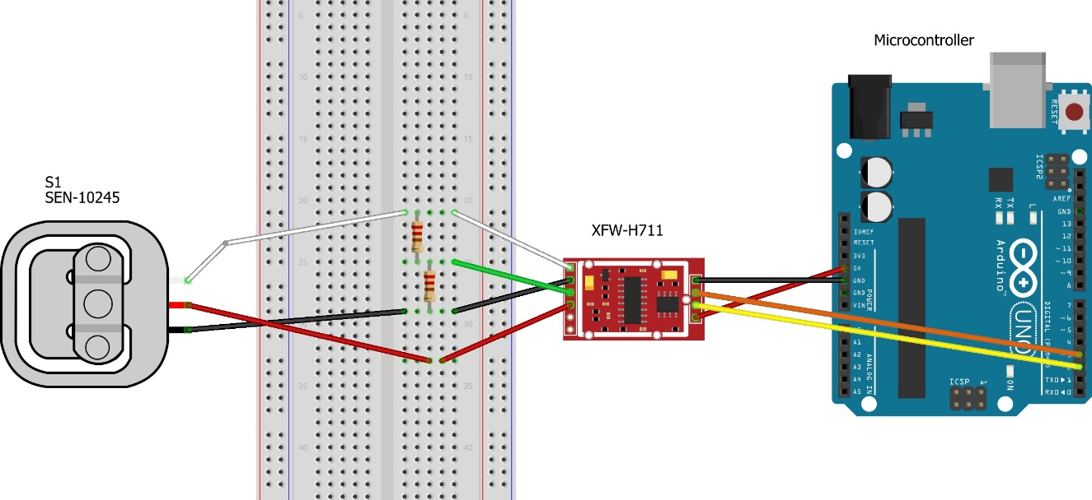
Prototype
Simulated weight scale

Slide 4

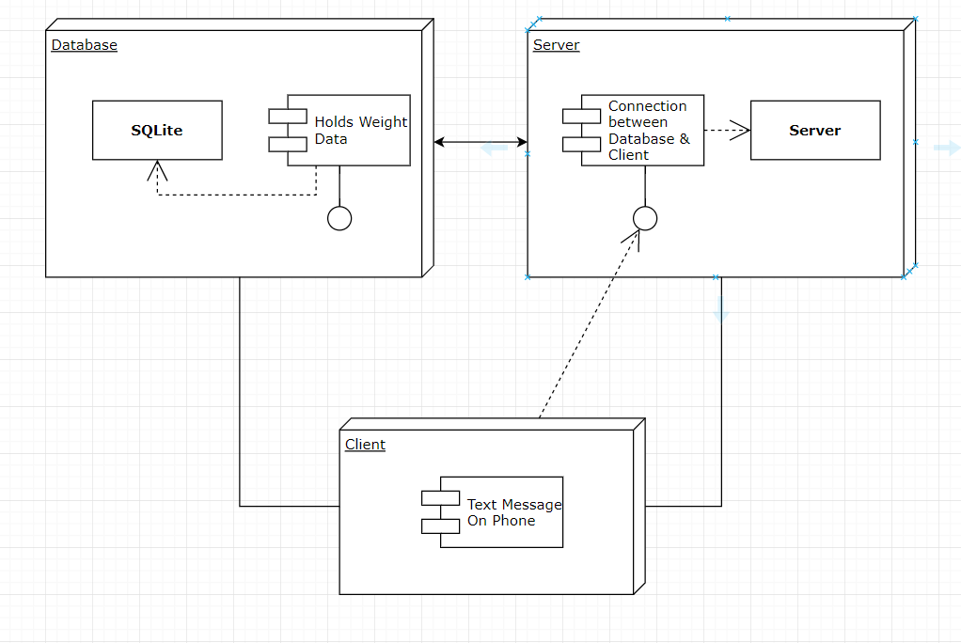
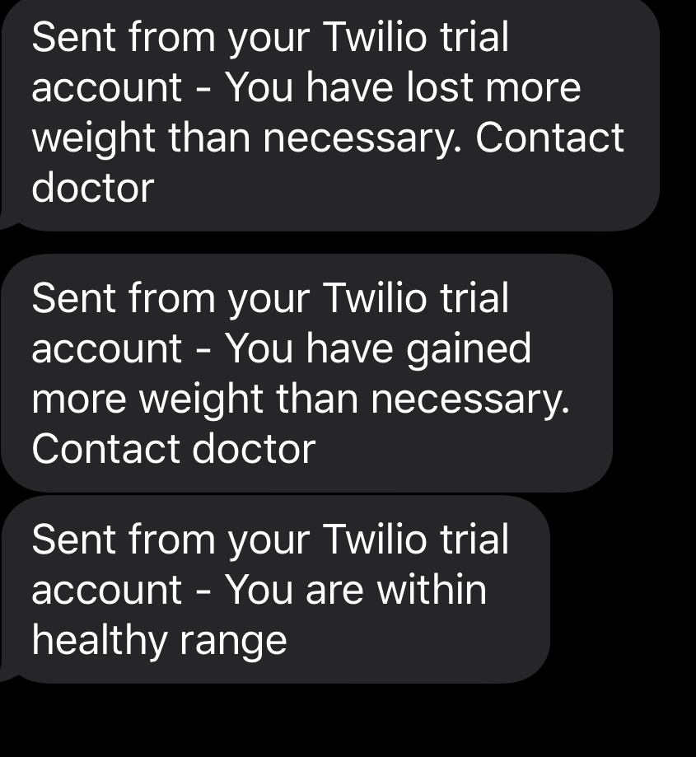
Results
All project-related documentation and code is on: https://github.com/NCBI-Codeathons/MONITORING-POST-OPERATIVE-HEAD-NECK-CANCER-PATIENTS-VIA-SELF-POWERED-SMART-INSOLES

Slide 5
Challenges and future work
Bluetooth low energy communication
Fit sensors into insole
Low power consumption
Self-powered
Testing
Ecosystem
Clinical application

