Slide 1
Working with Buckets in GCP
Adam Stine

Slide 2
Overview
What are buckets?
Create a bucket.
Add and remove files.

Slide 3
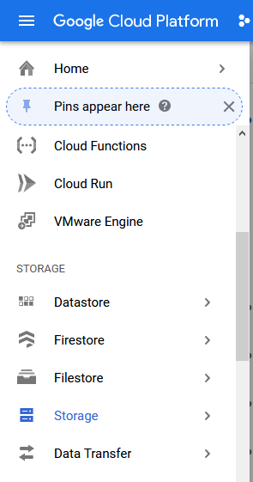
What is a Bucket?
Buckets are key part of working in the cloud.
They provide centralized stable storage that can be accessed by multiple VMs to do work.
There are several levels of storage for a bucket with frequency of use being the primary consideration.
Infrequently accessed data can be stored on nearline, cold storage, or archive buckets that will save money but be much slower to access.
Frequently used data buckets typically use the “Standard” storage class.
https://cloud.google.com/storage/docs/storage-classes

Slide 4
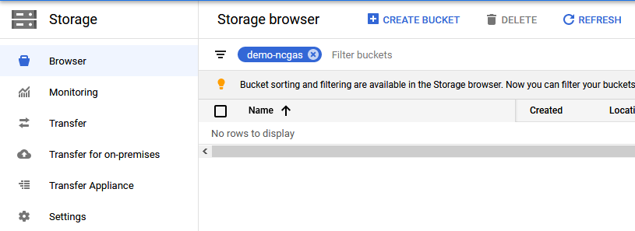
Create a Bucket
The Storage Browser will be helpful to see and manage our buckets.
It is also where we will create our new bucket from.

Slide 5
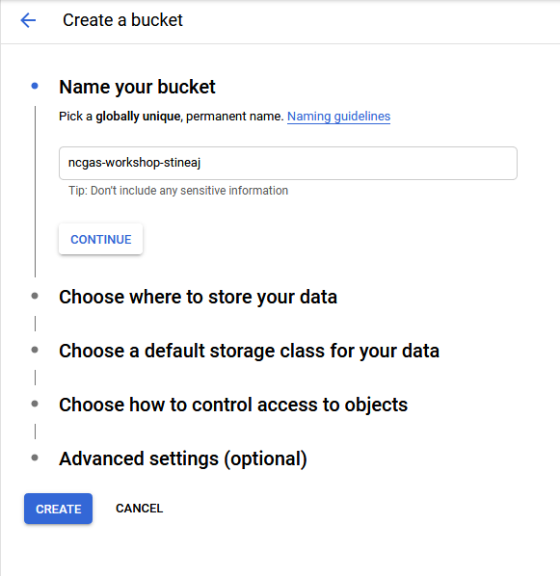
Create a Bucket
It is important to remember that bucket names must be globally unique as they all exist in a single namespace.
This allows any service or VM to point to specific buckets and objects within those buckets.
Bucket names can contain only lowercase letters, numbers, dashes, underscores, and dots. There are additional guidelines for bucket names available here.
https://cloud.google.com/storage/docs/naming-buckets
For this workshop please make sure all bucket you create begin with ‘ncgas-workshop-’ and a unique name afterward that you can identify as your own bucket.

Slide 6
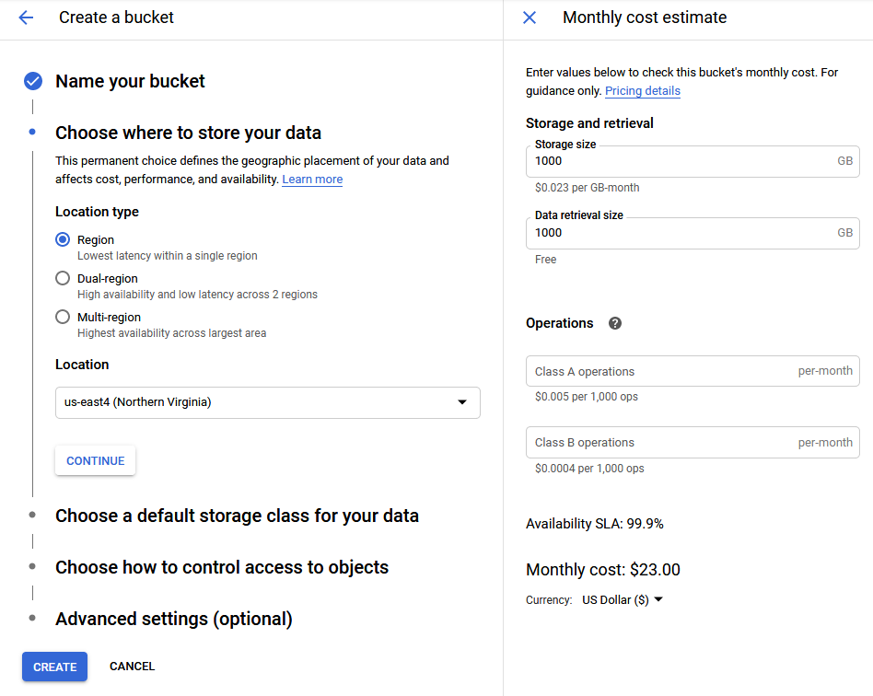
Create a Bucket
Storage regions determine how much the data in a bucket is replicated to data centers across the US.
The monthly cost estimator on the right side of the bucket creation page is a nice way to see how different parameters will impact storage costs..
The monthly cost difference between Region and Multi-region data for 1000 GB in us-east4 (Northern Virginia) $23 for Region and $26 for Multi-region when this slide was written.
For this workshop please make a Multi-region bucket.

Slide 7
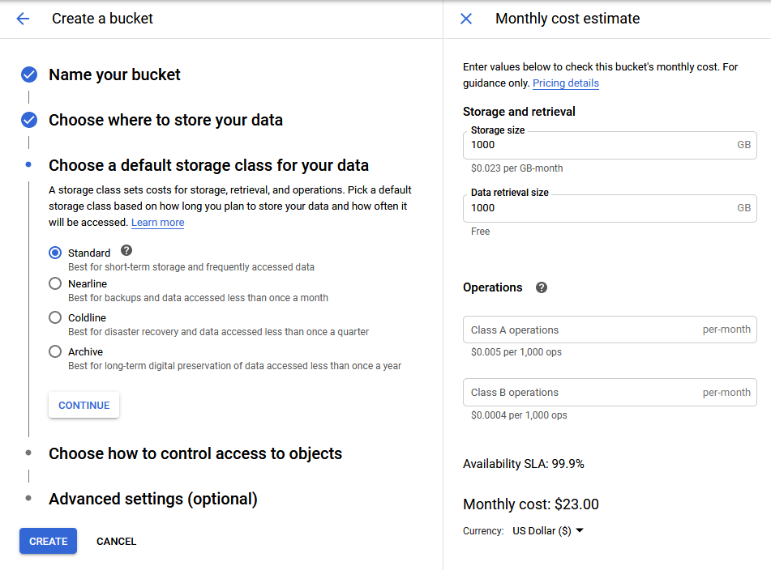
Create a Bucket
Storage Class has a large impact on bucket cost.
Standard is what we will use for this workshop and is the best choice for “working” storage.
The other classes are much cheaper for storage but add costs for access/retrieval.
You can use the cost estimation tool provided by GCP to understand how much expense is generated by your choices and usage.

Slide 8
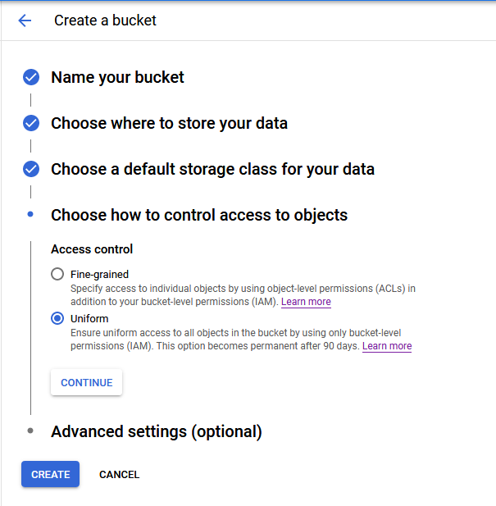
Create a Bucket
Access control is a deep topic for bucket management. There are several sections devoted to access control of bucket objects on the GCP documentation.
https://cloud.google.com/storage/docs/access-control
The recommended default from Google is Uniform so we will use that in this workshop.
If you need to set object level access control using an Access Control List (ACL) then you will need to select Fine-grained when creating your bucket.
Click CREATE to make your new bucket.

Slide 9
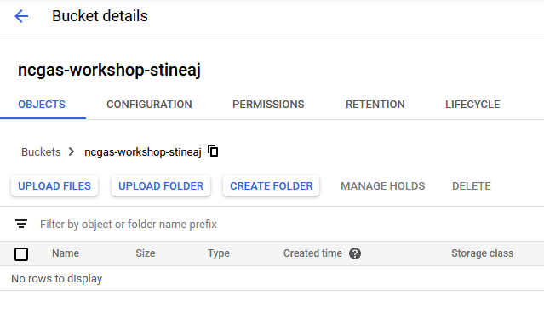
Create a Bucket
Now we have a new bucket at GCP
But we have nothing in the bucket yet.
There are several methods for getting data into our bucket and we will look at the following methods:
Upload via console from current computer
Transfer via gsutil
Streaming from VM to bucket with gsutil

Slide 10
Yes/No Question
File management interface preference. I prefer to use command line?

Slide 11
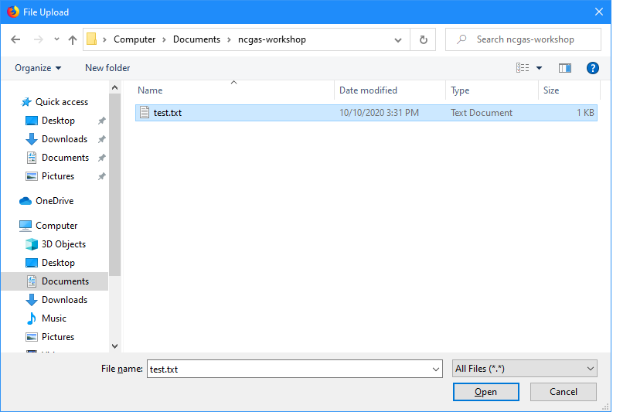
Save Files to Buckets
Transfers using the console can be a simple way to get files from your current computer into your GCP bucket.
From the bucket console page click UPLOAD FILES.
Use the browser window to find a file on your computer and click Open to transfer the file to the bucket.

Slide 12
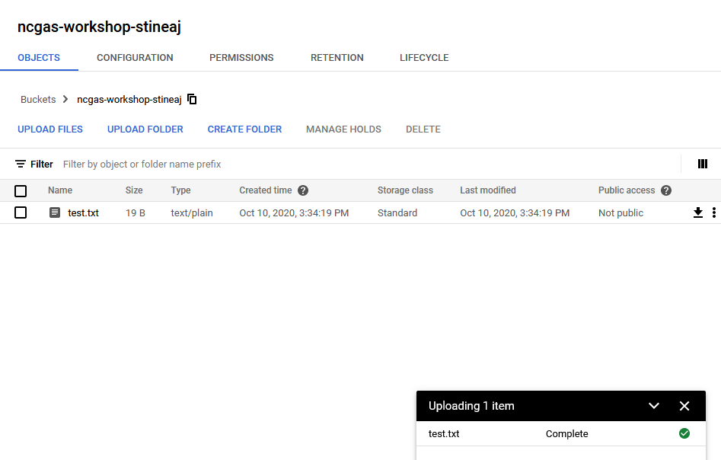
Save Files to Buckets
In the console for the bucket you will be able to see the files as well as the details about them.
You can also change bucket options like:
Lifecycle: move to different storage classes or delete once conditions are met
Retention policy: files can’t be altered or deleted for a minimum time period
You can add or change metadata on a file using the three dots on the right side of the table.

Slide 13
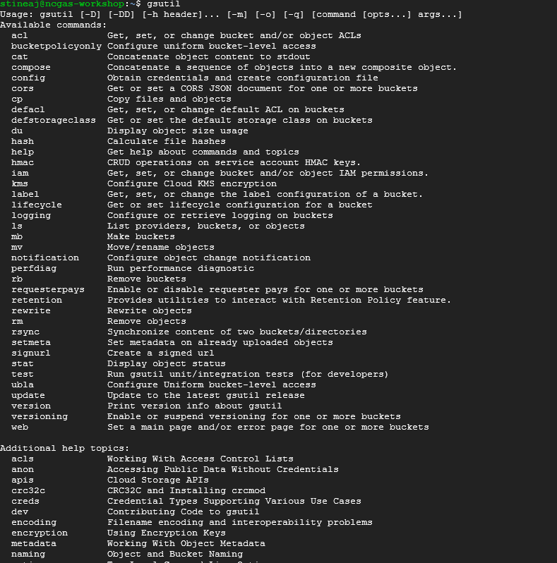
Save Files to Buckets
The program gsutil is included with the standard GCP images and is likely a good idea to include on any personal containers.
Allows command-line operation for common functions like:
Create or remove buckets
Remove or modify objects
Copy files to and from buckets
Modify policies

Slide 14
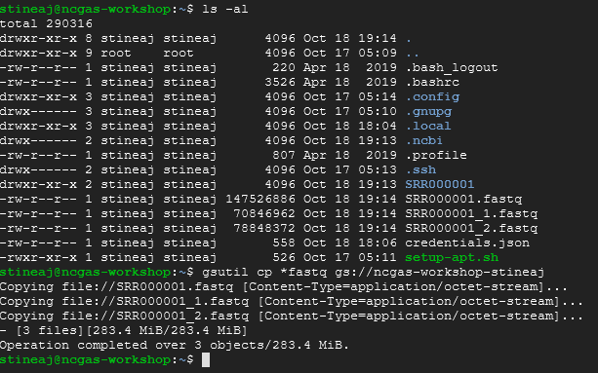
Save Files to Buckets
Gsutil can copy files using the cp function with a similar syntax to the unix cp program.
Accepts a cloud bucket location in either the source or destination portion of the command.
gsutil cp *fastq gs://ncgas-workshop-stineaj
Gsutil can stream small files to or from a bucket using – as the source or destination as needed.
gsutil cp gs://ncgas-workshop-dpr/hello.txt - | less
But Google doesn’t recommend streaming files larger than 100MB.

Slide 15
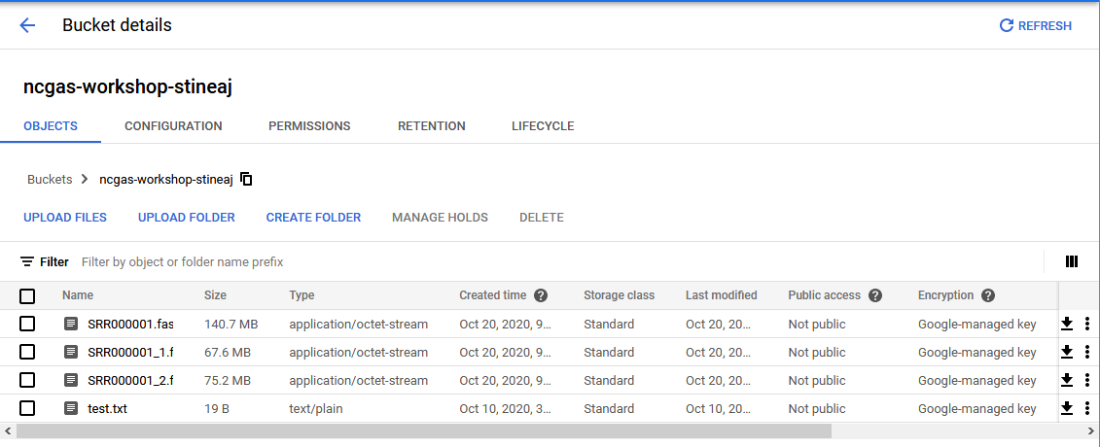
View Bucket Contents
The web console can be used to view the contents of your buckets, download them, edit metadata, and more.
Note the REFRESH button if you are monitoring transfers with the web interface.

Slide 16

View Bucket Contents
You can also list the contents of a bucket with gsutil.
gsutil ls gs://bucket
Like unix there are options for longer listings with more information as well as size in bytes or human readable formats.
Learn all the options by running the following help command:
gsutil help ls

Slide 17
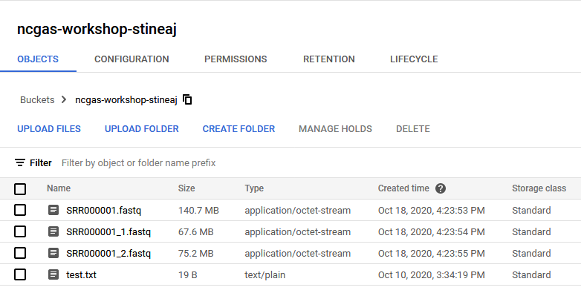
Delete Files from Buckets
The browser console can also be used to remove files and folders from a bucket.

Slide 18
Delete Files from Buckets
Gsutil can also be used to delete files from a bucket.
Retention policy will be enforced and may prevent deleting files due to the policy.
There is no restore/recover feature for accidentally deleted files so be careful!
You can even delete every file an entire directory or bucket using the recursive (-r) option.

Slide 19
Review
Buckets (Storage) are an integral part of working with large data sets or providing access to multiple VMs from a single storage location.
Costs of storage can represent a significant portion of cloud expenses if files are being stored for a long period of time.
Storage buckets can be managed through the GCP console or through the command line with gsutil.

Slide 20
Additional Resources
Google Cloud Next Best Practices video https://www.youtube.com/watch?v=mOHy6m8KzJk
Google docs for their Storage product https://cloud.google.com/compute/docs/disks
Documentation for gsutil https://cloud.google.com/storage/docs/gsutil

