Slide 1
NLM Codeathon: Protein Variant Impact Score
Team
Hua Zhang
Peter Cooper
Sema Kachalo
Rich McVeigh
Jialin (Charlie) Xiang
Jiyao Wang

Slide 2
Prot-Var Goal
Predict the phenotypic consequence protein variants
human coding region missense variants in dbSNP
generally applicable to all (most) proteins

Slide 3
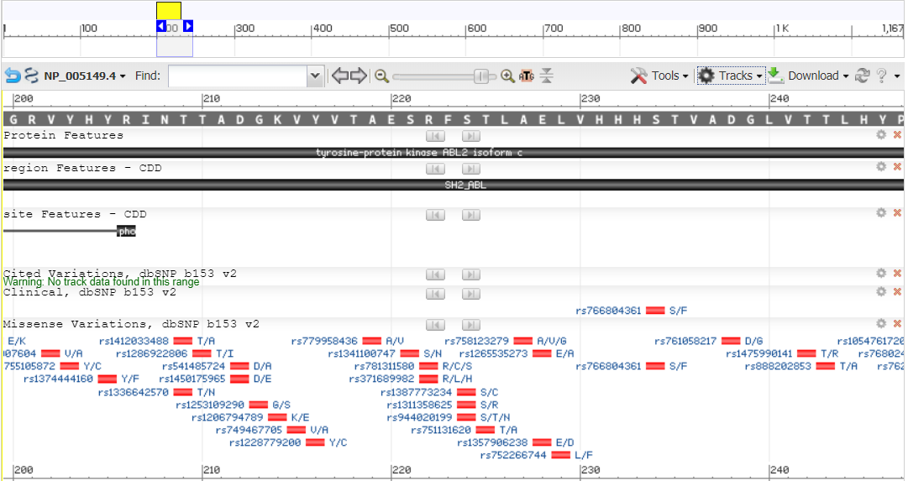
Variants in ABL2

Slide 4
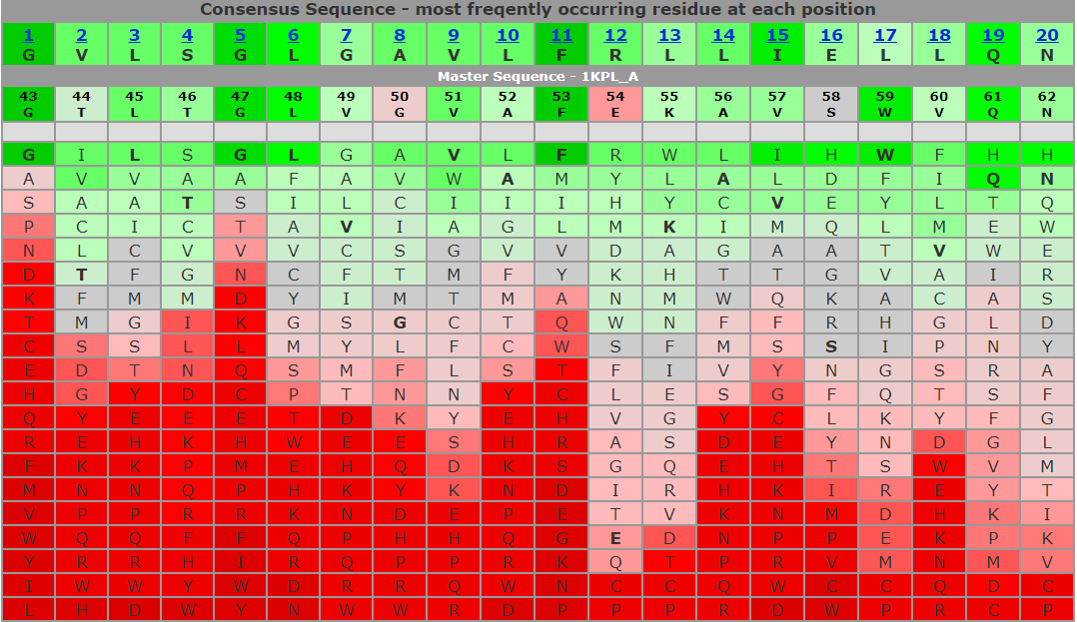
PSSM ABL2 SRC Homology Domain
Score represents likelihood of observing the change

Slide 5
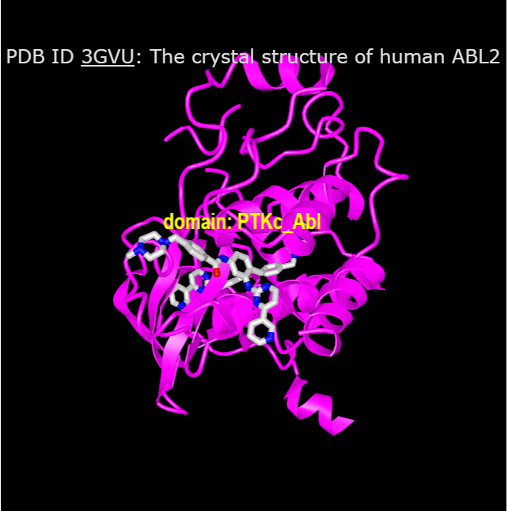
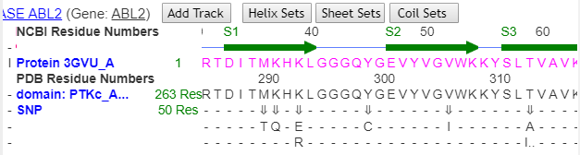
ABL2 Structure and SNPs

Slide 6
Workflow and Products
38K human proteins
Output substitution matrix for conserved domain for each domain
Also binding site information
Prefilter SNPs (JSON data)
missense
in the Conserved Domain
Map changes onto PSSM matrix for each position
Output score for each SNP
Validate phenotypes using ClinVar assertions
Demo web interface

