Slide 1


Development of R/Bioconductor framework to analyze AMR data
Team Lahti
Team lead: Leo Lahti
Tech lead
Akewak Jeba, Geraldson Teneng Muluh
Writer
Dattatray Mongad, Nitin Bayal
Flex
Shivang Bhanushali, Mahkameh Salehi

Slide 2
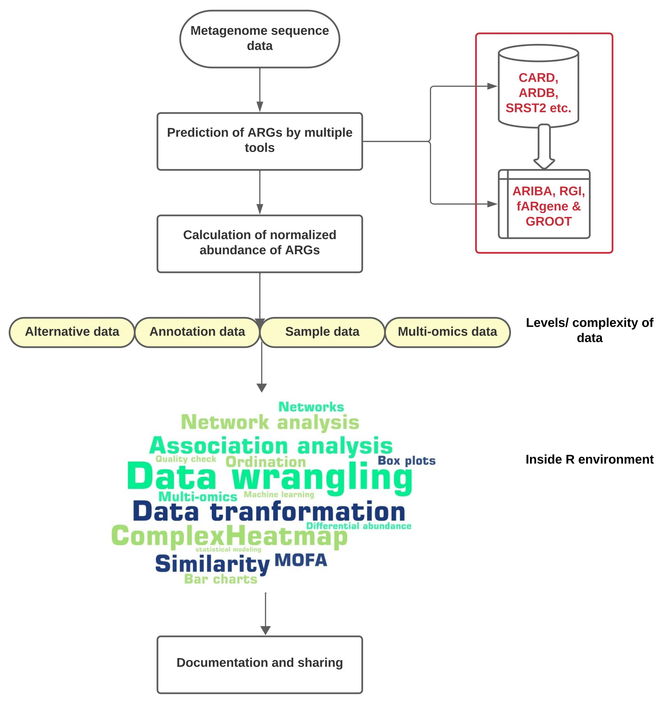
Team Lahti
Metagenomics workflow
Problems to tackle
Multiple tools gives different outputs
Multi-level data integration
Multiple choices of R packages and methods
Lack documentation and easy to share data format

Slide 3
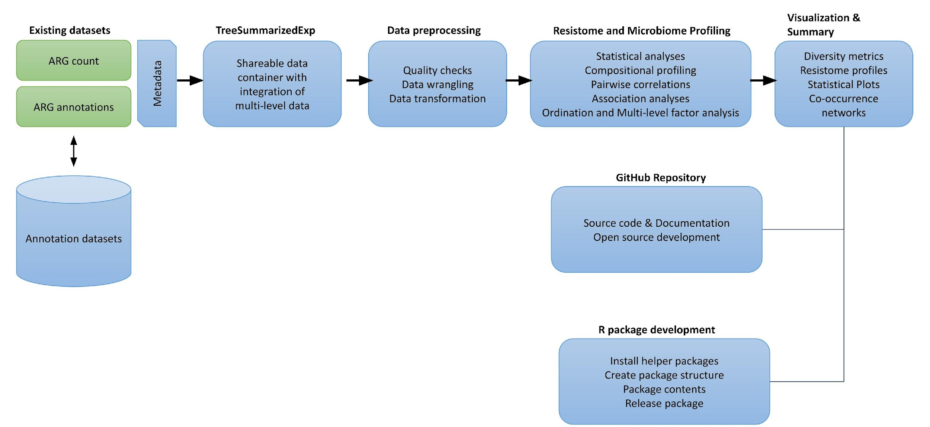
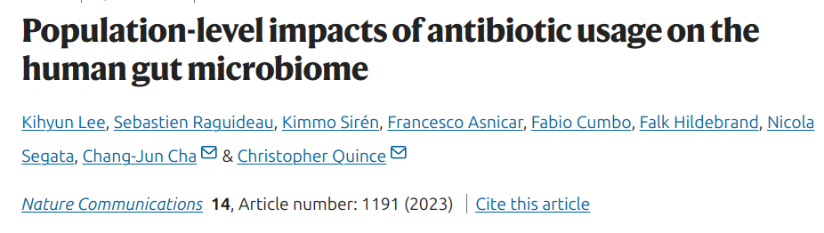

Team Lahti
Proposed framework
using R/Bioconductor packages
Extensive survey of ARGs in 8972 metagenomes from 11 countries spanning 3 continents
Mia: https://microbiome.github.io/

