Slide 1
Connecting AMR AST to AMR Genes on and off Plasmids
Nicole Bowers^{A}, Clark Cucinell^{A}, Don Dempsey^{B}, Curtis Hendrickson^{B}, Marcus Nguyen^{A}, Andrew Warren^{C}
^{A}University of Chicago ^{B}University of Alabama in Birmingham ^{C}University of Virginia

Slide 2
Project Goals
Are AMR genes that are likely to be on plasmids more correlated to AST phenotypes?
Does it make sense to augment the AMR AST data with predictions from an ML model?

Slide 3
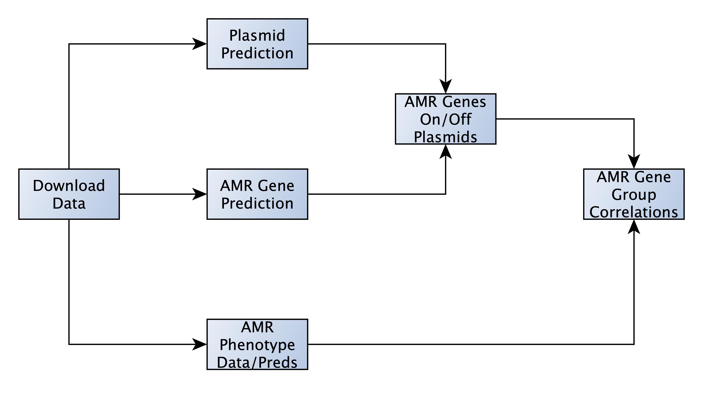
Pipeline

Slide 4
Pipeline
Data Sets Used
NDARO
All AST Data
All Precomputed MicroBIGG-E (type:AMR)
All Assemblies with AST Data (26102 assemblies)
Tools Used
Plasmid Prediction
Zou, et al.
PlasmidFinder
AMR Phenotype Prediction
Private (similar to VanOeffelen, et al.)
KMC

Slide 5
Pipeline
Ground Truth
NDARO
Downloaded via AST Browser
Augmented Data
Predictions using pre-trained ML Models
Accuracies computed for data in ground truth
23859 Genomes Predicted On
Two Datasets
All AST Data
NDARO AST Data

Slide 6
Pipeline
Matrix
Row per Genome
Columns Represent Antibiotics
Susceptible = -1
Resistant = 1
None/NA = blank or Nan

Slide 7
Pipeline
Predict plasmids on all contigs
Zou, et al.
PlasmidFinder

Slide 8
Pipeline
Precomputed from NCBI
Using MicroBIGG-E
Filtered down to Type:AMR
SELECT *
FROM `ncbi-pathogen-detect.pdbrowser.microbigge`
WHERE type = 'AMR’
Downloaded Via GSUtil

Slide 9
Pipeline
Find AMR Genes
Must occur in > 5% of genomes
Mainly on Chromosome
On plasmid < 10% of time
Mainly on Plasmid
One plasmid > 90% of time
All AMR Genes
Matrix
Rows per Genome
Columns represent AMR Genes
Presence = 1
Absence = -1

Slide 10
Pipeline
Two matrices
AMR Gene
Columns are gene presence/absence per genome
Three tables
On Chromosome
On Plasmid
All
AMR Phenotype
Columns are antibiotic S|R per genome
Two tables
NDARO-only
Augmented with Predictions
Correlate every combination of columns

Slide 11
Results
 | NDARO |  | Original
Species | F1 Score | Samples | F1 Score | 95% CI
acinetobacter baumannii | 0.8975 | 920 | 0.9328 | 0.9321 | 0.9335
campylobacter jejuni | 0.9948 | 2138 | 0.9849 | 0.9847 | 0.9852
clostridioides difficile | 0.0000 | 1 | 0.9678 | #DIV/0! | #DIV/0!
enterococcus faecium | 0.3406 | 14 | 0.9711 | 0.9707 | 0.9716
klebsiella pneumoniae | 0.8497 | 469 | 0.8960 | 0.8952 | 0.8969
neisseria gonorrhoeae | 0.5939 | 458 | 0.9640 | 0.9635 | 0.9645
pseudomonas aeruginosa | 0.8398 | 324 | 0.7894 | 0.7873 | 0.7914
salmonella enterica | 0.9230 | 7032 | 0.9319 | 0.9311 | 0.9327
staphylococcus aureus | 0.8324 | 456 | 0.9764 | 0.9761 | 0.9767
streptococcus pneumoniae | 0.9281 | 132 | 0.9629 | 0.9623 | 0.9634
AMR AST Prediction Accuracy
Clostridioides
Enterococcus
Neisseria
Notes:
AMR Phenotype prediction models on: NDARO AST data and the original accuracies of the model. Scores are represented as macro-F1 scores (F1 of susceptible and resistant computed separately then averaged).

Slide 12
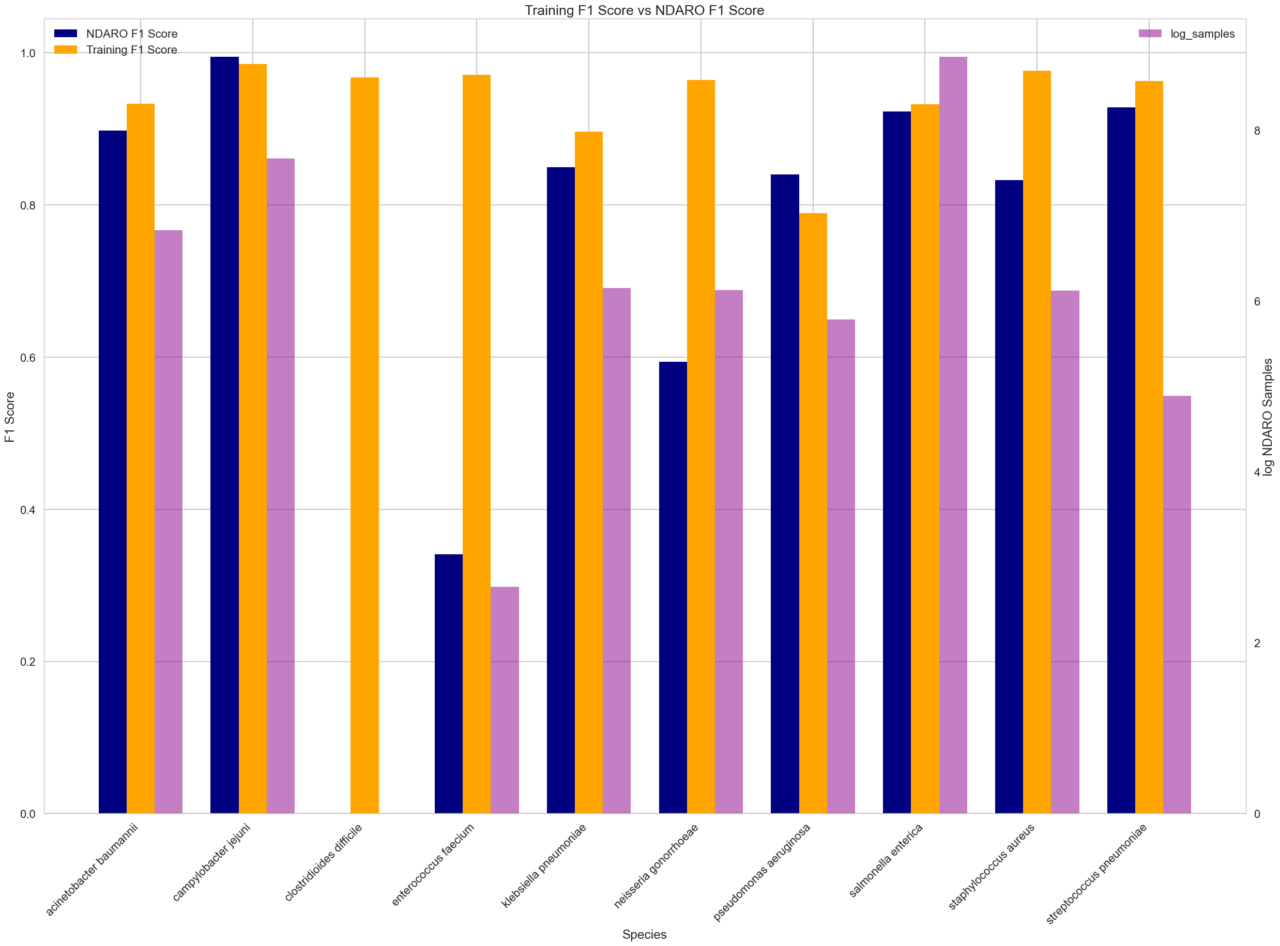
Results
Model Representative of NDARO Data?
AMR AST Prediction Accuracy
Clostridioides
Enterococcus
Neisseria
Notes:
AMR Phenotype prediction models on: NDARO AST data and the original accuracies of the model. Scores are represented as macro-F1 scores (F1 of susceptible and resistant computed separately then averaged).

Slide 13
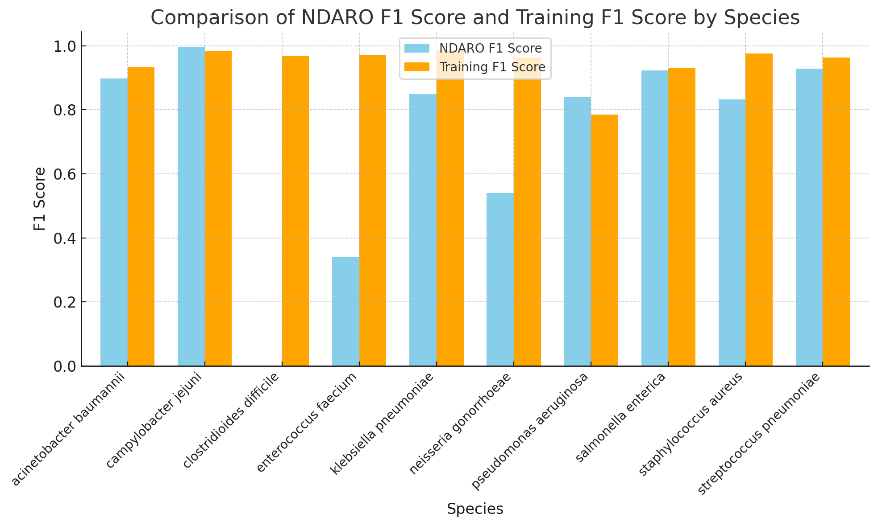
Results
Model Representative of NDARO Data?
AMR AST Prediction Accuracy
Clostridioides
Enterococcus
Neisseria
Notes:
AMR Phenotype prediction models on: NDARO AST data and the original accuracies of the model. Scores are represented as macro-F1 scores (F1 of susceptible and resistant computed separately then averaged).

Slide 14
Results
Model Representative of NDARO Data?
AMR AST Prediction Accuracy
Clostridioides
Enterococcus
Neisseria
Sample Counts
Notes:
AMR Phenotype prediction models on: NDARO AST data and the original accuracies of the model. Scores are represented as macro-F1 scores (F1 of susceptible and resistant computed separately then averaged).

Slide 15
Results
AMR Gene Correlations
Plasmid > All > Chromosome
Augmented <= NDARO
Gene Correlation | Dataset | Avg AST Corr | 95% CI
ALL | Augmented | 0.0115 | 0.0006 | 0.0224
ALL | NDARO | 0.0179 | 0.0059 | 0.0299
Plasmid | Augmented | 0.0663 | 0.0476 | 0.0850
Plasmid | NDARO | 0.0668 | 0.0464 | 0.0872
Chromosome | Augmented | -0.0310 | -0.0483 | -0.0136
Chromosome | NDARO | -0.0217 | -0.0409 | -0.0024
Notes:
AMR Phenotype prediction models on: NDARO AST data and the original accuracies of the model. Scores are represented as macro-F1 scores (F1 of susceptible and resistant computed separately then averaged).

Slide 16
Results
AMR Gene Correlations
Plasmid > All > Chromosome
Augmented = NDARO
Notes:
AMR Phenotype prediction models on: NDARO AST data and the original accuracies of the model. Scores are represented as macro-F1 scores (F1 of susceptible and resistant computed separately then averaged).

Slide 17
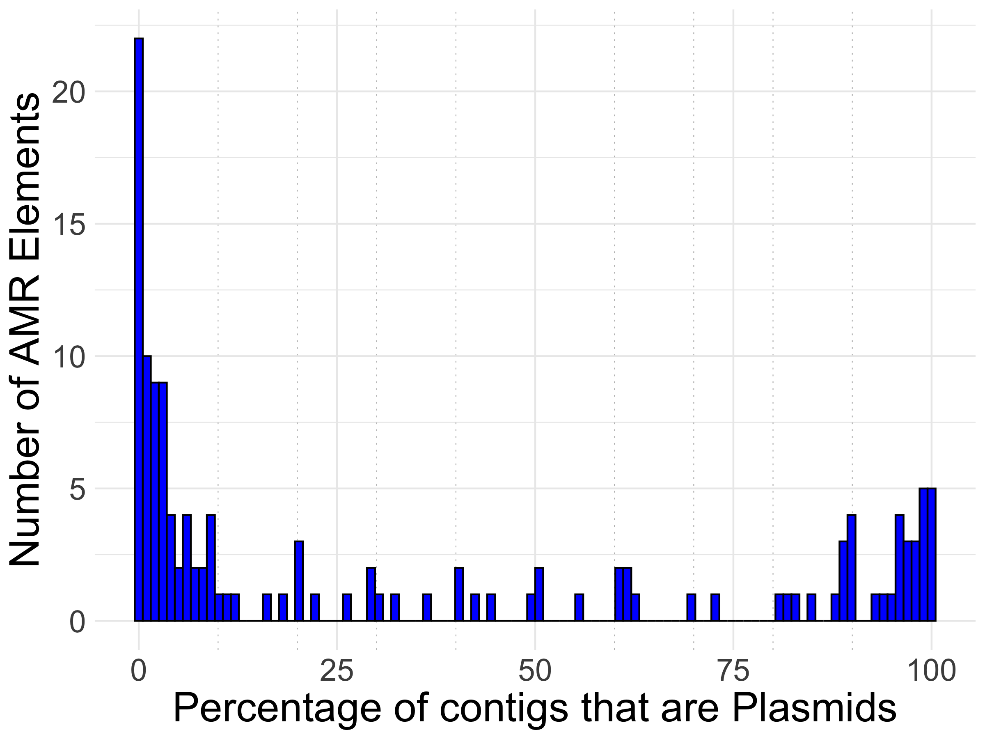
AMR Gene Plasmid Distribution
Changing % Threshold
10% -> 20%

Slide 18
Results
Changing % Threshold
10% -> 20%
Similar Results
Gene Correlation | Dataset | Avg AST Corr | 95% CI
ALL | Augmented | 0.01148478 | 0.00060057 | 0.02236899
ALL | NDARO | 0.01790713 | 0.00589149 | 0.02992277
Plasmid | Augmented | 0.06693145 | 0.05226228 | 0.08160063
Plasmid | NDARO | 0.07347377 | 0.05734198 | 0.08960556
Chromosome | Augmented | -0.0309514 | -0.0483025 | -0.0136003
Chromosome | NDARO | -0.0216797 | -0.0409326 | -0.0024268
Notes:
AMR Phenotype prediction models on: NDARO AST data and the original accuracies of the model. Scores are represented as macro-F1 scores (F1 of susceptible and resistant computed separately then averaged).

Slide 19
Results
Changing % Threshold
10% -> 20%
Similar Results
Notes:
AMR Phenotype prediction models on: NDARO AST data and the original accuracies of the model. Scores are represented as macro-F1 scores (F1 of susceptible and resistant computed separately then averaged).

Slide 20
Future Work
Many thresholds were set arbitrarily
10% cutoff for chromosome vs plasmid
5% threshold to filter out genes
Filtering of AMR genes
Removed low occurrence genes
Roll into upper family?
BLA-8 is low count, incorporate it as BLA?
Filter out gene-antibiotic combinations that have no relation
Denovo vs Guided
We only made predictions on denovo assemblies

Slide 21
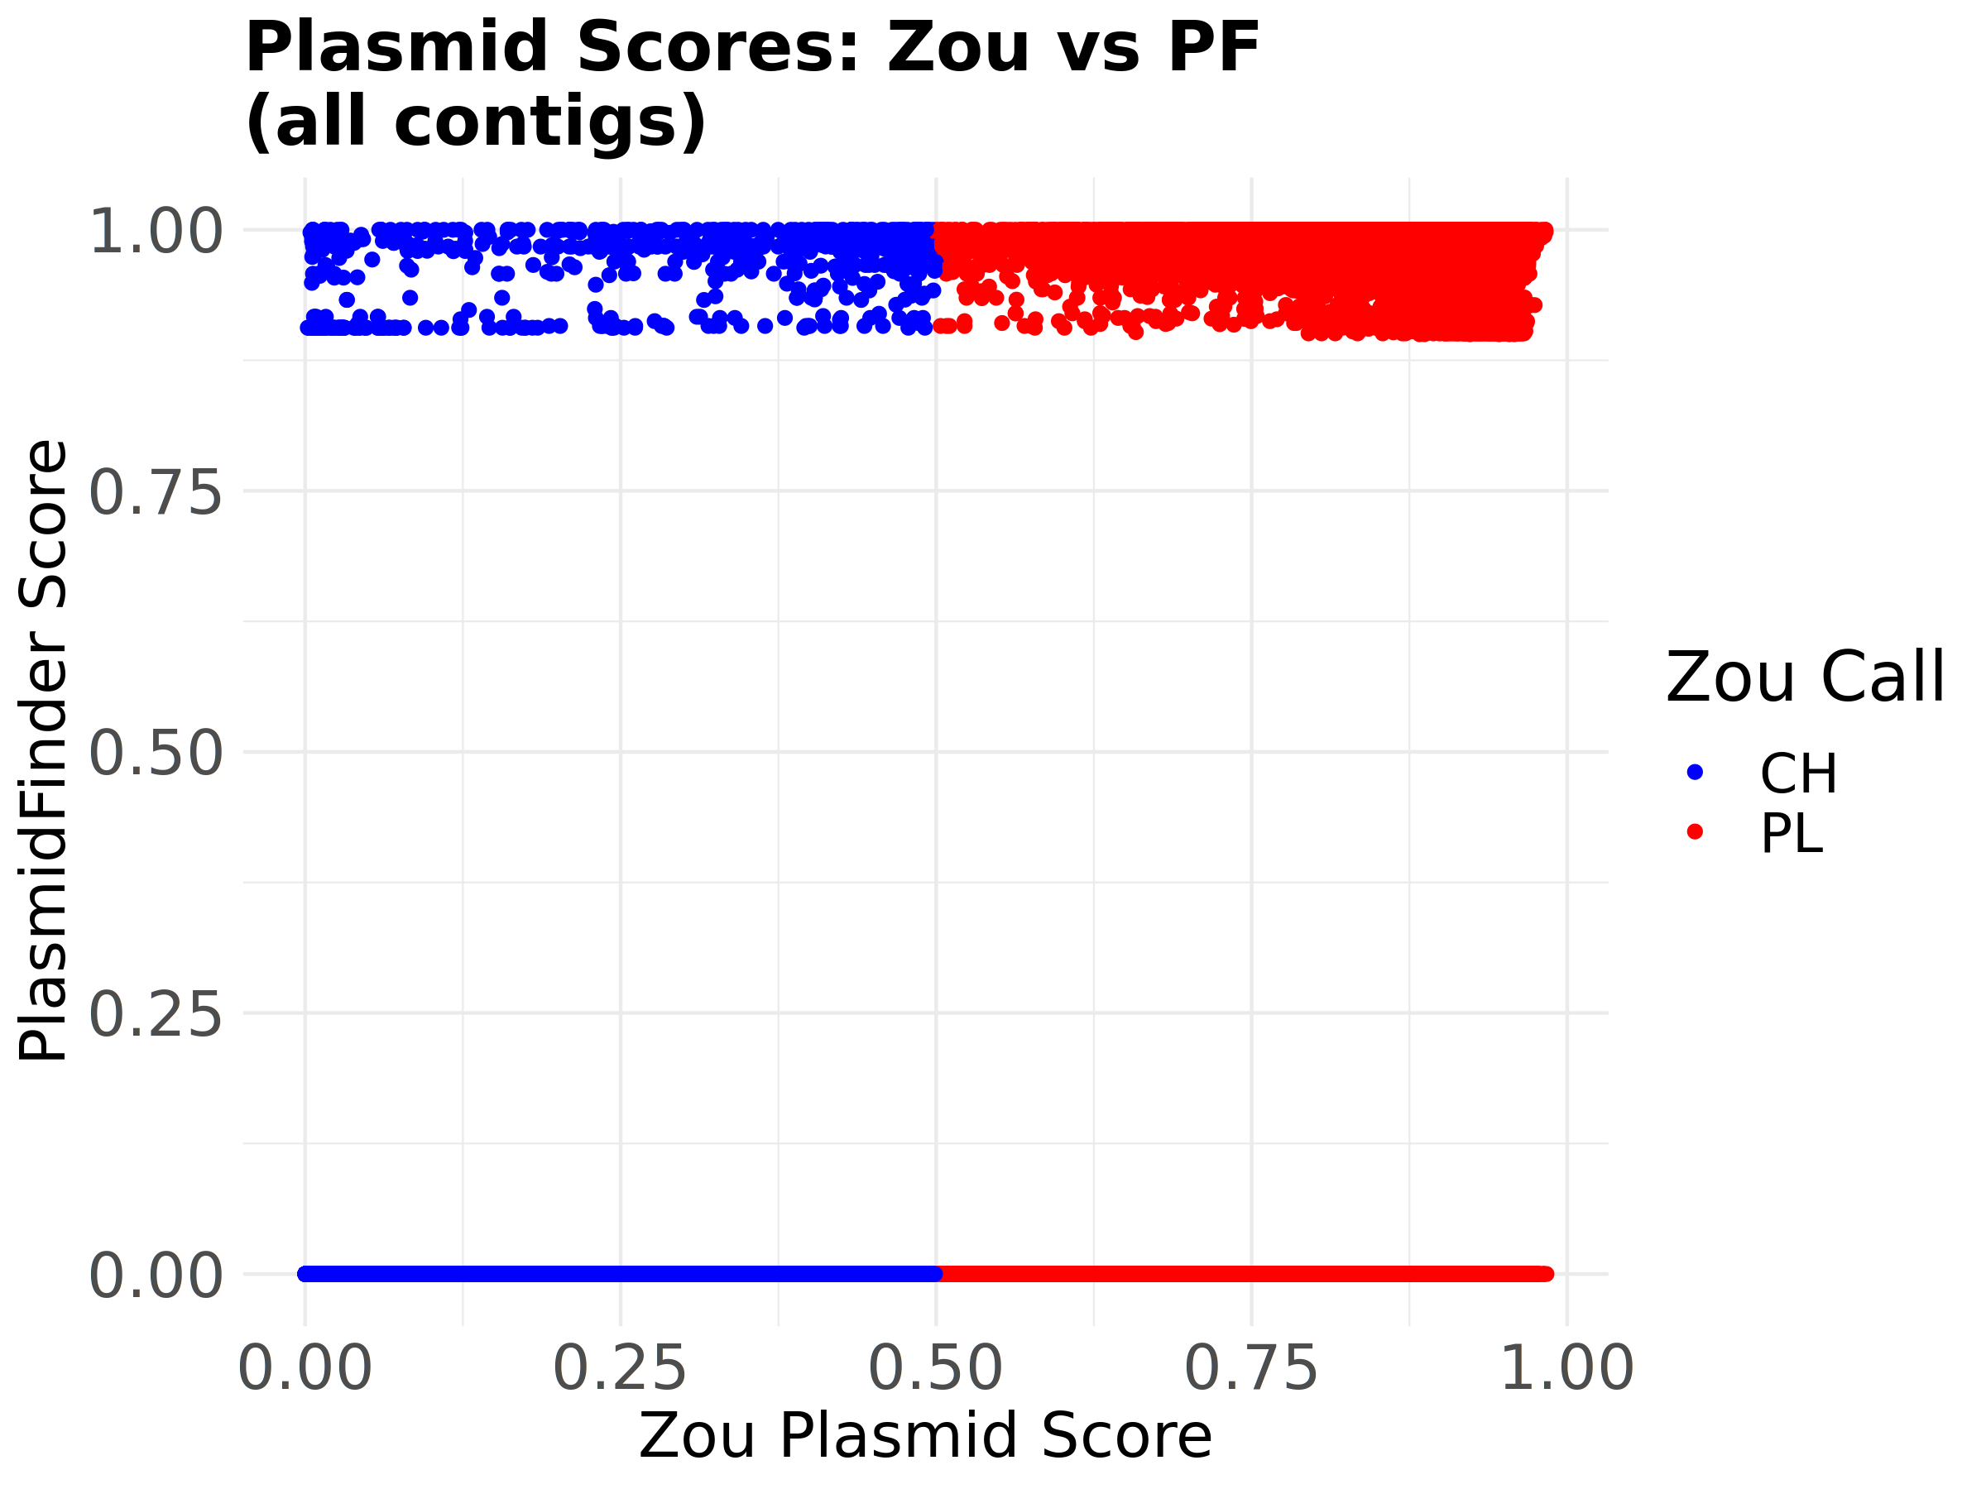
Future Work
Plasmid prediction
We have PlasmidFinder working
Analysis only on Zou, et al.
Failed Plasmid Runs
AMR Phenotypes
Stuck to mainly S|R
Correlate to MIC?
Check if any NDARO data was used in training
Keep Augmented data?
Remove non-representative species from augmented
 |  | PlasmidFinder
 |  | CH | PL
ZOU | CH | 1,222,135 | 694
 | PL | 191,437 | 35,598

Slide 22

Team
University of Chicago | University of Alabama in Birmingham | University of Virginia
Nicole Bowers (writer) | Don Dempsey (💪) | Andrew Warren ( )
Clark Cucinell (tech lead) | Curtis Hendrickson (💪)
Marcus Nguyen (team lead)
All Sources Available on GitHub: https://github.com/NCBI-Codeathons/amr-2024-team-nguyen/

Slide 23
Team
University of Chicago | University of Alabama in Birmingham | University of Virginia
Nicole Bowers (writer) | Don Dempsey (💪) | Andrew Warren ( )
Clark Cucinell (tech lead) | Curtis Hendrickson (💪)
Marcus Nguyen (team lead)
Compute
Servers Used
Machine 1: 176 cores, 1500 GB RAM
Machine 2: 24 cores, 600 GB RAM
Machine 3: 176 cores, 1500 GB RAM
All Sources Available on GitHub: https://github.com/NCBI-Codeathons/amr-2024-team-nguyen/

