Slide 1

Machine Learning with Genomic Information for Predicting Cancer Drug Response

Slide 2
Genomics of Drug Sensitivity in Cancer
(GDSC)
ANOVA analysis
one drug ~ one feature

Slide 3
Models have built and Methods have tried
GDSCTools, Elastic Net, Lasso, Ridge.
Thomas Cokelaer, Elisabeth Chen, Francesco Iorio, Michael P Menden, Howard Lightfoot, Julio Saez-Rodriguez, Mathew J Garnett, GDSCTools for mining pharmacogenomic interactions in cancer, Bioinformatics, Volume 34, Issue 7, April 2018, Pages 1226–1228, https://doi.org/10.1093/bioinformatics/btx744
Using mutation data
Meta-GDBP: a high-level stacked regression model
Su, Ran, et al. "Meta-GDBP: a high-level stacked regression model to improve anticancer drug response prediction." Briefings in Bioinformatics 21.3 (2020): 996-1005.
Using expression data
Support vector machines (SVMs) and beam search
Yanan Gao1,Qiong Lyu2,Peng Luo 2,Mujiao Li,Rui Zhou, Jian Zhang,Qingwen Lyu. Applications of Machine Learning to Predict Cisplatin Resistance in Lung Cancer. International Journal of General Medicine. 2021, 5911-5924
Using mutation and CNV data for one chemotherapy drug, expression data for interpretation
MOLI: multi-omics late integration with deep neural networks
Sharifi-Noghabi, Hossein, et al. "MOLI: multi-omics late integration with deep neural networks for drug response prediction." Bioinformatics 35.14 (2019): i501-i509.
Using mutation, CNV and expression data

Slide 4

Workflow
Model Ranking
- Mean Absolute error
- Median Absolute Error
- Mean Squared Error
-Root Mean Squared Error
- Mean Absolute Percentage Error
- Median Absolute Percentage Error
Drug Selection-Tunning
- Based on the Ranking, most relevant drug models are selected and fine-tuned to improve prediction
288 Cancer Drugs
- Gene Mutation (Binary)
- CNV (Binary)
- Features (Sparse)
XGBRegressor
- 288 Models generated and tested

Slide 5
Train
Test
Motesanib
CZC24832
MIRA-1
LJI308
THR-103
KRAS (G12C) Inhibitor-12
Mean Absolute Percentage Error (MAPE)
Median Absolute Percentage Error (MDAPE)
Targeted
Drugs
Targeted
Drugs
N-acetyl cysteine
Leflunomide
Temozolomide
Nelarabine
KU-55933
Mean Absolute Percentage Error (MAPE)
Median Absolute Percentage Error (MDAPE)
Non Targeted
Drugs
Non Targeted Drugs

Slide 6
Highest Prediction
Drug | MAPE
N-acetyl cysteine | 7.07%
glutathione | 7.79%
alpha-lipoic acid | 9.51%
ascorbate (vitamin C) | 11.20%
PFI3 | 11.26%
Picolinici-acid | 11.37%
LMB_AB2 | 12.07%
Veliparib | 12.13%
Cyclophosphamide | 12.76%
Carmustine | 13.07%
Leflunomide | 13.12%
LMB_AB1 | 13.27%
GSK2801 | 13.41%
BDILV000379a | 13.55%
CZC24832 | 13.72%
Motesanib | 13.81%
Lenalidomide | 13.81%
BDF00022089a | 13.82%
CCT007093 | 13.87%

Slide 7
Results – Targeted | Non-Targeted
Drug Name | MAPE | Targets | Targeted
CZC24832 | 13.72% | PI3Kgamma | target
Motesanib | 13.8% | VEGFR, RET, KIT, PDGFR | target
MIRA-1 | 17.95% | TP53 | target
LJI308 | 18.11% | RSK2, RSK1, RSK3 | target
THR-103 | 26.40% | Mutant RAS | target
KRAS (G12C) Inhibitor-12 | 43.63% | KRAS (G12C) | target
N-acetyl cysteine | 7.07% | Metabolism | not targeted
Leflunomide | 13.11% | Pyrimidine synthesis inhibitor | not targeted
Temozolomide | 15.37% | DNA alkylating agent | not targeted
KU-55933 | 17.86% | ATM | not targeted
Nelarabine | 21.33% | - | not targeted
XGBRegression | MAPE
Targeted | 18.68
Non Targeted | 27.24

Slide 8
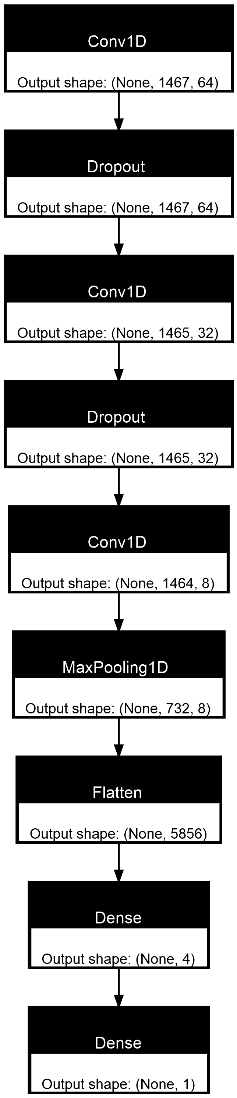
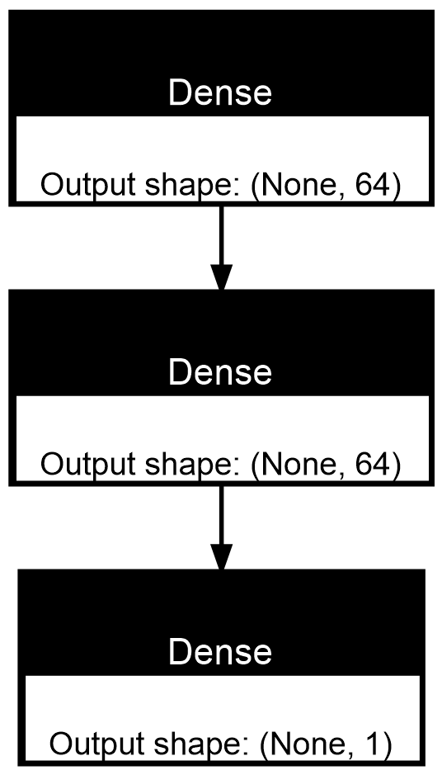
Neural Network Models - Sample
Dense Model
MAPE | N-acetyl cysteine
XGBRegression | 7.07%
Dense NN | 6.28%
CNN | 6.12%
Convolutional Model

Slide 9
CZC24832
Target P13K/MTOR pathway
Target P13Kgamma
Mutation features in the panel prediction:
PTEN
TP53
KRAS
NRAS
MLL2 a substrate of AKT1
EP300 a substrate of AKT
CDC27 interacted with PI3K/Akt/mTOR pathway
CREBBP related to P13K pathway

Slide 10
Future Work
The models created require further refinement.
Including RNA information could be beneficial for the prediction.
An exhaustive study from the parameters of each drug should be conducted.

Slide 11

Bingfang Ruth Xu (Team Lead)
Frederick National Laboratory for Cancer Research (FNLCR), Leidos Biomedical Research, Inc.
Daniel Sierra-Sosa (Tech Lead)
Assistant Professor, Department of Computer Science and IT, Hood College
Julie Bocetti (Writer)
NICHD
Todd Young
Frederick National Laboratory for Cancer Research (FNLCR), Leidos Biomedical Research, Inc.
Helga Saizonou
Tropical Infections Diseases Research Centre (TIDRC), Univeristy of Abomey-Calavi (UAC)
Shaojun Xie
Frederick National Laboratory for Cancer Research (FNLCR), Leidos Biomedical Research, Inc.
Brendan Reilly
Co-PI NSF 2221959, Co-PI NSF 2314315, Adjunct Lecturer Brooklyn College
Rana Morris & Alexa Salsbury
NCBI
Miranda Darby
Director of Bioinformatic program at Hood College

