Slide 1
Final Team Presentation:
Benchmarking Metagenomic Contig Matches
Team 2
Mihai Pop, Rob Patro, Jackie Michaelis
Michael Shaffer, Nicholas Cooley,
Priyanka Ghosh, Vini Salazar, Andrew Tritt,
Amatur Rahman, Harihara Subrahmaniam Muralidharan, Baris Ekim
Notes:
JACKIE
Thanks for a productive week! This week, Team 2 focused on benchmarking metagenomic contig matches.

Slide 2
Notes
Please adhere to 8-minute presentations with 2 minutes for questions following.
You will be given a 2-minute warning!
Final presentations will be recorded and shared with the group.
You may use the following slides as an outline, but do not need to.

Slide 3
Sequence search problem
Identifying the similarity between one or more query contigs and a "reference" collection of metagenomic samples
Focused on containment for the codeathon
Given a query contig c, and a database of sequences (contigs from multiple assemblies) return a set of contigs that either contain the query contig c or contained in the query.
A contig q is contained in contig c if the ANI between q and c is at least 95% and it covers more than 95% of the length of the shortest contig
Notes:
JACKIE
What does this mean?
It started with the idea-- if I have a metagenomic sample and I identify one or more contigs of interest-- how can I quickly and easily see if this contig has been seen in other metagenomic samples or datasets before?
To make this problem a little more practical for a week long codeathon, we focused specifically on contaminants. So we only consider matches where a contig q is contained in a contig c if the average nucleotide identity between q and c is at least 95% and the overlap between the two contigs covers more than 95% of the length of the shortest contig

Slide 4
Divide & Conquer Approach
What current solutions exist for this problem? Can we develop new solutions to improve upon them?
How do we benchmark approaches to this problem?
Generating a “gold-standard” dataset to test with
Identifying evaluation metrics and developing benchmarking tools
Notes:
JACKIE
To tackle this problem, we further divided it into sub-problems.
First-- determining what current solutions exist for this problem and if we can expand upon these solutions or develop new solutions to improve upon them.
Second- How do benchmark approaches to this problem? This involved both generating a “gold-standard” dataset where we have a defined truth to test with, and also identifying important evaluation metrics and developing a workflow to determine, given a “gold-standard” and containment output from a computational tool, how well does that tool identify contaminants

Slide 5
What current solutions exist for this problem?
Current methods to detect containment include:
Alignment based approaches such as
BLAST
MiniMap2
MashMap
Alignment free approaches such as
Mash Seq Screen
Dashing
Sourmash

Slide 6
Can we develop new solutions to improve upon them?
We looked at a sketching based approach to calculate contaminants.
Sketch the reference/database using a sketch that retains the order information.
Maintain bins from hashes to sketches containing this hash.
Within each bin, compute the min hamming distance between the query and the reference sequences.
Filter results by (currently gapless) ANI.
Things to do in the future:
Indexed colored mDBG representation within each bin?
extend to other kinds of contig-contig relationships?
Notes:
Currently runs in the order of seconds on 4000 queries on a reference of database of similar size with 8 threads.

Slide 7
Benchmarking: Generating a “gold-standard” dataset
Build a consensus set of contig containments for a given dataset
Three distinct approaches:
Sequence searching with BLASTN
Sequence searching with MMSeqs2
Identify shared information with synteny maps - R package DECIPHER

Slide 8
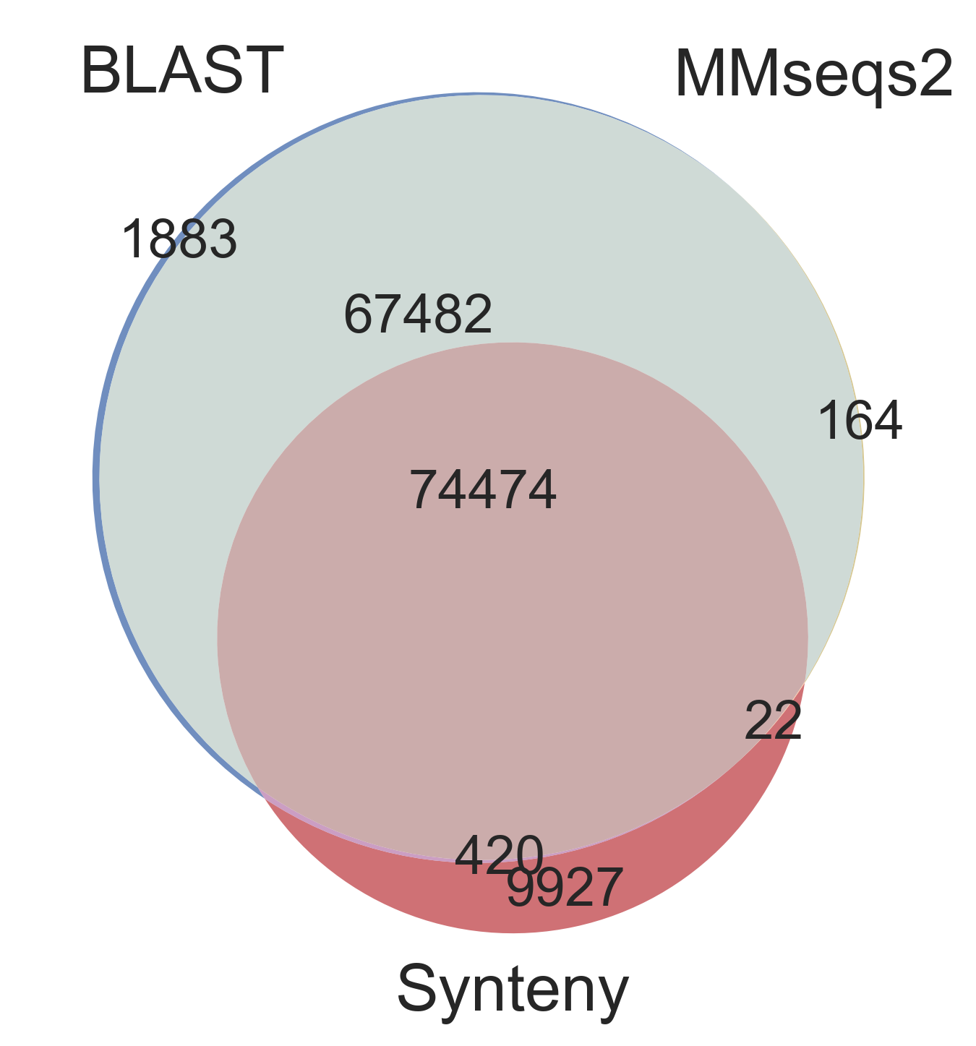
Benchmarking: Evaluating containments
Reaching a standard consensus:
All containments: 154372
BLASTn containments: 144259
MMseqs2 containments: 142142
Synteny containments: 84843
All 3 containments: 74474
BLASTn and MMseqs2 containments: 141956
BLASTn and synteny containments: 74894
MMseqs2 and synteny containments: 74496
Only BLASTn containments: 1883
Only MMseqs2 containments: 164
Only synteny containments: 9927

Slide 9
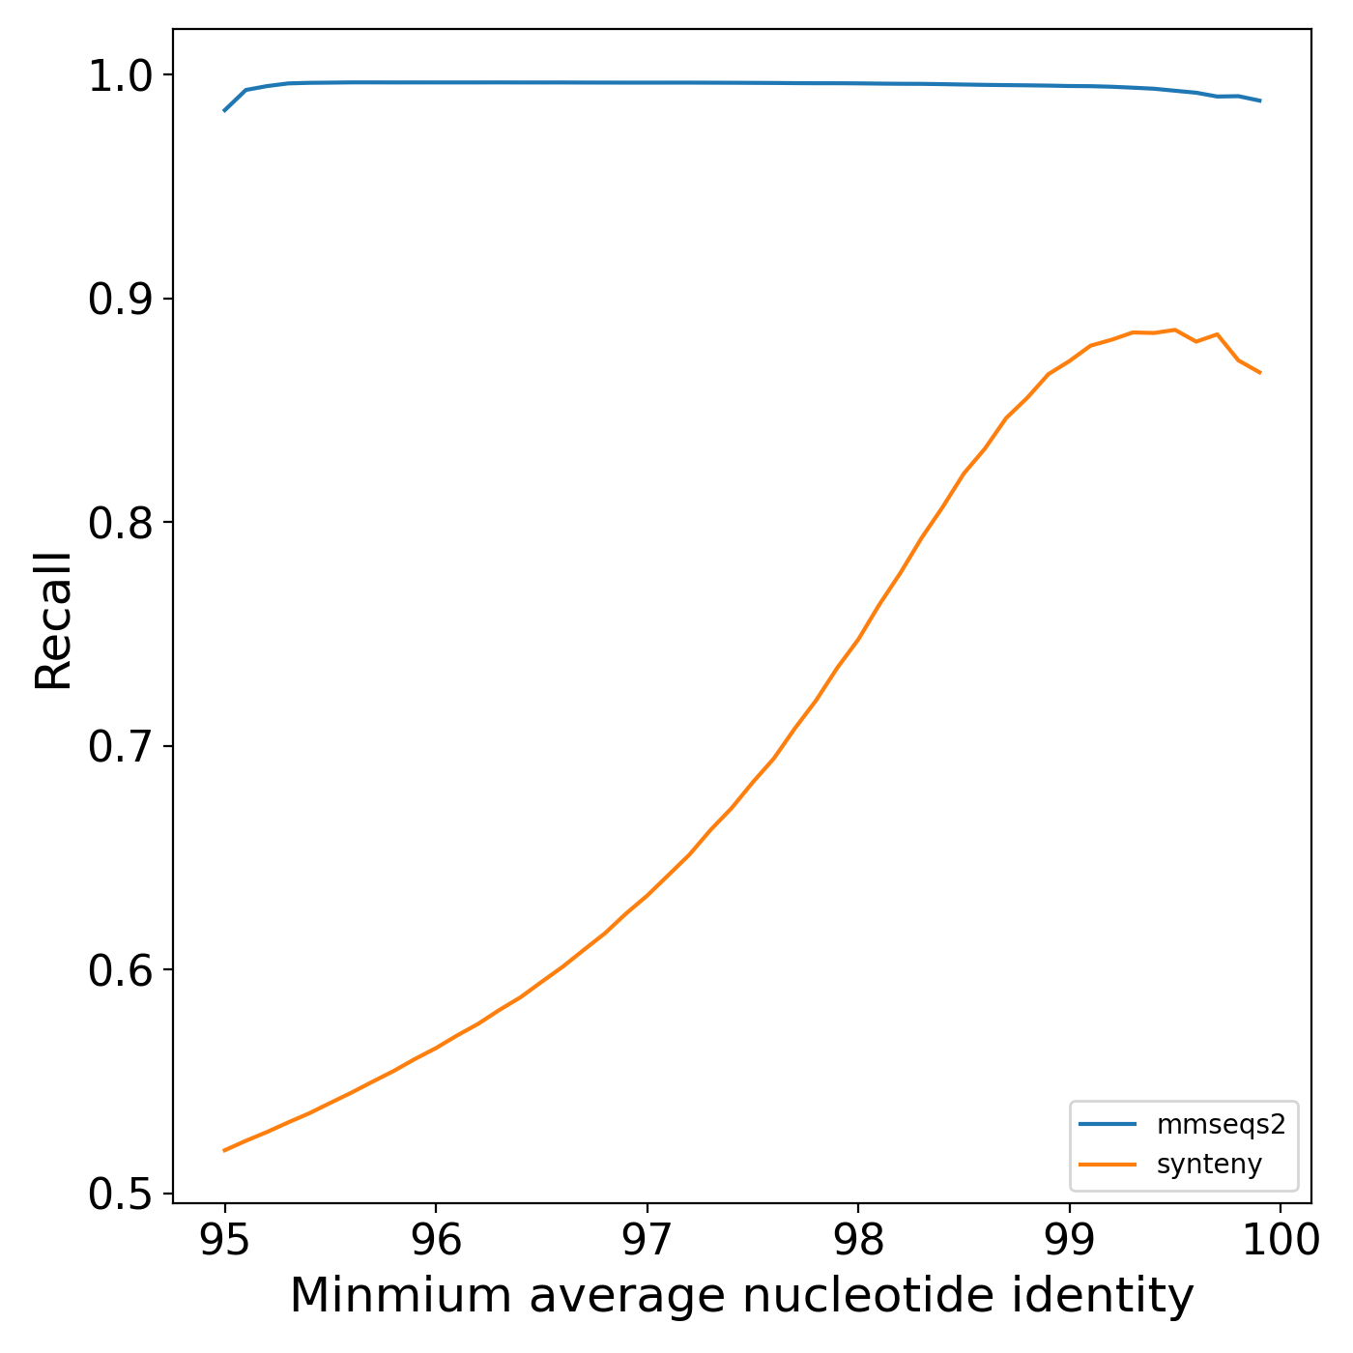
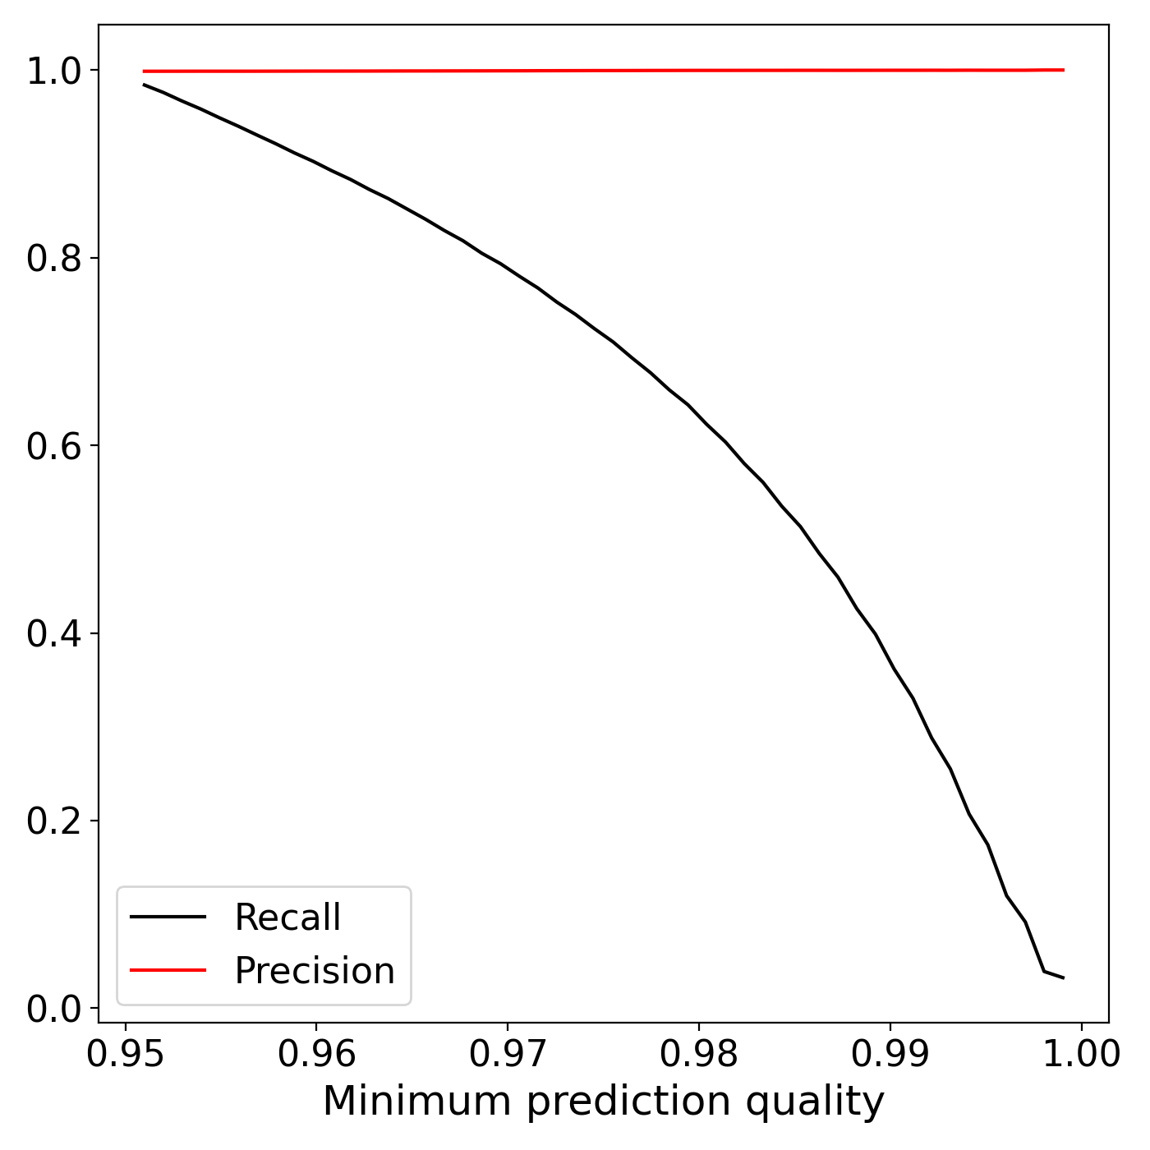
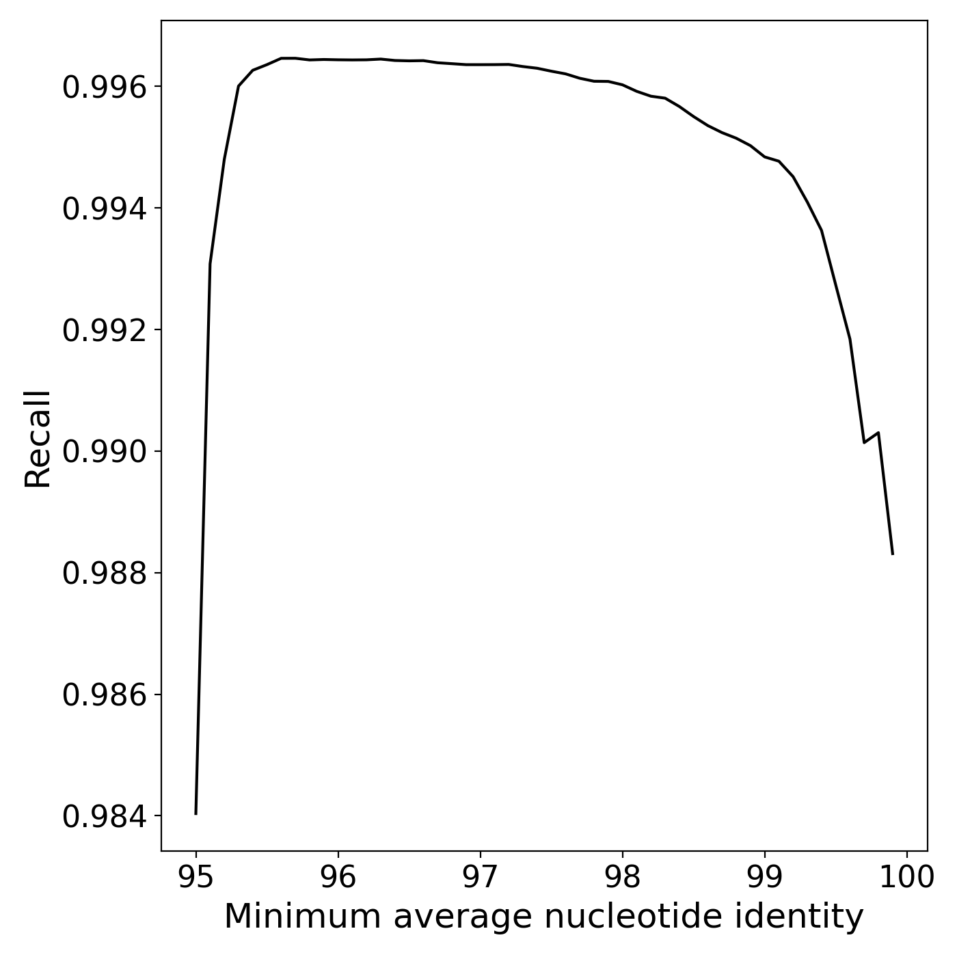
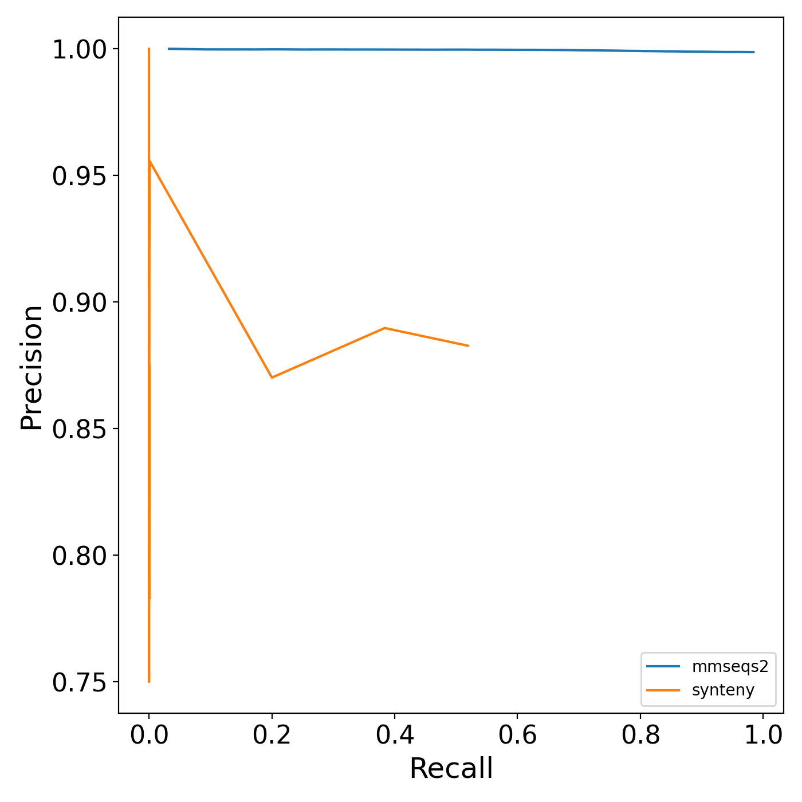
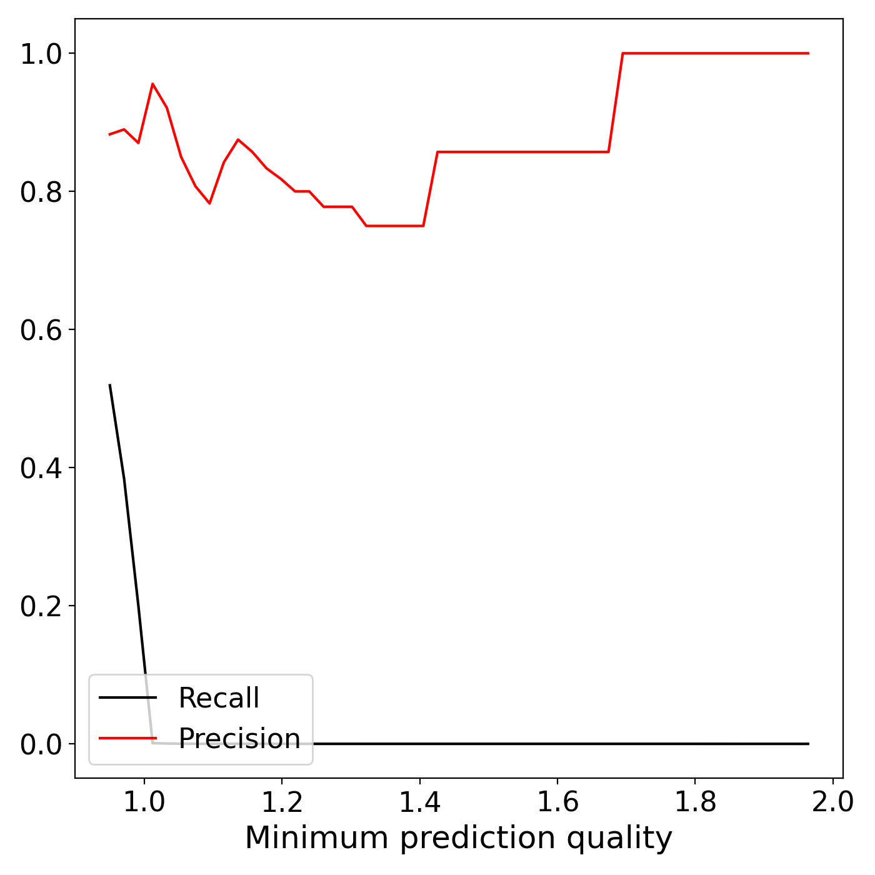
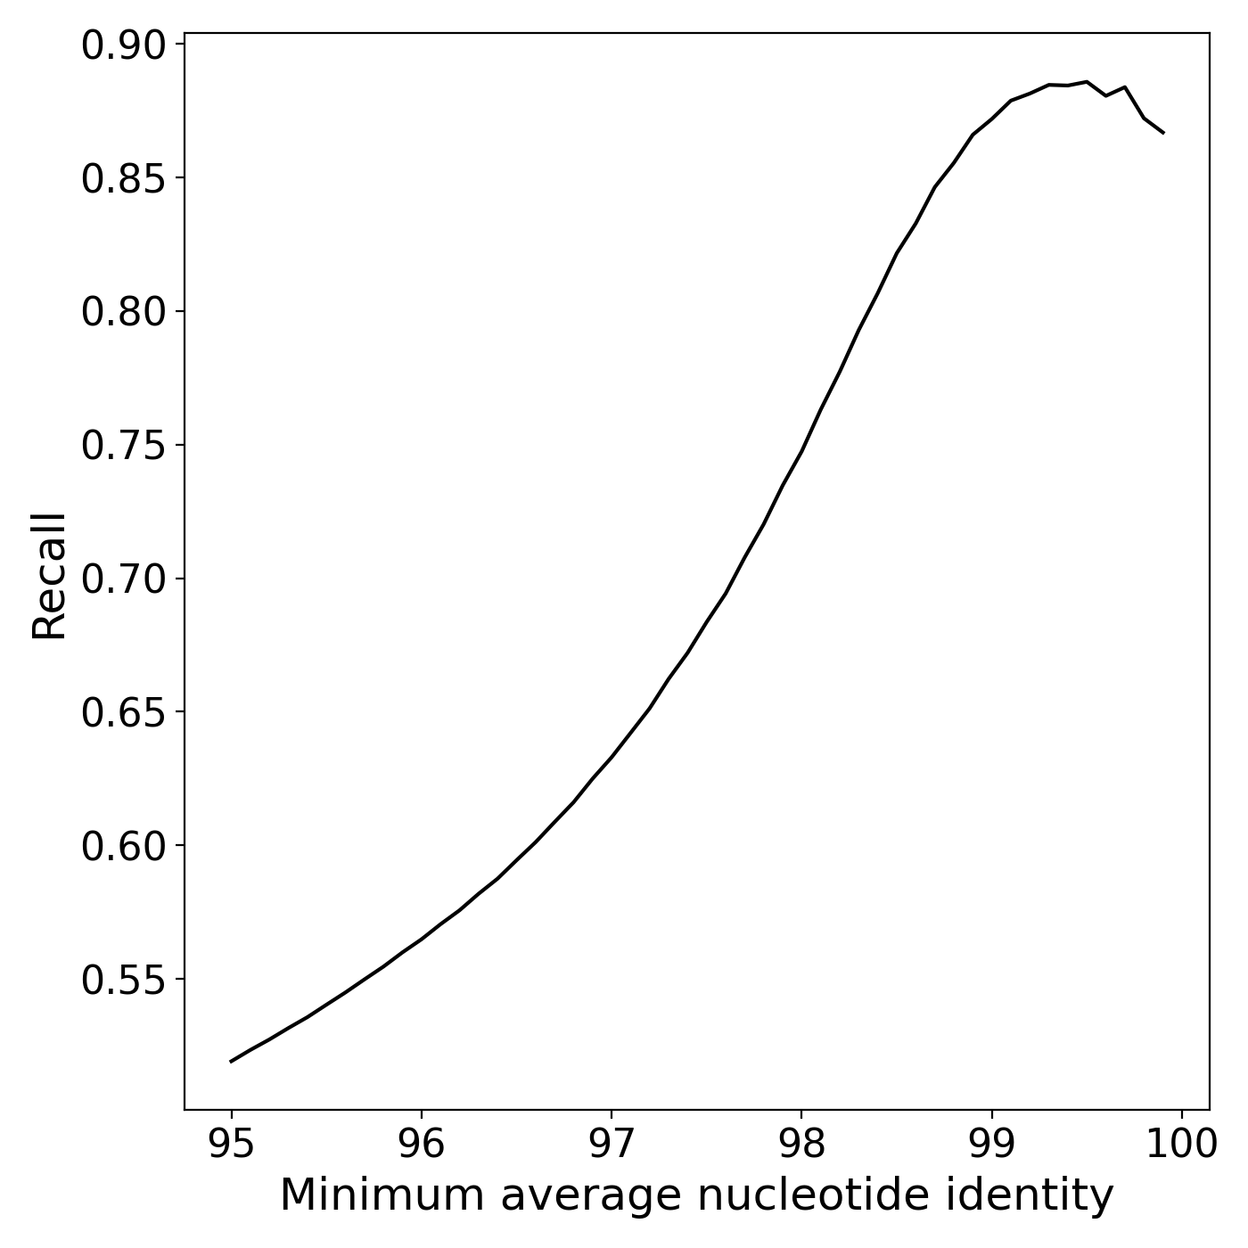
Benchmarking Results - Marine dataset
mmseqs2
synteny
Ground truth generated with BLAST

Slide 10
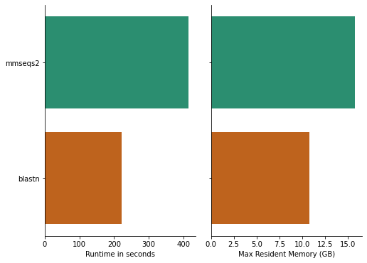
Benchmarking Results - Efficiency

Slide 11
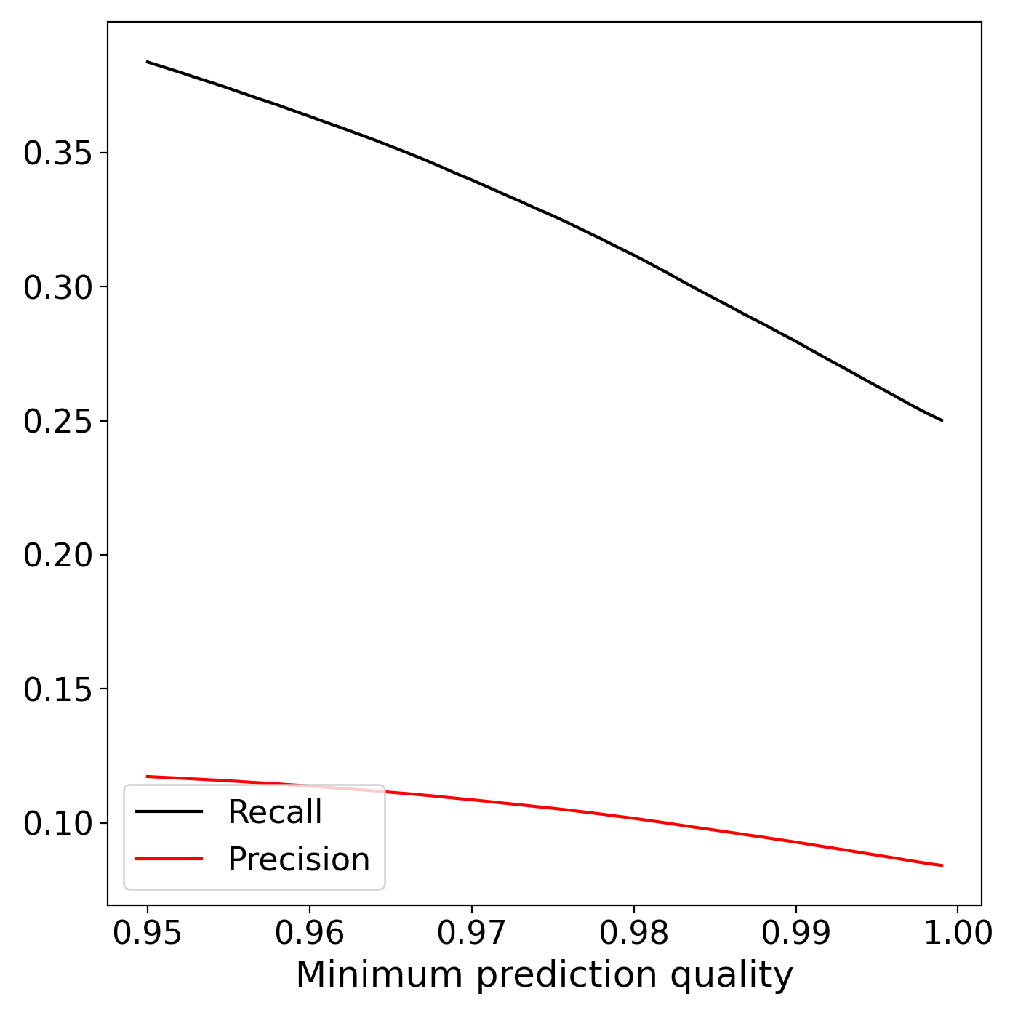
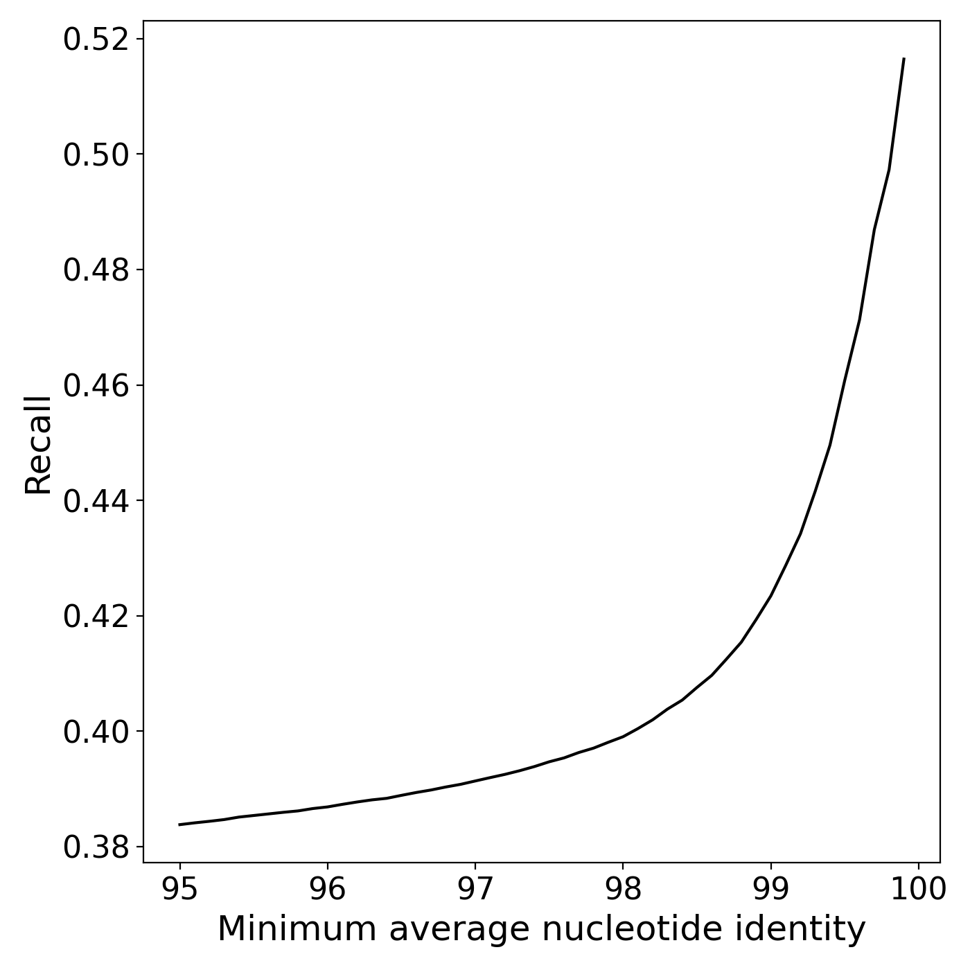
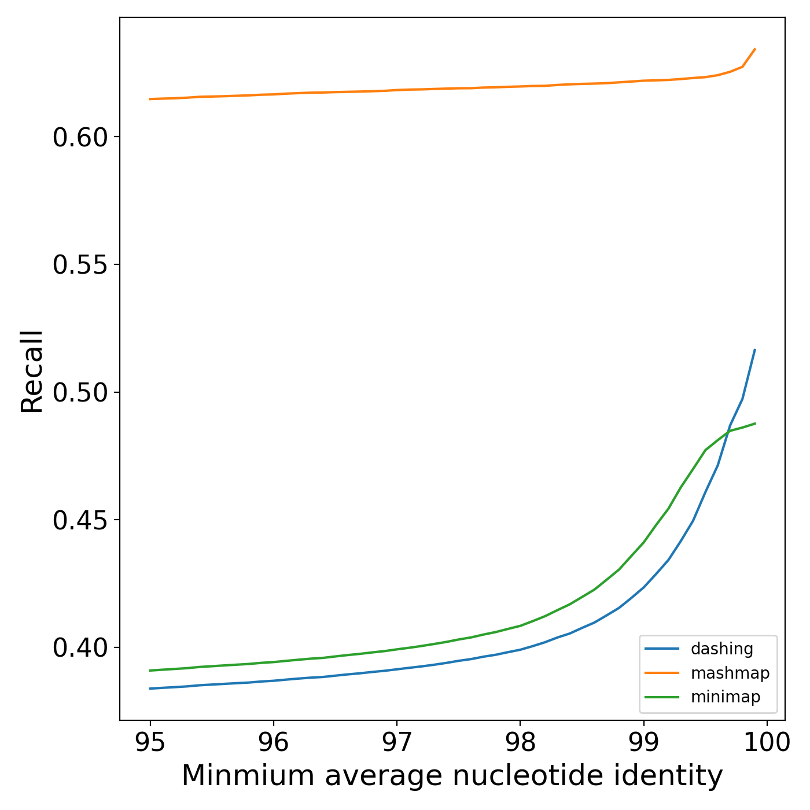
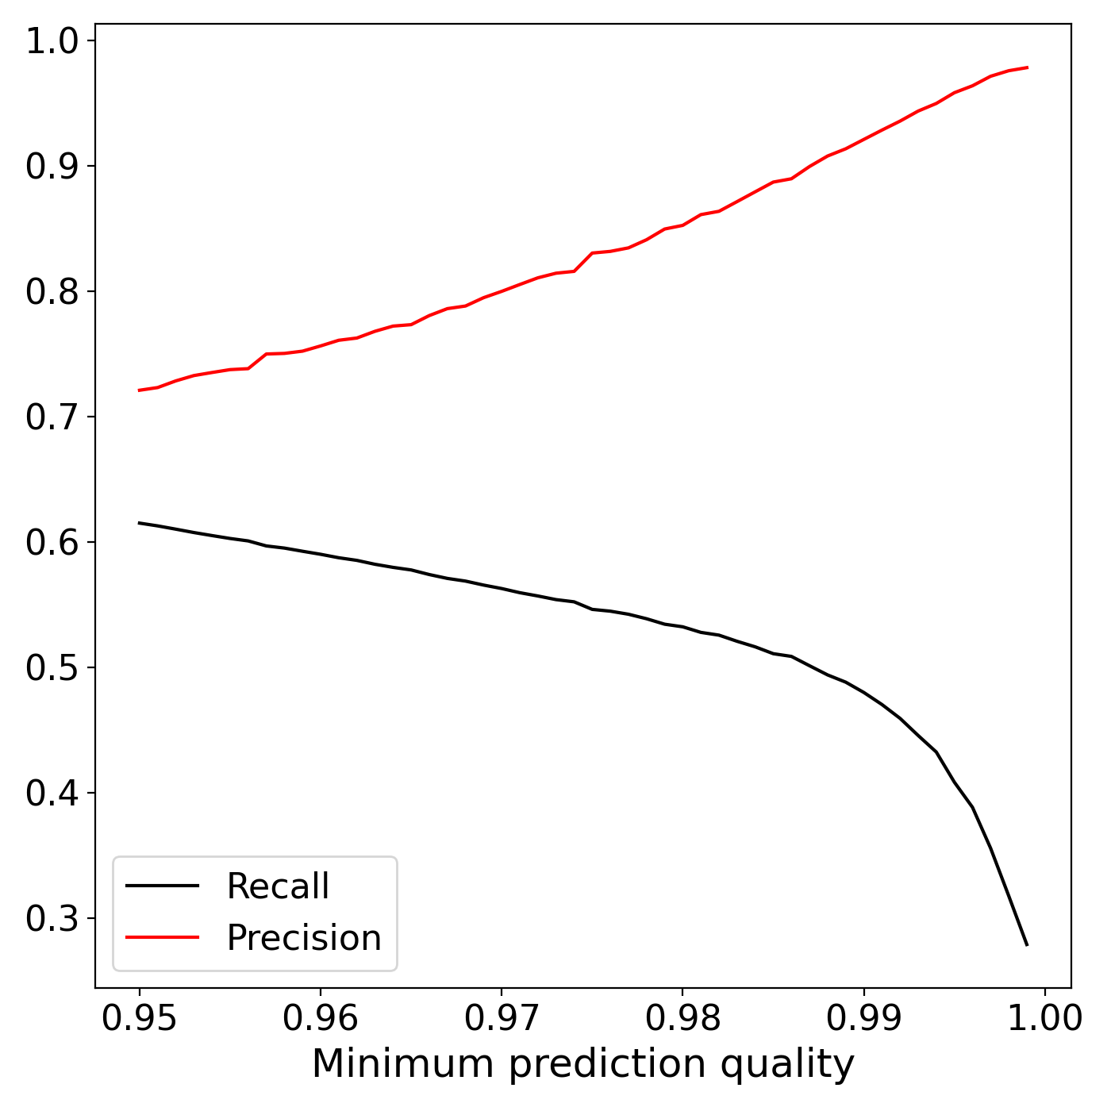
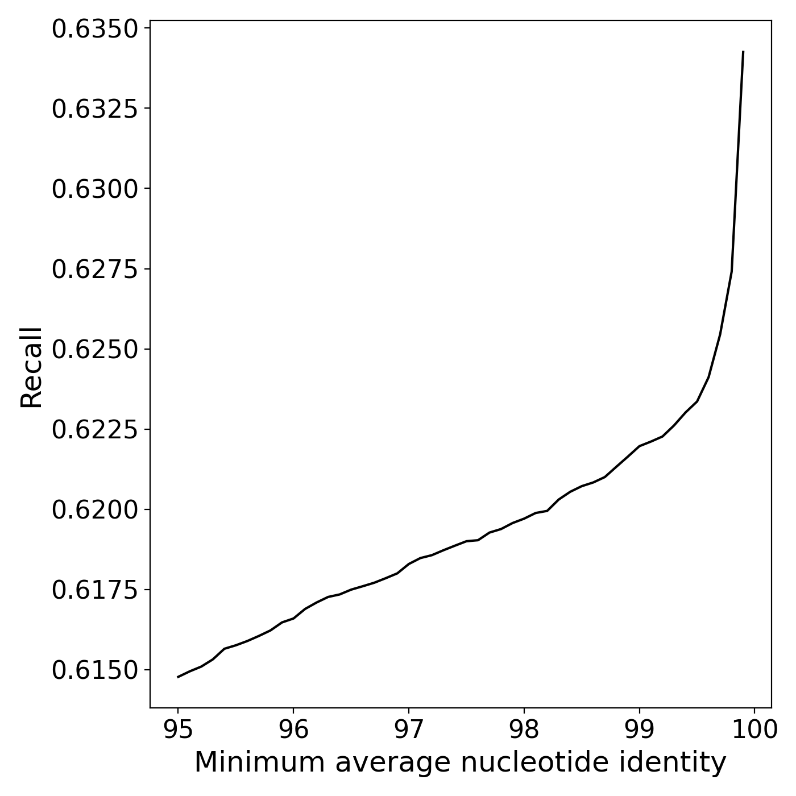
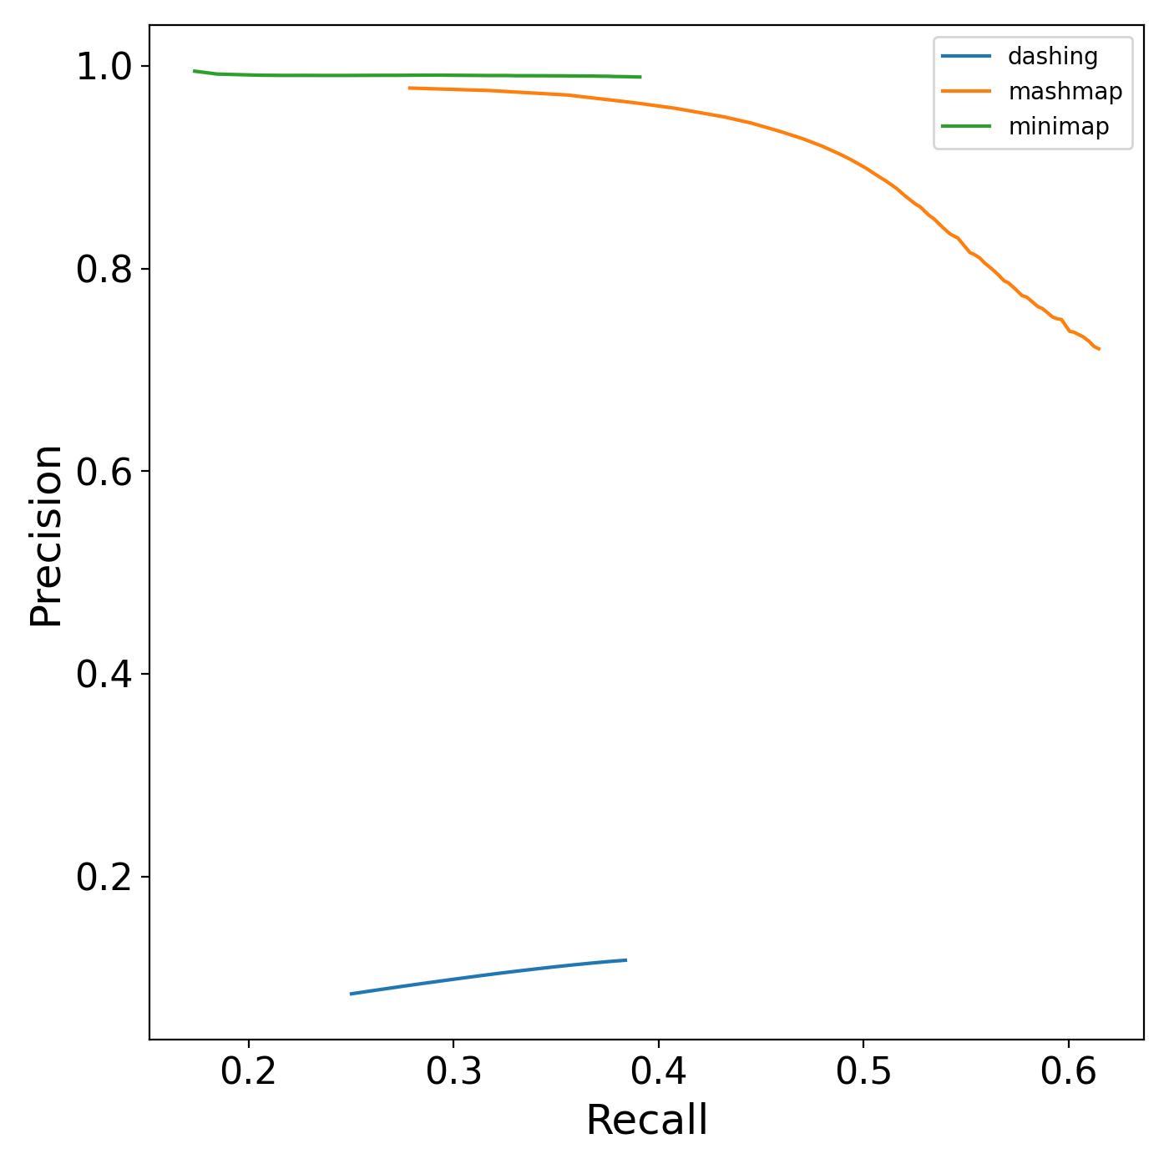
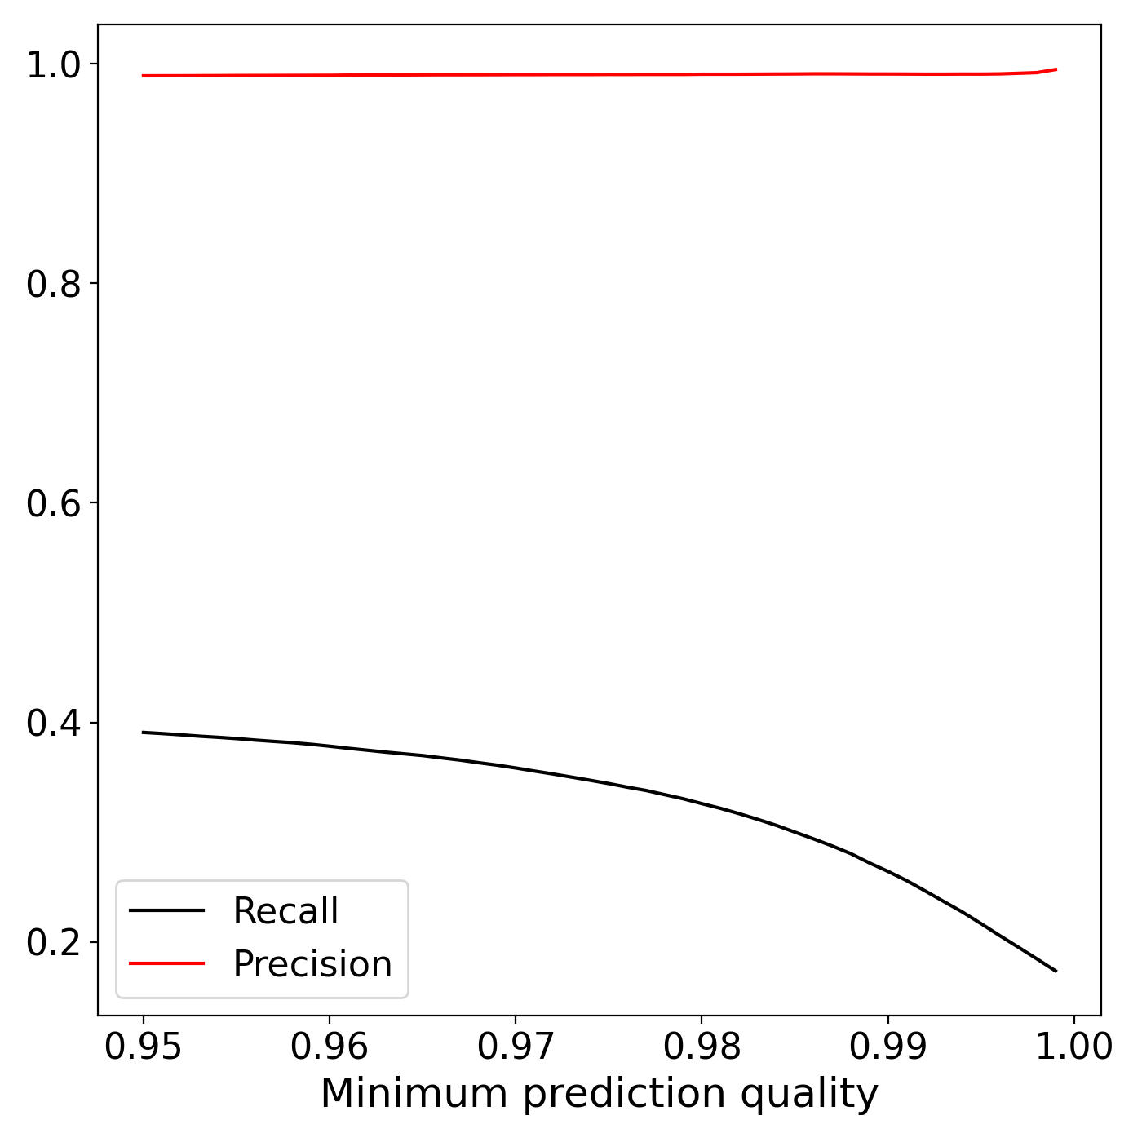
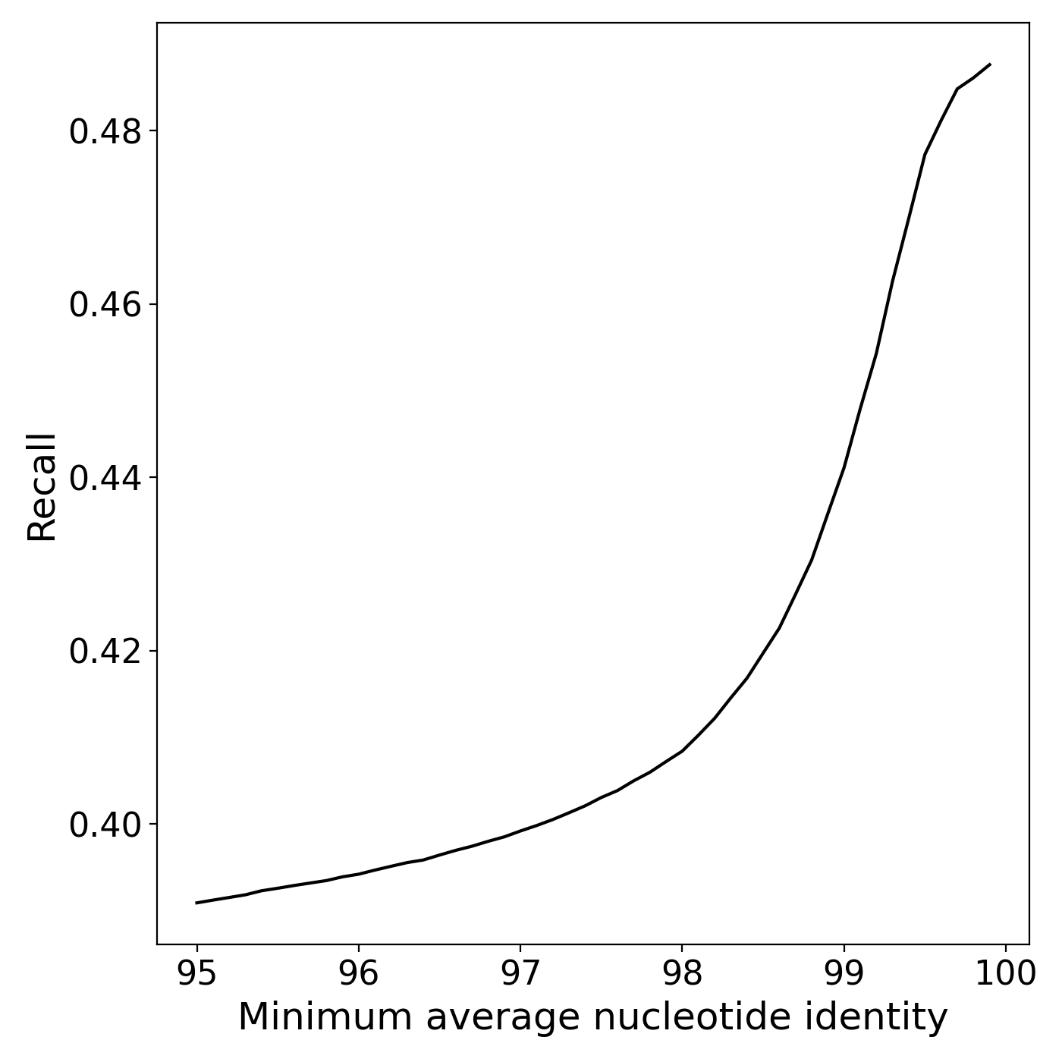
Benchmarking Results - Sharon dataset
dashing
had to partition queries into
separate files; timing not comparable
8 threads
mashmap
0:10.52
minimap
8 threads
0:16.49
Ground truth generated with BLAST
https://www.ncbi.nlm.nih.gov/sra/?term=SRA052203

Slide 12
Codeathon product
“Gold-standard” containment datasets
Snakemake pipeline
Input: query and reference data or tabular output with containments
Output: benchmarking report and tabular output with contaminants in case query and reference data as input

Slide 13
Conclusions and future work
We successfully developed a Snakemake workflow
Challenges we faced this week
Defining a “gold-standard”
Managing complexity of Snakemake workflow and running it seamlessly on the cloud
Future Goals
Add additional tools to benchmarking pipeline
Expanding beyond containments
Scaling to larger datasets

Slide 14
Thank you!
PSSS-Codeathon organizers & support staff
Dan Rice, Alexa Salsbury
PSSS-Codeathon teams

