Slide 1
Predicting SARS-CoV-2 Evolution with Population-Scale Intra-Host Diversity Data Derived from Public SRA Reads
By Jesse Elder, Rahil Ryder, Indresh Singh, Tamas Szabo, Xyanthine Parillon, Ruvarashe Madzime

Slide 2
Background
Minor Alleles in SARS-CoV-2 are not depicted in GISAID results used throughout the world
These minor alleles can give insight to:
Intra-host diversity
What mutations are occurring “in the background”
Could this give us insight to mutations in new variants of concern?
Goals:
Understand minor alleles throughout major COVID-19 lineage periods and determine if we can predict mutations of newer variants.

Slide 3
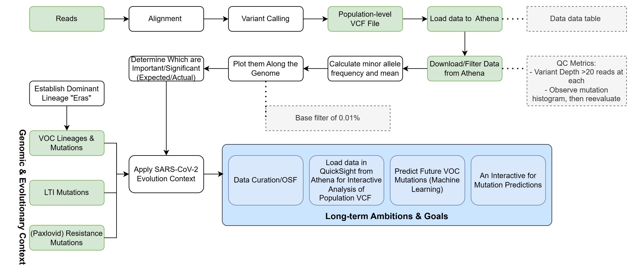
Project Workflow

Slide 4
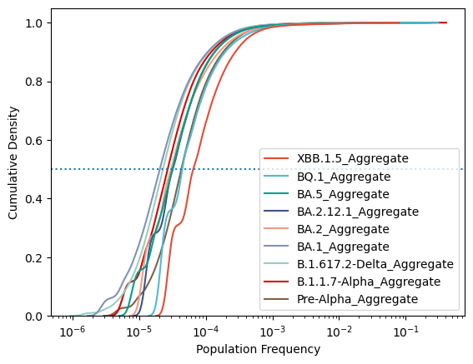
Kernel Density Plot – Minor Alleles in the Population
Extracted minor alleles and analyzed them by Covid Wave
Minor alleles infrequently recur
Most only appearing in 0.01% or less of samples
Slight differences between major lineages/waves
XBB.1.5 has higher Pop. Frequency
More diverse minor allele landscape?
Proportion of samples with a minor allele

Slide 5
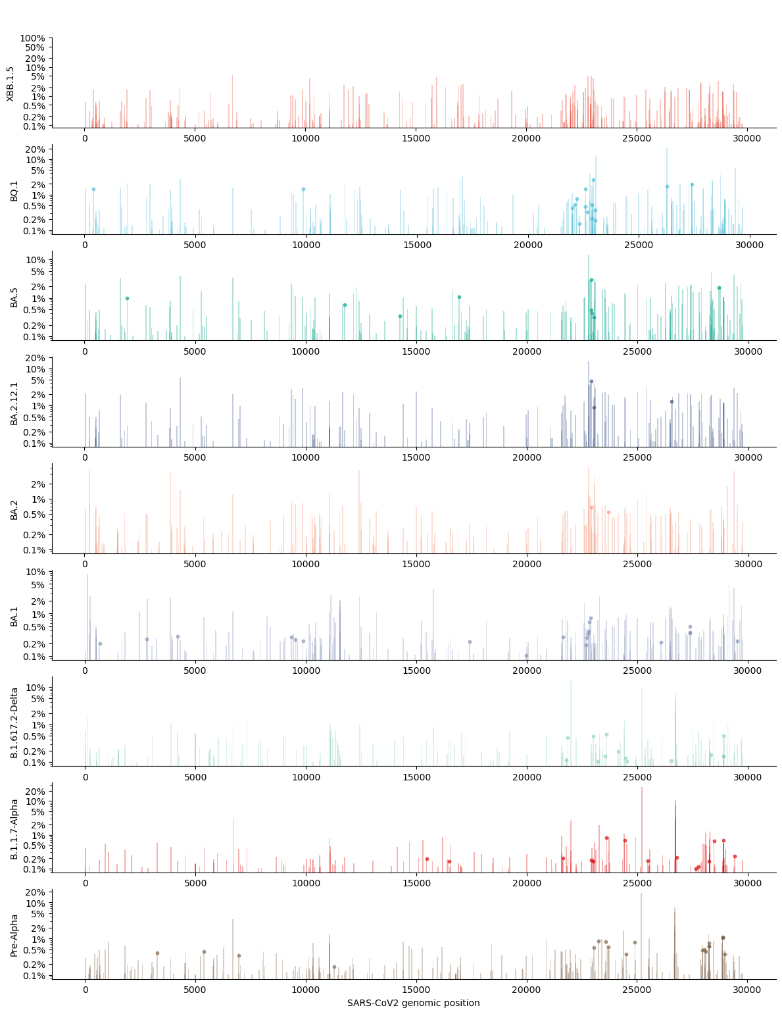
XBB.1.5 Minor Alleles,
??? Pi ??? Points
BA.5 Minor Alleles,
BQ.1 Points
BA.1 Minor Alleles,
BA.2 Points
Pre-Alpha Minor Alleles, Alpha Points

Slide 6
Early Pandemic Mutation Outliers
Position 25202: S:W1214R
Homoplasic mutation (Beta, Gamma variants)
Known to destabilize proteins
https://journals.asm.org/doi/full/10.1128/mbio.01188-21

Slide 7
Early Pandemic Mutation Outliers
Position 21987: S:G142D
Omicron defining mutation!!!
Dot out of place bc deletion
Associated with back mutations
Immune evasion
Position 26714-15: M:C65_FRAMESHIFT
Unclear, possible error
Disrupts M gene
Detrimental

Slide 8
BA.2 & Beyond
Position 23055, 26270:
S:Q498R, E:T9I
Characteristic mutations of BA.1
Consensus in BQ.1, but minor allele here
Position 22786: S:R408S
BA.2 defining mutation
Sometimes only a minor allele
Around 30% MAF when it is present
Other RBD mutations recur frequently

Slide 9
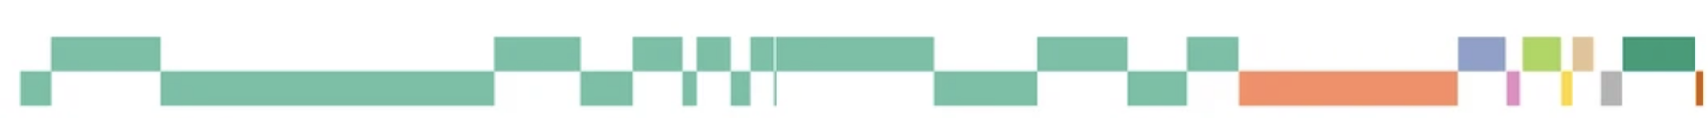
Clear bump in recurrent mutations around Spike, RBD
Relatively stable, fewer mutations
Non-spike gene mutations more common post BA.1

Slide 10
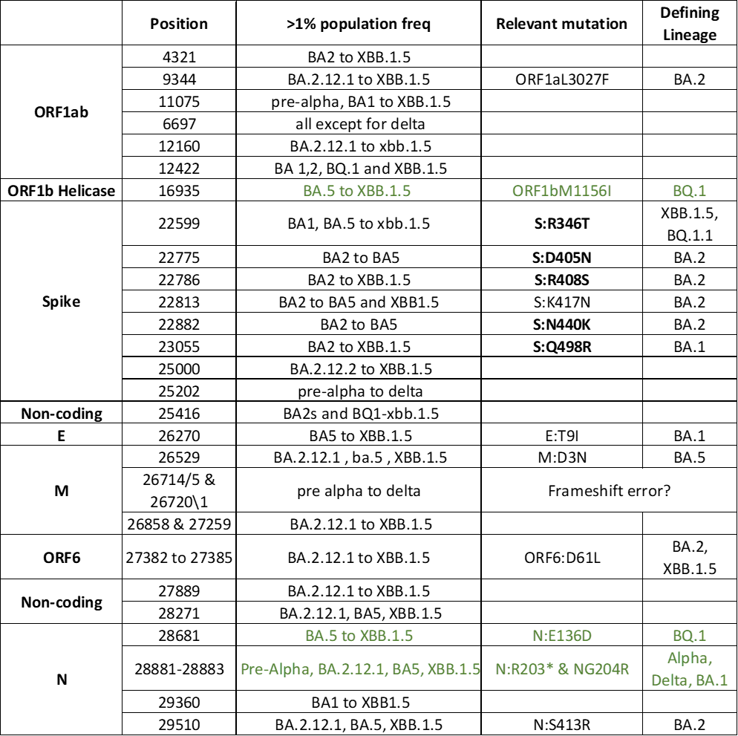
Trends between Lineages
Known S-Gene Immune Escape regions from Bloom Lab calculator
Notes:
https://twitter.com/jbloom_lab/status/1684649571086131200/photo/1

Slide 11
Conclusion
Covid pandemic characterized by waves of new lineages taking over
Population-scale intra-host diversity data is under-studied
Rich data not captured by consensus genome analyses
Spike and N gene mutations are common recurrent minor alleles
More diverse mutations after S gene post-BA.1 wave
Gives insight to gene regions outside of S-gene to look into for immune escape
Lineage-defining mutations do recur in population prior to lineage dominance
Not clear if more frequent than other minor alleles
Statistical testing needed to know if population frequency elevated

Slide 12
Future Considerations
Machine Learning & Algorithms for predicting future mutations in dominant lineages
Hotspots-Genes mutated more frequently than would be in the absence of selection
Apply additional genomic context to evaluate evolutionary selection pressures

Slide 13

Humans = Humans
Raptors = SARS-CoV-2
😬

Slide 14
Future Considerations
Machine Learning & Algorithms for predicting future mutations in dominant lineages
Hotspots-Genes mutated more frequently than would be in the absence of selection
Apply additional genomic context to evaluate evolutionary selection pressures
Involves Filtering – drivers, indels, noncoding mutations, mutations not matching the reference dominant lineages
dN/dS ratio by gene/domain
Apply a Binomial Statistical Model –lineage diversity, mutational specificity, and identifying recurring mutations- in identifying the frequency of minor alleles Nat Biotechnol. 2016 February ; 34(2): 155–163. doi:10.1038/nbt.3391
Paxlovid-resistance mutations – do they start appearing as minor alleles after its approval for treating severe Covid-19?
Long-term infection associated mutations – how frequently do they appear as minor alleles
Project Curation
Elder, J., Singh, I., Ryder, R., Parillon, X., Madzime, R., & Szabo, T. (2023, August 3). Predicting SARS-CoV-2 Evolution Using Population-Scale Intra-Host Diversity Data Derived from Public SRA Data. https://doi.org/10.17605/OSF.IO/YVDRM

