Slide 1
Background
Enterococcus is an important bacterial pathogen
Mobile elements such as transposons and plasmids are important features
Often contain resistance genes, which compromise therapy
Enterococcus can be used as test case to identify mobilome and resistome

Slide 2
15,000 SRR of Enterococcus faecalis and Enterococcus faecium
Assembly by SKESA
AMRFinder
BLAST
Annotation of mobile elements by PGAP
Plasmid identifiers
Transposons
Combine results
Report of features at contig level
Map back to known mobile elements
Comprehensive resistome and mobilome analysis

Slide 3
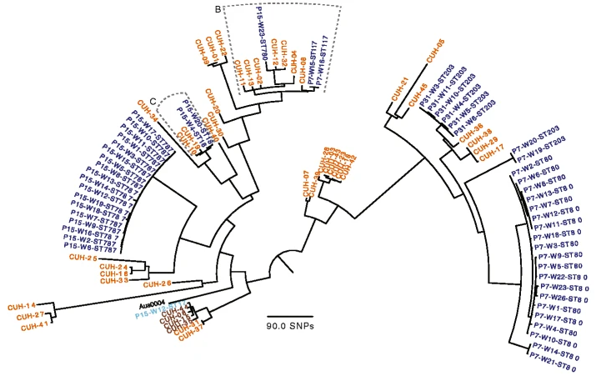
Comparison to known published studies and other interests
1. WGS showing vancomycin transmission in healthcare network Brodrick, et al., 2016
clusters matched the Pathogen Detection clustering
except for only a few instances
vancomycin genotypes matched, other AMR genes
were variable
mobile elements were sometimes similar within
transposons are fragmented
plasmids are highly variable

Slide 4
Example output - p15 cluster
Contig | Start | Stop | Gene symbol | Type | % Coverage | Accession of closest sequence
SAMEA3108573-rid19343.denovo.103 | 1 | 819 | NA | Plasmid | 5.43 | HM565172.1
SAMEA3108573-rid19343.denovo.103 | 47 | 2971 | NA | IS
SAMEA3108573-rid19343.denovo.103 | 820 | 5698 | NA | Transposon | 3 | FJ349556.1
SAMEA3108573-rid19343.denovo.103 | 3117 | 3692 | NA | IS
SAMEA3108573-rid19343.denovo.103 | 3906 | 4601 | vanR | AMR | 100 | WP_001280781.1
SAMEA3108573-rid19343.denovo.103 | 4579 | 5730 | vanS | AMR | 97.14 | WP_002305818.1
SAMEA3108573-rid19343.denovo.103 | 5699 | 5896 | Tn1546 | Transposon | 1.54 | KR047792.1
SAMEA3108573-rid19343.denovo.103 | 5753 | 5896 | IS6 | IS
SAMEA3108573-rid19343.denovo.121 | 1 | 3018 | NA | Transposon | 2.23 | FJ349556.1
SAMEA3108573-rid19343.denovo.121 | 256 | 1224 | vanH-A | AMR | 100 | WP_001059542.1
SAMEA3108573-rid19343.denovo.121 | 1217 | 2248 | vanA | AMR | 100 | WP_001079845.1
SAMEA3108573-rid19343.denovo.121 | 2254 | 2862 | vanX-A | AMR | 100 | WP_000402347.1
SAMEA3108573-rid19343.denovo.121 | 2926 | 3018 | IS6 | IS
SAMEA3108573-rid19343.denovo.137 | 1 | 1932 | Tn1546 | Transposon | 15.03 | KR047792.1
SAMEA3108573-rid19343.denovo.137 | 208 | 693 | vanZ-A | AMR | 100 | WP_000516404.1
SAMEA3108573-rid19343.denovo.137 | 846 | 1757 | vanY-A | AMR | 100 | WP_001812592.1

Slide 5
p7 cluster, shows variable plasmid coverage, even in cases where AMR genes were the same
aac(6'),ant(6)-Ia,aph(3')-IIIa,eat(A),msr(C),sat4,tet(S),vanA,vanH-A,vanR,vanS,vanX-A,vanY-A,vanZ-A

Slide 6
2. optrA genes in E. faecalis (Zhou et al., 2019)
only region that matches is fexA-optrA (~3 kb) to the plasmid
reported in the paper
mobile element results are inconclusive
3. comparison to mlplasmids (SVM built specifically for E. faecium
(on small subset ~95% concordance to contigs identified by blast)
but does not name the plasmid

Slide 7
4. evaluation of vancomycin resistance in US isolates with
similarity to pLG1 megaplasmid (for which no complete
sequence exists)
- may result in efforst to recover plasmids and completely
sequence and close (PacBio, etc.)

Slide 8
Issues
Plasmids are modular, taking the best blast hit will not suffice - a global analysis is needed - especially as SKESA assemblies are fragmented
Reference set was incomplete, needs more evaluation
Reference plasmids are not completely closed, need more complete plasmid sequences
Enterococcal plasmids can mobilize chromosal genes - complicating assignment to plasmid vs. chromosome

Slide 9

Future directions
Further evaluation of algorithm and reference set
Incorporate tool into NCBI Pathogen Detection Pipeline
Expand to additional bacterial genera
Report on detailed variants of mobile elements - mobile networks?
https://www.ncbi.nlm.nih.gov/pathogens/

