Slide 1
BioAssay Express: Applying FAIR Principles to BioAssay Protocols
Bioassay experiments should provide a minimum amount of information to be FAIR (even in principle)
Detailed
Machine Readable
Searchable
Standardized
Different consortiums have established minimum reporting guidelines for various experiments
MIBBI - Minimum Information for Biological and Biomedical Investigations
NCBI SRA (Sequence Read Archive), GEO (Gene Expression Omnibus)
How well are these guidelines actually implemented in publications?

Slide 2
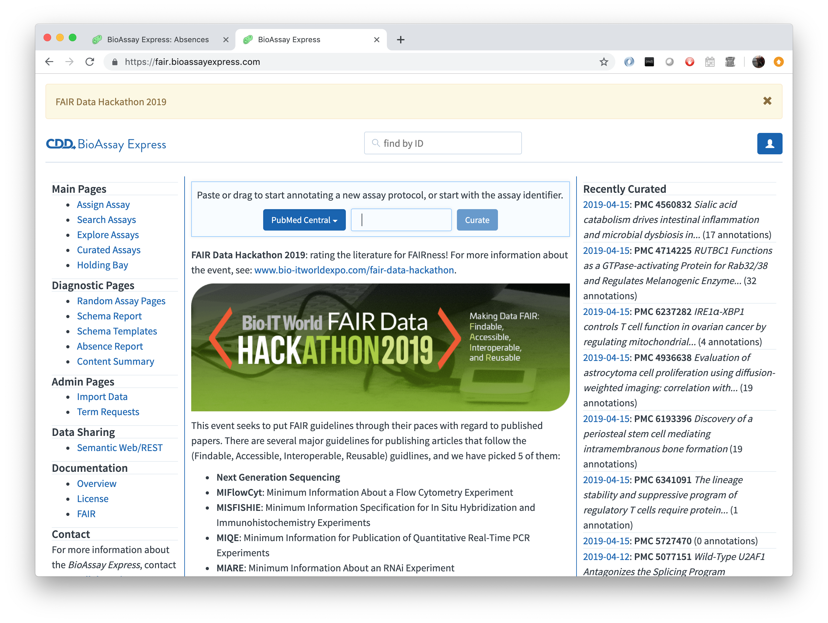
FAIR Data Hackathon: BioAssay Protocols
The right way should be the easy way
Applying FAIR data principles should not be a burden to the scientist,
if they are, how could we ever hope for universal implementation?

Slide 3
Goals
Created 5 templates based on published recommendations:
NextGen Sequencing: Suggested metadata submission information for the Sequence Read Archive
MIARE: Minimum Information About an RNAi Experiment
MIFlowCyt: The Minimum Information About a Flow Cytometry Experiment
MIQE: Minimum Information for Publication of Quantitative Real-Time PCR Experiments
MISFISHIE: Minimum information specification for in situ hybridization and immunohistochemistry experiments
Customized the BioAssay Express for this purpose:
https://fair.bioassayexpress.com
Select publications – and try to annotate them. How well will they fare?

Slide 4
FAIR Data Hackathon: BioAssay Protocols
Find articles on PMC with relevant bioassays
Search Methods sections, SRA and GEO links for reported info
Populate BioAssay Express template with details provided
Note MISSING details
Assess missing details / # of assays
Outcome Analysis & Questions:
How well are minimum information standards implemented?
Is there a problem? Can we provide a solution?
How can we make it easier for the scientist and more FAIR?

