Slide 1
Bio-IT hackathon
Method Optimization for NEAT WDL
Diversifying BAMSurgeon WDL to add functionality

Slide 2
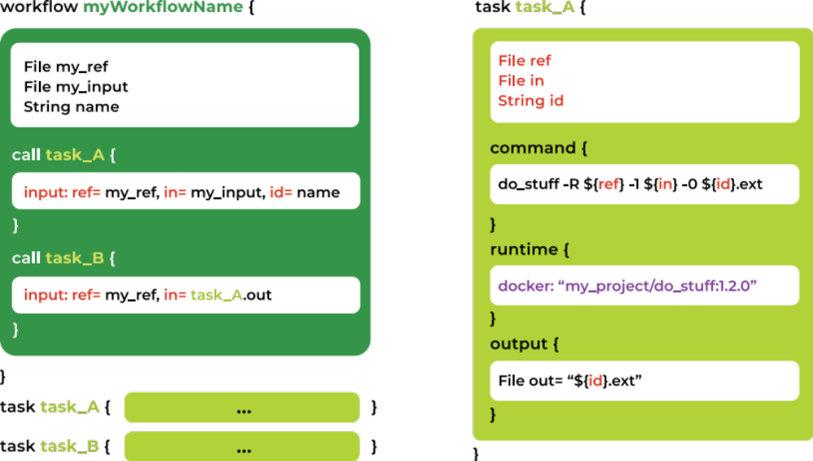
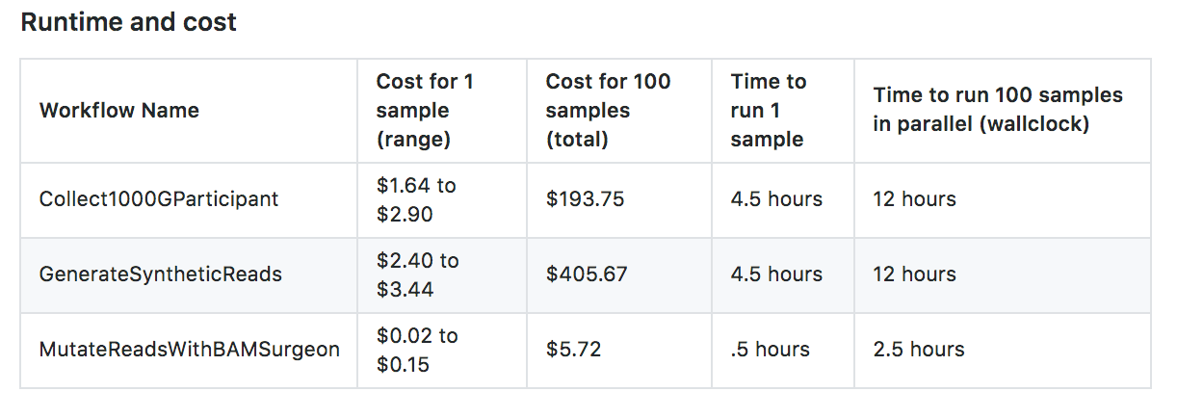
Method Optimization
Generating synthetic reads with 1000 genomes and additional parameters to provide even coverage, etc.
This tool is meant to support FAIR principles
Decreasing the cost will aid in adoption

Slide 3
Diversifying BamSurgeon options
A WDL uses Bamsurgeon for spiking variants
Currently the WDL only supports SNVs
Adding INDELs & SVs

