Slide 1
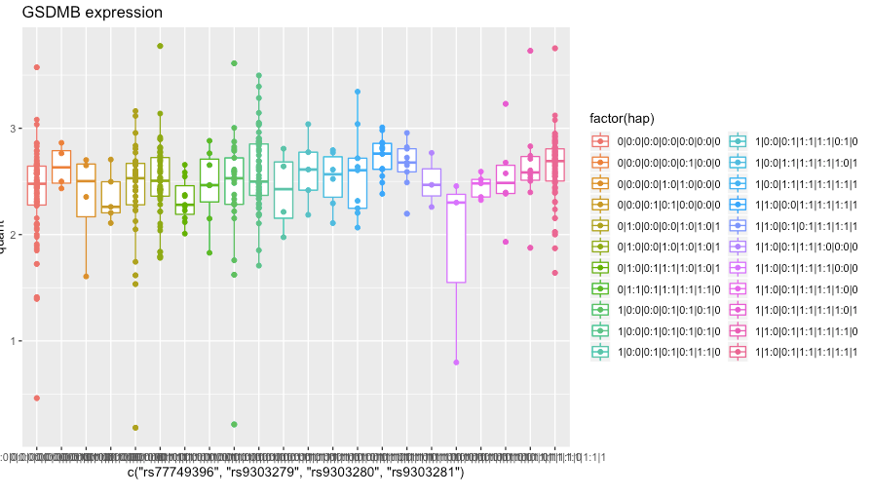
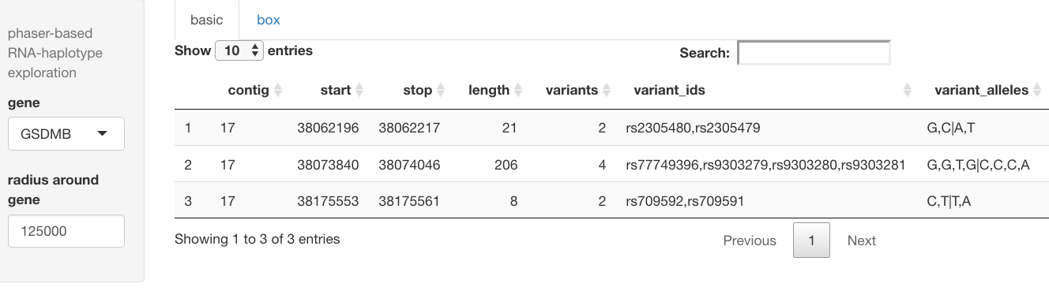
DNA phased
VCF
phASER
RNA-seq
BAM files
haplotype.txt
BiocRNAHap
https://github.com/vjcitn/BiocRnaHap

