Slide 1
Supplemental Figures
Consensus Machine Learning for Gene Target Selection in Pediatric AML Risk

Slide 2
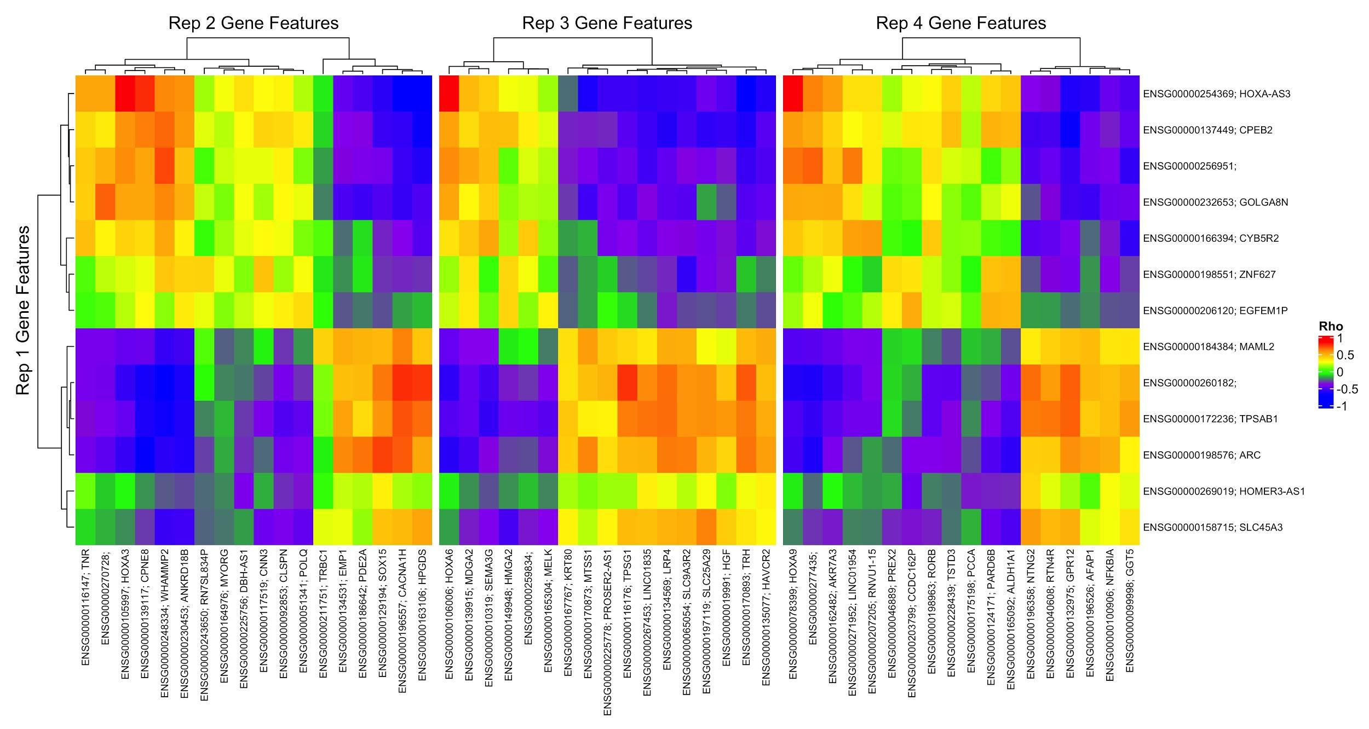
Notes:
1. Correlation of gene expression (entire dataset) across gene features selected in iteration 1 vs. iterations 2-4 of XGBoost ablation tests (see Results, Supplemental Materials).

Slide 3
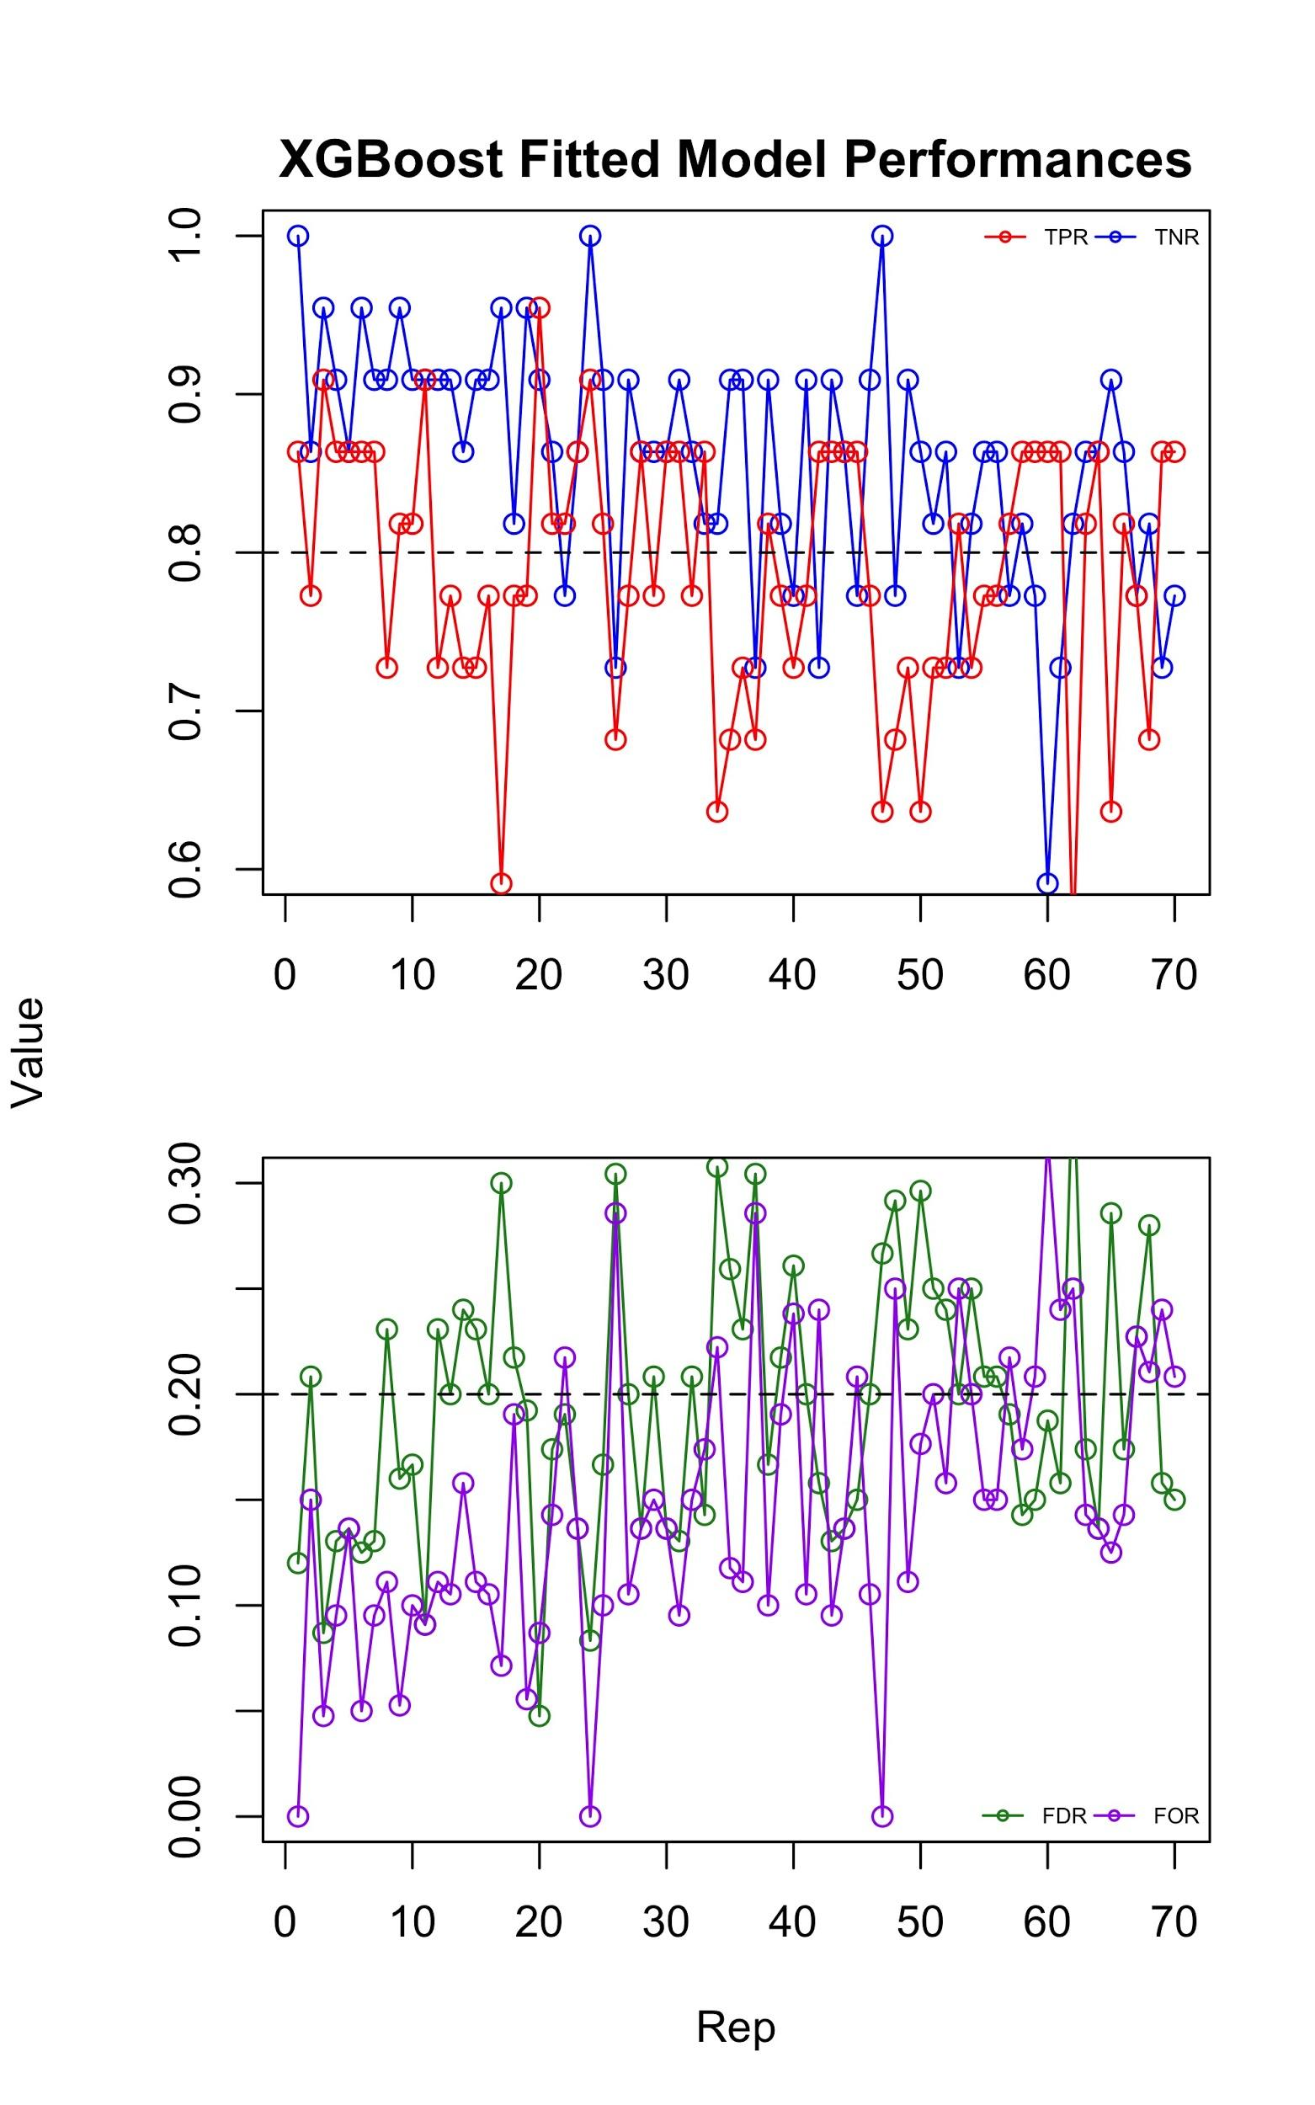
Notes:
2. XGBoost fitted model performances across 70 iterations of ablation. (Top) true positive rate (TPR), and true negative rate (TNR). (Bottom) false discovery rate (FDR) and false omission rate (FOR).

Slide 4
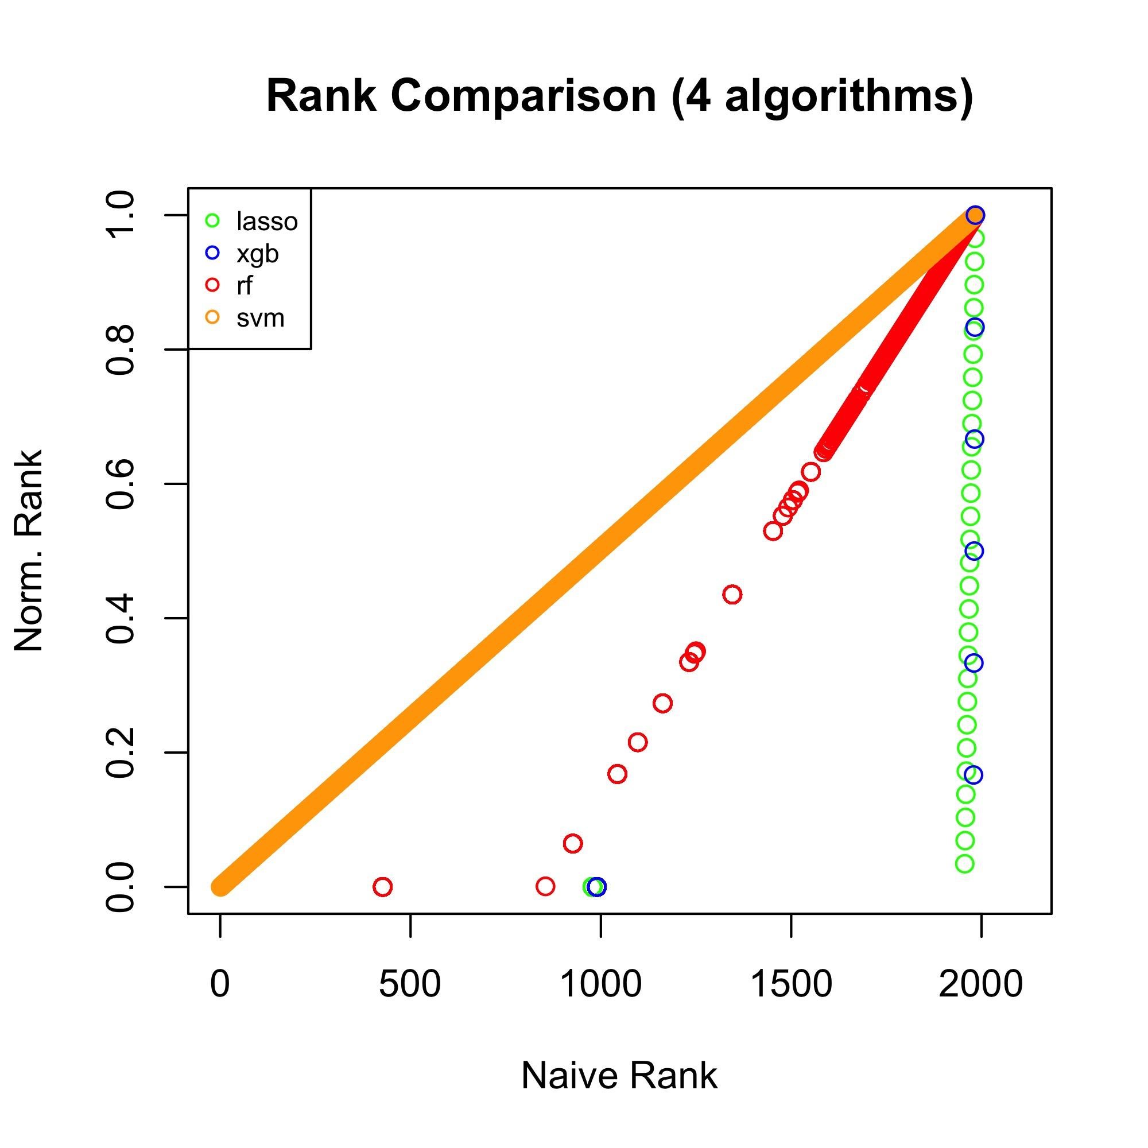
Notes:
3. Boruta permutations consensus rank metric comparison. Comparison of naive (x-axis) and normalized (y-axis) rank across features, for each of 4 algorithms used (see Figure 4A, Supplemental Materials).

Slide 5
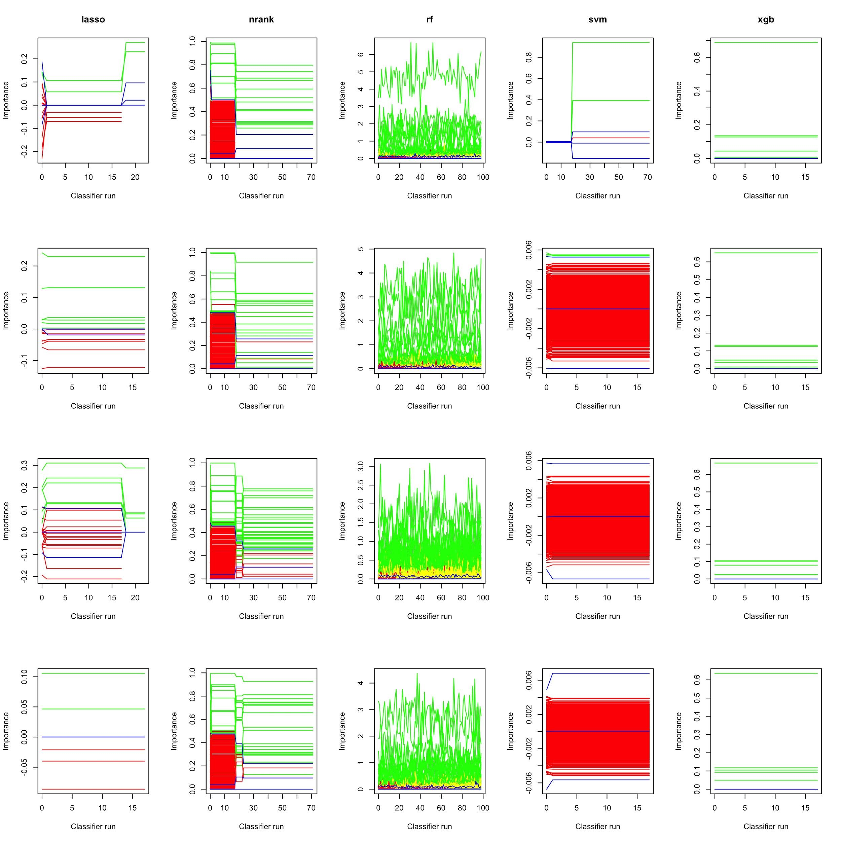
Notes:
4. Comparison of feature importance across Boruta permutations for 5 bootstrap iterations (selected at random). Each column shows bootstraps for premutations with a different importance metric (either lasso, consensus importance “nrank”, random forest “rf”, SVM “svm”, or XGBoost “xgb”).

Slide 6
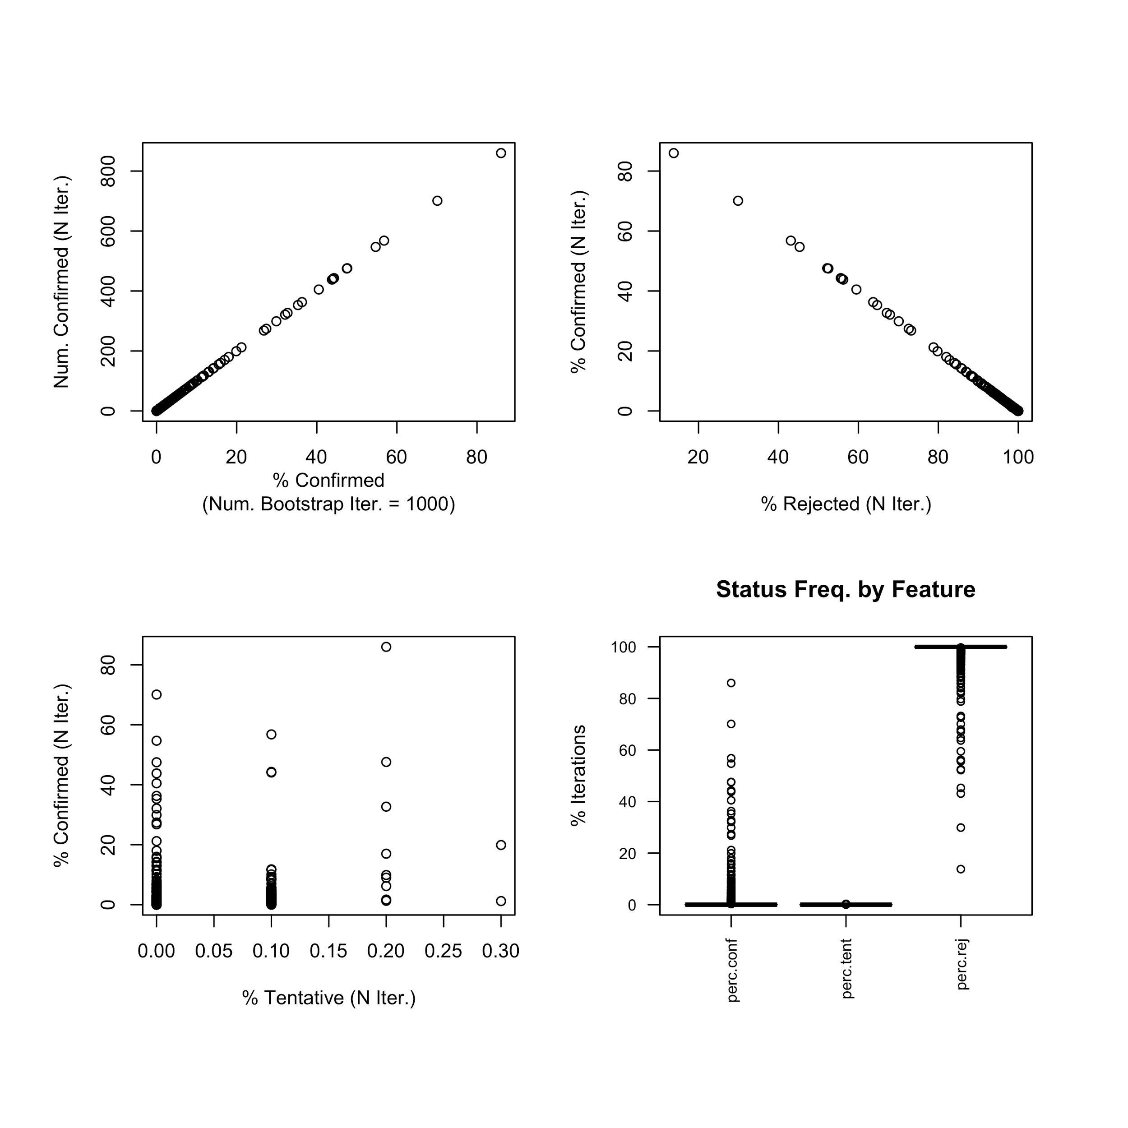
Notes:
5. Feature classification summary across Boruta bootstraps (N = 1,000) with consensus importance (“nrank”).

Slide 7
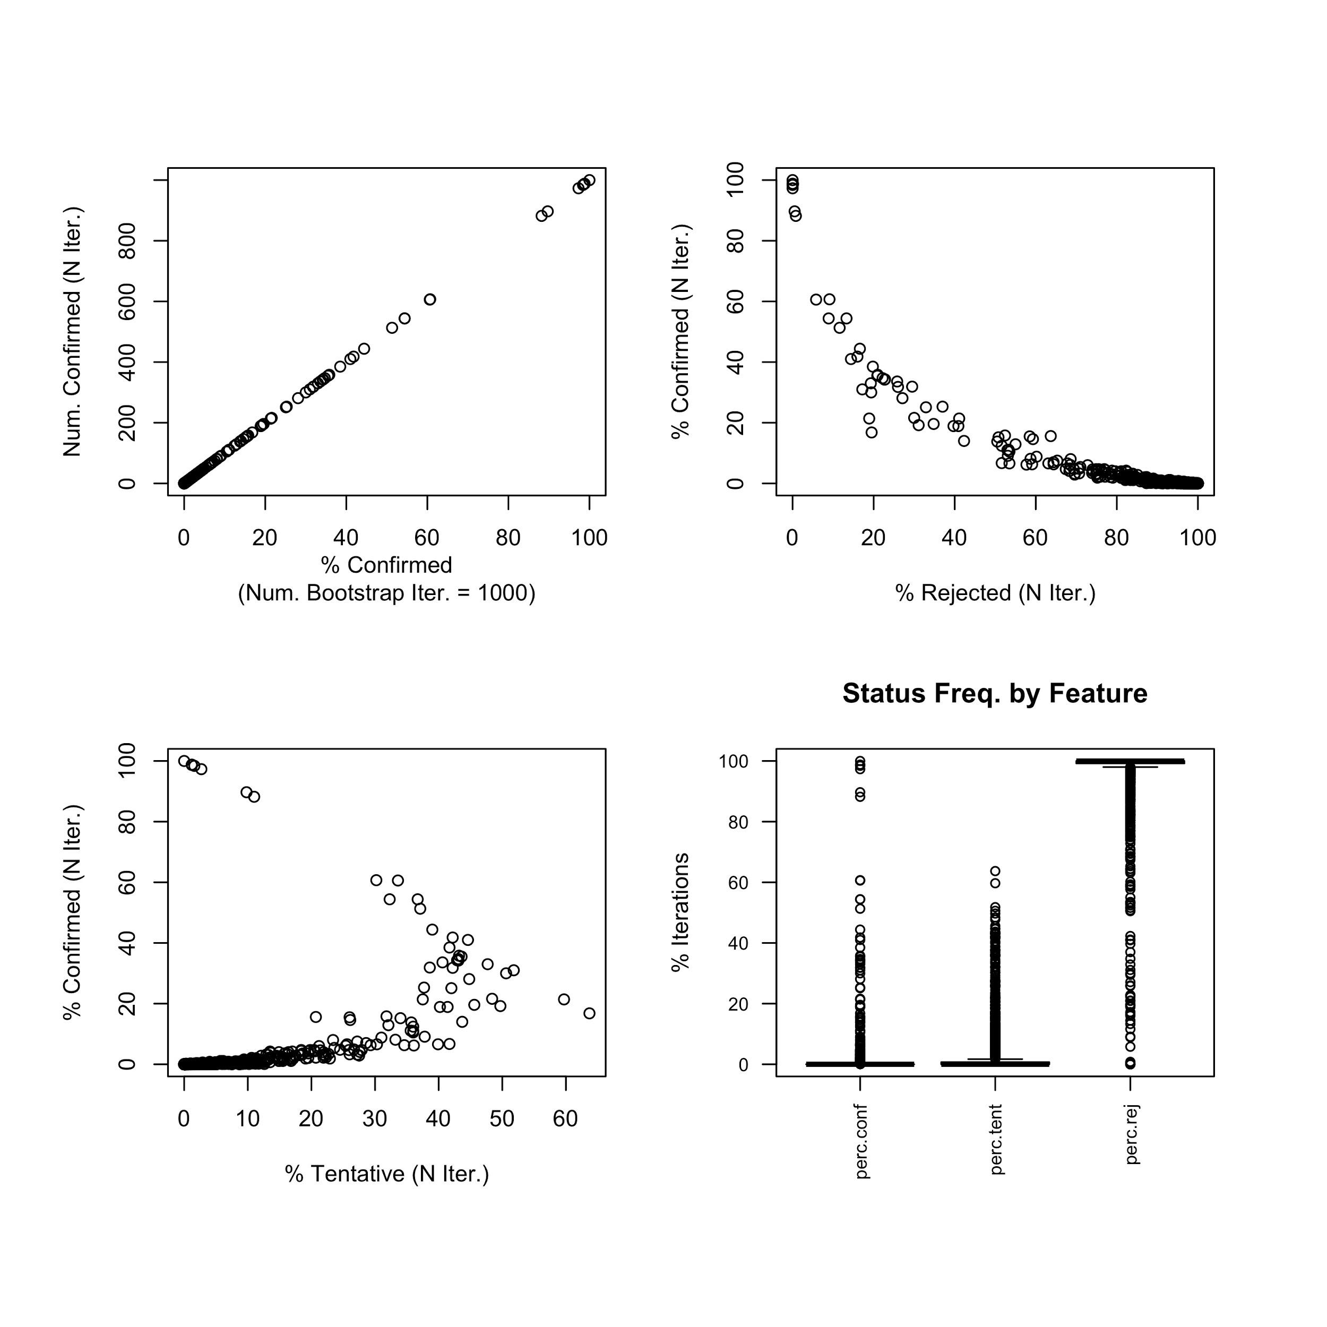
Notes:
6. Feature classification summary across Boruta bootstraps (N = 1,000) with Random Forest importance.

Slide 8
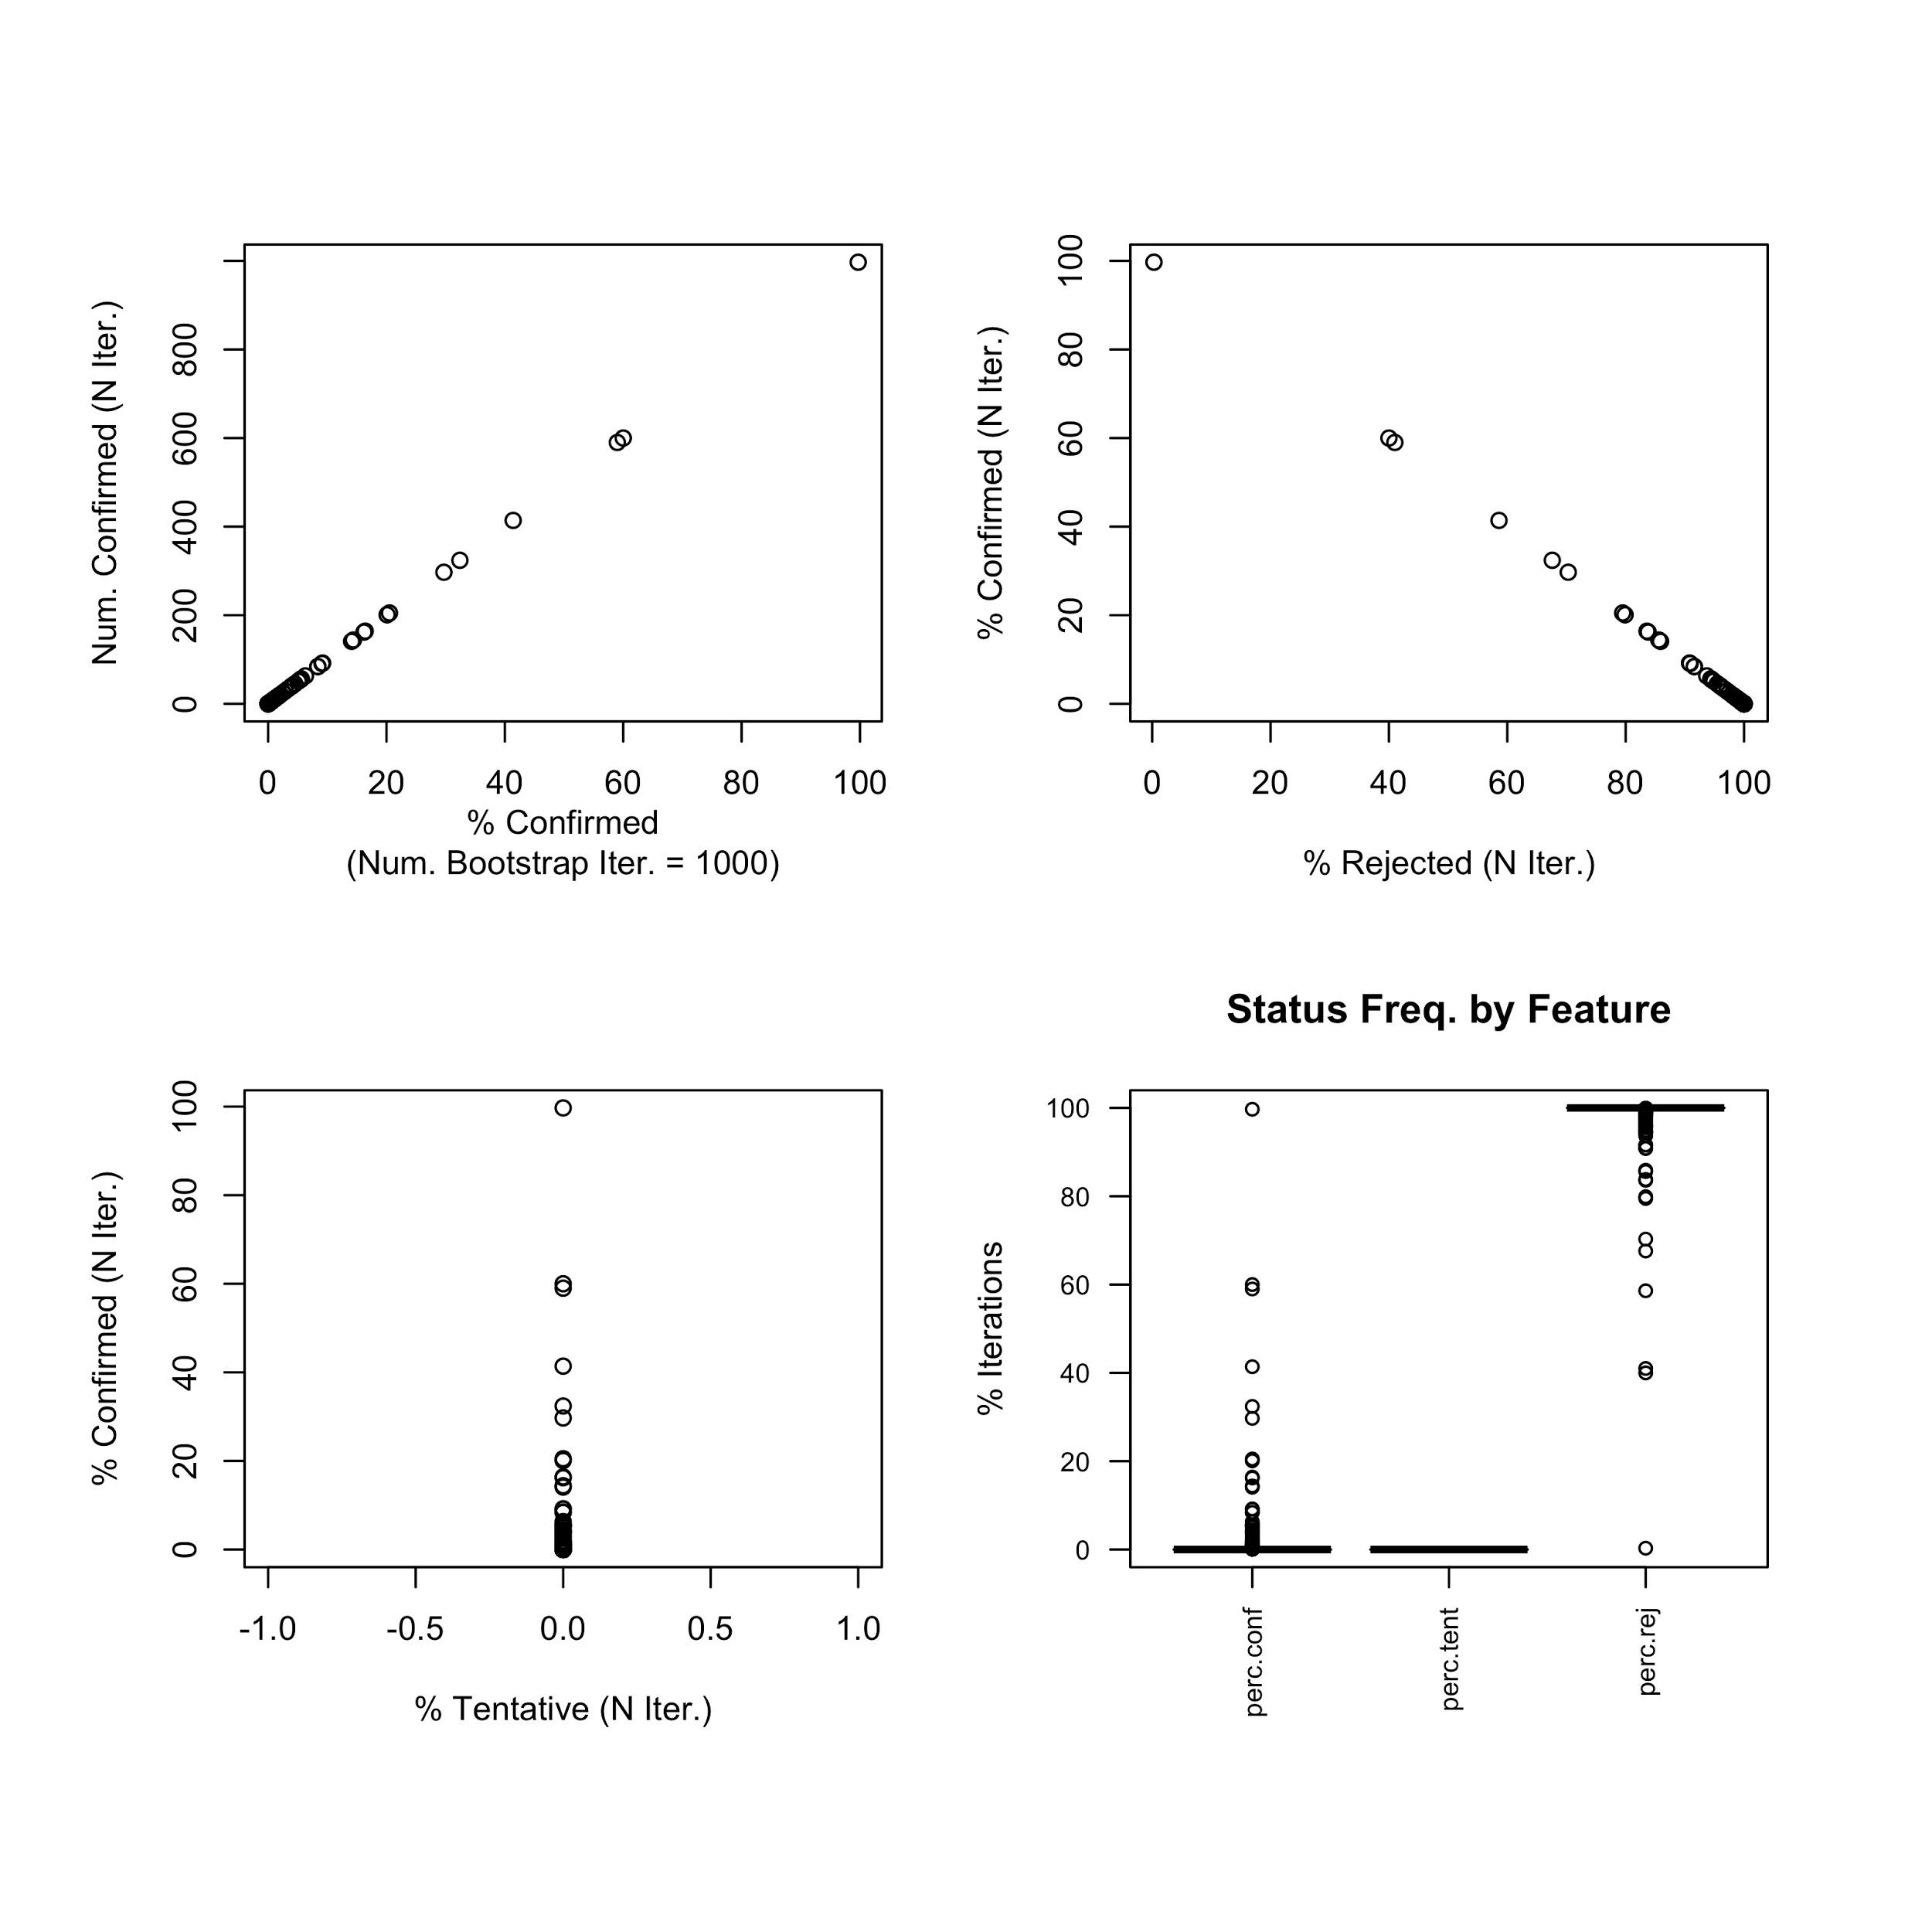
Notes:
7. Feature classification summary across Boruta bootstraps (N = 1,000) with lasso importance.

Slide 9

Notes:
8. Feature classification summary across Boruta bootstraps (N = 1,000) with SVM importance.

Slide 10

Notes:
9. Feature classification summary across Boruta bootstraps (N = 1,000) with XGBoost importance.

Slide 11
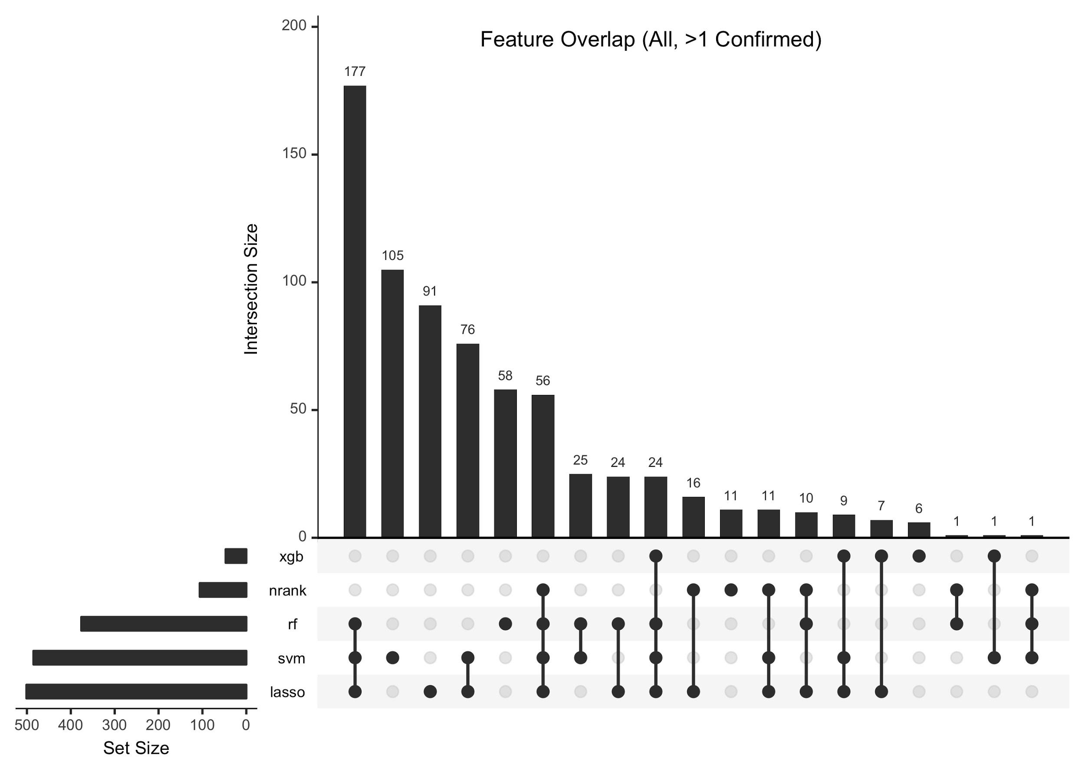
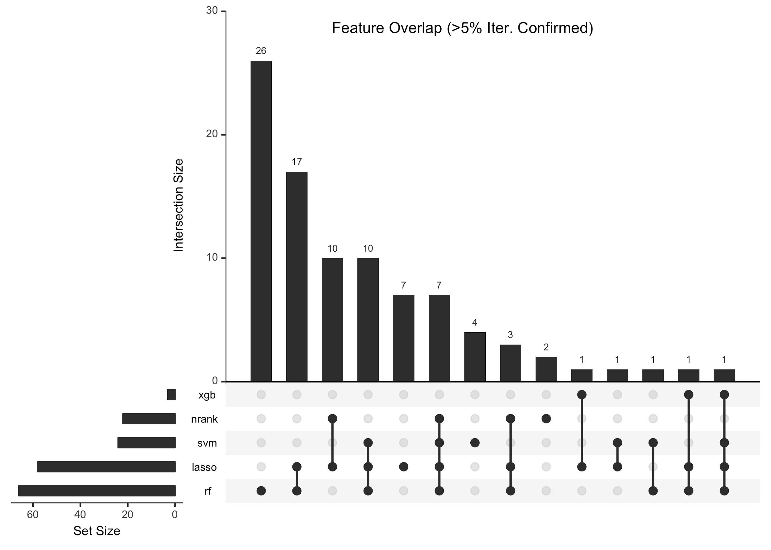
A
B
Notes:
10. Recurrent important gene features from Boruta bootstraps with 5 importance metrics, showing genes confirmed in 1/1,000 bootstraps (A), or at least 5% or 50/1,000 bootstraps (B).

