Slide 1
NeuroFindeRs
Fatma Ayhan
Maria Bagonis
Spencer Barnes
Prissha Krishna Moorthy
Balaji Parameswaran
Yunjie XU

Slide 2
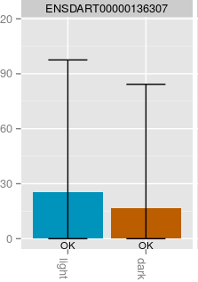


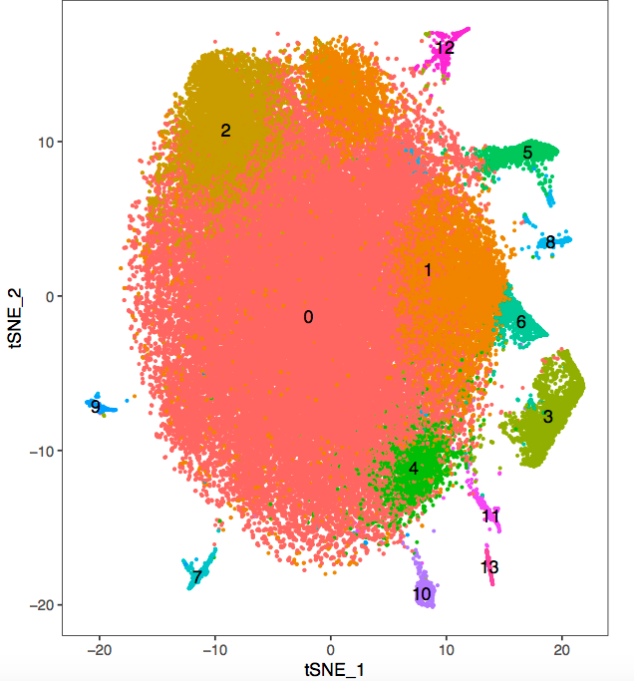


Single-Cell RNA-seq
RNA-Seq
Single-cell
RNA-seq

Slide 3
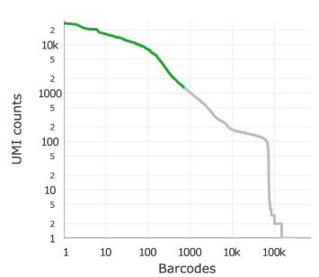
Filtering Noisy Data

Slide 4
NeuroFindeR Workflow
27000 genes
86000 cells
Determine PCAs
Cluster data
with Seurat
1
2
Total molecules
vs
Distance to cluster
centroid
Use A priori high confidence/high expressed markers
For major cells types

Slide 5
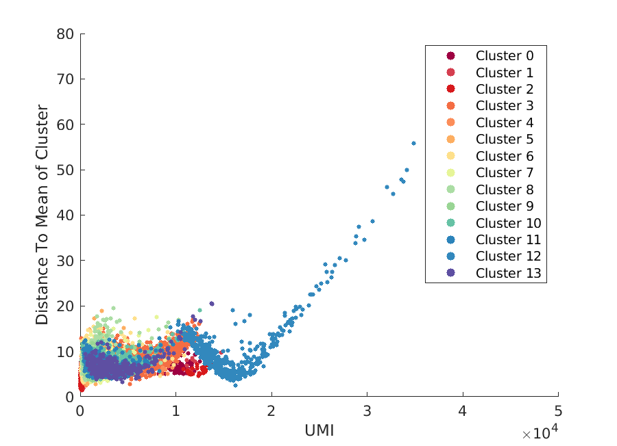
Approach 1: Total Molecules vs Distance to Cluster Centroid

Slide 6
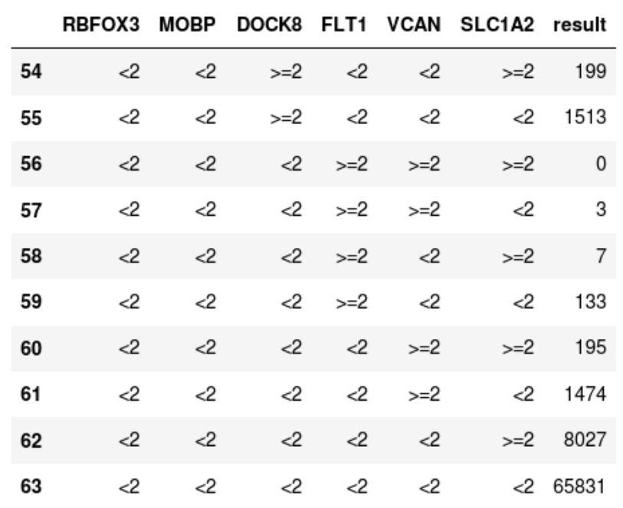
Approach 2: Major cell type markers

Slide 7
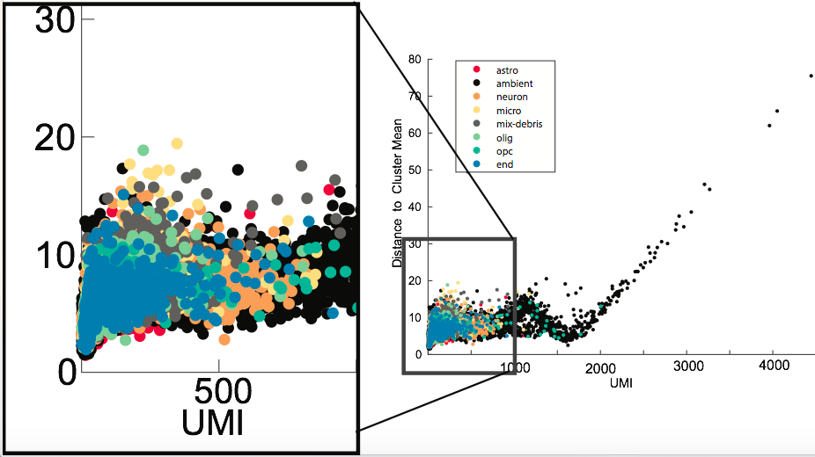
Overlay Two Approaches

