Slide 1
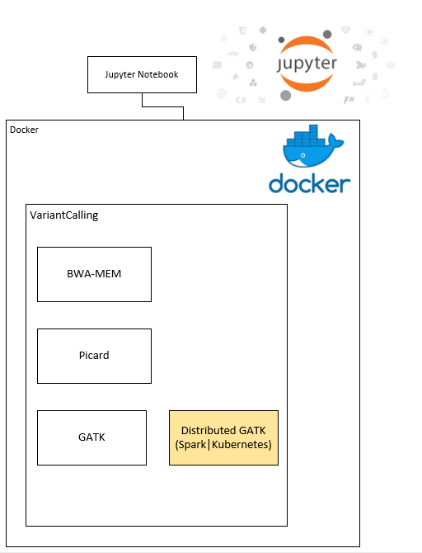
Embedding Docker
Seattle SnowHack2019 at Fred Hutch (2/4-6)
Team Members:
Aakash Sur
Dev Nambi
Ling-Hong Hung
Xingzhi Niu
Vera Diaz
Base Goal
Stretch Goals
Improve nbdocker
Hi-C pipeline

Slide 2
Jupyter Progress
Done:
Jupyter notebook has been structured with variant calling workflow, with docker commands.
(FASTQ – VCF)
DATA:
FASTQ files from 1000 genome project
BWA samtools docker container
In progress:
Embedding nbdocker commands to the notebook
Small POP data sets that can be stored on git
parameter_output file
Test with GATK4 on Kubernetese

Slide 3
Jupyter Notebook Review

