Slide 1
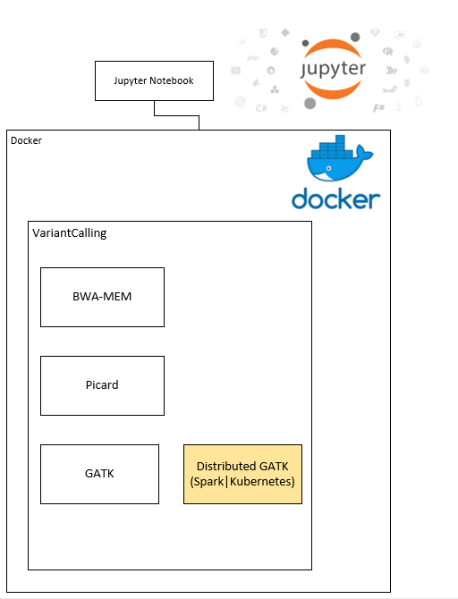
Embedding Docker
Seattle SnowHack2019 at Fred Hutch (2/4-6)
Team Members:
Aakash Sur
Dev Nambi
Ling-Hong Hung
Xingzhi Niu
Vera Diaz
Base Goal
Stretch Goals
Improve nbdocker

