Slide 1






FAIR Beyond Data – Applications as FAIR
Notes:
The files stored on TCGA are in 2 different formats,
The goal is to get the data into a format so that the rmats_trim.py program could trim it to 48 BP
Case 1: fastq files individually saved as gzipped data fastq1.gz, fastq2.gz
wget $ftpfile1 &&
wget $ftpfile2 &&
gunzip *.gz &&
Case 2: both fastq files are tar‘d and zipped into a single tar.gz file
tar xvfz *.tar.gz &&
Case 3: fastq files are gzipped and then tar‘d
tar xvf *.tar &&
zcat /mnt/data/input/$file1gz > /mnt/data/output/$file1 &&
zcat /mnt/data/input/$file2gz > /mnt/data/output/$file2 &&

Slide 2
FAIR Beyond Data – Applications as FAIR
Complete Workflow
Data are FAIR
Applications are FAIR
Data out are FAIR

Slide 3
FAIR Beyond Data – Applications as FAIR
Dockerized
Exomizer
Link-out
Lifebit.ai (deploit)
Exomizer
Human gene list
+ Metadata
DisQover
Select a vcf file using metadata
Vcf
Metadata
Data Biology
Exomizer
HIPPA
Dockerized
geneweaver
Lifebit.ai (deploit)
geneweaver
mouse gene list
+ Metadata
Link-out
Data Biology
Exomizer

Slide 4
FAIR Beyond Data – Applications as FAIR
Subteam formation
Exomiser - dockerization – lifebit.ai, databiology (leads: Juan/Pablo)
Geneweaver – homology call (lead: Filipe)
DisQover – (lead: Niels)
Data Input/Output – gene, genesets (lead: Nolan)

Slide 5
FAIR Beyond Data – Applications as FAIR
Workplan
Initial/Baseline Assessments (Data and applications)
Conduct interventions
Re-Assessments (Data and Applications)

Slide 6
FAIR Beyond Data – Applications as FAIR
Challenges
For Diagnostic purposes – VCF data is diagnostic information only available

Slide 7
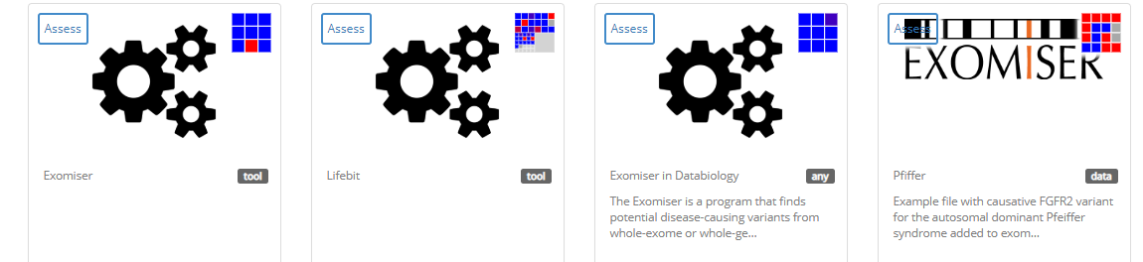
FAIR Beyond Data – Applications as FAIR
FAIRshake assessment
Assessment made on 4 levels:
Exomiser as
standalone
Exomiser in Lifebit
Exomiser in Databiology
Example VCF file for Pfeiffer syndrome case

Slide 8
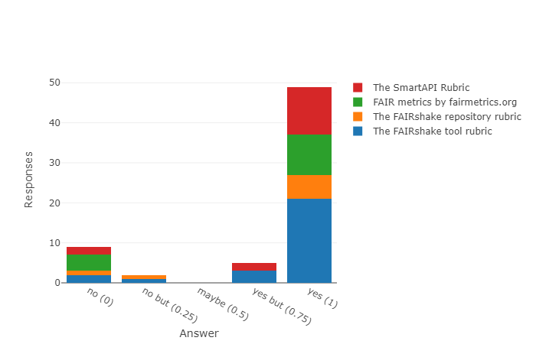
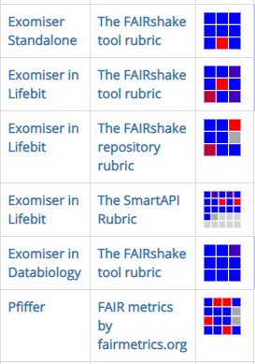
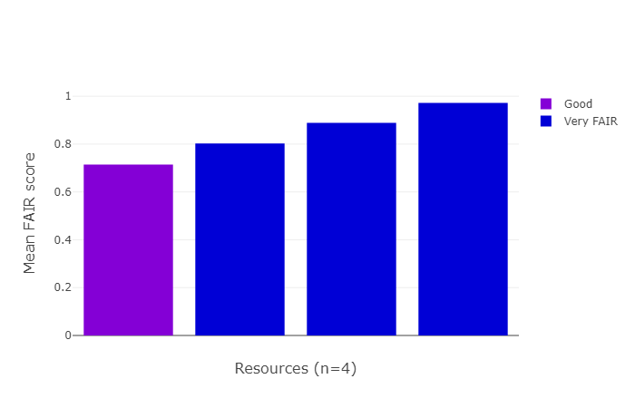
FAIR Beyond Data – Applications as FAIR
FAIRshake analytics
Un-FAIR data
FAIRifying needed mostly on the data
Standalone version could be more FAIR with implementation of an API
Data
Standalone
Lifebit
Databiology
Databiology application is most FAIR

Slide 9
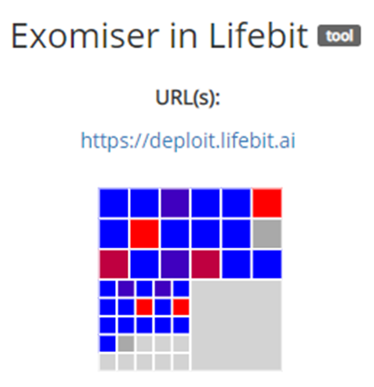

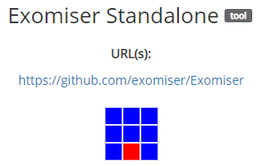


FAIR Beyond Data – Applications as FAIR
FAIRshake assessment – Points to improve
tool
tool
repository
tool
SmartAPI
Tool cannot be accessed programmatically through an API
Tool Rubric: Source code not shared, Contact info about the author only on username level
Repository Rubric: Does not provide documentation for each data resource, Contact info is limited
SmartAPI Rubric: Machine readable metadata not available yet.
The tool uses community accepted ontology
but…
https://fairshake.cloud/project/75/assessments/

Slide 10
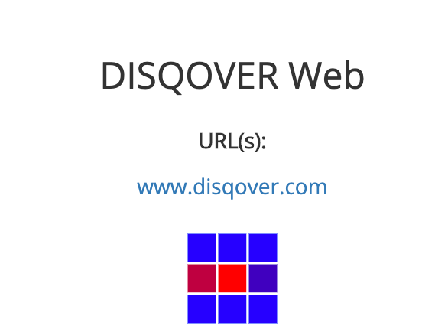



FAIR Beyond Data – Applications as FAIR
FAIRshake assessment
Homology search
Source code is not shared
Tutorials for the tool are not available on the homepage
No Persistent identifier
Not a machine readable data
The resource and metadata is not persistent
No Provenance scheme
https://fairshake.cloud/project/75/assessments/

Slide 11



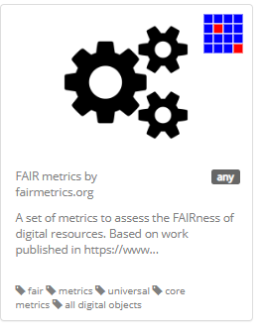
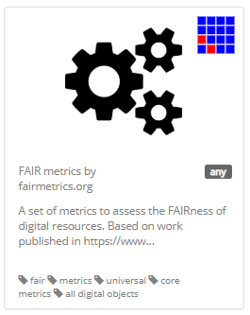
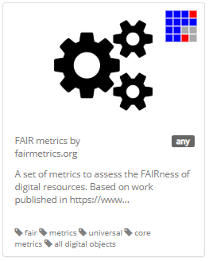
FAIR Beyond Data – Applications as FAIR
FAIRshake assessment – on FAIR metrics (Rubric 25)
No Provenance scheme
No Standardized data
Resource discovery through Web missing
Certificate of compliance to community standard missing
Persistence of resource and metadata not applicable
Metadata license missing
https://fairshake.cloud/project/75/assessments/

Slide 12

FAIR Beyond Data – Applications as FAIR
Exomiser as a FAIR App
https://bitbucket.org/databiology/app-dbio-exomiser/
Geneweaver
Disqover
Docker container
App metadata (CIAO)
Output
(TSV)
Input
(VCF)
App
params
Exomiser
Run meta

