Slide 1






FAIR Beyond Data – Applications as FAIR
Notes:
The files stored on TCGA are in 2 different formats,
The goal is to get the data into a format so that the rmats_trim.py program could trim it to 48 BP
Case 1: fastq files individually saved as gzipped data fastq1.gz, fastq2.gz
wget $ftpfile1 &&
wget $ftpfile2 &&
gunzip *.gz &&
Case 2: both fastq files are tar‘d and zipped into a single tar.gz file
tar xvfz *.tar.gz &&
Case 3: fastq files are gzipped and then tar‘d
tar xvf *.tar &&
zcat /mnt/data/input/$file1gz > /mnt/data/output/$file1 &&
zcat /mnt/data/input/$file2gz > /mnt/data/output/$file2 &&

Slide 2
FAIR Beyond Data – Applications as FAIR
Complete Workflow
Data are FAIR
Applications are FAIR
Data out are FAIR

Slide 3
FAIR Beyond Data – Applications as FAIR
Dockerized
Exomizer
Link-out
Lifebit.ai (deploit)
Exomizer
Human gene list
+ Metadata
DisQover
Select a vcf file using metadata
Vcf
Metadata
Data Biology
Exomizer
HIPPA
Dockerized
geneweaver
Lifebit.ai (deploit)
geneweaver
mouse gene list
+ Metadata
Link-out
Data Biology
Exomizer

Slide 4
FAIR Beyond Data – Applications as FAIR
Subteam formation
Exomiser - dockerization – lifebit.ai, databiology (leads: Juan/Pablo)
Geneweaver – homology call (lead: Filipe)
DisQover – (lead: Niels)
Data Input/Output – gene, genesets (lead: Nolan)

Slide 5
FAIR Beyond Data – Applications as FAIR
Workplan
Initial/Baseline Assessments (Data and applications)
Conduct interventions
Re-Assessments (Data and Applications)

Slide 6
FAIR Beyond Data – Applications as FAIR
Challenges
For Diagnostic purposes – VCF data is diagnostic information only available

Slide 7
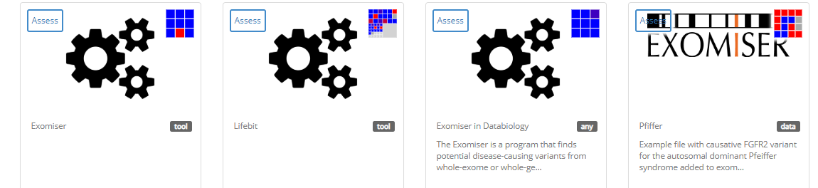
FAIR Beyond Data – Applications as FAIR
FAIRshake assessment
Assessment made on 4 levels:
Exomiser as
standalone
Exomiser in Lifebit
Exomiser in Databiology
Example VCF file for Pfeiffer syndrome case

Slide 8
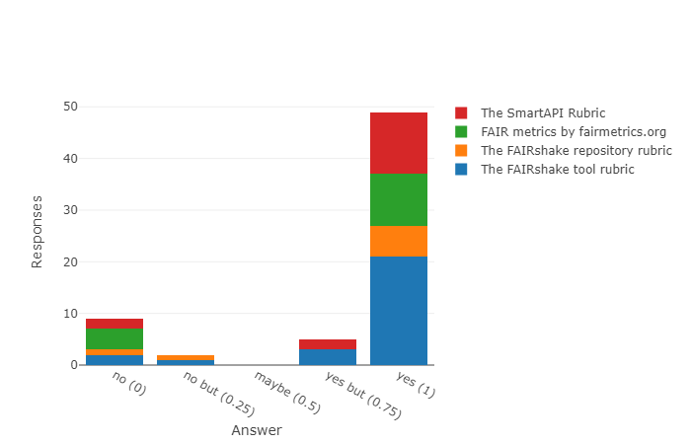
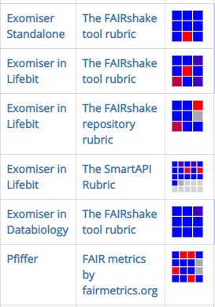
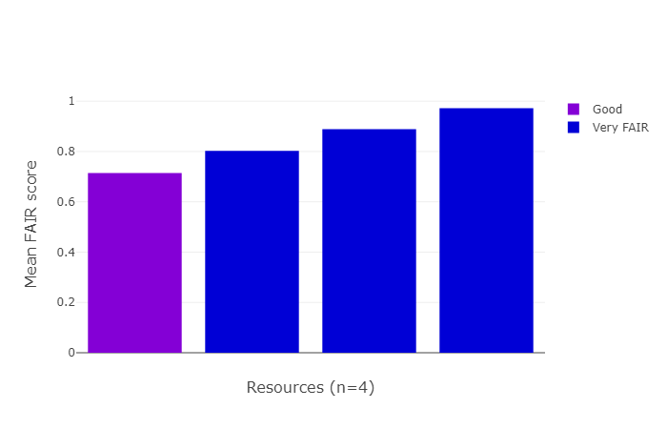
FAIR Beyond Data – Applications as FAIR
FAIRshake analytics
Un-FAIR data
FAIRifying needed mostly on the data
Standalone version could be more FAIR with implementation of an API
Data
Standalone
Lifebit
Databiology
Databiology application is most FAIR

Slide 9
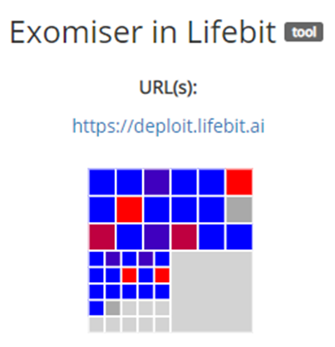

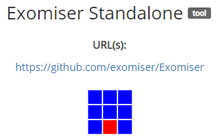


FAIR Beyond Data – Applications as FAIR
FAIRshake assessment – Points to improve
tool
tool
repository
tool
SmartAPI
Tool cannot be accessed programmatically through an API
Tool Rubric: Source code not shared, Contact info about the author only on username level
Repository Rubric: Does not provide documentation for each data resource, Contact info is limited
SmartAPI Rubric: Machine readable metadata not available yet.
The tool uses community accepted ontology
but…
https://fairshake.cloud/project/75/assessments/

Slide 10
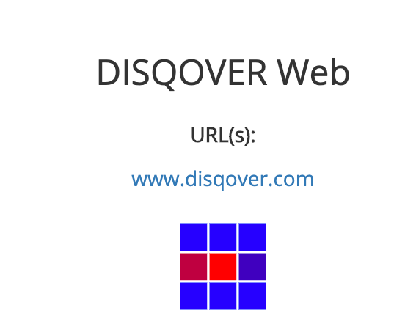



FAIR Beyond Data – Applications as FAIR
FAIRshake assessment
Homology search
Source code is not shared
Tutorials for the tool are not available on the homepage
No Persistent identifier
Not a machine readable data
The resource and metadata is not persistent
No Provenance scheme
https://fairshake.cloud/project/75/assessments/

Slide 11

FAIR Beyond Data – Applications as FAIR
Exomiser as a FAIR App
https://bitbucket.org/databiology/app-dbio-exomiser/
Geneweaver
Disqover
Docker container
App metadata (CIAO)
Output
(TSV)
Input
(VCF)
App
params
Exomiser
Run meta

