Slide 1

Scan2CNV
Contributors | Years of Bioinformatics Experience
Eric Karlins (Lead) | 4
Maria Brown | <1
Samantha Sevilla | <1
Nick Giangreco | 3
TOTAL | 7

Slide 2
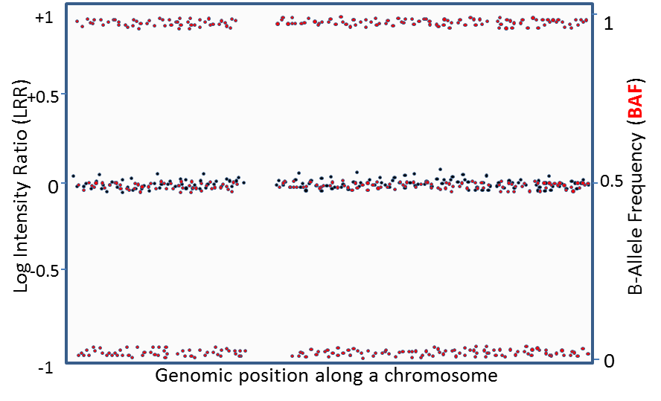
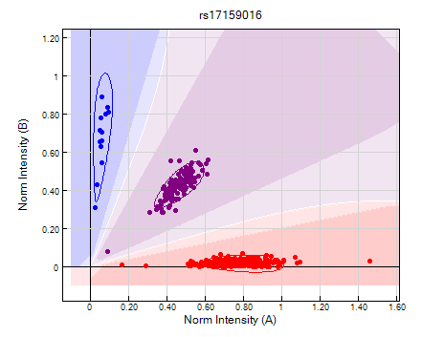
Project Problem
GWAS discover trait- and disease-associated SNPs, identifying regions with copy number variation (CNV).
Traditionally, these GWAS rely on cumbersome GUI processing of thousands and even millions of samples.
Moreover, multiple algorithms and packages for downstream analyses can provide orthogonal but useful information.
Necessary to streamline processing of RAW data through CNV calling and downstream analyses.

Slide 3
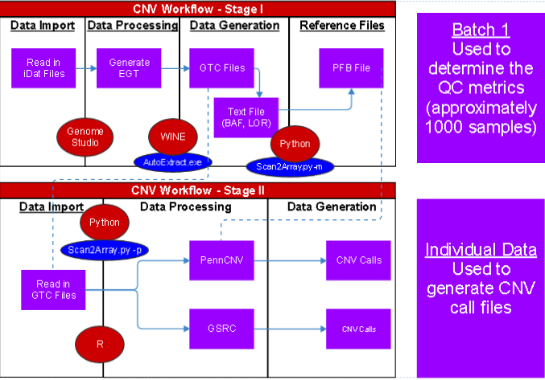
Project Workflow: Current
Utilizes
Genome Studio
Python
Perl
R
Two Phases:
Phase I : Sample subset
Phase II: individual samples
Beginning / End
Input: idat file
Output: CNV Calls
Output: Plots
Snakemake

Slide 4

Current Project Workflow (Scan2CNV)
Genome Studio to process idat to GTC files
Scan2Arrray –m (1000 samples)
Input
directory for GTC files
BPM file location
Output
PFB File
Text files – CNV Calls

Slide 5
Current Project Workflow (Scan2CNV)
Scan2Arrray –p (remaining sample files)
Input
directory for GTC files
BPM file location
PFB File (-m generated)
HMM File
Output
Txt files – CNV Calls

Slide 6
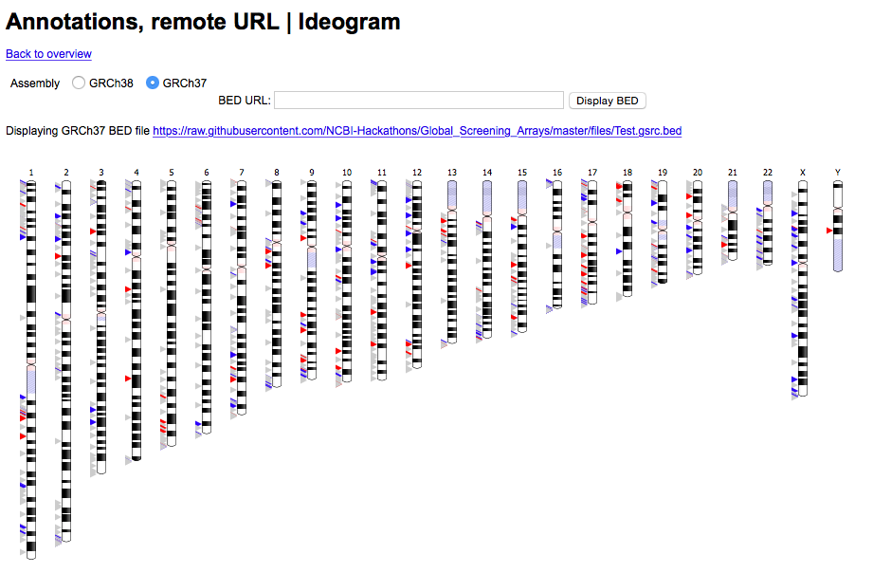
Visualizing CNV calling
Eric Weitz
https://github.com/eweitz/ideogram

Slide 7
Next Steps
Today’s Pipeline
Goal Pipeline
Genome Studio
SnakeMake
R Script
Python Script
Perl Script
SnakeMake
Genome Studio
Python Script
Perl Script
R Script
Completing pipeline to connect Python to R
Re-format pipeline for other users
Combine multiple output CNV callers
Combined Statistics | Overlapping calls

