Slide 1

NCBI 2017 Hackathon
Contributors | Years of Bioinformatics Experience
Eric Karlins (Lead) | 4
Maria Brown | <1
Samantha Sevilla | <1
Nick Giangreco | 3

Slide 2
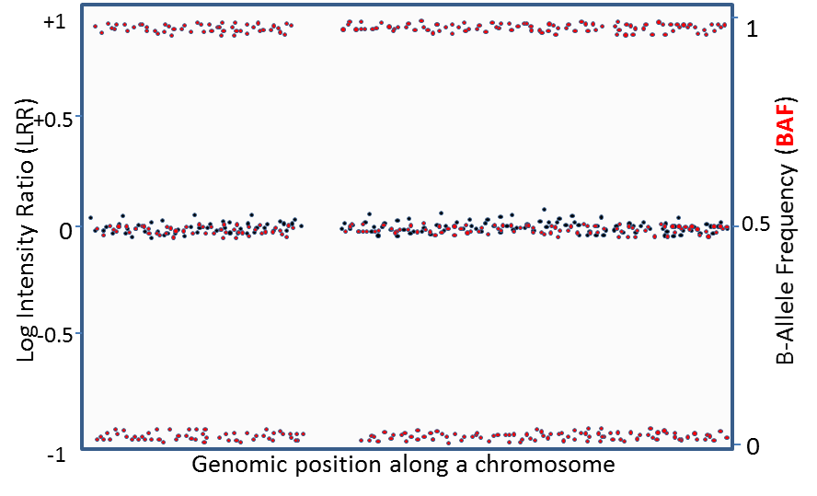
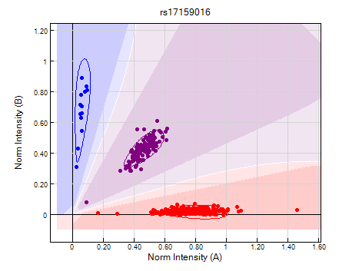
Project Problem
GWAS discover trait- and disease-associated SNPs, identifying regions with copy number variation (CNV).
Traditionally, these GWAS rely on cumbersome GUI processing of thousands and even millions of samples.
Moreover, multiple algorithms and packages for downstream analyses can provide orthogonal but useful information.
Necessary to streamline processing of RAW data through CNV calling and downstream analyses.

Slide 3
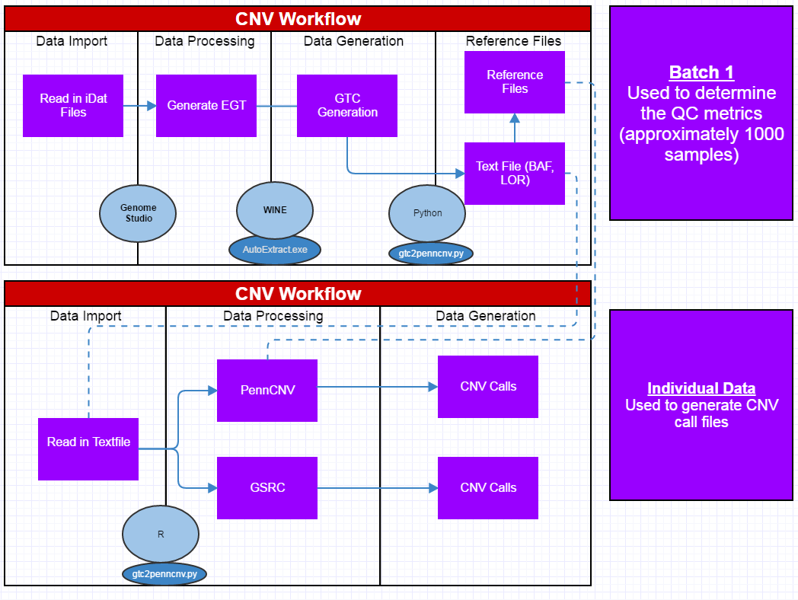
Project Workflow
Utilizes
Genome Studio
Python
R
Perl
Two Phases:
Phase I : Sample subset
Phase II: individual samples
Beginning / End
Input: idat file
Output: CNV Calls
Snakemake

Slide 4

Workflow Example
Genome Studio to process idat to GTC files
CML
Scan2Arrray –m (1000 samples)
Input
directory for GTC files
BPM file location
Output
PFB File
Individual txt files

Slide 5
Workflow Example
CML
Scan2Arrray –p (remaining sample files)
Input
directory for GTC files
BPM file location
PFB File (-m generated)
Output
Individual txt files

Slide 6
Output Example

Slide 7
Next Steps
Combine multiple output CNV callers
Combined Statistics
Overlapping calls
Re-format pipeline for other users
Currently specific for NCI cluster

