Slide 1
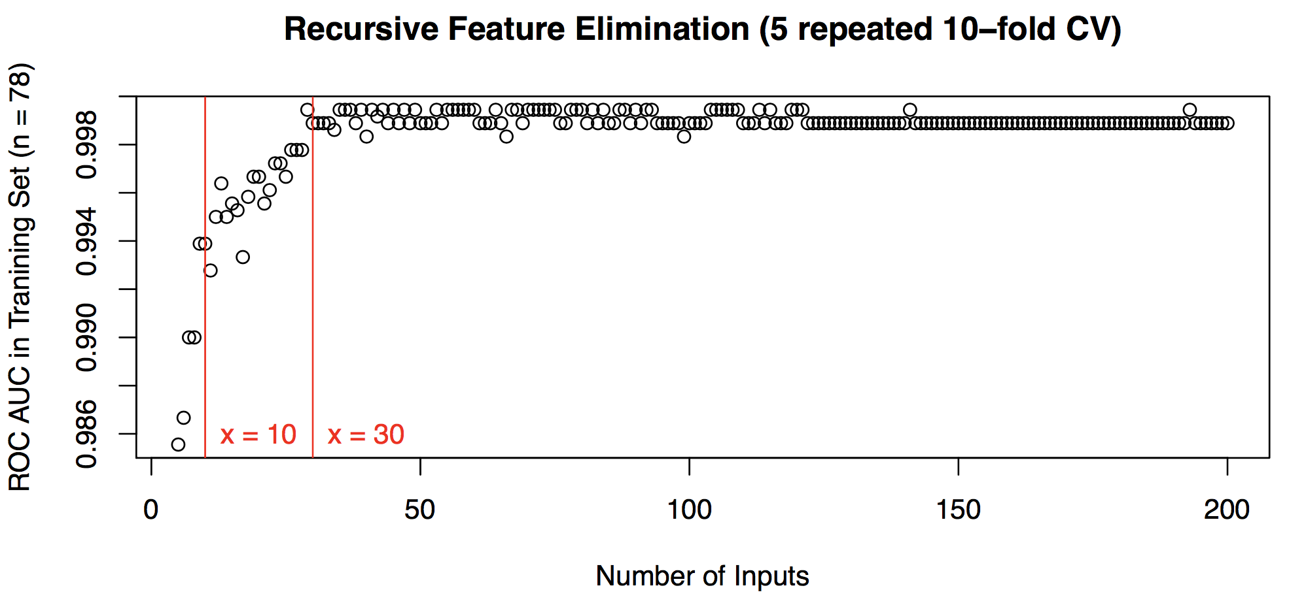
Feature Selection / Dimension Reduction (out of 1846 lipid variables)

Slide 2
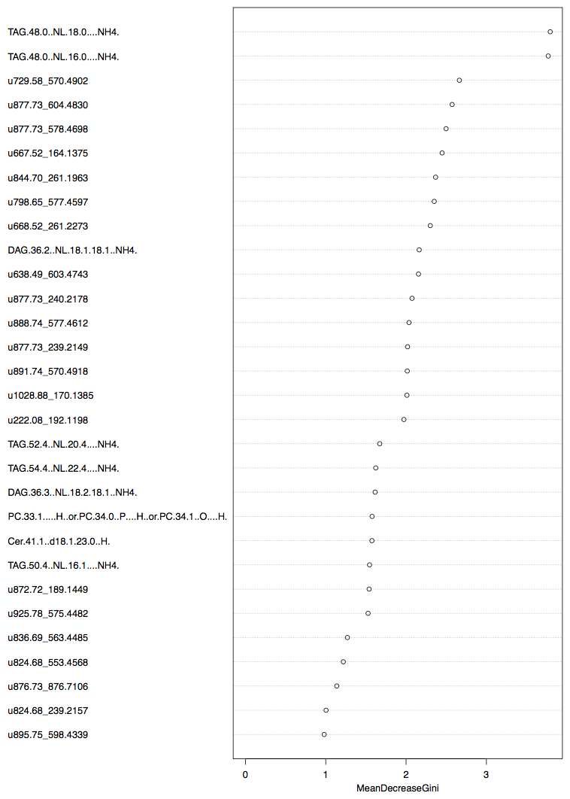
Lipid Markers of Stage 3 Classifier
Top known lipid signal:
TAG(48:0) – NL FA(18:0)
TAG(48:0) – NL FA(16:0)
DAG(18:1_18:1)
TAG(52:4) – NL FA(20:4)
TAG(54:4) – NL FA(22:4)
DAG(18:2_18:1)
PC(33:1) or PC(P-34:0) or PC(0-34:1)
Cer(15:0/18:1{d8})
TAG(50:4) – NL FA(16:1)
Top unknown lipid signal (mass pairs):
U1 (729.58/570.49)
U2 (877.73/604.48)
U3 (877.73/578.46)
U4 (667.52/164.13)
U5 (844.70/261.19)

Slide 3
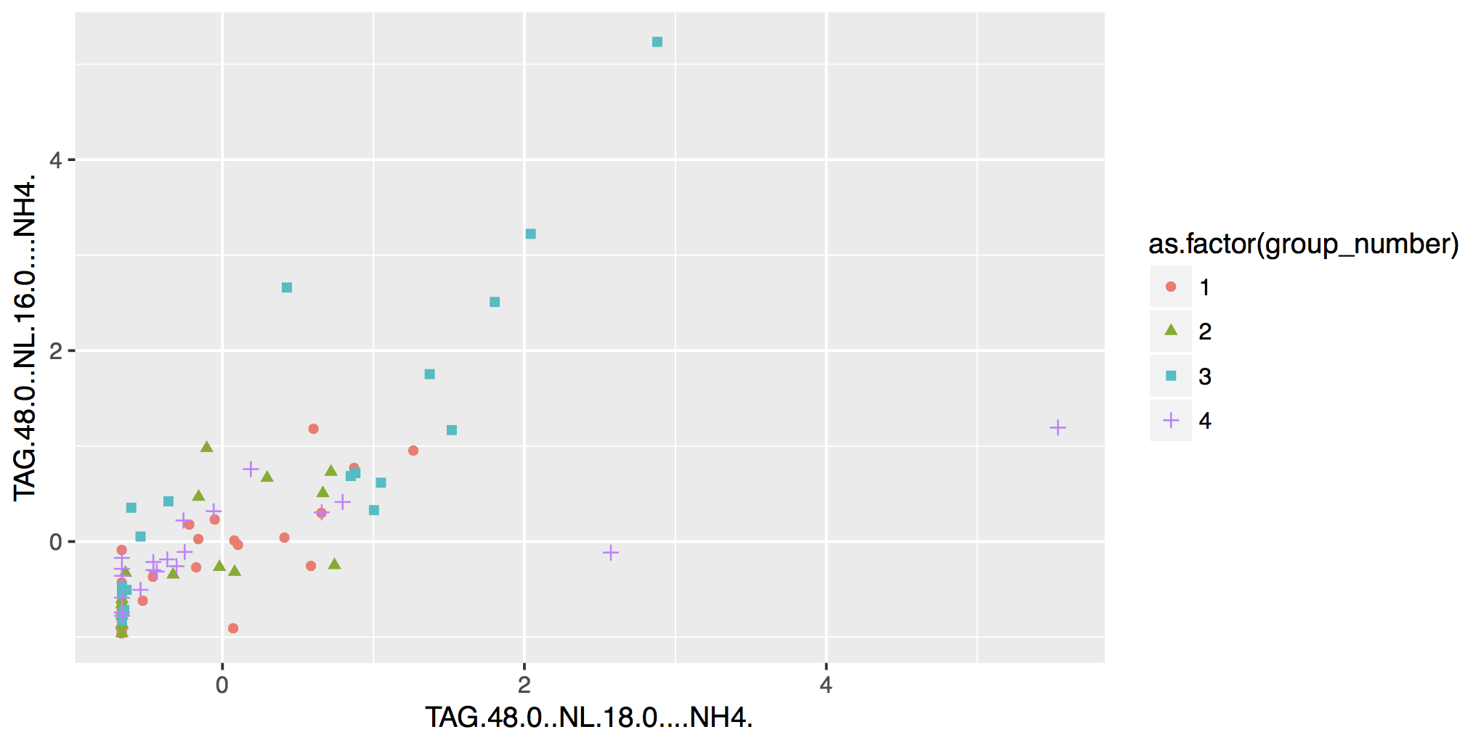
6 out of 20 stage 3 samples get clear separation in the following 2D space:
TAG(48:0) – NL FA(16:0)
TAG(48:0) – NL FA(18:0)

Slide 4
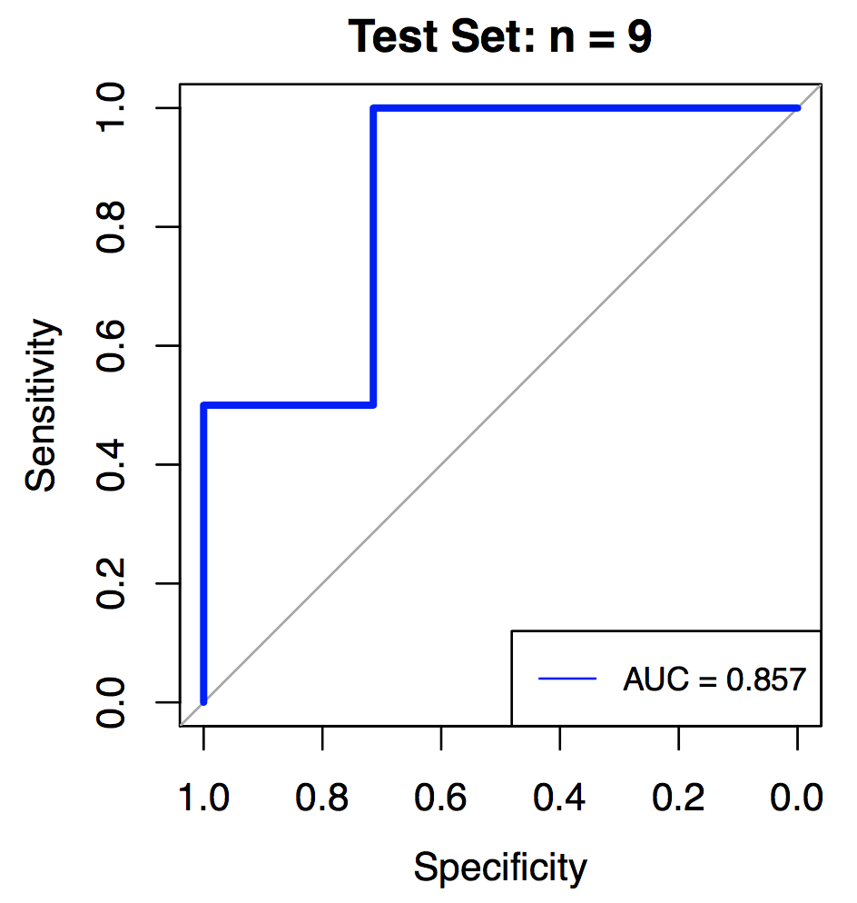
Stage 3 Random Forest Classifier Performance in Testing Set:
Common Marker of different classifiers:
TAG(48:0) – NL FA(18:0)
TAG(56:8) – NL FA (22:6)
Unknown (680.53/551.27)
Unknown (828.68/523.42)
Unknown (902.75/339.25)

