Slide 1
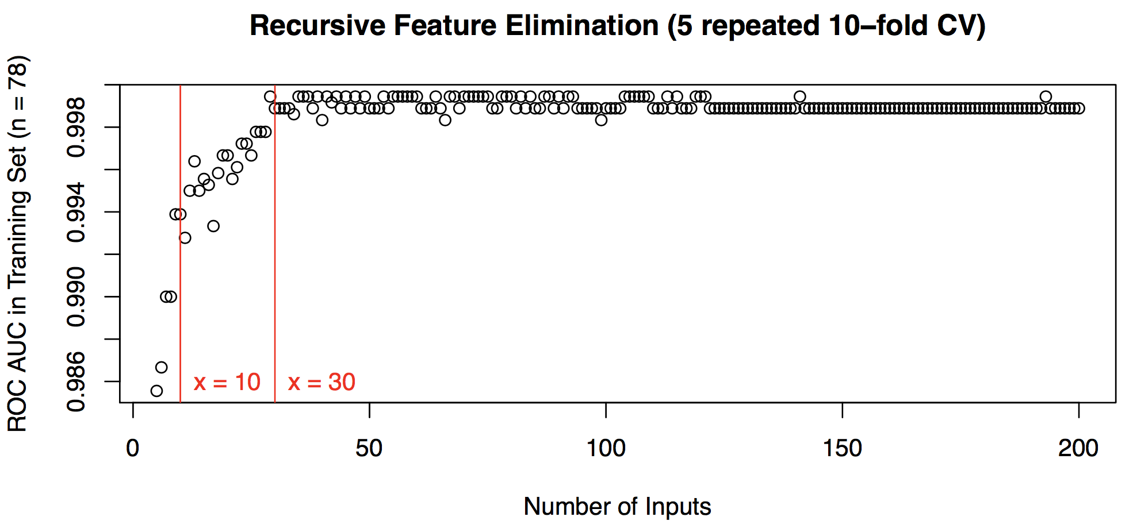
Feature Selection / Dimension Reduction (out of 1846 lipid variables)

Slide 2
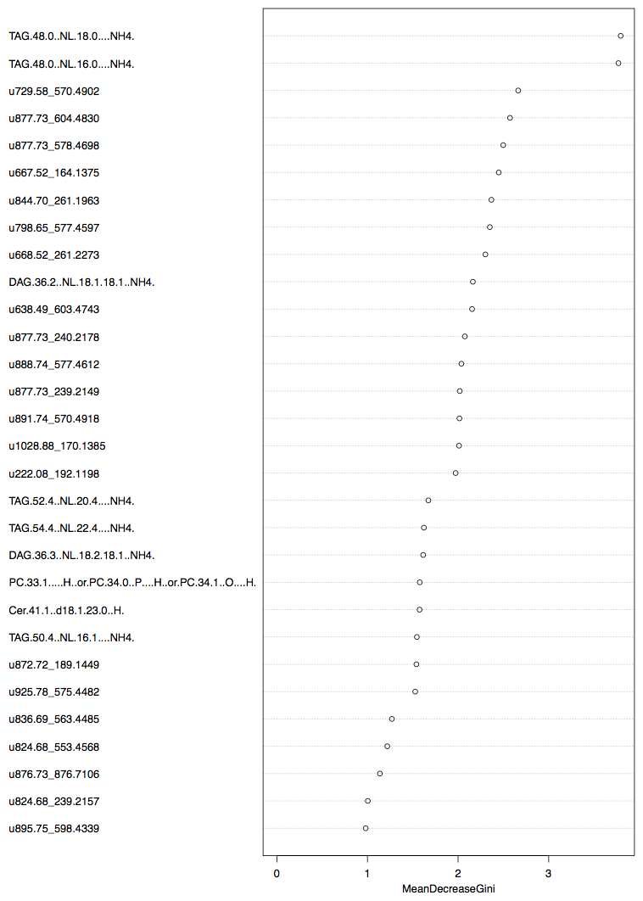
Lipid Markers of Stage 3 Classifier
Top known lipid signal:
TAG.48.0..NL.18.0....NH4.
TAG.48.0..NL.16.0....NH4.
DAG.36.2..NL.18.1.18.1..NH4.
TAG.52.4..NL.20.4....NH4.
TAG.54.4..NL.22.4....NH4.
DAG.36.3..NL.18.2.18.1..NH4.
PC.33.1.....H..or.PC.34.0..P....H..or.PC.34.1..O....H.
Cer.41.1..d18.1.23.0..H.
TAG.50.4..NL.16.1....NH4.
Top unknown lipid signal:
u729.58_570.4902
u877.73_604.4830
u877.73_578.4698
u667.52_164.1375
u844.70_261.1963

Slide 3
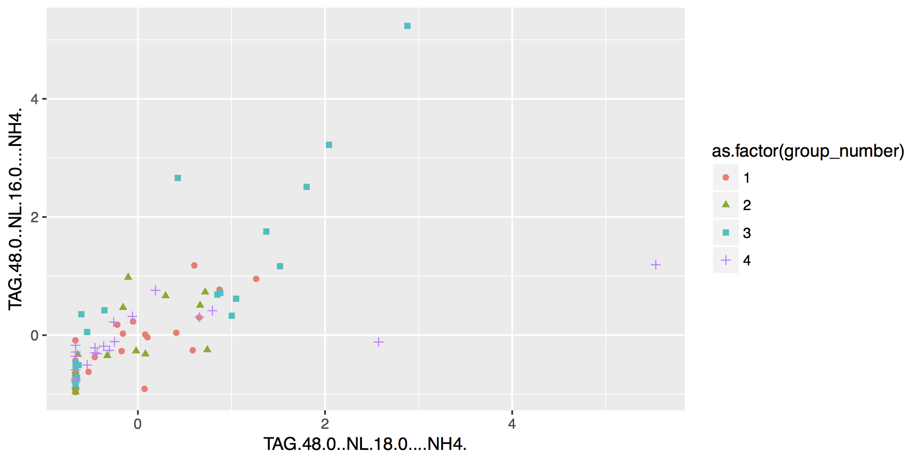
6 out of 20 stage 3 samples get clear separation in the following 2D space:

Slide 4
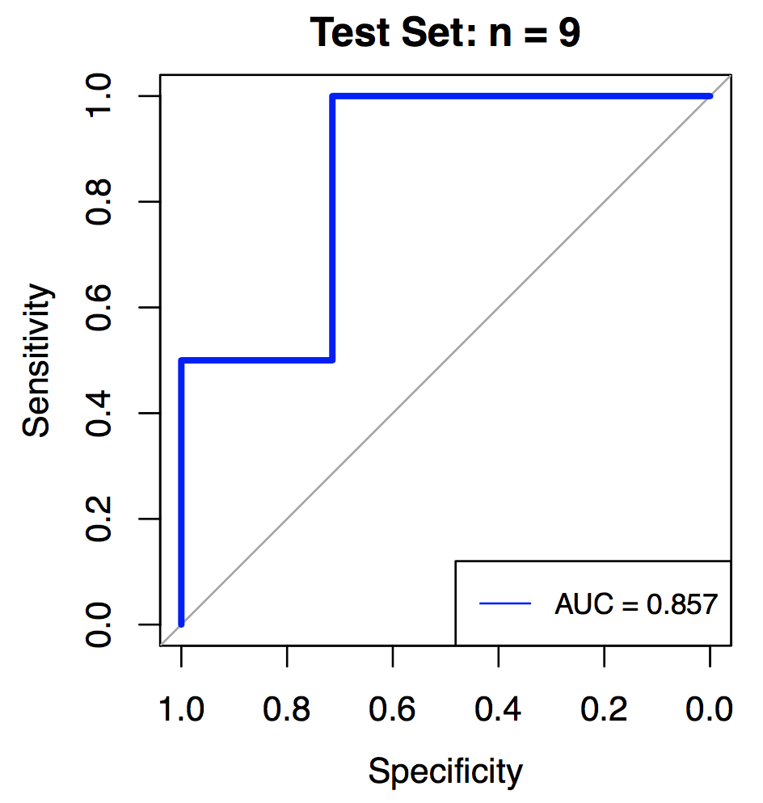
Stage 3 Random Forest Classifier Performance in Testing Set:
Common Marker of different classifiers:
TAG.48.0..NL.18.0....NH4.
TAG.56.8..NL.22.6....NH4.
u680.53_551.2772
u828.68_523.4207
u902.75_339.2559

