Slide 1
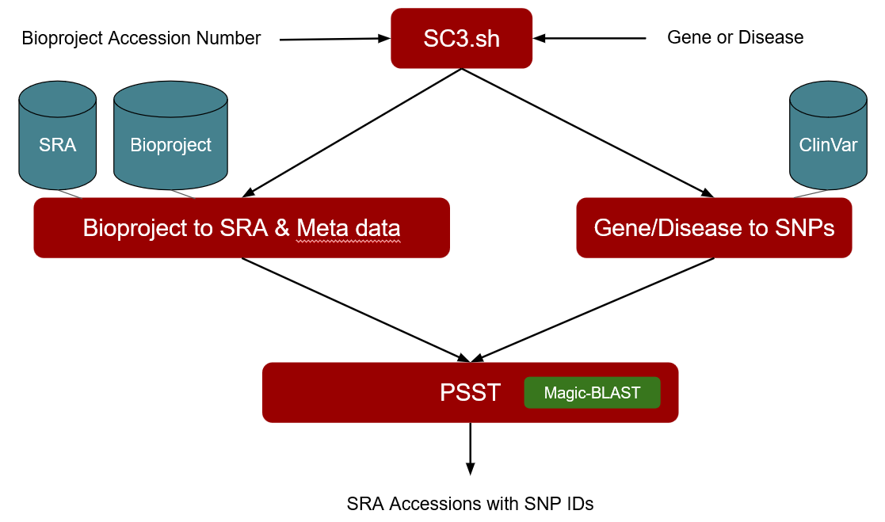
Visualization (cell type, patient, gene- or disease- specific variants)

Slide 2
BioProject Accession Number
SC3.sh
Gene or Disease
SRA
BioProject
ClinVar
BioProject to SRA and metadata
Gene/Disease to SNPs
PSST
Magic-BLAST
SRA Accessions with SNP IDs
Interactive visualization of variants
by cell type, patient, disease, etc.
ViRGo
Shiny App

