Slide 1
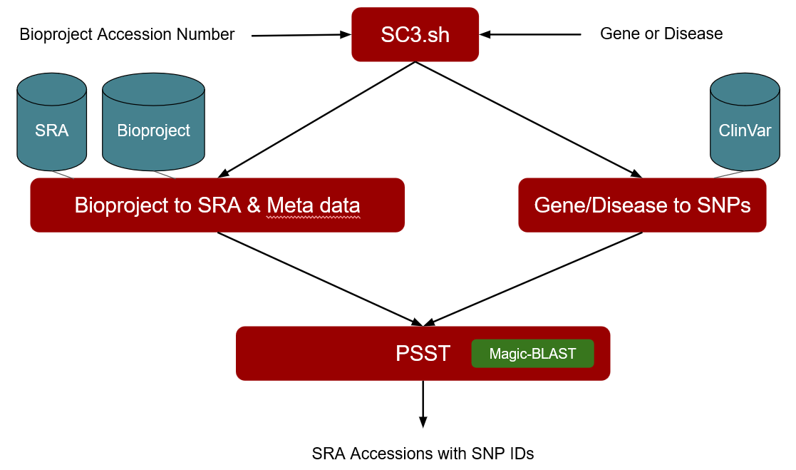
Visualization (cell type, patient, gene- or disease- specific variants)

