Slide 1
viSRA too
viSRA too bridges the gap between advanced bioinformatic data and users
Kristin Valdez
Simone Stanley
Mike Muchow

Slide 2
What’s ?
viSRA too
viSRA is a tool for visualizing RNA-seq data from SRA datasets on the fly and compare two sets of NGS data for differences in gene expression.
What's the problem?
How should we solve it?
The NCBI Sequence Read Archive (SRA) provides NGS data along with sample and project metadata (NCBI Resource Coordinators 2017).
Unfortunately, it can be time-consuming and difficult to access and analyze the data, especially if you want to quickly develop meaningful hypotheses.
The amount of NGS data stored in the Sequence Read Archive (SRA) data-base is growing rapidly.
viSRA increases the utility and return on investment of NGS projects by making the data more accessible to a wider range of individuals.

Slide 3
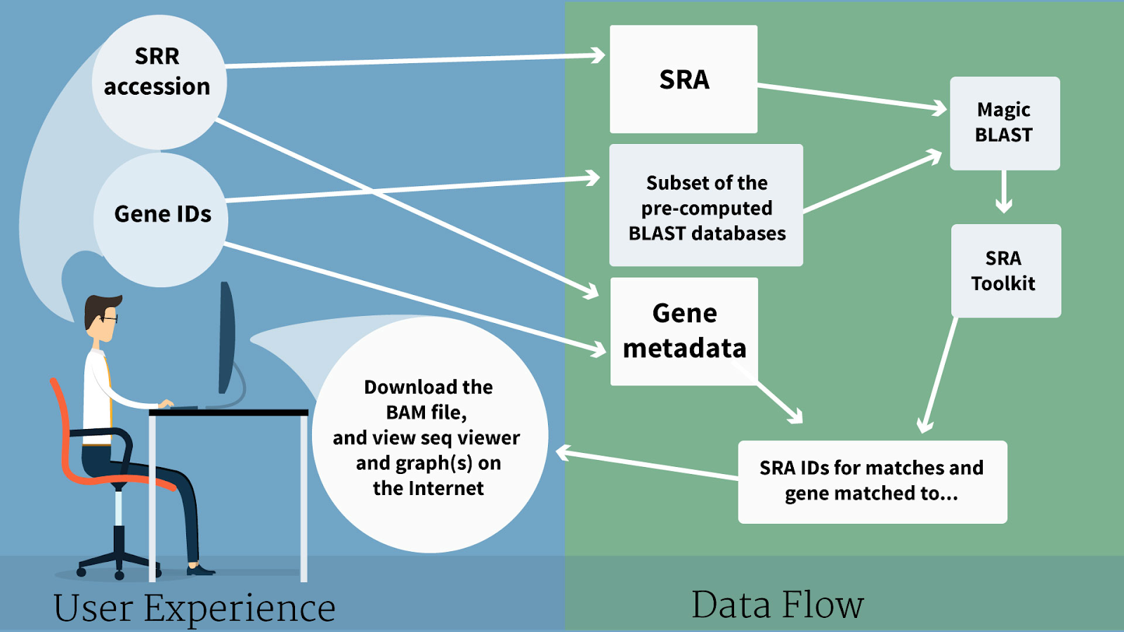
What’s new?
TMM instead of TPM for normalization
Python to command line through R
Shiny App in progress. Will output graphs directly to user’s working directory

Slide 4
Pipeline
User Inputs
SRR Accession
Gene IDS
Magic Blast
Stream sequences from SRA database in command line to pipe to magic Blast
Subread
Published RNASeq Data @ NCBI
Users choose two samples to compare
Users provides custom gene IDs list
New line separated gene symbols
Generate extracted annotation file
Map SRA accessions, Produce SAM File, SRA toolkit
SAM files to count.txt files
Filter counts
Dot plots, heatmaps, Ideogram
Normalize
Visualize
output graphs directly to user’s working directory
Remove zero count reads
Using Limma voom with TMM

Slide 5
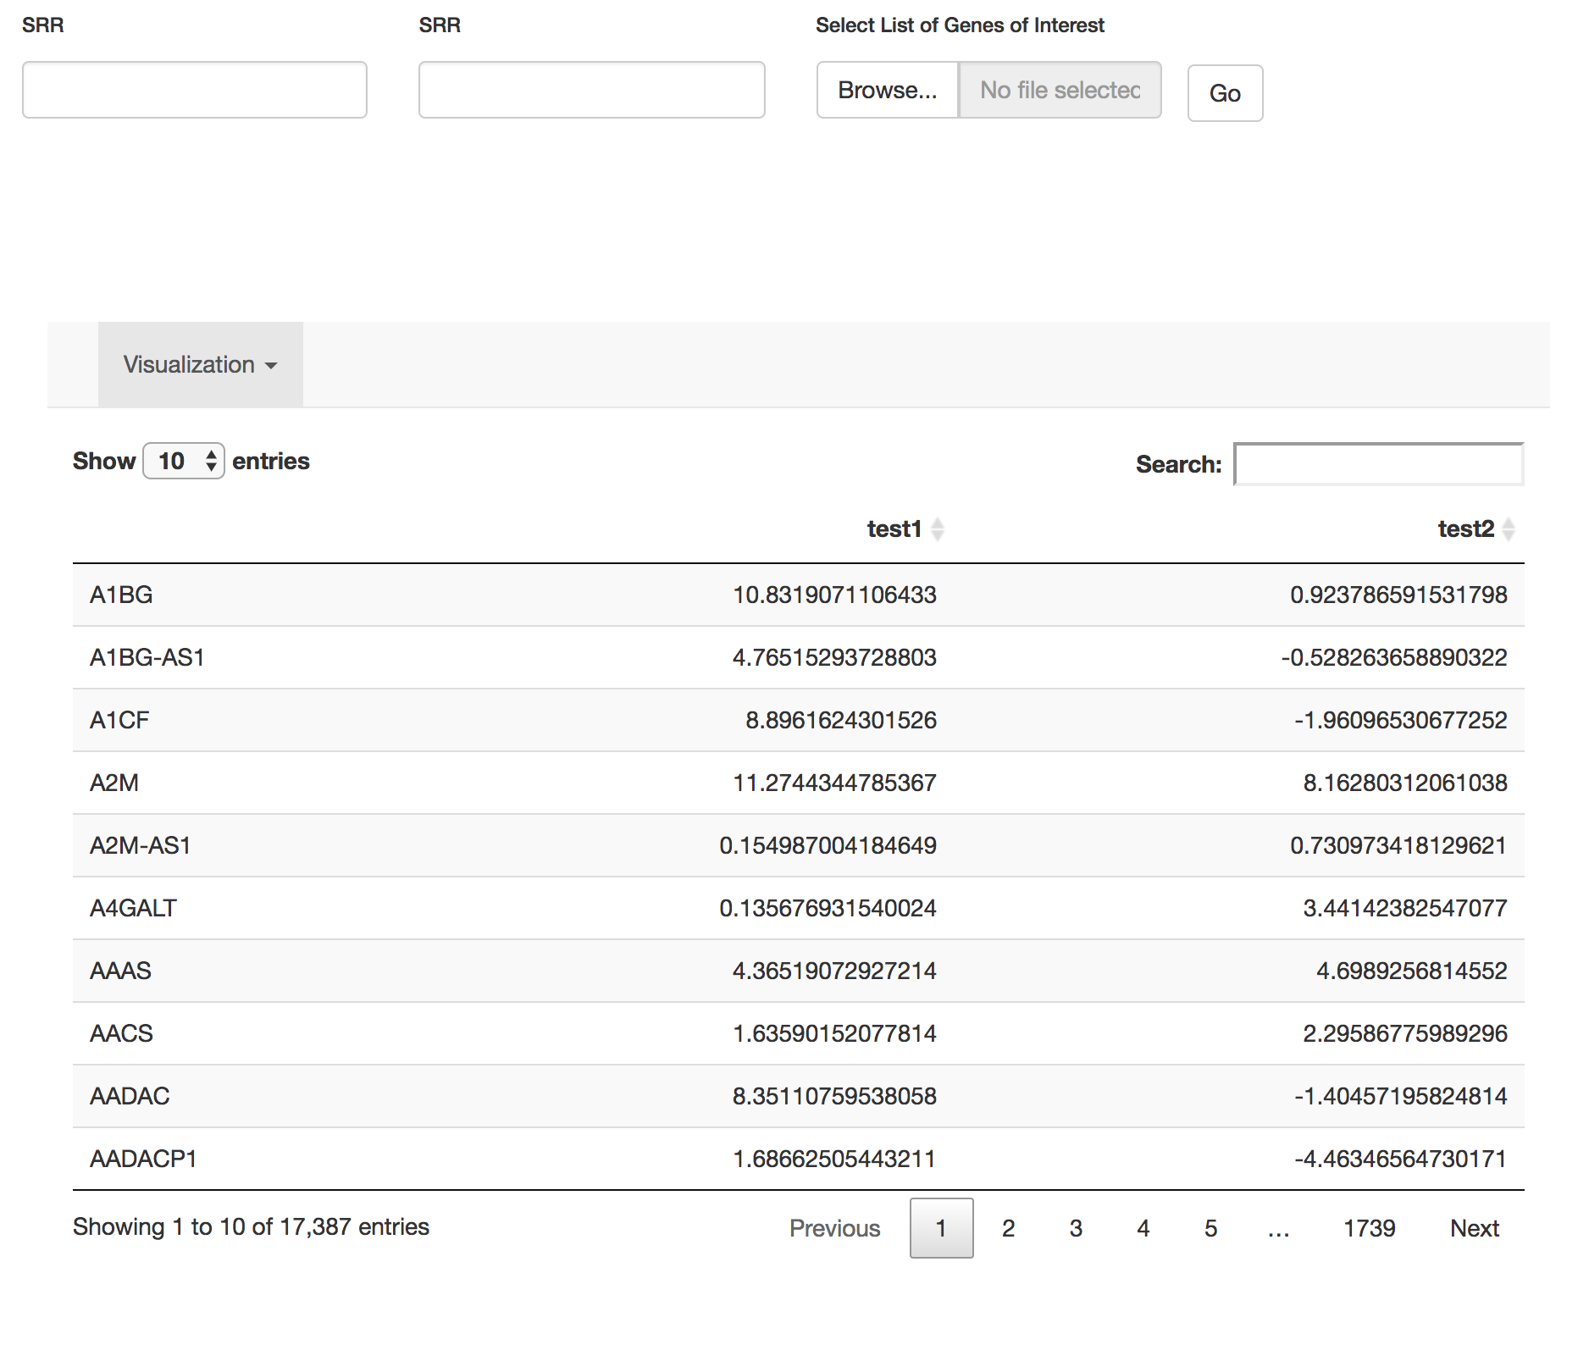
User Input
SRR Accession
Published RNASeq Data @ NCBI
Users choose two samples to compare
Gene IDS
Users provides custom gene IDs list
New line separated gene symbols
Generate extracted annotation file

Slide 6
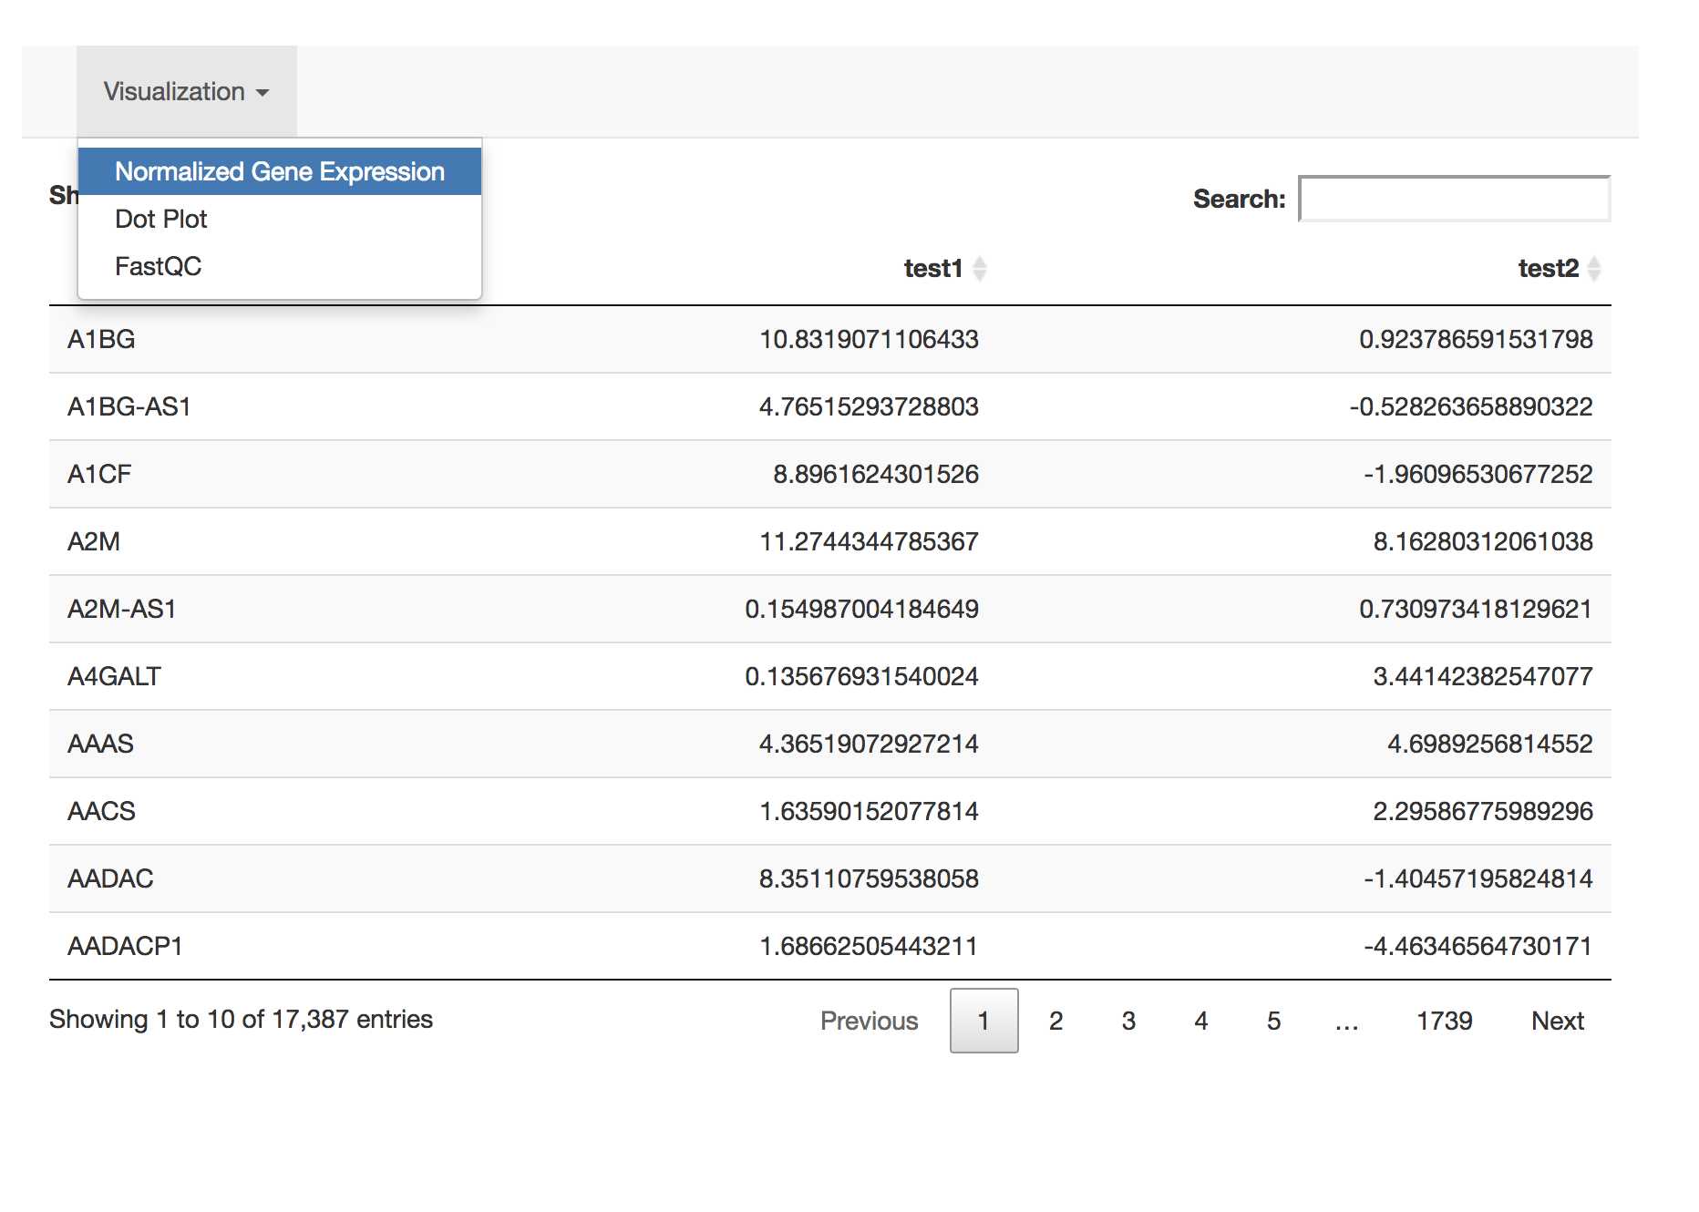
Visualization on the Fly
User can choose between different graphs and plots:
Table of Gene Expression
Dot Plot
Violin Plot
Heat Map
FastQC report
Ideogram

Slide 7
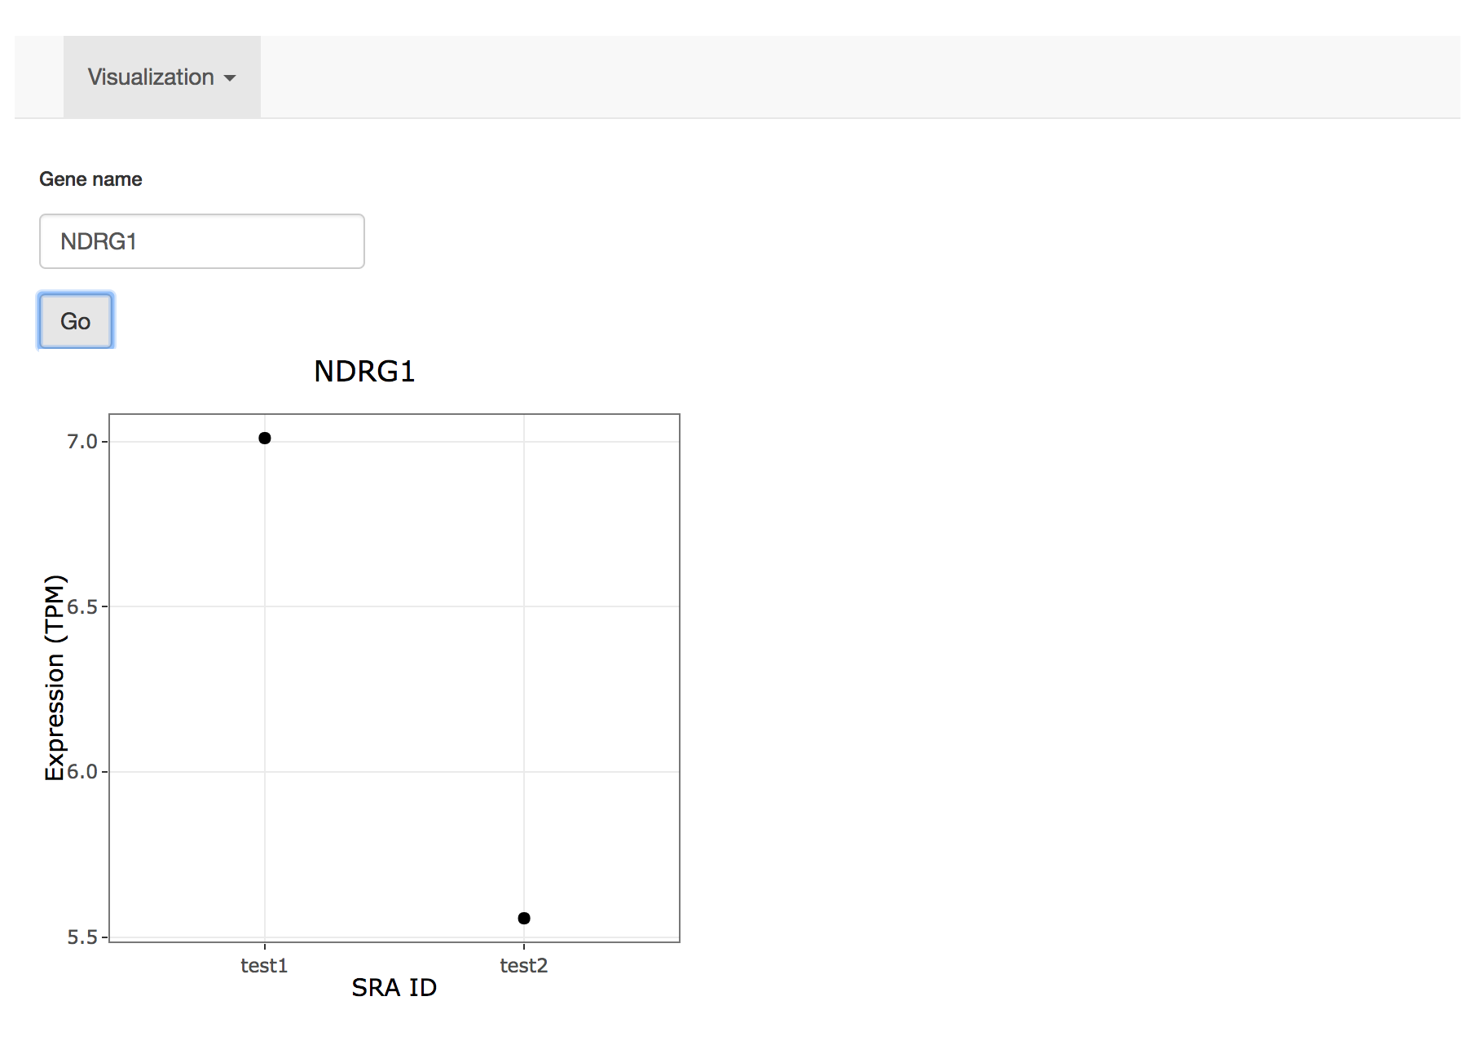
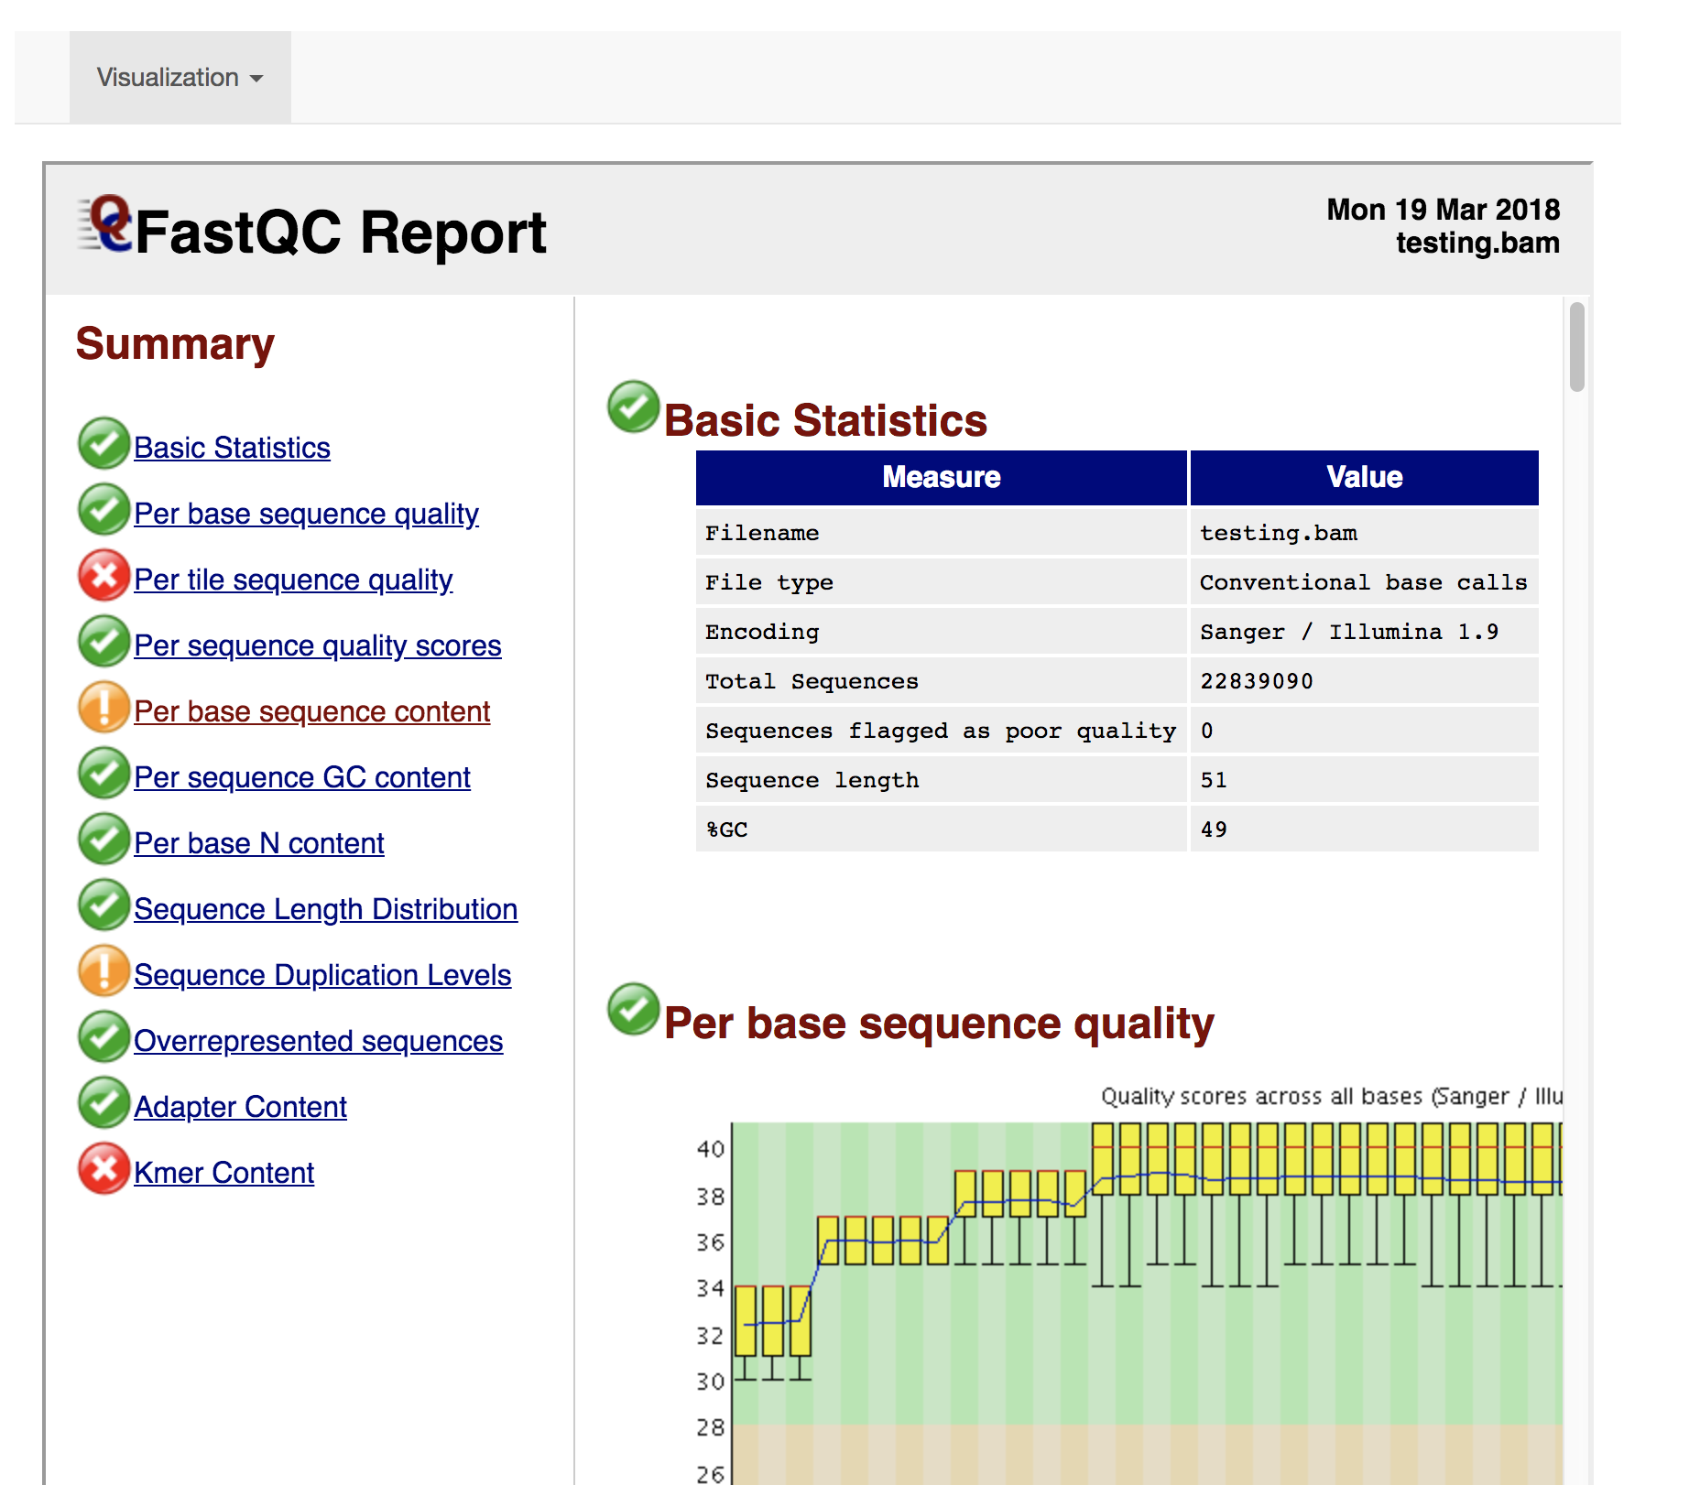
Visualization Cont.

Slide 8
Thank You!
Any Questions?

