Slide 1

PhenotypeXpression: Subclassification of disease states based on the intersection of literature and expression

Slide 2
Why?
Disease Architecture ➔ Umbrella MeSH terms
Use Case: Clinician approaching a disease classification
Known sub-classifications Unknown sub-classifications

Slide 3
Disease Term
MeSH based query: exact match or ask
* keep track of MeSH sub-terms
Differentially expressed gene list (array, seq)
Word Cloud
Abstract
Keywords
Title
NCBI GEO
(per GDS dataset)
PMID List
HPO DOID
* MeSH subterms
Merge Clouds & Clusters
Subtype Classifications
* Sub-MeSH that is highly represented
Merged word cloud per cluster
Word Cloud
HeatMap
Differential Expression Clustering
change in gene sets

Slide 4

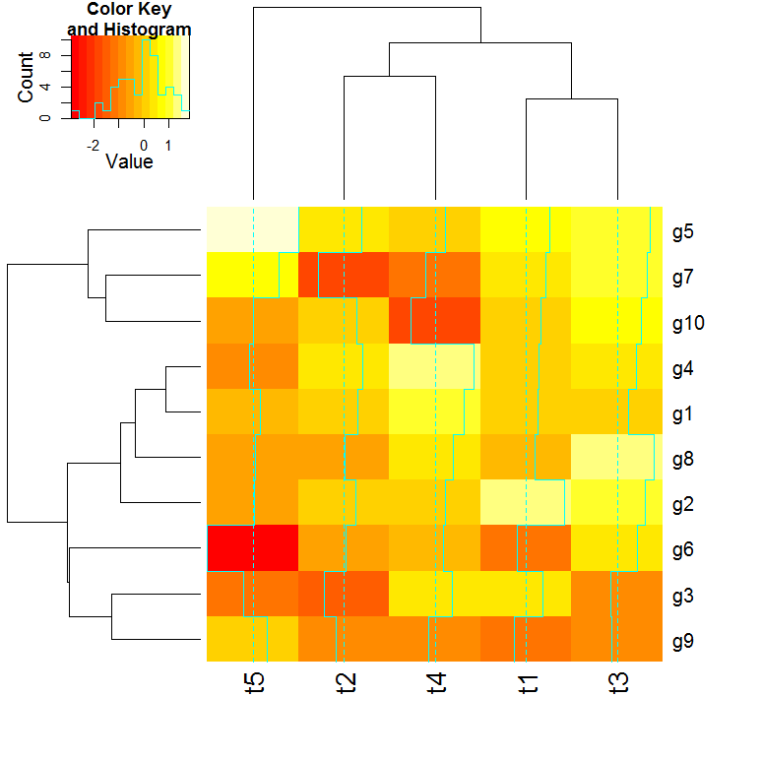
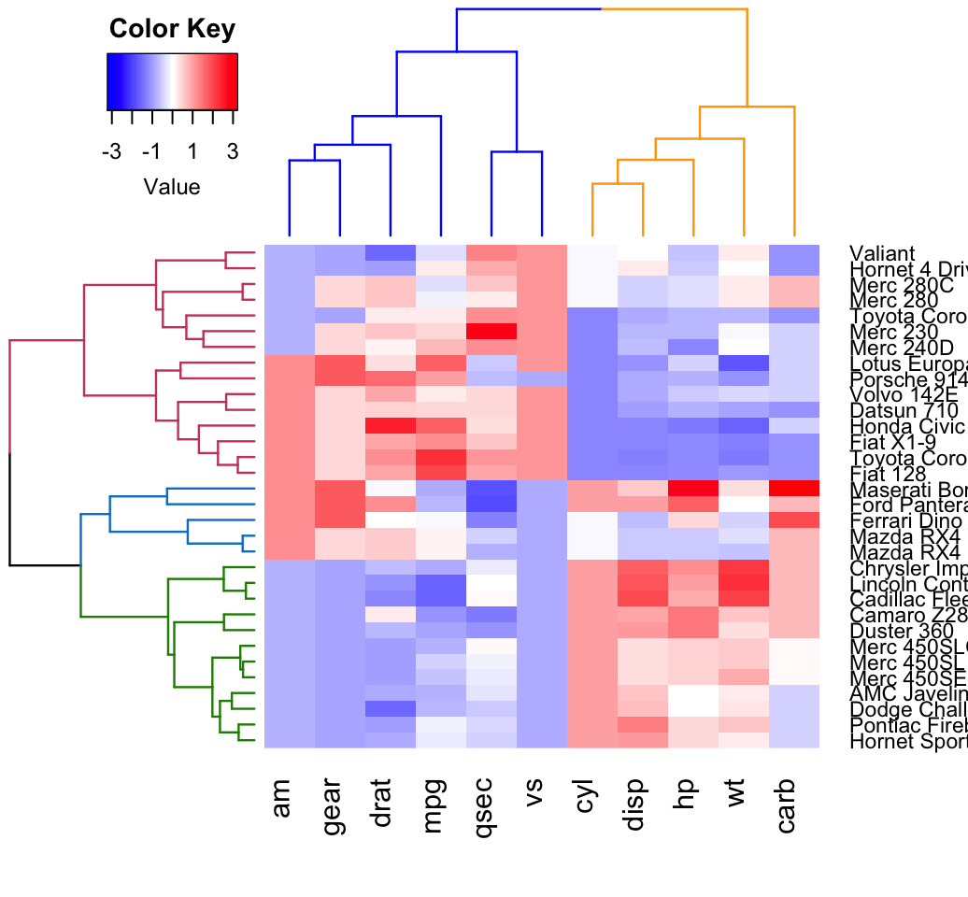
Subtype Output
Subtype A Matched MeSH SubtypeC

