Slide 1
Leadership Styles and Indicators of Leadership
Submitted by:
AFREEN SHAIK
AP18SWA414836
10(A) GIRLS BN

Slide 2

Who is a Leader?
“A leader is one who guides and directs other people through their own actions and behavior.”

Slide 3

What is Leadership?
“Leadership is generally defined as influence, the art of process of influencing people so that they will strive willingly towards the achievement of group goals”.

Slide 4
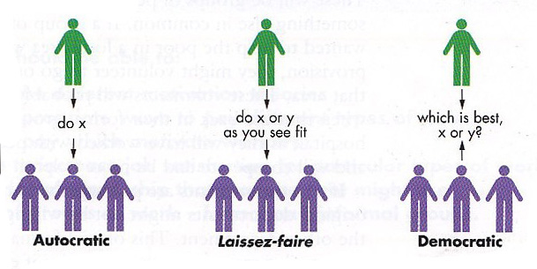
TYPES OF LEADERSHIP
Autocratic Leadership
Democratic Leadership
Laissez-Faire Leadership

Slide 5

AUTOCRATIC LEADERSHIP
It is also known Authoritarian Leadership.
An autocratic leader is one who dominates and drives his subordinates through coercion, command and the instilling of fear in his followers.
“I want both of you to….”

Slide 6
ADVANTAGES
The first and foremost advantage of this type of leadership style is that it helps the company in making a quick decision as the decision is centralized with the leader.
Autocratic - good for inexperienced workers
Autocratic - decision making, planning or organizing needs no initiative.

Slide 7
DISADVANTAGES
One way communication without feedback leads to misunderstanding, and communications breakdown.
An autocratic leader makes his own decisions which can be very dangerous in this age of technological and sociological complexity.
It fails to develop the worker's commitment to the objectives of the organization.
It creates problems both with employee morale and production in the long-run; due to their resentment.

Slide 8

Democratic Leadership
It is also known as Participative Leadership.
As the name itself indicates, in this style, the entire group is involved in goal setting and achieving it. A democratic leader follows the majority opinion as expressed by his group.
“Lets work together to solve this…”.

Slide 9
ADVANTAGES
Democratic - workers or subordinates are consulted or participate in the decision making process hence feel satisfied.
Democratic - workers are aware of what is happening in the organization and thus they take interest in producing more and more.
Democratic - subordinates get full opportunity to utilize their capabilities

Slide 10
DISADVANTAGES
Democratic - time consuming, requires long discussion.
Democratic - everyone tries to have their say and mould situation according to their liking, which hinders progress.
Democratic - can turn into a disastrous condition in times of crisis when there is an urgent need of definite and strong direction.

Slide 11

Laissez-Faire Leadership
It is also known as Delegative or Free rein Leadership.
This type of leadership is employee centered and the subordinates are free to establish their own goals and chart out the course of action.
“You two take care of the problem while I go”

Slide 12
ADVANTAGES
Positive effect on job satisfaction and moral of subordinates.
It gives chance to take initiative to the subordinates.
Maximum possible scope for development of subordinates.

Slide 13
DISADVANTAGES
Under this style of leadership, there is no leadership at all.
Subordinates do not get the guidance and support of the leader.
Subordinates may move in different directions and may work at cross purpose which may create problem for the organization.

Slide 14

INDICATORS OF LEADERSHIP

Slide 15
Key Indicators
You know what you value and act accordingly.
You Show The Way.
You Know his Team Members.
You Support Healthy Conflict.
You Listen.
Learn From Successes and Mistakes.

Slide 16

What type of leader you are?

Slide 17

“A leader, without a follower, is just a lone nut.”

Slide 18
THANK YOU

